Slide 1
Python bitwise

Slide 2
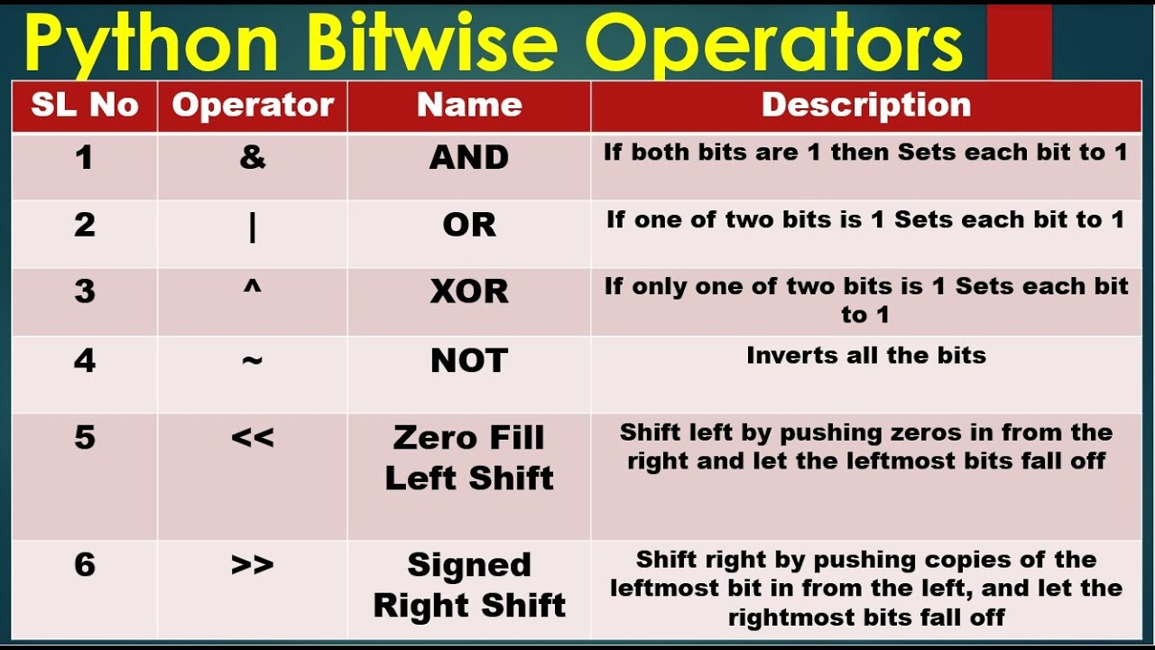

Slide 3
explainations
https://www.youtube.com/watch?v=5J4rWJHwLSE

Slide 4
