Slide 1
Python vs Java

Slide 2
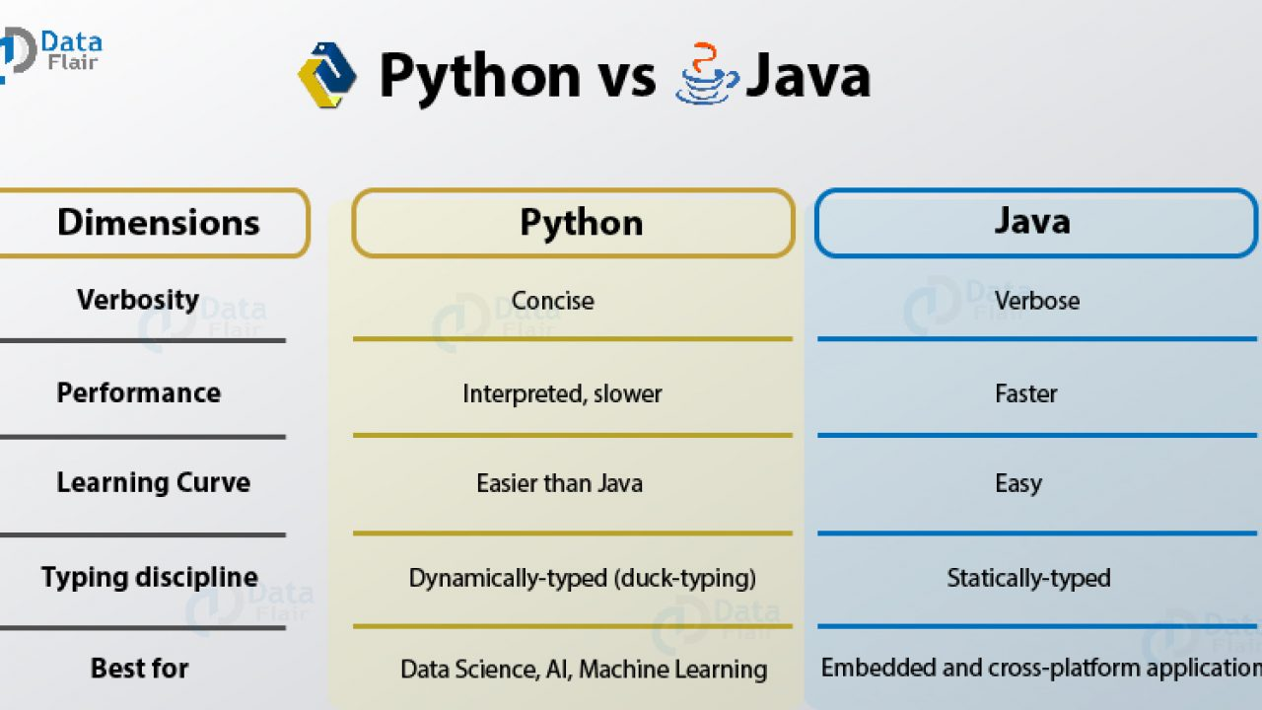
Notes:
C:\Users\arunk\Downloads\Intelli\IntelliDataSciencePython\PythonDataScience\1PythonTrainingToUSe\Module1_GettingStarted_With_python\Read\BasicOfPythonPrint

Slide 3
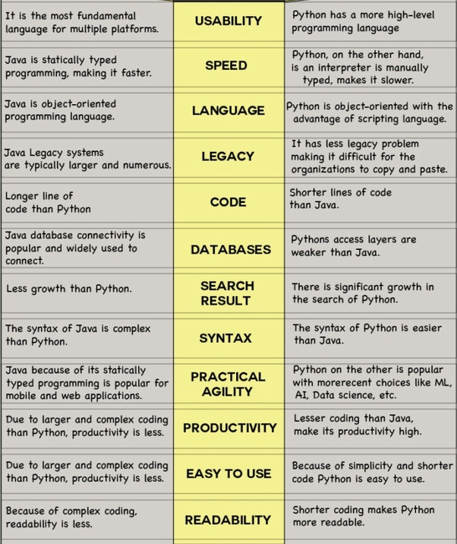
Java Python

Slide 4
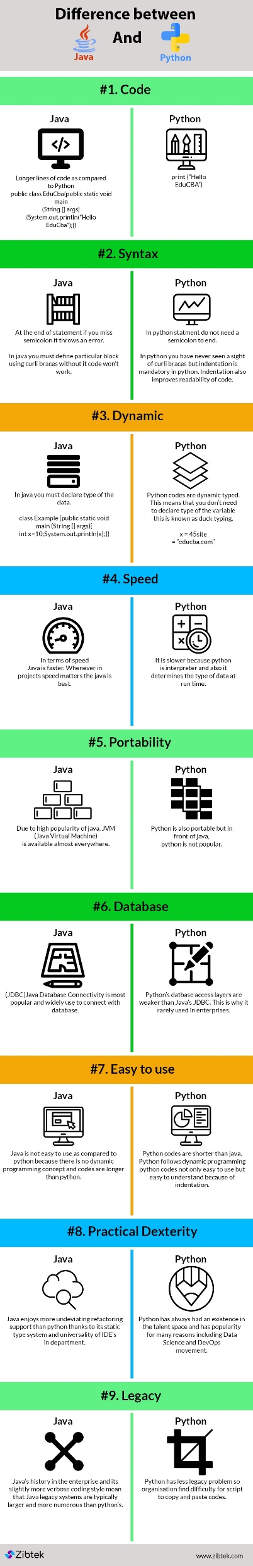

Slide 6
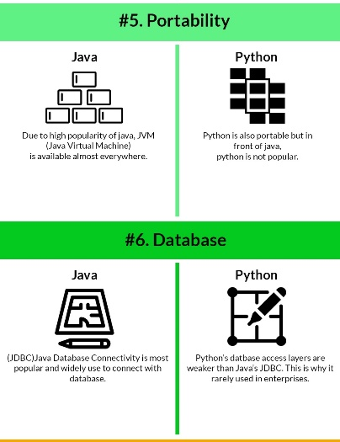

Slide 8
End

