Slide 1
Anaconda Set Up
How to install

Slide 2
About Anaconda
www.anaconda.com
Anaconda® is a package manager, an environment manager, a Python/R data science distribution, and a collection of over 1,500+ open source packages. Anaconda is free and easy to install, and it offers free community support.

Slide 3

Download Anaconda

Slide 4
Anaconda Help
https://docs.anaconda.com/anaconda/

Slide 5
Download Anaconda Distribution
https://www.anaconda.com/distribution/#windows

Slide 6
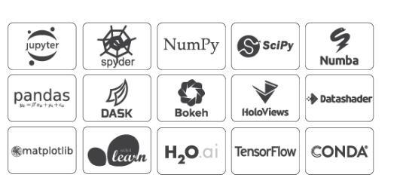
Software's in Anaconda

Slide 7
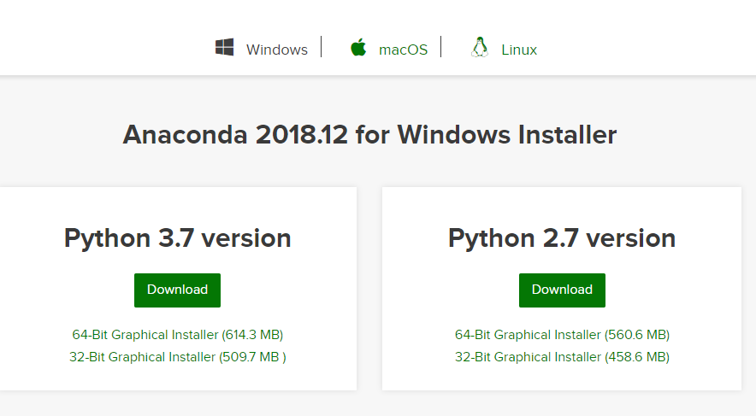
Download Anaconda from https://www.anaconda.com/download/
Chose the appropriate Bit : 64 or 32

Slide 8
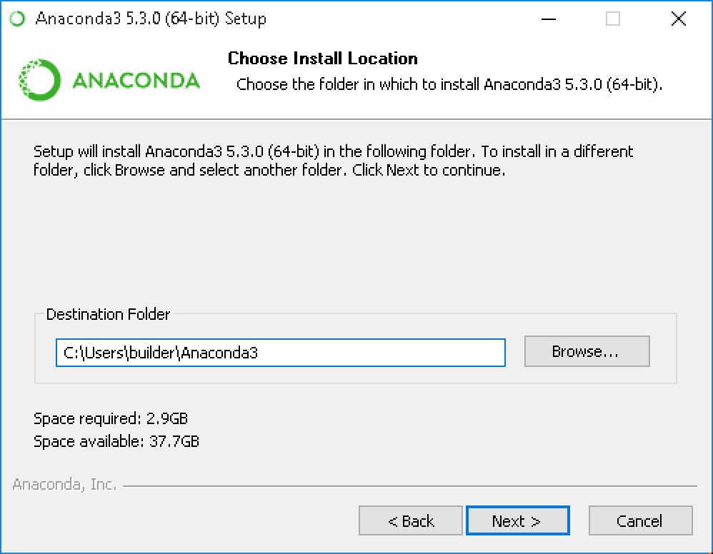
It will select a default location. No need to change

Slide 9
Installation Steps
https://docs.anaconda.com/anaconda/install/windows/

Slide 10
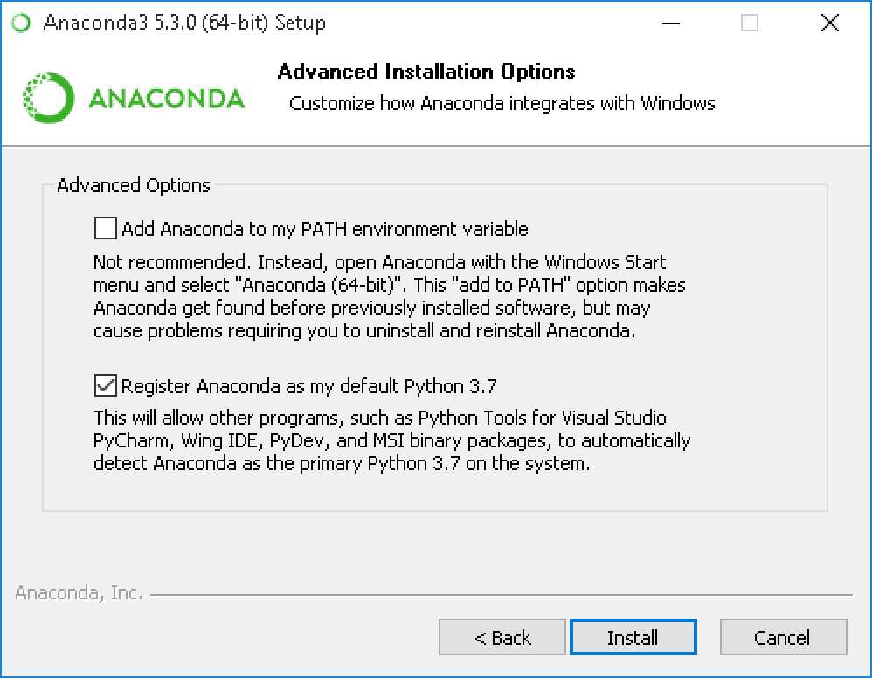
Choose whether to add Anaconda to your PATH environment variable. We recommend not adding Anaconda to the PATH environment variable, since this can interfere with other software.
Instead, use Anaconda software by opening Anaconda Navigator or the Anaconda Prompt from the Start Menu

Slide 11
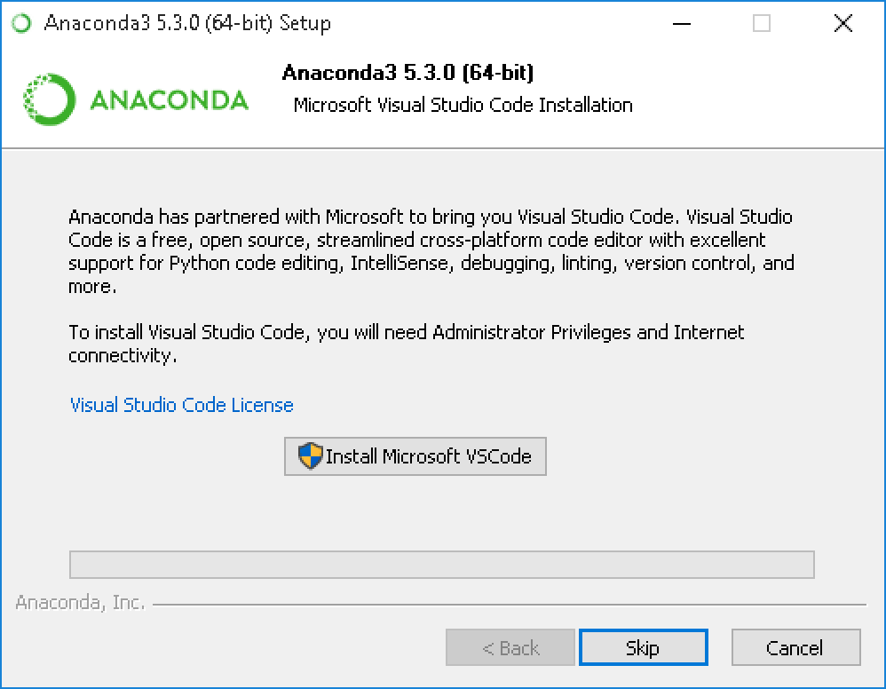
Be patient. This step takes awhile

Slide 12
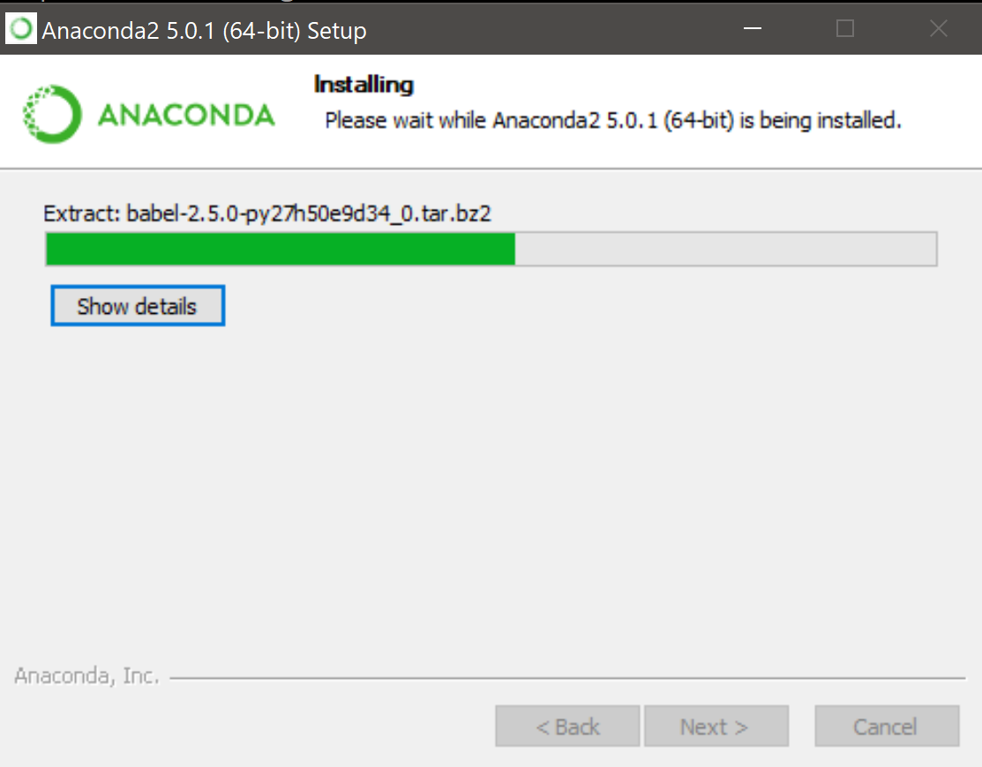
Be patient. This step takes awhile

Slide 13
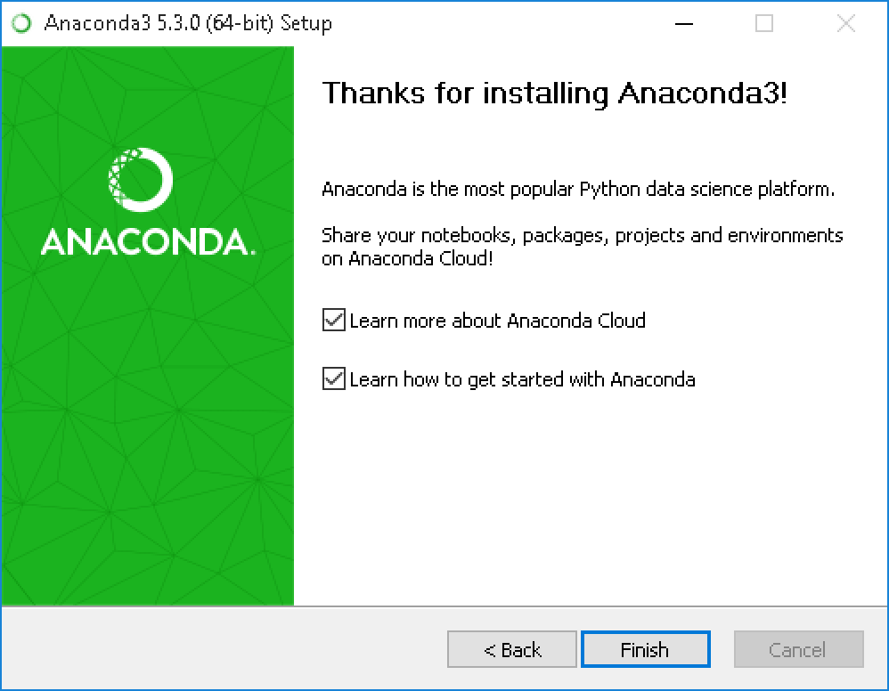
Be patient. This step takes awhile

Slide 14
Starting Anaconda Navigator
After your install is complete, verify it by opening Anaconda Navigator, a program that is included with Anaconda: from your Windows Start menu, select the shortcut Anaconda Navigator. If Navigator opens, you have successfully installed Anaconda. If not, check that you completed each step above

Slide 15
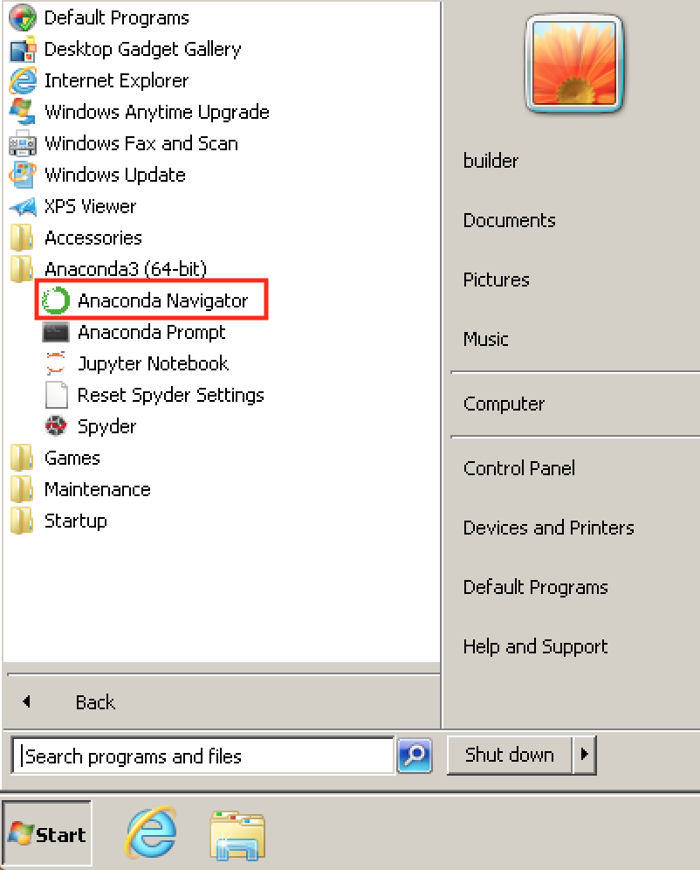
Starting Anaconda Navigator

Slide 16
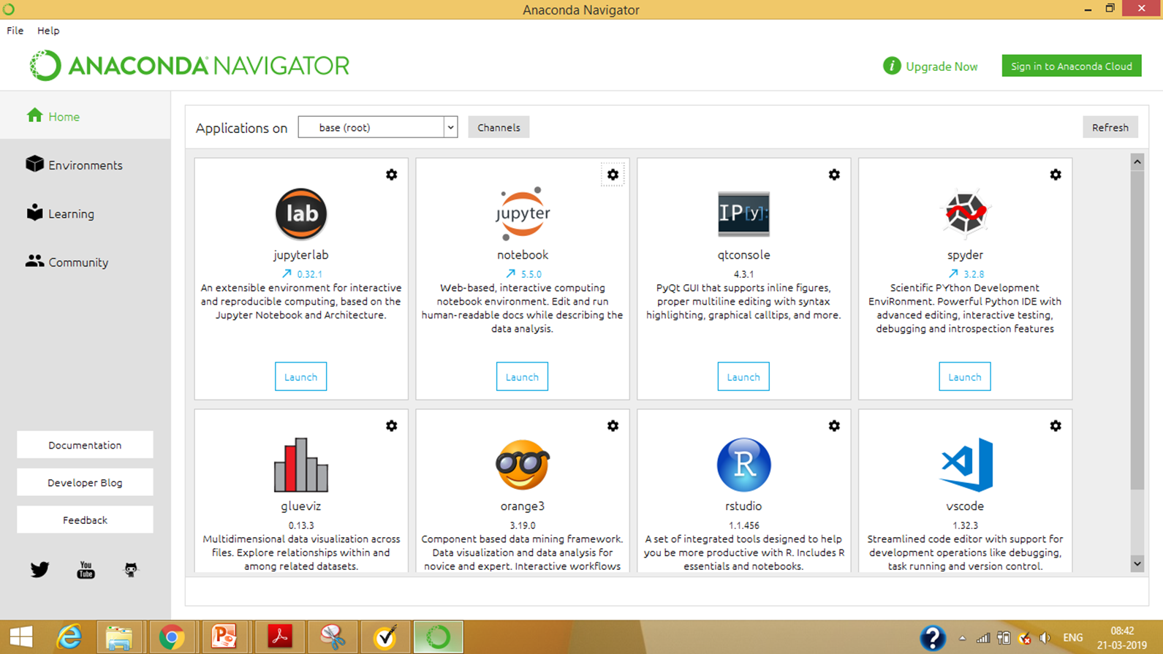

Slide 17

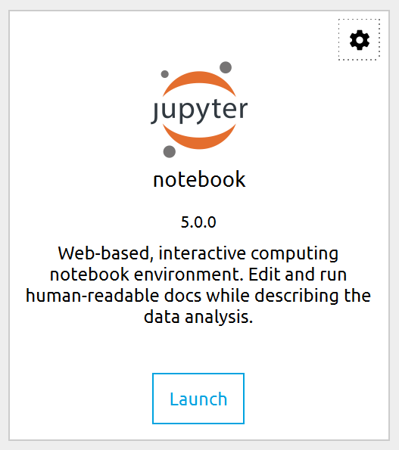
To run, open Anaconda Navigator
Click to launch Jupyter notebook

Slide 18
If Jupyter opens in Internet Explorer (IE):
To change the default browser when,
open Anaconda Navigator,
Launch Jupyther
On you laptop click on
settings ->apps->default apps
Set the default browser to Chrome

Slide 19
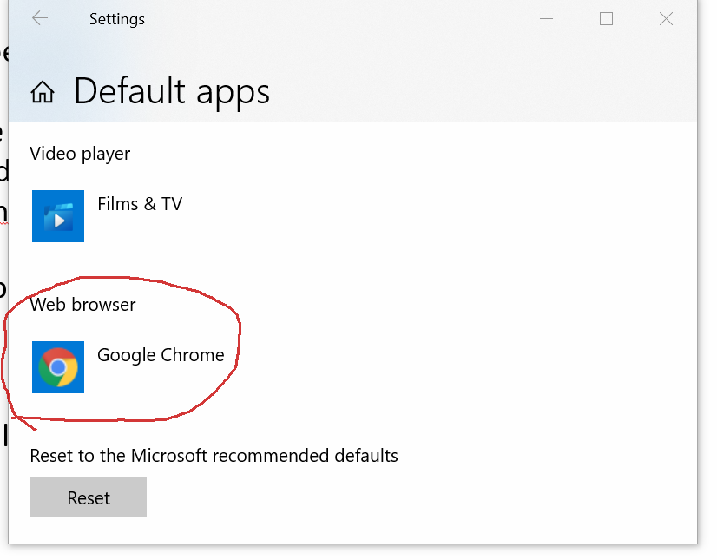

Slide 20
Change file path for jupyter

Slide 21
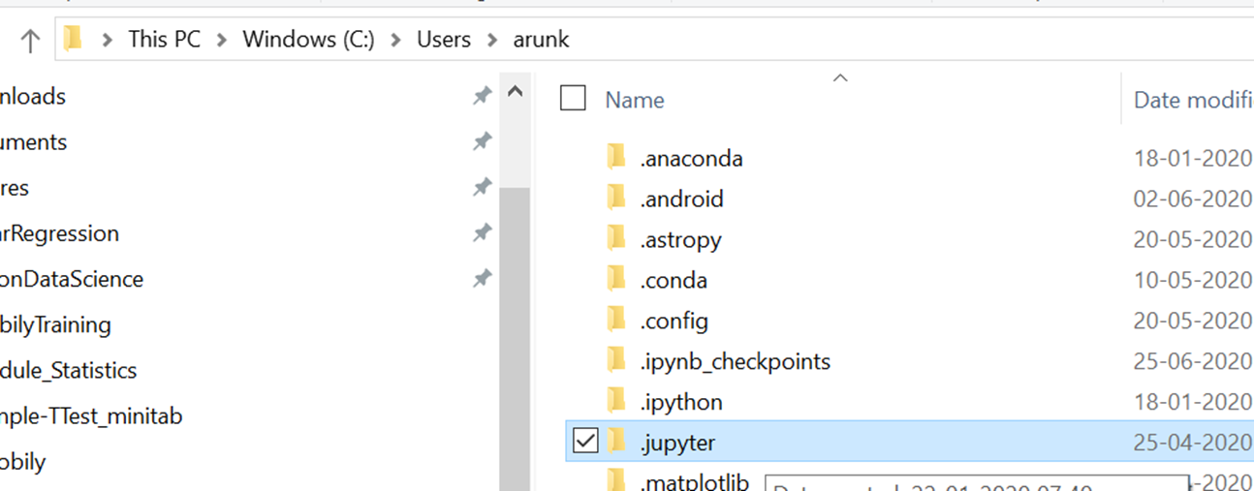
To change the file path for jupyther
Check path for config file. (First time users will not have jupyter_notebook_config.py, So we have to Generate the File.)
C:\Users\HP\.jupyter
jupyter_notebook_config.py

Slide 22
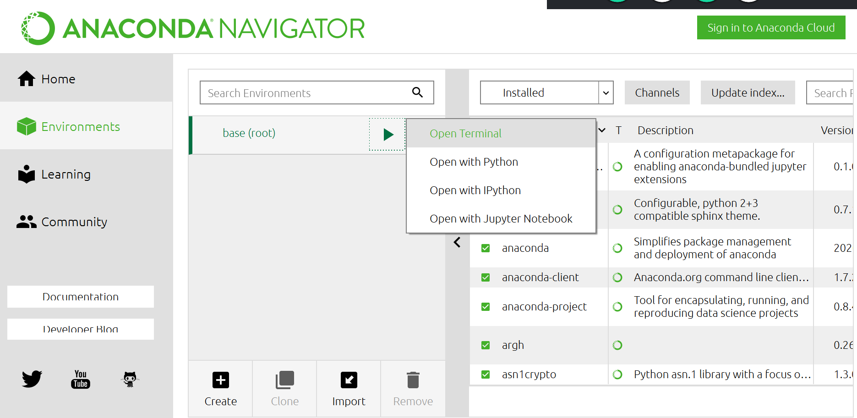
To generate, config file jupyter_notebook_config.py

Slide 23
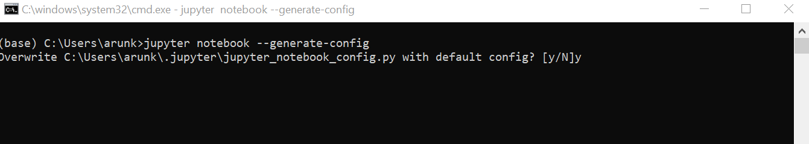
To generate, config file jupyter_notebook_config.py
Check path for config file. (First time users will not have jupyter_notebook_config.py, so we have to Generate the File.)
C:\Users\HP\.jupyter
Open the terminal and run the following code to generate the config file
>jupyter notebook --generate-config

Slide 24
To change the file path for jupyther- add file path
Make changes to the jupyter_notebook_config.py file:
C:\Users\HP\.jupyter
jupyter_notebook_config.py
Add the file path:
## The directory to use for notebooks and kernels.
c.NotebookApp.notebook_dir = 'C:/25July2018/Analytics_Learning2018'

Slide 25
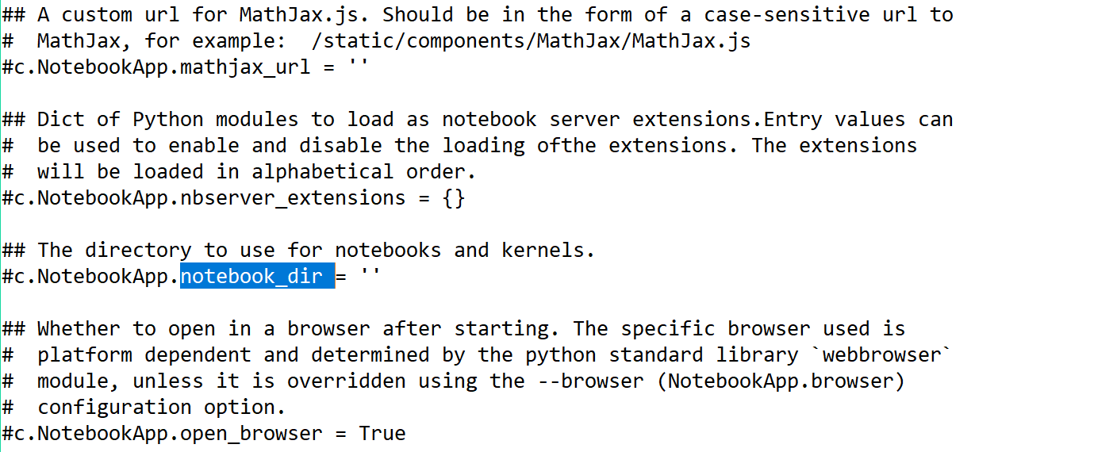

Slide 26
To change the file path
C:\Users\HP\.jupyter
## The directory to use for notebooks and kernels.
#c.NotebookApp.notebook_dir = 'C:/25July2018/Analytics_Learning2018’
(“Note the file paths”)
c.NotebookApp.notebook_dir = 'C:/25July2018/Analytics_Learning2018/ExcelRDemo/DeepLearningTutorial’
Uncomment the config file

Slide 27
To change the file path
C:\Users\HP\.jupyter
## The directory to use for notebooks and kernels.
c.NotebookApp.notebook_dir = 'C:\\25July2018\\Analytics_Learning2018\\ExcelRDemo\\DeepLearningTutorial'

Slide 28
How to use Jupyther

Slide 29
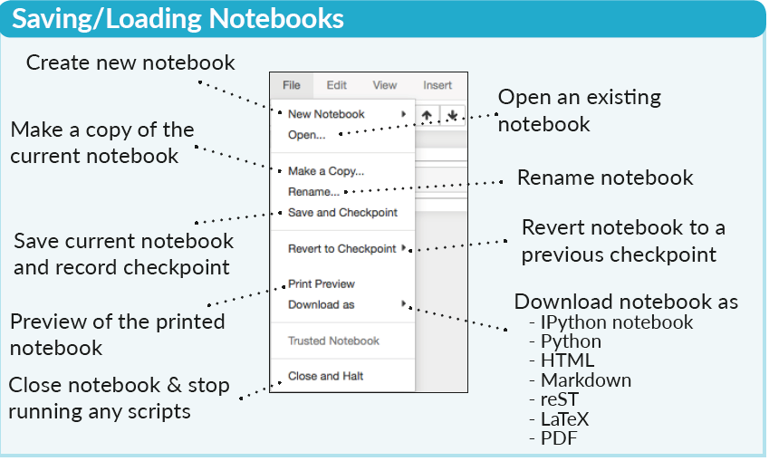

Slide 30
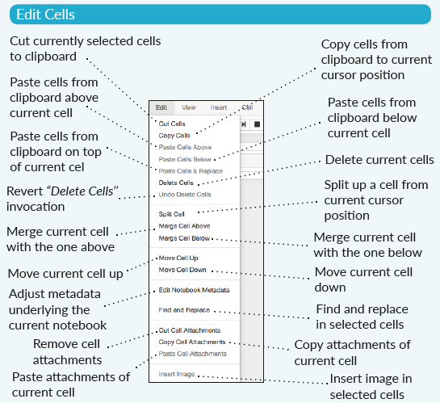
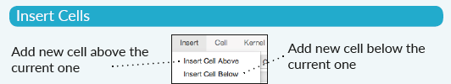

Slide 31
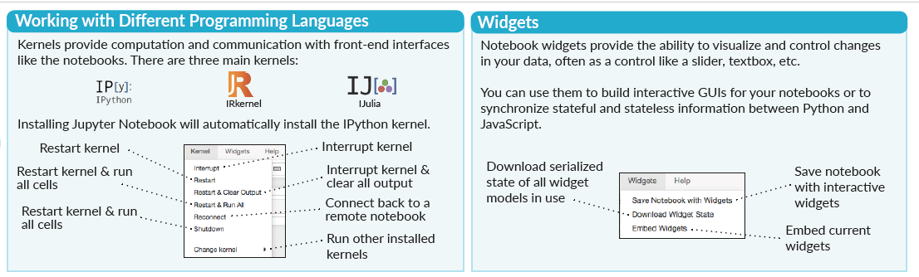

Slide 32
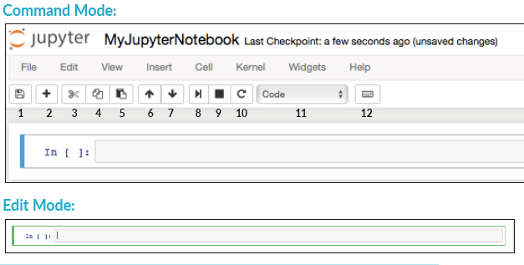

Slide 33
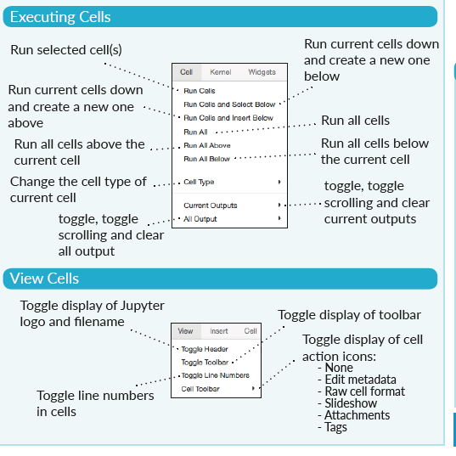

Slide 34
UnTyped Language - Python
Java is a typed Language
  Before assigning the integer has to be specified
  Int a and then assign the values
  I can hold only Values
Python is untyped Language
  Before assigning the integer need not be specified
  Directly assign the values

Slide 35
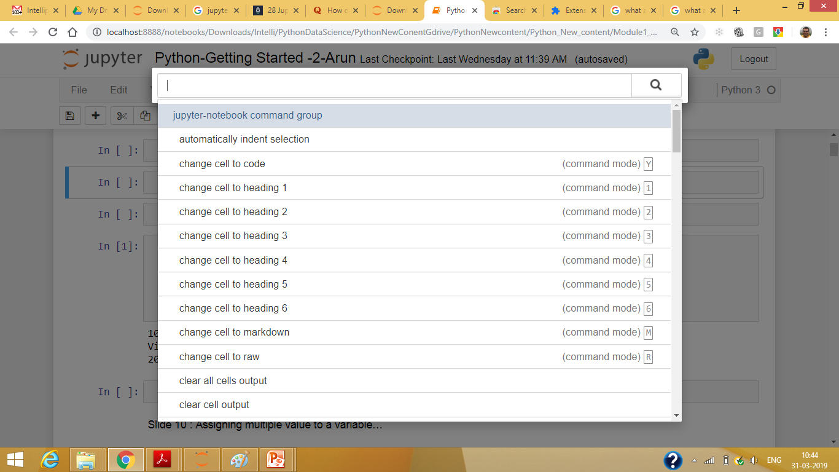
Another way to access keyboard shortcuts, Ctrl + Shift + P Windows)

Slide 36
End

Slide 37
import os
os.getcwd()

Slide 38
Convert notebook to .py
jupyter nbconvert --to script [YOUR_NOTEBOOK].ipynb
jupyter nbconvert --execute --to pdf notebook.ipynb

