Slide 1
Python OOPS
Object oriented Programming

Slide 2
Introduction to oop
Object Oriented ProGramming

Slide 3
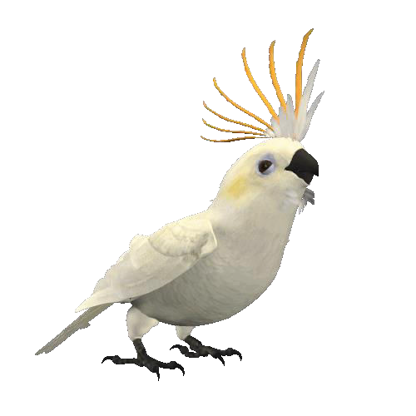
What is OOP?
O:OBJECT
O:ORIENTED
P:PROGRAMMING
For Eg:
Attribute: Name, Age,Color
Behaviour: Singing, Dancing
Parrot

Slide 4
Basic Principle of OOPS:
Class
Object
Inheritance
Encapsulation
Polymorphism
Abstraction

Slide 5
Let’s understand with a Real-Life ExamplE
Concepts of oop

Slide 6
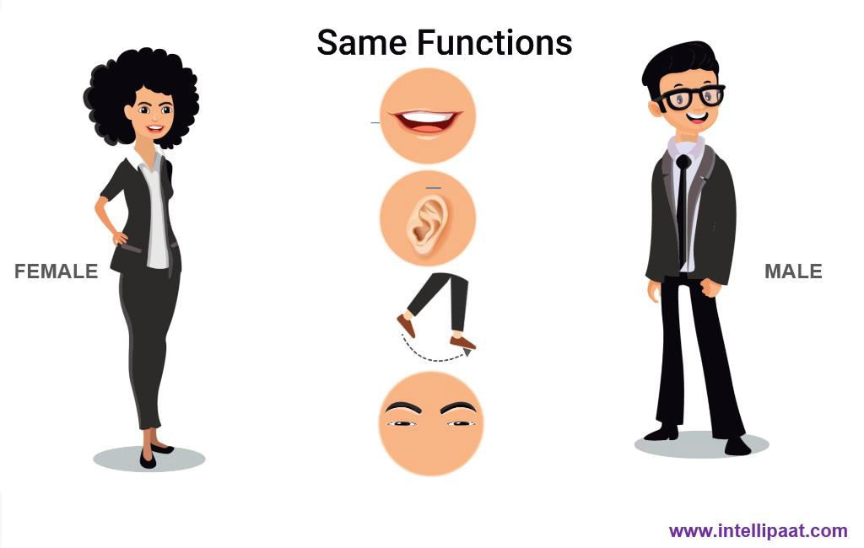
Every Human Being is Classified into:

Slide 7


Class
Consider Human Being is a Class

Slide 8
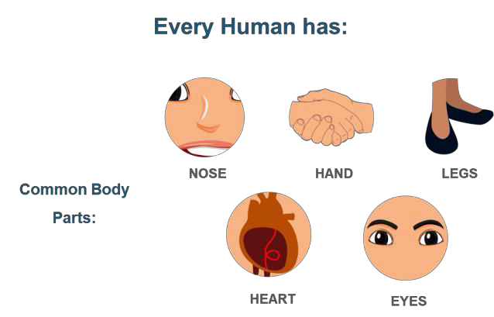
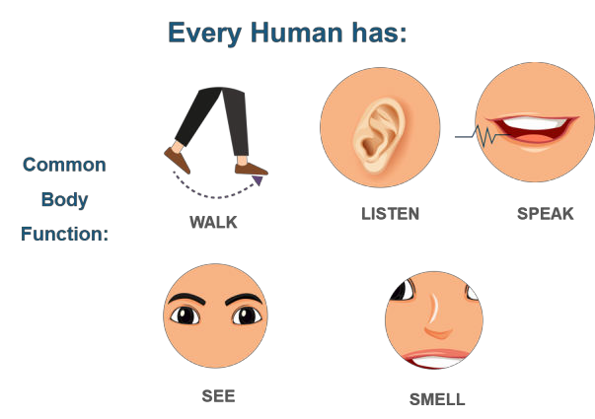
Class
Common body features and functions are Class Attributes

Slide 9


Inheritance
Male and Female are inherited from Class Human Being

Slide 10

Object
Name’ and ‘Age’ are object of class MALE
Objects have a physical existence
Class is just a logical definition
Class: MALE
Name: Victor
Age: 24

Slide 11




Encapsulation
You don’t know the detail of how you walk, listen or see, i.e, its hidden
WALK
HEAR
SEE

Slide 12



Polymorphism
‘She’ can be a woman, wife, mother and a teacher at the same time
WOMAN
WIFE or MOTHER
TEACHER

Slide 13
OOPS: Classes and Objects

Slide 14
Things you will learn after this Session
OOPS: Classes and Objects
What are Classes and Objects?
How to create a class in Python?
How to create objects in Python?
How to access class members?
Concept of init method/constructor in Python

Slide 15







What are Object and Class?
Class is a blueprint for an object
Objects: Defined and created from classes(blueprint)
Obj1 (House 1)
Obj2 (House 2)
Class (House Blue Print)
Obj3 (House 3)

Slide 16
What are Object and Class?
Object is the basic unit of object-oriented programming
An object represents a particular instance of a class
There can be more than one instance of an object
Each instance of an object can hold its own relevant data
Objects with similar properties and methods are grouped together to form a Class

Slide 17
How to create a Class in Python?
Syntax
class ClassName:
variable= “I am a class Attribute”
def function(self):
print(“I am from inside the class”)
class NameOfClass:
<statement-1>
.
.
<statement-2>
EXAMPLE

Slide 18
How to create a Object in Python?
Syntax
obj1 = ClassName()
<obj-name> = NameOfClass()
EXAMPLE

Slide 19
How to access Class Members?
EXAMPLE
Here obj1 and obj2 are object of class ClassName
To access the members of a Python class, we use the dot operator.
obj1 = ClassName()
obj2 = ClassName()
#Creating new instance attribute for obj2
obj2.variable = “I was just created”
print(obj1.variable)
print(obj2.variable)
print(ClassName.variable)
Obj1.function()

Slide 20
__init__() method in Python
__init__ is a special method in Python classes
Is a constructor method for a class
__init__ is called when ever an object of the class is constructed

Slide 21
__init__() method in Python
EXAMPLE
class Student(object):
def __init__(self, name, branch, year):
self.name = name
self.branch = branch
self.year = year
print("A student object is created.")
def print_details(self):
print("Name:", self.name)
print("Branch:", self.branch)
print("Year:", self.year)
ob1= Student( “Paul","CSE",2019)
ob1.print_details()

Slide 22
__init__() method in Python
OUTput
A student object is created.
Name: Paul
Branch: CSE
Year: 2018

Slide 23
T1.
Create two new vehicles called car1 and car2. Set car1 to be a red convertible worth $70,000.00 with a name of Ferrari, and car2 to be a blue van named JEEP worth $15,000.00.
Code
# define the Vehicle class
class Vehicle:
name = ""
kind = "car“
color = ""
value = 100.00
def description(self):
desc_str = "%s is a %s %s worth $%.2f." %(self.name, self.color, self.kind, self.value)
return desc_str
# your code goes here
#......................
print(car1.description())
print(car2.description())

Slide 24
OOPS: Inheritance in Python

Slide 25
Things you will learn after this Session
OOPS: Inheritance in Python
What is Inheritance?
Real life example of Inheritance
Different types of Inheritance in Python
Overriding vs Overloading

Slide 26
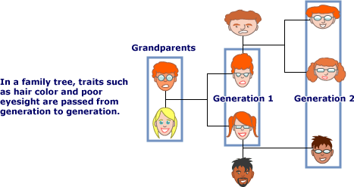
What is Inheritance in Python?
One class acquiring the property of another class”
Eg: You have inherited qualities from your parents

Slide 27
Inheritance Syntax in Python
Creating a Class AND It’s SubClass in Python
class ClassName:
<statement-1>
.
.
<statement-n>
class SubClassName(ClassName):
<statement-1>
.
.
<statement-n>

Slide 28














Different Types of Inheritance in Python
Inheritance in Python
Single Inheritance
Multiple Inheritance Multilevel Inheritance
Hierarchical Inheritance Hybrid Inheritance
www.intellipaat.com

Slide 29
Different Types of Inheritance in Python
Single Inheritance
Multiple Inheritance
Multilevel Inheritance
Hierarchical Inheritance
Hybrid Inheritance

Slide 30













“single class inherits from a class”
What is Single Inheritance?
Inheritance in Python
Parent Class
Single Inheritance
Multiple Inheritance
Multilevel Inheritance
Child Class
Hierarchical Inheritance
Hybrid Inheritance
www.intellipaat.com

Slide 31


“single class inherits from a class”
What is Single Inheritance?
Inheritance in Python
Single Inheritance
class fruit:
def init (self):
print("I'm a fruit") class citrus(fruit):
def init (self):
super(). init () print("I'm citrus")
Lemon = citrus()
Single Inheritance
Multiple Inheritance Multilevel Inheritance
Hierarchical Inheritance
Hybrid Inheritance
www.intellipaat.com

Slide 32



“A class inherits from multiple class”
What is Multiple Inheritance?
Inheritance in Python
Class A
Class B
Single Inheritance
Multiple Inheritance Multilevel Inheritance Hierarchical Inheritance
Hybrid Inheritance
Class C
www.intellipaat.com

Slide 33


“Multiple class inherits from a class”
What is Multiple Inheritance?
Inheritance in Python
Multiple Inheritance
class A:
pass class B:
pass class C(A,B):
pass
issubclass(C,A) and issubclass(C,B)
Single Inheritance
Multiple Inheritance Multilevel Inheritance Hierarchical Inheritance
Hybrid Inheritance
www.intellipaat.com

Slide 34



“One class inherits from another, which in turn inherits from another”
What is Multilevel Inheritance?
Inheritance in Python
Parent Class
Single Inheritance
Multiple Inheritance
Child/Parent Class
Multilevel Inheritance
Hierarchical Inheritance
Child Class
Hybrid Inheritance
www.intellipaat.com

Slide 35


“One class inherits from another, which in turn inherits from another”
What is Multilevel Inheritance?
Inheritance in Python
Multilevel Inheritance
Single Inheritance
class A:
x=1
Multiple Inheritance
class B(A):
pass
Multilevel Inheritance
class C(B):
pass
Hierarchical Inheritance
cobj=C() cobj.x
Hybrid Inheritance
www.intellipaat.com

Slide 36




“More than one class inherits from a class”
What is Hierarchical Inheritance?
Inheritance in Python
Class A
Single Inheritance
Multiple Inheritance Multilevel Inheritance Hierarchical Inheritance
Class B
Class C
Class D
Hybrid Inheritance
www.intellipaat.com

Slide 37


“More than one class inherits from a class”
What is Hierarchical Inheritance?
Inheritance in Python
Hierarchical Inheritance
Single Inheritance
Multiple Inheritance Multilevel Inheritance Hierarchical Inheritance
class A:
pass class B(A):
pass class C(A):
pass
issubclass(B,A) and issubclass(C,A)
Hybrid Inheritance
www.intellipaat.com

Slide 38




“Combination of any two kinds of inheritance”
What is Hybrid Inheritance?
Inheritance in Python
Class A
Single Inheritance
Class B
Class D
Multiple Inheritance
Class C
Multilevel Inheritance
Hierarchical Inheritance
Hybrid Inheritance
Class E
www.intellipaat.com

Slide 39


“Combination of any two kinds of inheritance”
What is Hybrid Inheritance?
Inheritance in Python
Hybrid Inheritance
>>> class A:
Single Inheritance
x=1
>>> class B(A):
Multiple Inheritance
pass
>>> class C(A):
Multilevel Inheritance
pass
>>> class D(B,C):
pass
>>> dobj=D()
>>> dobj.x
Hierarchical Inheritance
Hybrid Inheritance
www.intellipaat.com

Slide 40



“Used to call a method from the parent class”
Inheritance Super Function
Inheritance in Python
Super Function
class Vehicle:
def start(self):
print("Starting engine") def stop(self):
print("Stopping engine")
class TwoWheeler(Vehicle):
def say(self):
super().start()
print("I have two wheels") super().stop()
Harley=TwoWheeler() Harley.say()
www.intellipaat.com

Slide 41

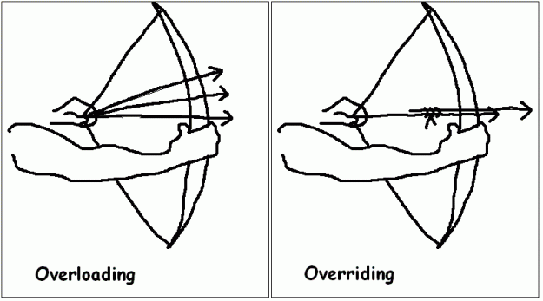
“Developers sometimes get confused between them”
Overriding vs Overloading
Inheritance in Python
www.intellipaat.com

Slide 42

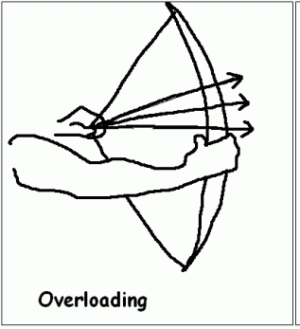


“Same function with different parameters”
Overloading a Function
Inheritance in Python
Why Overload a Function
def add(a,b):
return a+b def add(a,b,c):
return a+b+c add(2,3)
TypeError: add() missing 1 required positional argument: 'c'
www.intellipaat.com

Slide 43


“Used to call a method from the parent class”
Overloading a Function
Inheritance in Python
How to Overload a Function
def add(instanceOf,*args): if instanceOf=='int':
result=0
if instanceOf=='str':
result='' for i in args:
result+=i
return result add('int',3,4,5)
www.intellipaat.com

Slide 44
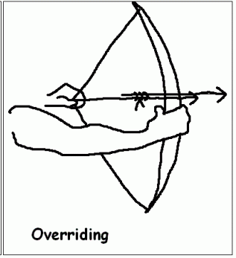


“Subclass may change the functionality of a Python
Overriding a Function
Inheritance in Python
method in the superclass”
Overriding a Function
class A:
def sayhi(self):
print("I'm in A")
class B(A):
def sayhi(self):
print("I'm in B")
bobj=B() bobj.sayhi()
www.intellipaat.com

Slide 45



Python Certification Course
www.intellipaat.com

Slide 46


OOPS: Encapsulation in Python
www.intellipaat.com

Slide 47
Things you will learn after this Session
OOPS: Encapsulation in Python
What is Encapsulation?
Real life example of Encapsulation
How to access a private method?
How to access a private variable?
www.intellipaat.com

Slide 48





What is Encapsulation?
Abstraction + Data Hiding
Encapsulatio n in Python
Abstraction is showing essential features and hiding non-
essential features to the user.
For example,
While writing a mail you don’t know how things are
actually happening in the backend
www.intellipaat.com

Slide 49

What is Encapsulation?
Abstraction + Data Hiding
Encapsulatio n in Python
Wrapping up of data into a single unit is Encapsulation
For example,
Multiple parts of cars encapsulates itself together to form a single object that is Car
www.intellipaat.com

Slide 50


What is Encapsulation?
Convention:
A class variable that should not directly be accessed(private) should be prefixed with an underscore
Encapsulatio n in Python
Encapsulating a Function
class Encap(object): def init (self):
self.a = 123
self._b = 123
self. c = 123
So what’s with the underscores and error?
obj = Encap() print(obj.a) print(obj._b) print(obj. c)
AttributeError: 'Encap' object has no attribute ' c'
www.intellipaat.com

Slide 51



How to access a Private Method?
Private method can be called using redcar._Car__updateSoftware()
Example
Encapsulatio n in Python
class Car:
def init (self):
self. updateSoftware()
def drive(self): print ('driving')
def updateSoftware(self): print ('updating software')
redcar = Car() redcar.drive()
redcar._Car updateSoftware()
www.intellipaat.com

Slide 52
How to access a Private Variable?
To change the value of a private variable, a setter method is used
Example
Encapsulatio n in Python
redcar = Car() redcar.drive()
redcar. maxspeed = 10 # will not change variable because its private
redcar.setMaxSpeed(320) redcar.drive()
def setMaxSpeed(self,speed): self. maxspeed = speed
www.intellipaat.com

Slide 53
OOPS: Polymorphism in Python
www.intellipaat.com

Slide 54
Things you will learn after this Session
OOPS: Polymorphism in Python
What is Polymorphism?
Real-Life Example of Polymorphism
Polymorphism in a function
www.intellipaat.com

Slide 55




“Functions with same name, but functioning in
What is Polymorphism?
different ways”
For Example:
Polymorphis m in Python
You behave differently in front of elders, and friends. A single person behaves differently at different time
www.intellipaat.com

Slide 56




Polymorphism with a function
Example
Polymorphis m in Python
def in_the_pacific(fish): fish.swim()
sammy = Shark()
casey = Clownfish()
in_the_pacific(sammy) in_the_pacific(casey)
www.intellipaat.com

Slide 57
j ntelliPaat
QUIZ
www.intellipaat.com

Slide 58



Quiz 1
jn telliPaat
Listl = ['Python', 'Py', 'Pyth', 'Python3'] print( Listl[-1][2])
•
•
•
•
Python
www.intellipaat.com

Slide 59

Answer 1
jn telliPaat
Listl = ['Python', 'Py', 'Pyth', 'Python3'] print( Listl[-1][2])
What is the output of the following?
•
•
•
•
Python
www.intellipaat.com

Slide 60


Quiz 2
jn telliPaat
x = range(lO) y = sum(x) print(y)
•
■
•
•
An exception is thrown
www.intellipaat.com

Slide 61



jn telliPaat
Answer 2
'
x = range(lO)
y = sum(x)
print(y)
II
•
•
An exception is thrown
www.intellipaat.com

Slide 62


Quiz 3
jn telliPaat
Listl = ['Python', 'Py', 'Pyth', 'Python3']
List2 = Listl*2 List3 = Listl[:]
•
List2[0] = 'Hello' List3[1] = 'World' sum= 0
for Is in (Listl, List2, List3): if ls[O] == 'Hello' :
sum+= 1
if ls[l] == 'World': sum+= 2
print(sum, List2)
a)3 ['Hello', 'Py', 'Pyth', 'Python3', 'Python', 'Py',
'Pyth', 'Python3']
•
]
a)2 ['Hello', 'Py', 'Pyth', 'Python3'
•
a)3 ['Hello', 'Py', 'Pyth', 'Python3']
•
a)2 ['Hello', 'Py', 'Pyth', 'Python3', 'Python', 'Py',
'Pyth', 'Python3']
www.intellipaat.com

Slide 63
Answer 3
jn telliPaat
Listl = ['Python', 'Py', 'Pyth', 'Python3']
List2 = Listl*2 List3 = Listl[:]
•
List2[0] = 'Hello' List3[1] = 'World' sum= 0
for Is in (Listl, List2, List3): if ls[O] == 'Hello' :
sum+= 1
if ls[l] == 'World': sum+= 2
print(sum, List2)
a)3 ['Hello', 'Py', 'Pyth', 'Python3', 'Python', 'Py',
'Pyth', 'Python3']
•
]
a)2 ['Hello', 'Py', 'Pyth', 'Python3'
•
a)3 ['Hello', 'Py', 'Pyth', 'Python3']
•
a)2 ['Hello', 'Py', 'Pyth', 'Python3', 'Python', 'Py',
'Pyth', 'Python3']
www.intellipaat.com

Slide 64
Quiz 4
jn telliPaat
1.We have two lists
We want to achieve the following output
['a', 'b', ['r', 'n']]
a=['a','b']
b=['r','n']
•
Which of the following should be used?
a}a.extend(b}
•
a}a.append(b}
•
a}a.insert(l,b}
•
a}None
www.intellipaat.com

Slide 65
Quiz 4
jn telliPaat
1.We have two lists
We want to achieve the following output
['a', 'b', ['r', 'n']]
a=['a','b']
b=['r','n']
•
Which of the following should be used?
a}a.extend(b}
•
a}a.append(b}
•
a}a.insert(l,b}
•
a}None
www.intellipaat.com

Slide 66

Quiz 5
jn telliPaat
def a(
d pass
•
a}defines a list and initializes it
•
a}defines a function, which does nothing - correct
•
a}defines a function, which passes its parameters
through
•
a}defines an empty class
www.intellipaat.com

Slide 67

Answer 5
jn telliPaat
def a(b, c, d): pass
•
a}defines a list and initializes it
•
a}defines a function, which does nothing - correct
•
a}defines a function, which passes its parameters
through
•
a}defines an empty class
www.intellipaat.com

Slide 68


Quiz 6
jn telliPaat
x = True y = False z = False
ifxoryandz: print("yes")
else:
print("no")
•
•
•
fails to compiler
www.intellipaat.com

Slide 69

Answer 6
jn telliPaat
x = True y = False z = False
ifxoryandz: print("yes")
else:
print("no")
•
•
•
fails to compiler
www.intellipaat.com

Slide 70





www.intellipaat.com
India : +91-7847955955
US : 1-800-216-8930 (TOLL FREE)
sales@intellipaat.com
www.intellipaat.com

