Slide 1
Object Oriented Programming in Python
- Procedural vs OOPs
Concepts
- Build a Resort Management software using OOPs
Arunkumar Nair, 9 Dec 2020

Slide 2
How programs/applications were written earlier before OOPs?
Suppose we wrote code in linear way as a huge ream of instructions in a single file. It might look something like this:
main program:
======================
======================
======================
if ===================
===================
===================
===================
======================
======================
======================
while ================
===================
===================
===================
===================
======================
======================
======================
======================
======================
for ==================
===================
===================
===================
======================
======================
======================
======================
if ===================
===================
===================
===================
else =================
===================
===================
===================
======================
======================
======================
Huge Lines of Code

Slide 3
main program:
======================
======================
======================
if ===================
===================
===================
===================
======================
======================
======================
while ================
===================
===================
===================
===================
======================
======================
======================
======================
======================
for ==================
===================
===================
===================
======================
======================
======================
======================
if ===================
===================
===================
===================
Huge lines of Code will become unmanageable

Slide 4
Procedural Programming
The first programming paradigm arises from. It’s called procedural programming, and it employs procedures or functions to break down our endless ream of code into more manageable pieces. A procedure or function is a block of instructions that can be called from anywhere;

Slide 5
main program:
======================
======================
======================
call fred
======================
======================
if ===================
===================
===================
call eric
======================
======================
======================
Call a Procedure

Slide 6
procedure fred:
======================
======================
======================
procedure eric:
if ===================
===================
===================
======================
======================
======================
Procedure

Slide 7
Then came Object Oriented Programming
OOPs solved the problems of procedural programming.
Object-oriented programming is a programming paradigm based on the concept of "objects", which can contain data, in the form of fields, and code, in the form of procedures. A feature of objects is an object's procedures that can access and often modify the data fields of the object with which they are associated.

Slide 8
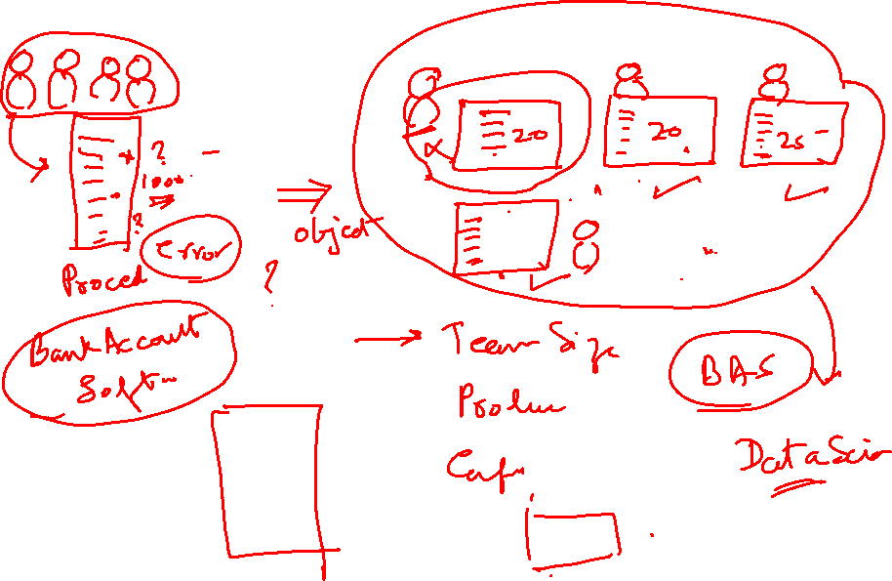



Slide 9
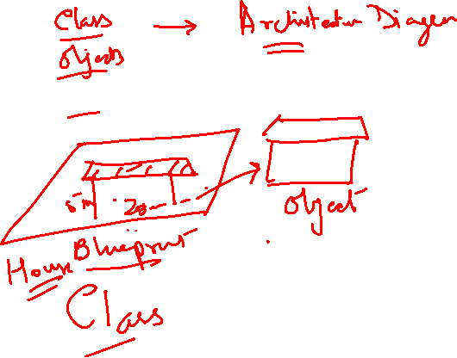

Slide 11
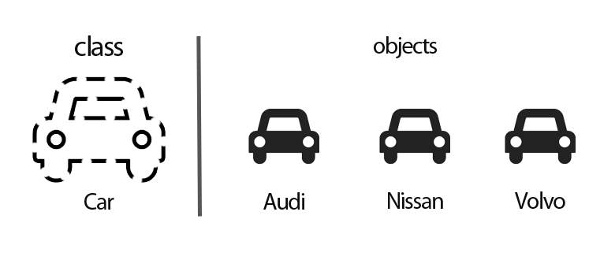
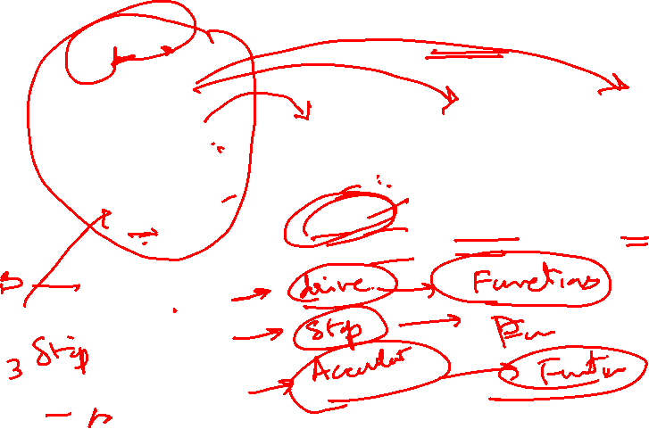
What is a Class, what is an Object

Slide 12
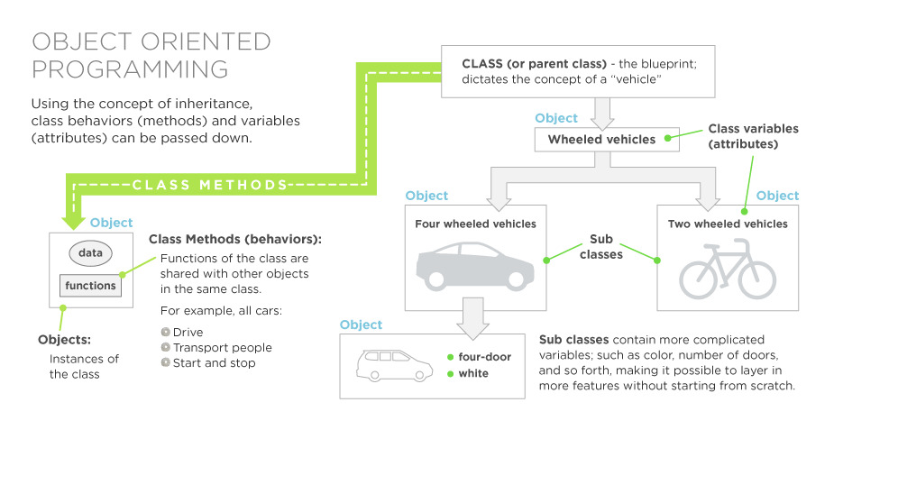
Class and Object are defined base on the Business Problems

Slide 13
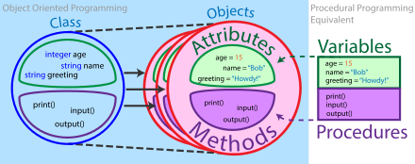
Object Oriented Programming
Note: In python the data types are not declared

Slide 14
What is an Object?
A software item that contains variables and methods
Object Oriented Design focuses on
  Encapsulation:
    dividing the code into a public interface, and a private implementation of that interface
  Polymorphism:
    the ability to overload standard operators so that they have appropriate behavior based on their context
  Inheritance:
    the ability to create subclasses that contain specializations of their parents

Slide 15
Build a - Reservation Management System for a Resort
Example-See the Jupyther Notebook File
OOPHotelWorkingCode-Training.ipynb

Slide 21
Reservation Management Software for a Resort
To make this a fun learning experience, let us design the classes for the RMS of a boutique resort that rents villas in Blue Lagoon Resort , Miami, Florida
The resort rents four standard villas and two VIP villas. VIP villas are larger and come with a personal yacht. All villas come with a personal assistant.
THE VILLA TYPES ARE :
#villa
#vipvilla

Slide 22
Reservation Management Software for a Resort
What are the different classes we need for implementing the software?
2 types of rooms- villa, vip villa
Class villa (rooms or room types, basic standard villa)
Class vipvilla (rooms or room types, basic standard villa+ more facilites)
********************
Class guest
Class resort
*************
Class reservation

Slide 23
Reservation Management Software for a Resort
What are the different classes we need for implementing the software?
THE VILLA TYPES ARE :
#villa
#vipvilla
GUEST: Class guest encapsulates the following attributes of a guest: first and last name, number of adults, and number of children in the room. It offers an access function to last name and a printing function for the guest object.

Slide 24
Reservation Management Software for a Resort
4. Reservation Class: Reservation encapsulates the following attributes of a reservation: the name of the reserved villa, checkin date, checkout date, reservation ID, a printing function for the reservation class.
5. Resort Class resort encapsulates the following attributes: a list with the names of the (standard) villas, a list with the names of the VIP villas, a guest list, a reservation list and a reservation ID list. It also offers access functions to a Guest object, Reservation object, reservation ID and a function that prints all lists.

Slide 25
Class
2 types of rooms- villa, vip villa
Class villa (rooms or room types, basic standard villa)
Class vipvilla (rooms or room types, basic standard villa+ more facilites)
********************
Class guest
Class reservation
Class resort

Slide 26
Create Class Villa
  Properties
-Name
-Personal Assitant
  Methods
CleanandChangeKey
GiftLabel

Slide 27
Class VipVilla(villa)
  Properties
Villa.Name of person
Villa.Personal Assistant
  Methods
Special Services

Slide 28
Class Guest
  properties
Name
Age
No.Adults
No.Children
  Method
    Get LastNameofGuest()

Slide 29
Class Reservation
Checkindate
Lengthofstay
Villaname
Checkoutdate()

Slide 30
Class Resort
List of villas,Names
Guest lists
Reservationlist
reservationids

Slide 31
END

Slide 32
Another OOP’s Example: Employee Information
OOPEmployeeExample-Train.ipynb

