Slide 1

numpy
Python library
1

Slide 2
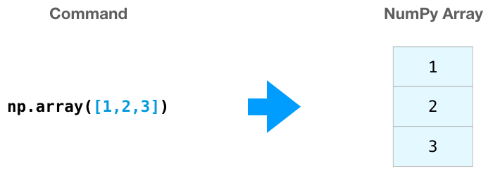

Create a Python numpy array

Slide 3
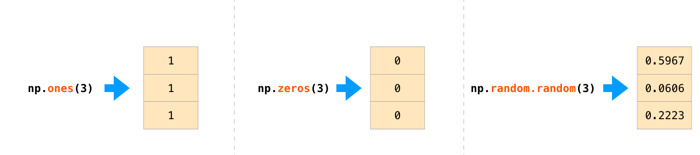
Creating random array

Slide 4
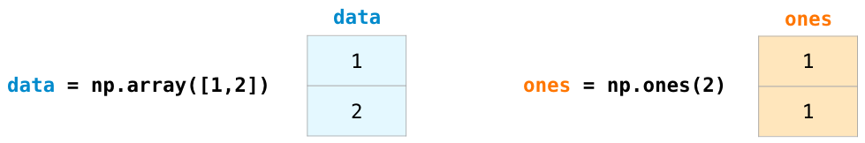
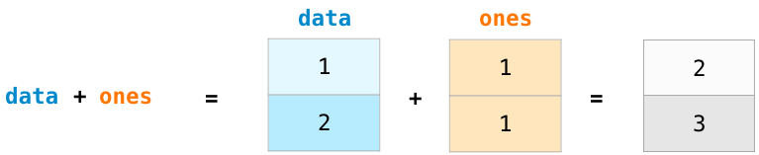
Array arithmetic

Slide 5
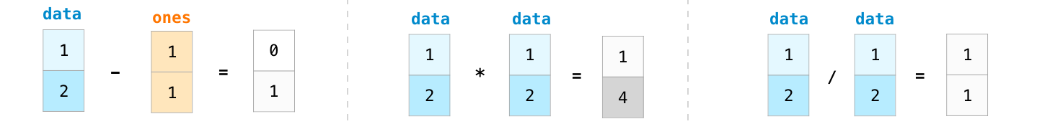
Array arithmetic

Slide 6
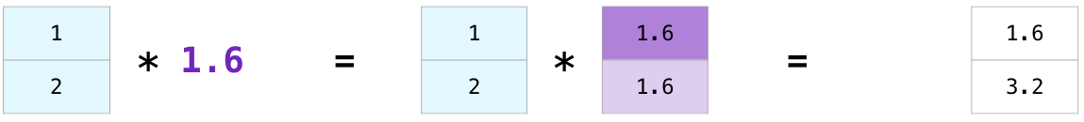
Multiplying array with specific value

Slide 7
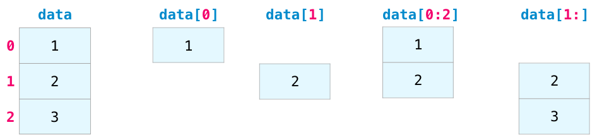
Indexing

Slide 8
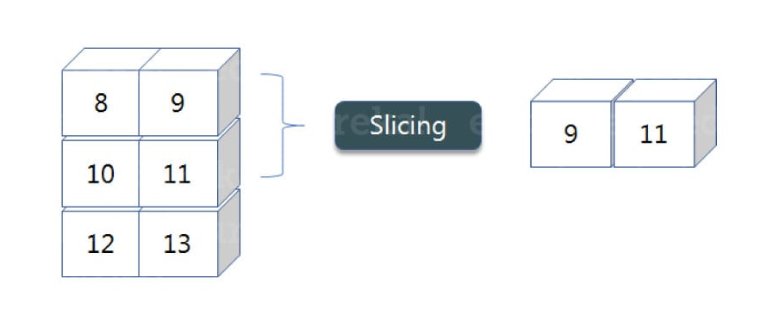
Slicing in array
Slicing is basically extracting particular set of elements from an array.
Slicing

Slide 9
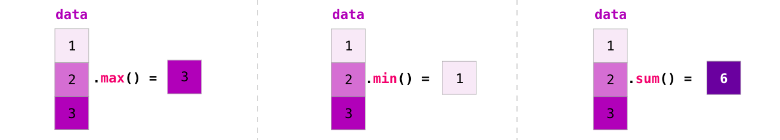
Aggregation

Slide 10
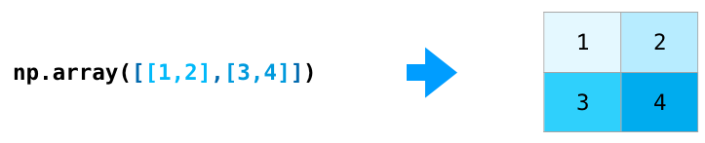
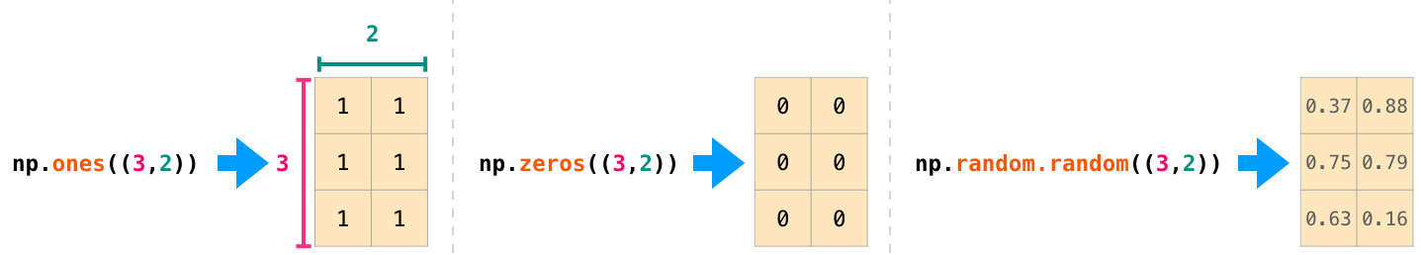
Creating Matrices

Slide 11
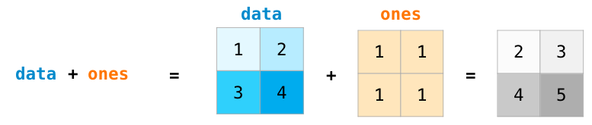
Matrix Arithmetic

Slide 12
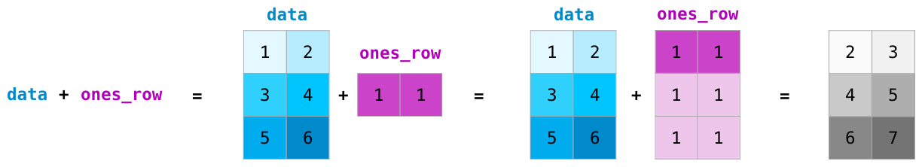
Matrix Arithmetic

Slide 13
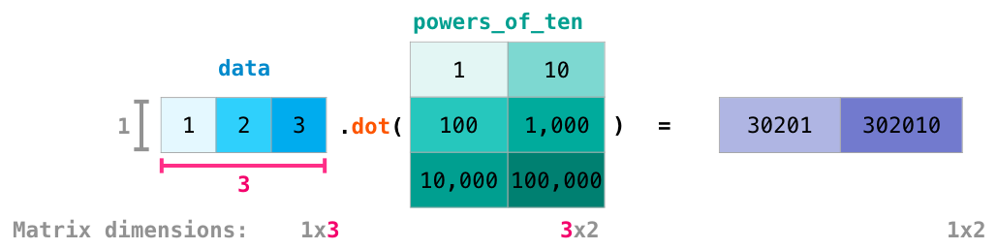
Dot Product
NumPy gives every matrix a dot() method we can use to carry-out dot product operations with other matrices:

Slide 14
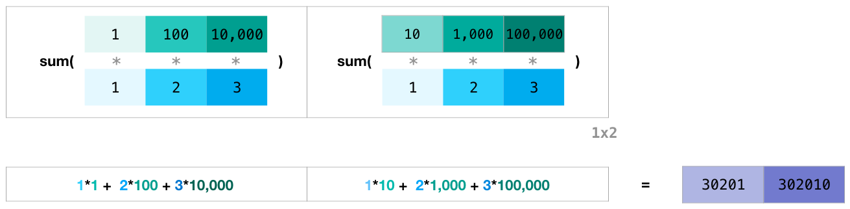
Summation of matrices
Two matrices have to have the same dimension on each side they face each other
Notes:
added matrix dimensions at the bottom of this figure to stress that the two matrices have to have the same dimension on the side they face each other with. You can visualize this operation as looking like this

Slide 15
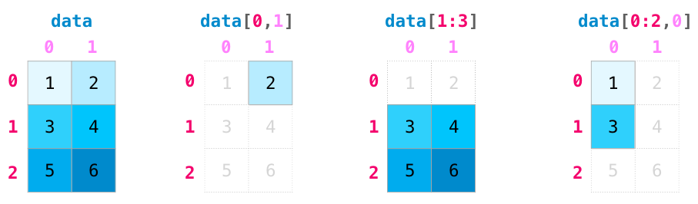
Matrix Indexing

Slide 16
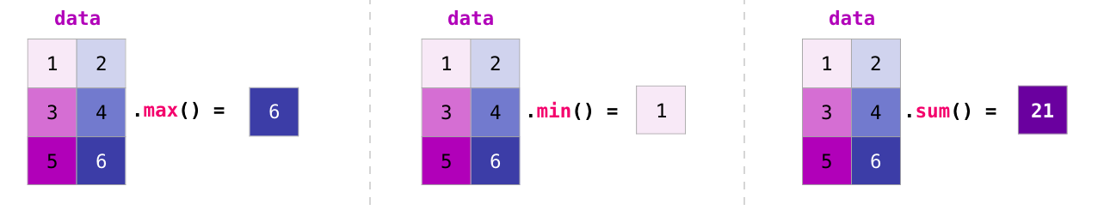
Matrix Aggregation
We can aggregate matrices the same way we aggregated vectors:

Slide 17
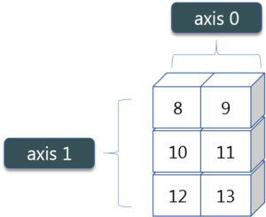
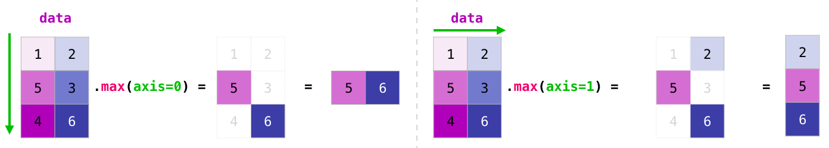
Matrix Aggregation using axis
Not only can we aggregate all the values in a matrix, but we can also aggregate across the rows or columns by using the axis parameter:

Slide 18
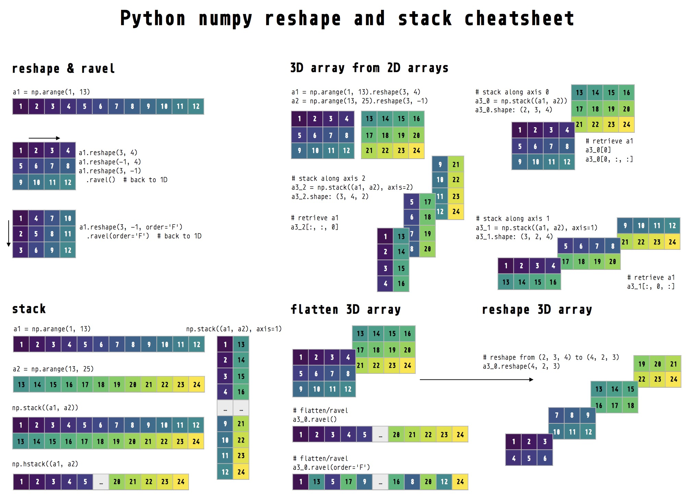
Reshape and ravel

Slide 19
3-d array from 2-d arrays

Slide 20
Stack

Slide 21
Flatten and reshape 3-D array

Slide 22
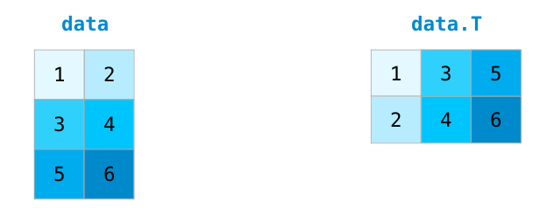
Transposing and Reshaping
NumPy arrays have a convenient property called T to get the transpose of a matrix:

Slide 23
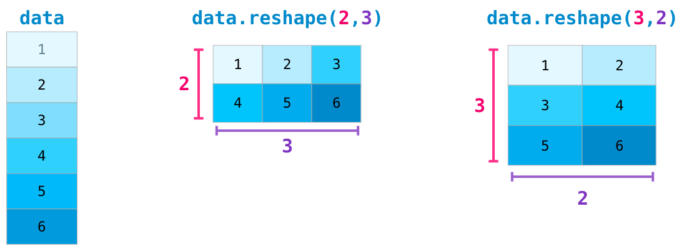
Changing the shape of array

Slide 24
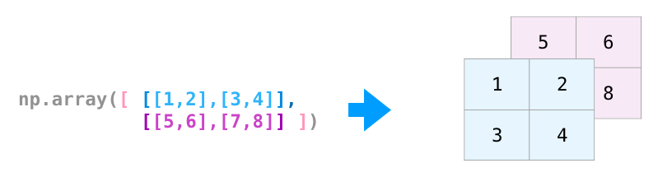
Multidimensional array

Slide 25
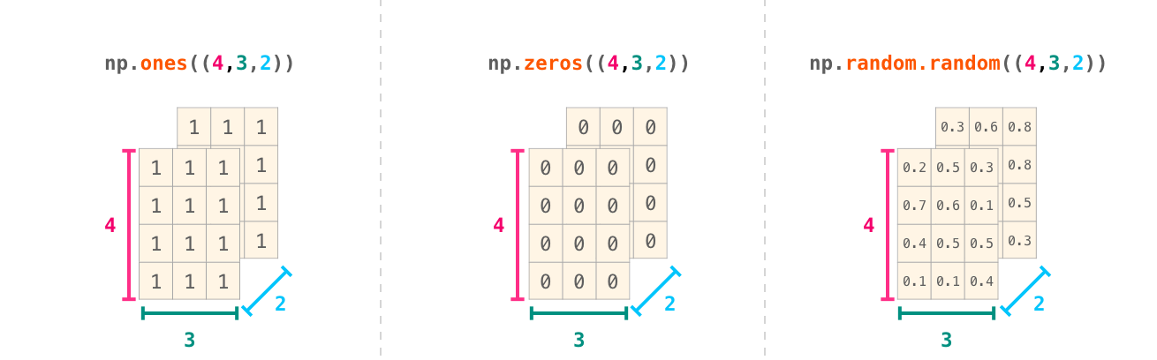
N dimensional array

Slide 26
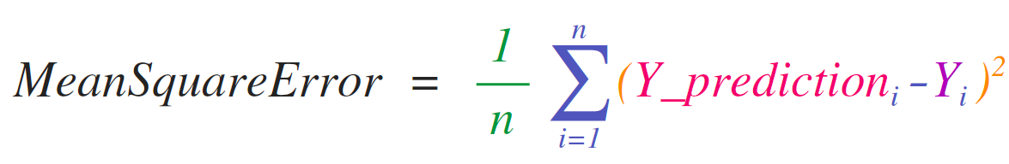
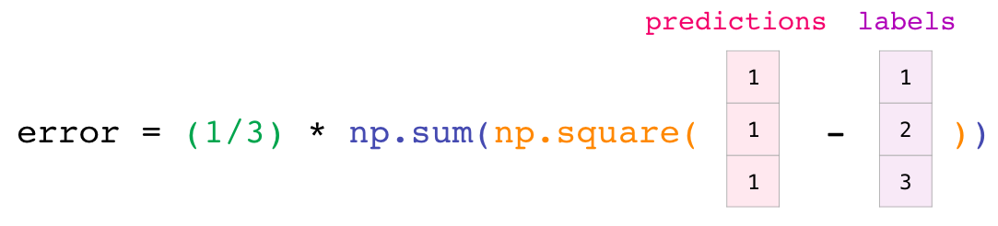
Mathematical / Practical Usage

Slide 27
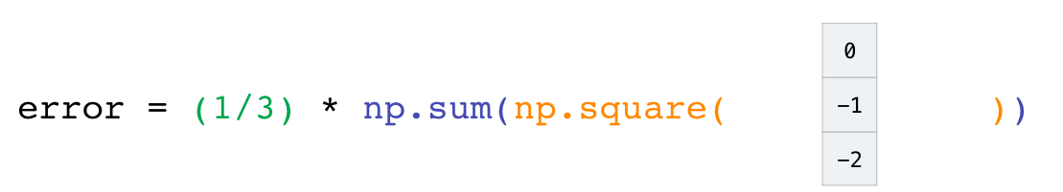
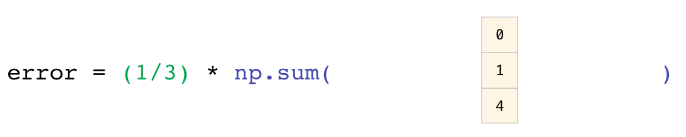
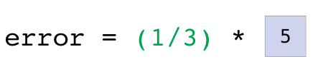
Mathematical / Practical Usage

Slide 28
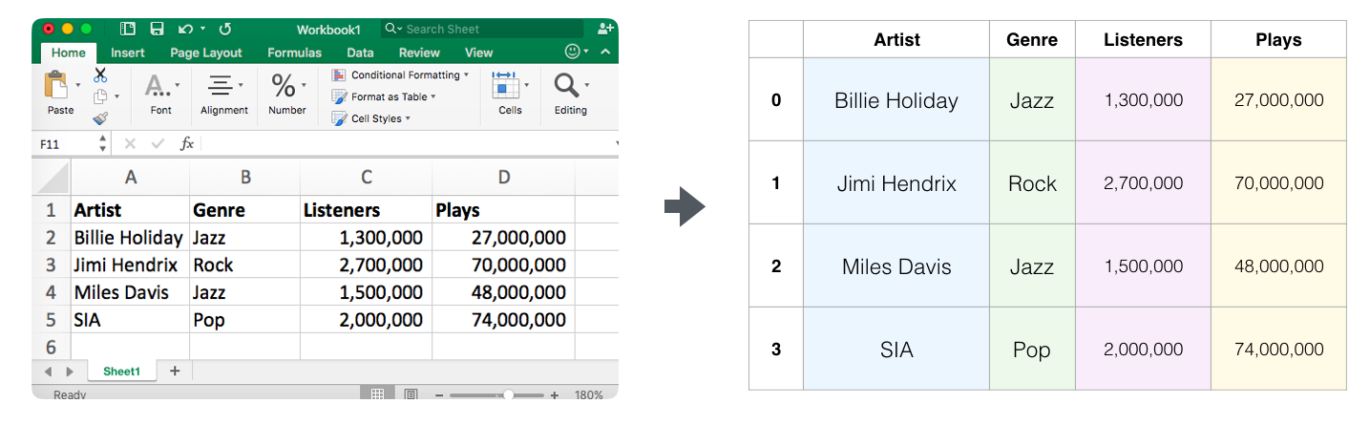
Data representation in an n-dimensional array
A spreadsheet or a table of values is a two dimensional matrix.
The most popular abstraction in python for those is the pandas dataframe, which actually uses NumPy and builds on top of it.
NumPy Array

Slide 29
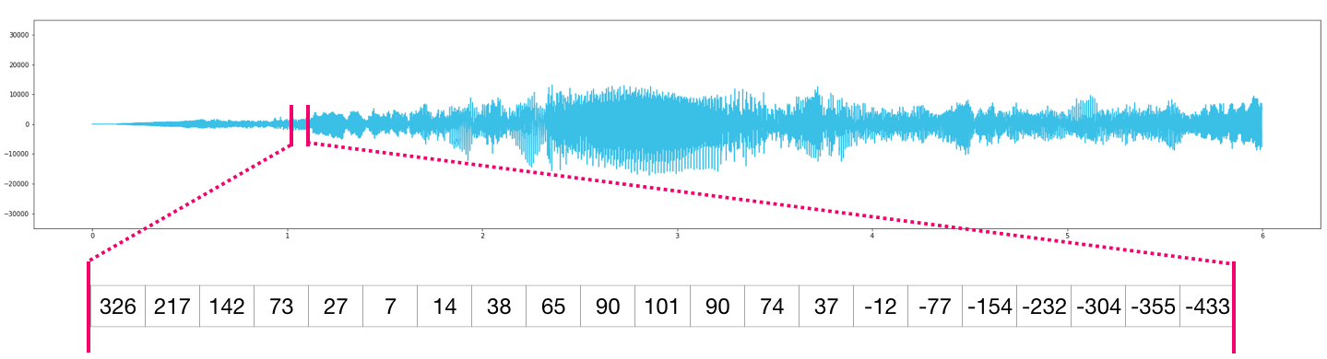
Audio and Time-series in n-dimensional array
Simply load the file into a NumPy array that we’ll call audio, and get audio[:44100].
CD audio quality data
Notes:
An audio file is a one-dimensional array of samples. Each sample is a number representing a tiny chunk of the audio signal. CD-quality audio may have 44,100 samples per second and each sample is an integer between -32767 and 32768. Meaning if you have a ten-seconds WAVE file of CD-quality, you can load it in a NumPy array with length 10 * 44,100 = 441,000 samples. Want to extract the first second of audio? simply load the file into a NumPy array that we’ll call audio, and get audio[:44100].

Slide 30
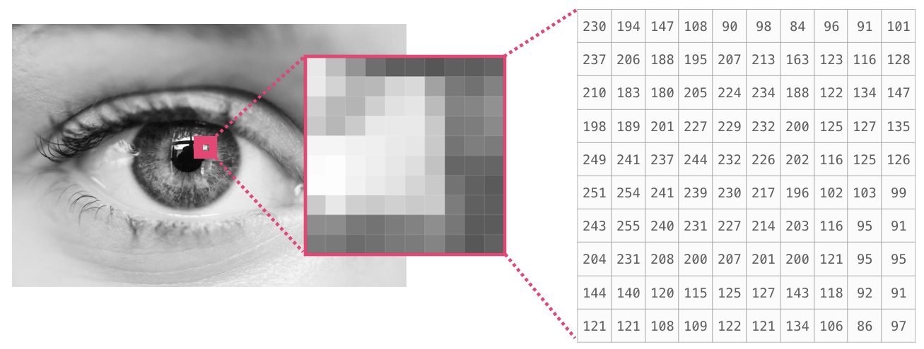
image is a matrix of pixels of size

Slide 31
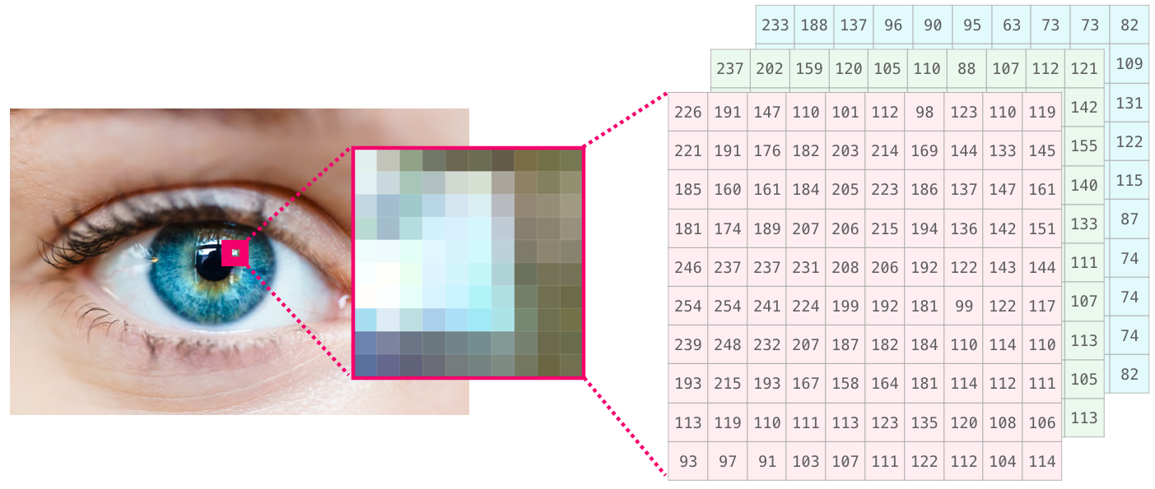
Colored image matrix of pixels size
If the image is colored, then each pixel is represented by three numbers - a value for each of red, green, and blue. In that case we need a 3rd dimension (because each cell can only contain one number). So a colored image is represented by an ndarray of dimensions: (height x width x 3)

Slide 32
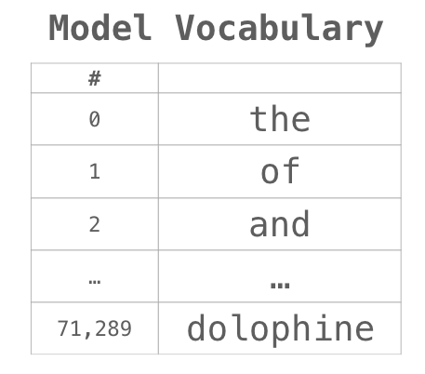
Use of numpy array in language modeling
A model takes large amount of text before it can numerically represents the sentence of anxious words. Here using small dataset to build a vocabulary by model.
For example consider sentence :
“Have the bards who preceded me left any theme unsung”
The sentence can then be broken into an array of tokens (words or parts of words based on common rules):
We then replace each word by its id in the vocabulary table:

Slide 33
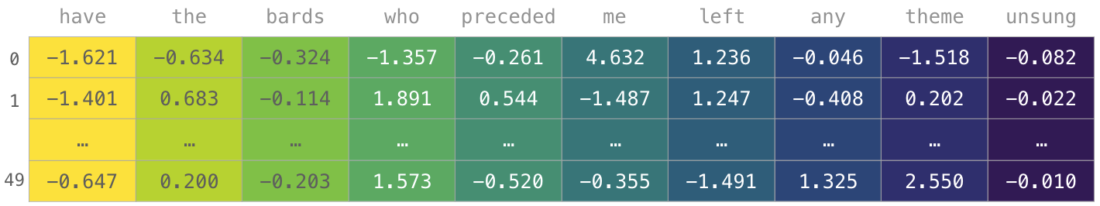
Use of numpy array in language modeling
The IDs in previous slide still don’t provide much information value to a model. So the words need to be replaced with their embeddings up to 50 dimensions.
NumPy array has the dimensions [embedding_dimension (50) x sequence_length (all the words in sentence)].
The model can be trained faster if multiple examples are trained in parallel. This is a clear case where reshape() becomes super useful.

Slide 34
Thank you
arunkg99@gmail.com
www.doitskills.com

