Slide 1
Python Ecosystem for Data Science
Arunkumar Nair

Slide 2
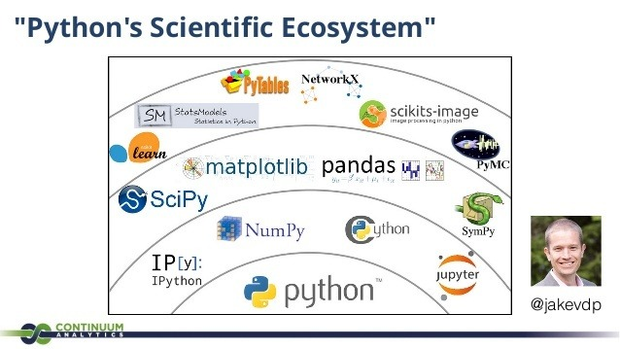
Python Scientific Ecosystem

Slide 3
What each Package does?
At the Base Level you have Python.
In Packages , Numpy is the lowest level sitting on Python. It reads in fixed datatypes. It's data layout is more concerned with efficiency of memory. If you are dealing with strings they are fixed length strings. (fit the data size for each element to the longest string length) but it shines when you are dealing with number calculations. The more you can think in vectors the faster your code runs. (learn how to get rid of the for statements for speed reasons by using Numpy broadcasting)
Pandas is spreadsheets for Python (something like R). It's able to describe the data for you. It can do grouping and pivot tables on larger data than most spreadsheet programs out there. The only limit (currently) is how much RAM you have on the machine same as Numpy. However there is a project Blazewhich is helping to overcome this limit.

Slide 4
Scipy Vs Sckit
SciPy is built in top of the NumPy
Sckit is built on top of Scipy
SciPy is a fully-featured version of Linear Algebra while Numpy contains only a few features.
Most new Data Science features are available in Scipy rather than Numpy.
SciPy is the algorithms area for so many math and science disciplines. SciPy also has ways of dealing with sparse matrices.

Slide 5
Scikit
https://www.scipy.org/scikits.html
SciKits (short for SciPy Toolkits), are add-on packages for SciPy, hosted and developed separately and independently from the main SciPy distribution
Scikit-learn is the higher level probability algorithms for machine learning. If you know the rules for dealing with your data then you will want something lower level. If you want the computer to learn the rules for you and give you probabilistic answers then this library is useful. This requires study of metaparameters to understand if you are getting a more correct answer than not.

Slide 6
End

Slide 7
Scipy vs Scikits

Slide 8
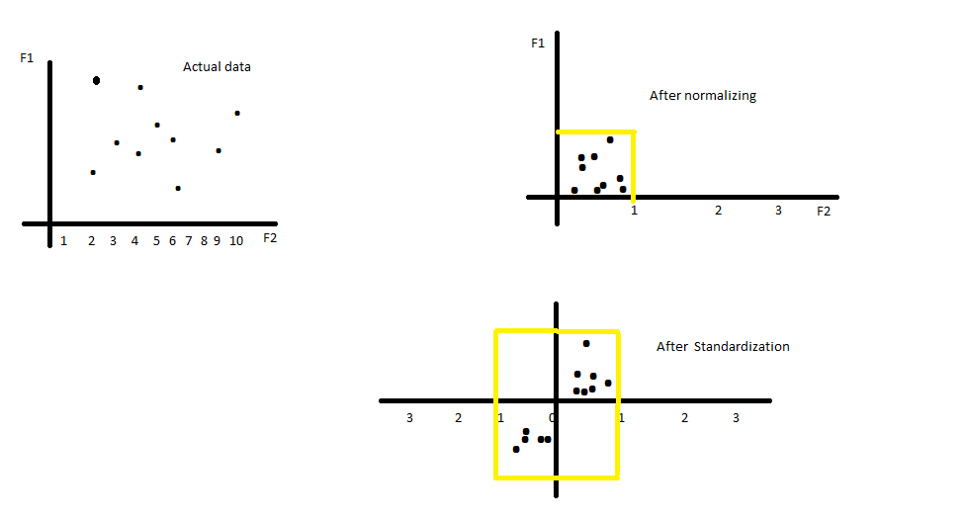
Normalization

Slide 9
Normalization brings data between 0- 1
Standardization brings data between 1 standardization
Normalization = ( X – Xmin) / (Xmax – Xmin)
Standardization = (x - µ ) / σ
Regularization is a concent of underfit and overfit
if an error is more in both train data and test data its underfit
if an error is more in test data and less train data it is overfit
Regularization is the way to manage optimal error

Slide 10
Data Whitening
Whitening of data is a way to preprocess the data. The idea behind whitening is to remove the underlying correlation in the data. It is a process done usually after the data is projected onto the eigen vectors as a result of PCA.

Slide 11
Data Whitening
Data whitening is a process of reducing the data to white noise vector. More precisely, it decorrelates the individual components of a random vector and makes the variance 1

Slide 12
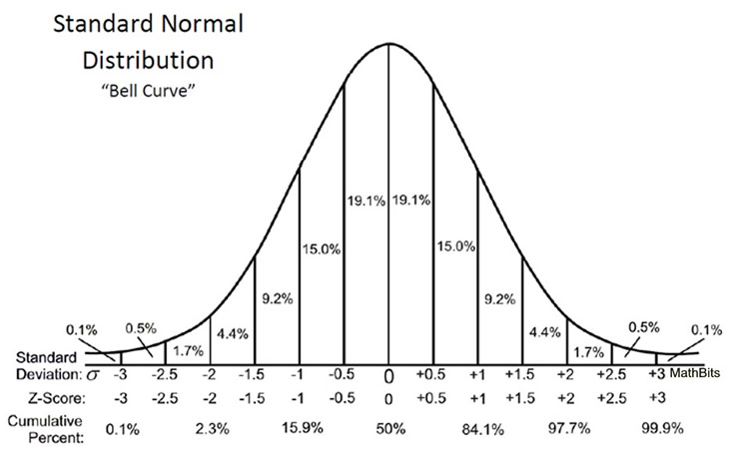
Distribution Chart

Slide 13
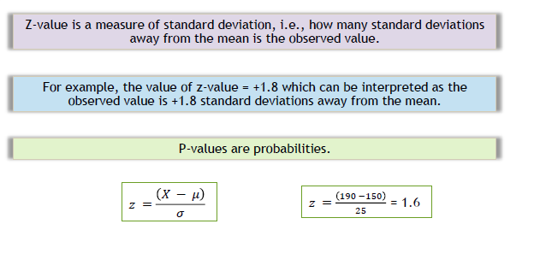
Z-value

Slide 14
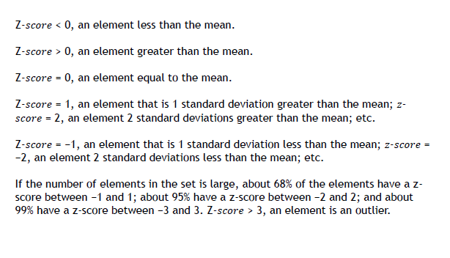
Z-Score Interpretation

