Slide 1
Numpy

Slide 2
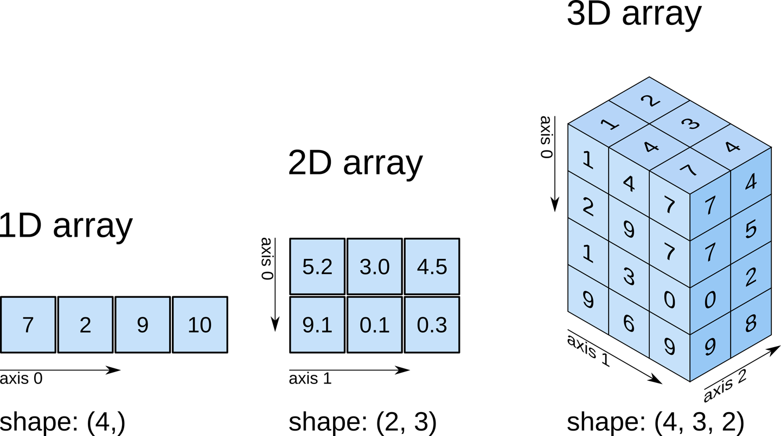
Dimensions

Slide 3
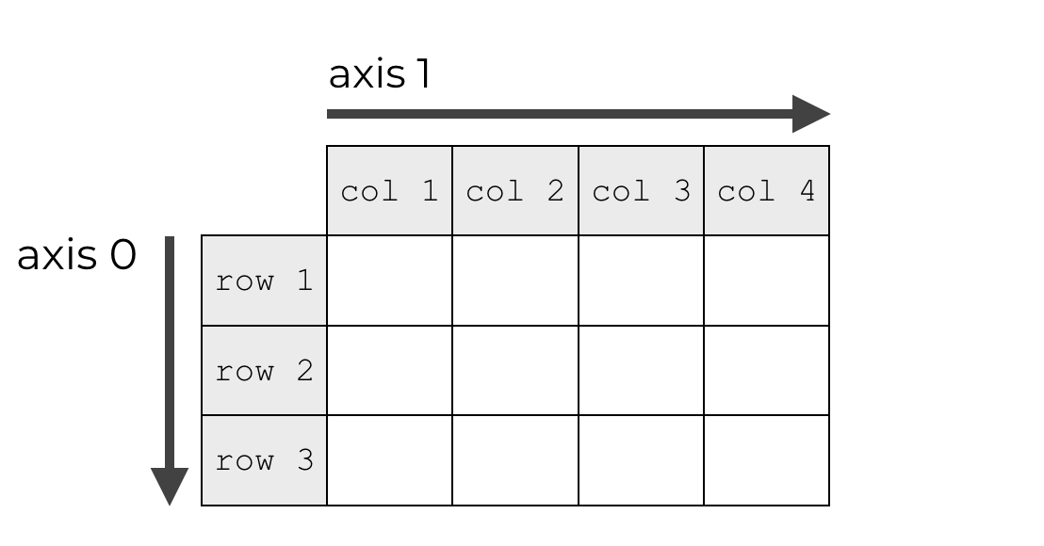
axis

Slide 4
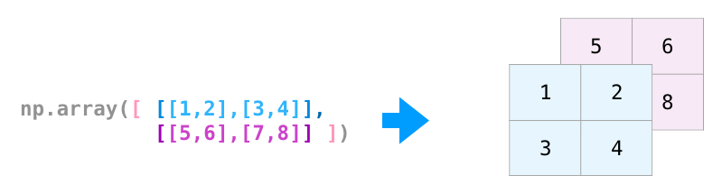
3-Dimensions
[[[1 2]
[3 4]]
[[5 6]
[7 8]]]
3
(2, 2, 2)
(Row,Col,Depth/layers)
Axis (0,1,2)

Slide 5
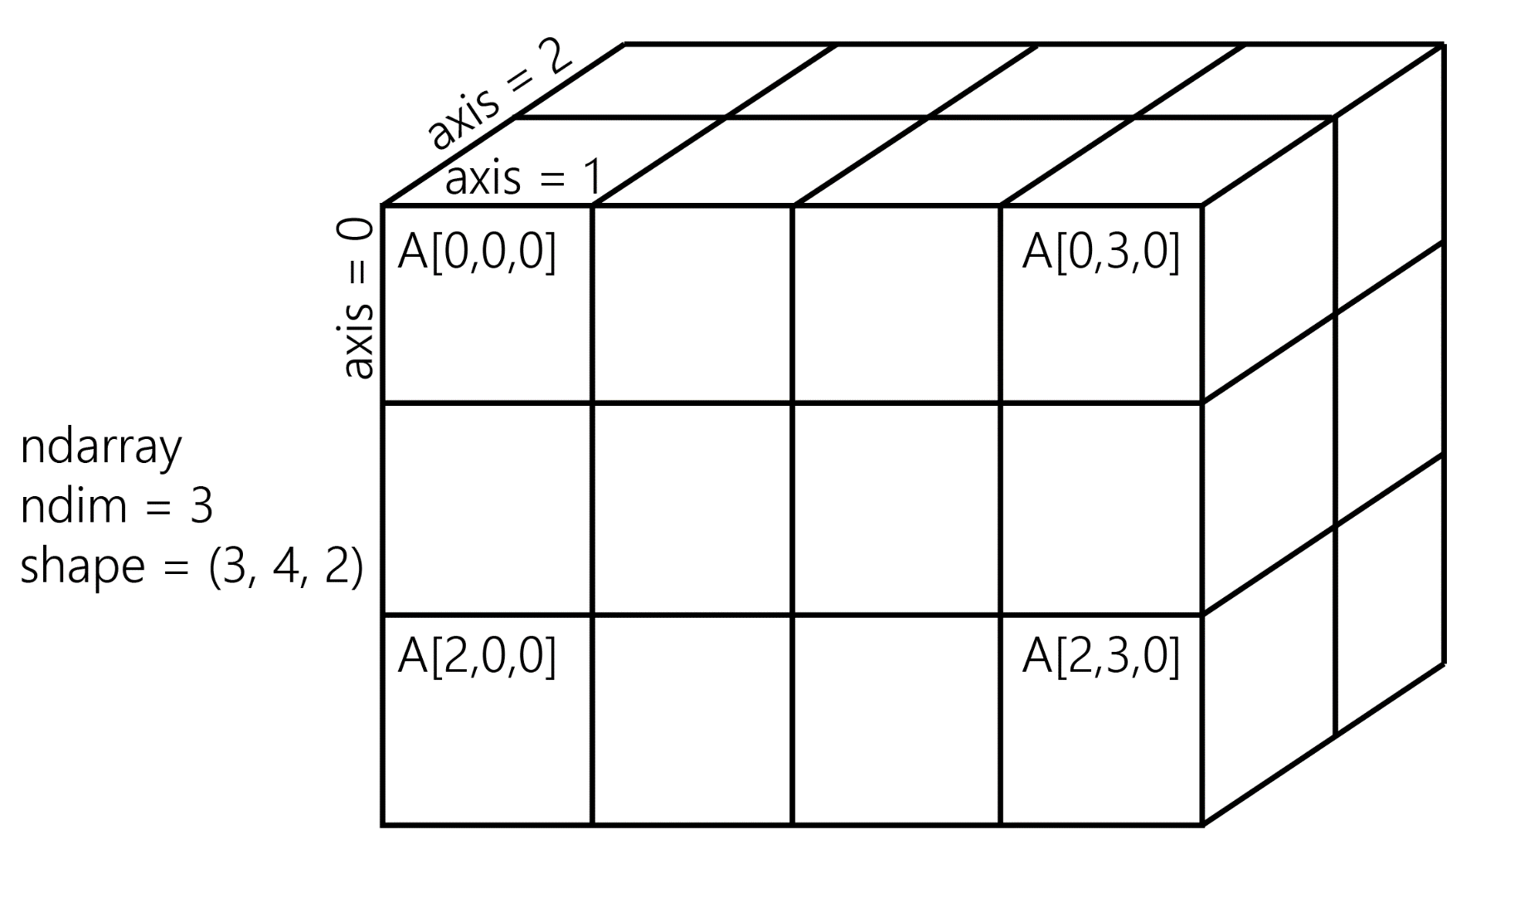
Numpy -3d

Slide 6
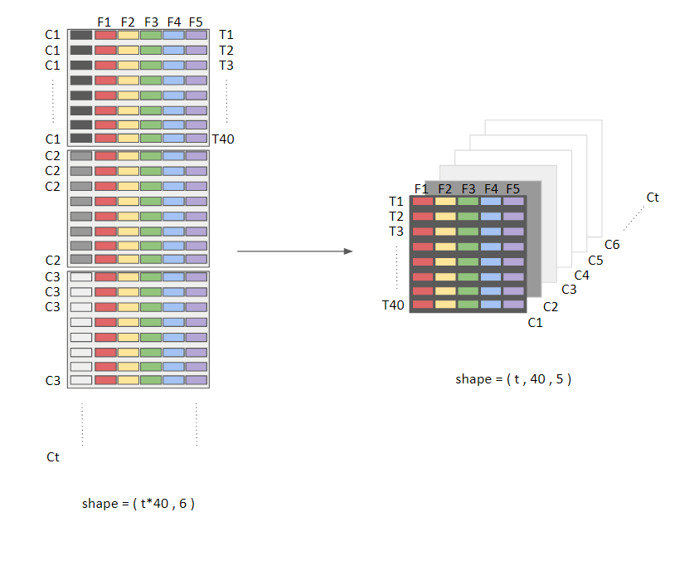

Slide 7
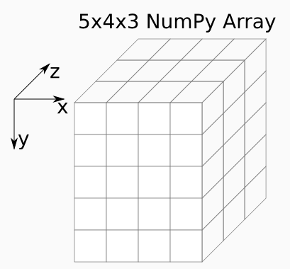
Numpy 3d

Slide 8
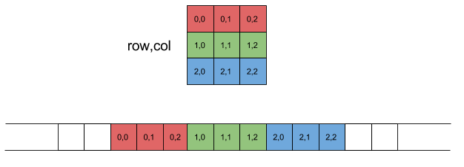
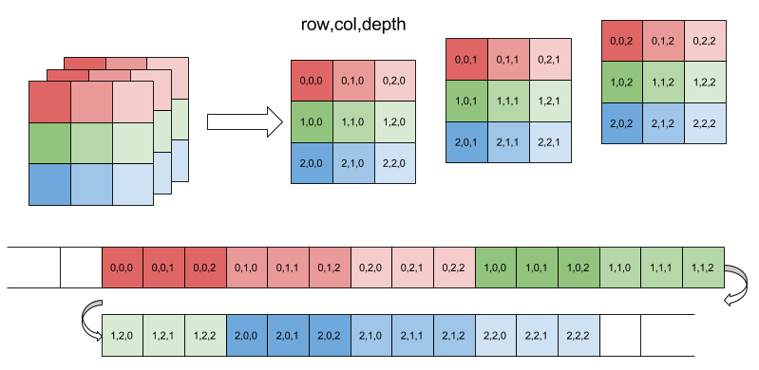

Slide 9
3-D Data
Panel data can be represented in three dimensions. Data that tracks attributes of a cohort (group) of individuals over time could be structured as (respondents, dates, attributes). The 1979 National Longitudinal Survey of Youth follows 12,686 respondents over 27 years.
Assuming that you have ~500 directly asked or derived data points per individual, per year, this data would have shape (12686, 27, 500) for a total of 177,604,000 data points.

Slide 10
4-D data
Color-image data for multiple images is typically stored in four dimensions. Each image is a three-dimensional array of (height, width, channels), where the channels are usually red, green, and blue (RGB) values. A collection of images is then just (image_number, height, width, channels). One thousand 256x256 RGB images would have shape (1000, 256, 256, 3). (An extended representation is RGBA, where the A–alpha–denotes the level of opacity.)

Slide 11
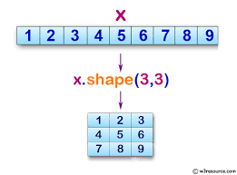
Shape
Shapes changes the same array

Slide 12
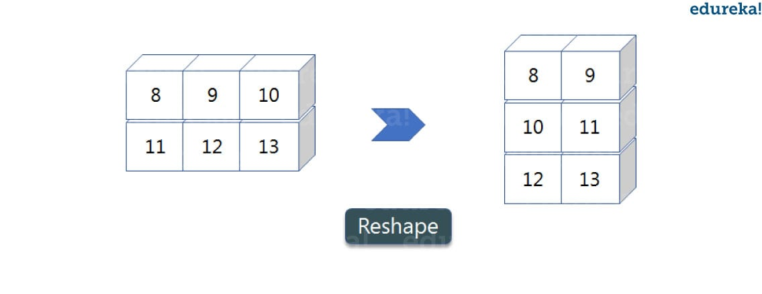
Reshape
Y
X
X
import numpy as np
a = np.array([(8,9,10),(11,12,13)])
print(a)
b=a.reshape(3,2)
print(b)
#reshape will change and but needs to assign to a new array

Slide 13
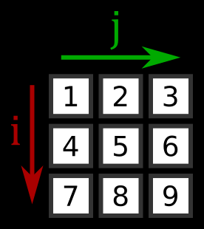
Numpy

Slide 14
Slicing
arr2d = np.array([[1, 2, 3], [4, 5, 6], [7, 8, 9]])
arr2d[2]
array([7, 8, 9])
arr2d[0][2]
3

Slide 15
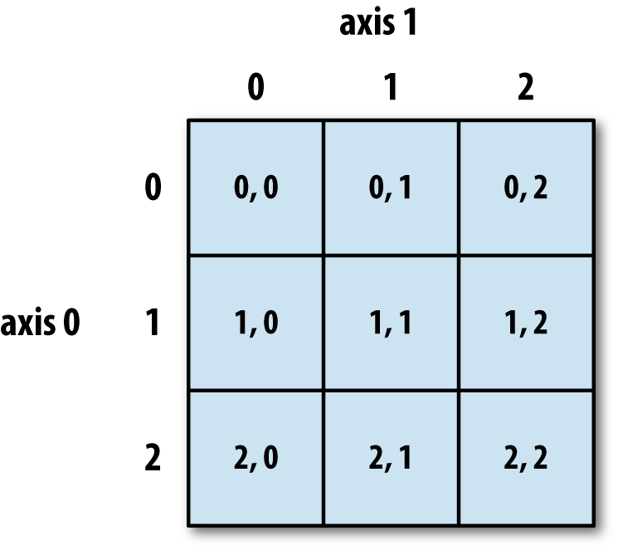
2-D array Index

Slide 16
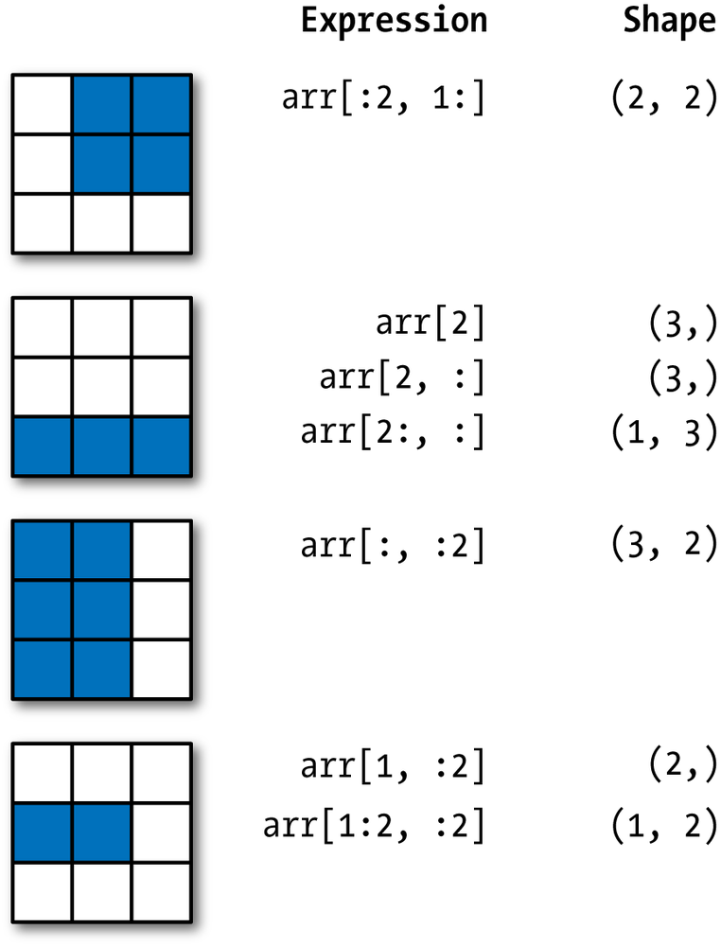
Two-dimensional array slicing
0
1
2
0
1
2
0
1
2
0
1
2
0
1
2

Slide 17
END

Slide 19
Dimensions

Slide 20
Dimensions
([[[ 0, 1],
[ 2, 3],
[ 4, 5]],
[[ 6, 7],
[ 8, 9],
[10, 11]],
[[12, 13],
[14, 15],
[16, 17]],
[[18, 19],
[20, 21],
[22, 23]]])

Slide 21
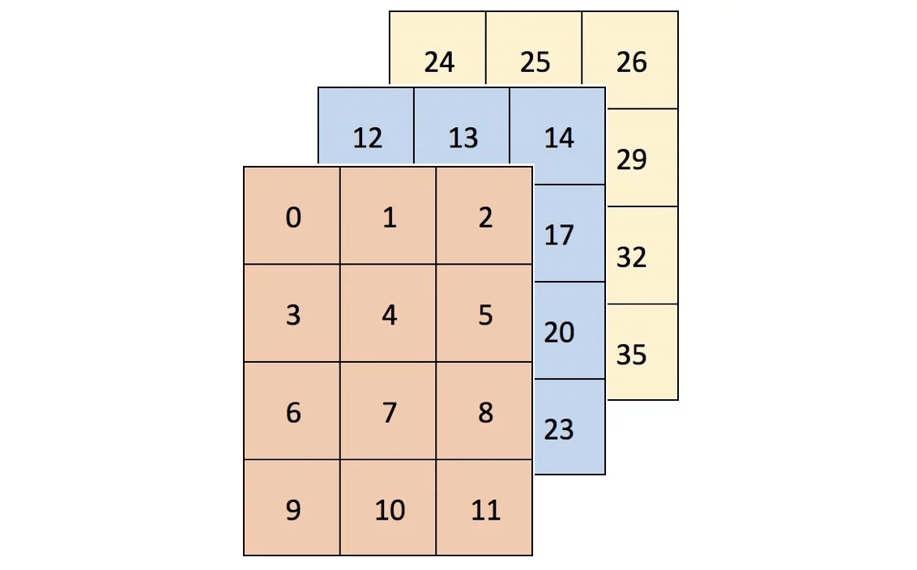
arr = np.arange(36).reshape(3, 4, 3)
arr is a 3 by 4 by 3 array
Visually, arr could be thought of as a container of three 4x3 grids (or a rectangular prism).
array(
[[[ 0, 1, 2],
[ 3, 4, 5],
[ 6, 7, 8],
[ 9, 10, 11]],
[[12, 13, 14],
[15, 16, 17],
[18, 19, 20],
[21, 22, 23]],
[[24, 25, 26],
[27, 28, 29],
[30, 31, 32],
[33, 34, 35]]])

