Slide 1
Numpy
Visual Representation

Slide 2
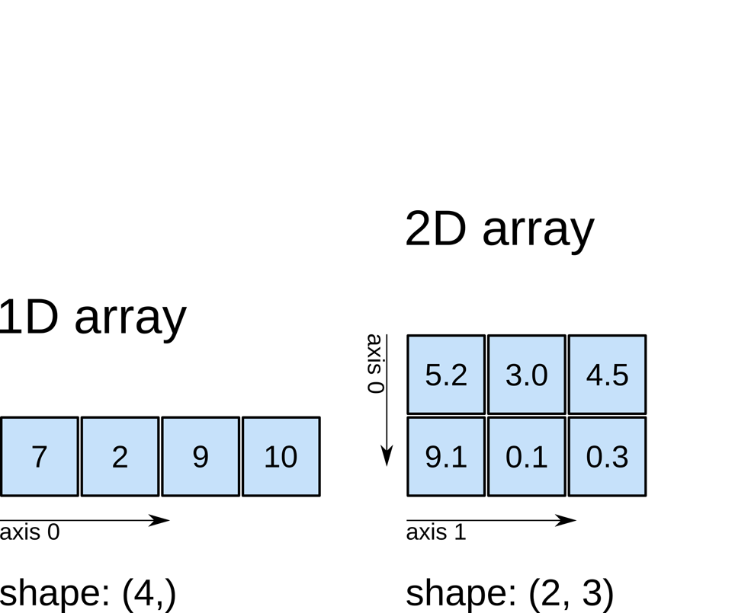
Dimensions

Slide 3
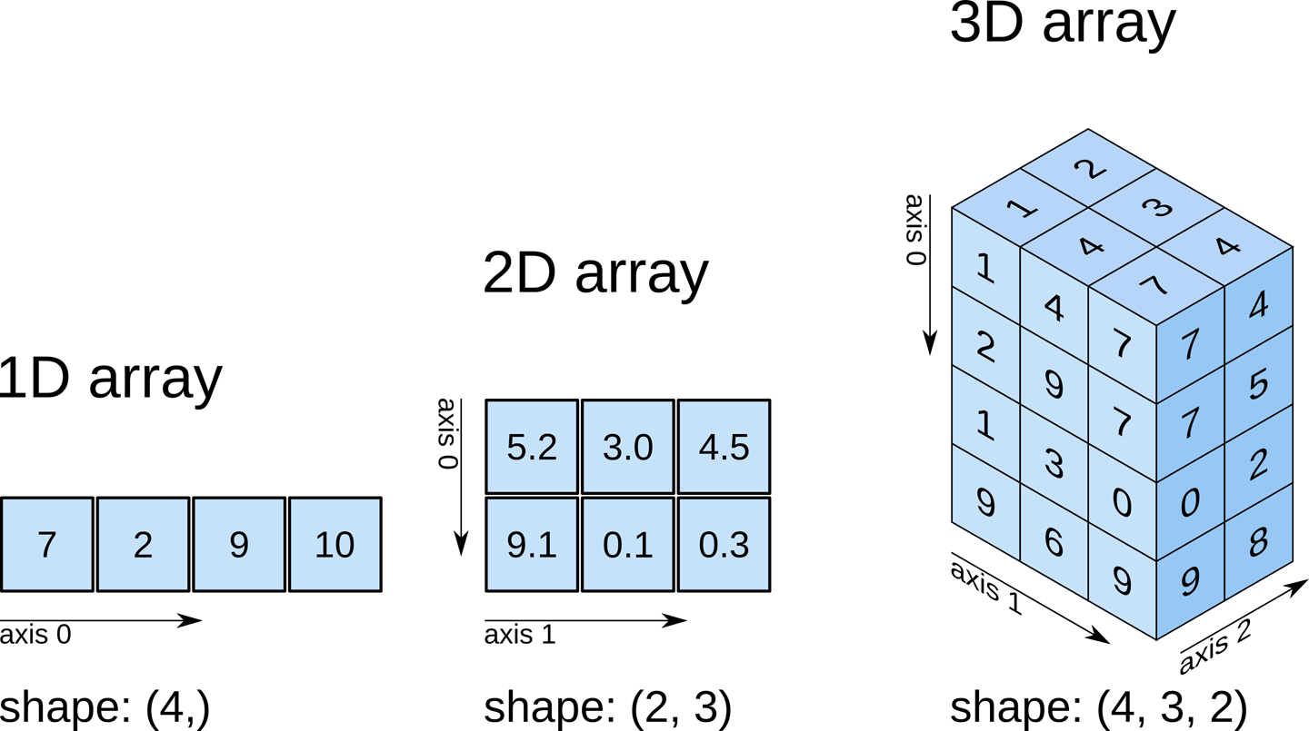

Slide 4
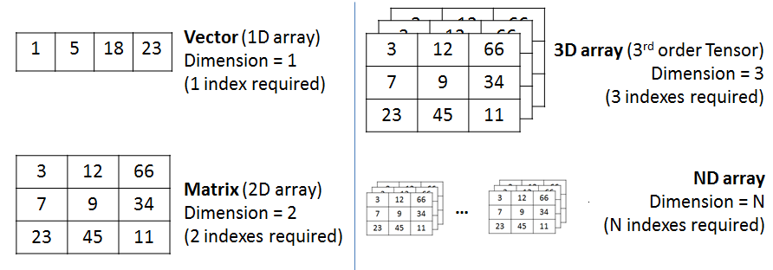

Slide 5
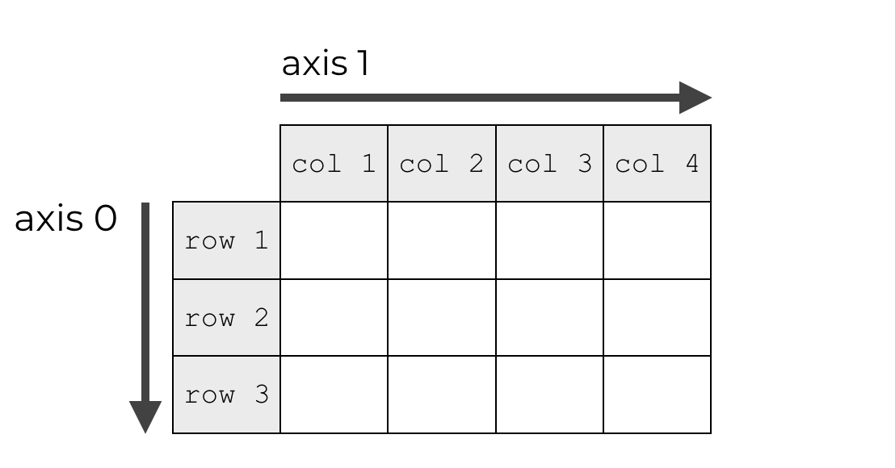
axis

Slide 6
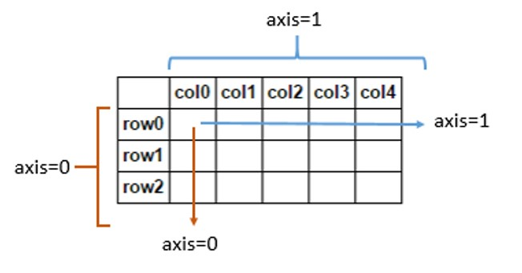

Slide 7
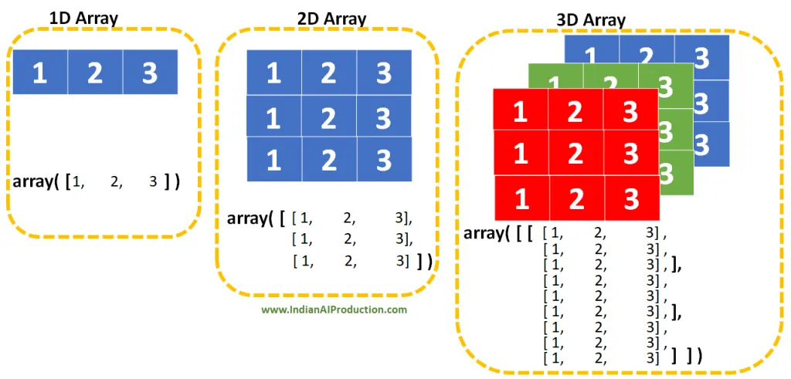

Slide 8
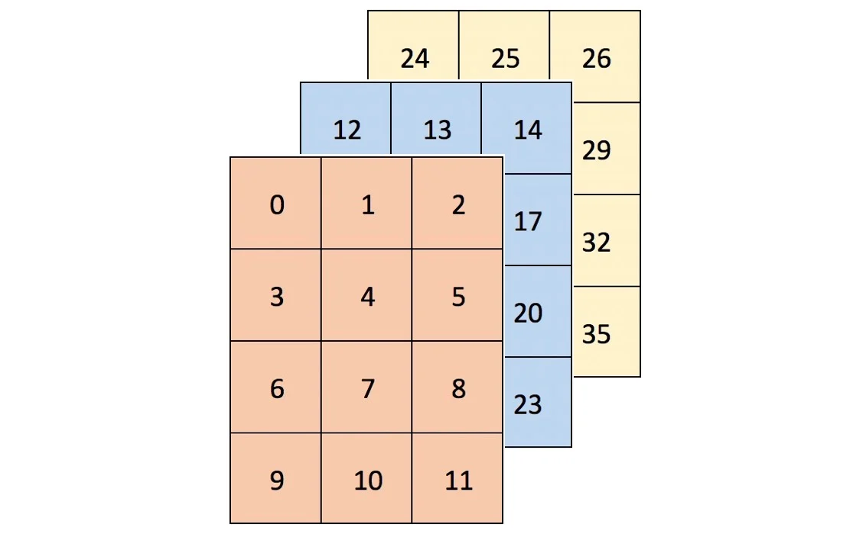
3-Dimensions
arr.shape
(3, 4, 3)
A container of three 4x3 grids (or a rectangular prism)

Slide 9
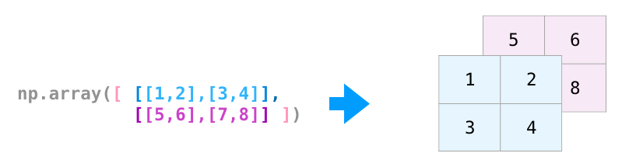
3-Dimensions
[[[1 2]
[3 4]]
[[5 6]
[7 8]]]
3
(2, 2, 2)
(Depth/layers,Row,Col)

Slide 10
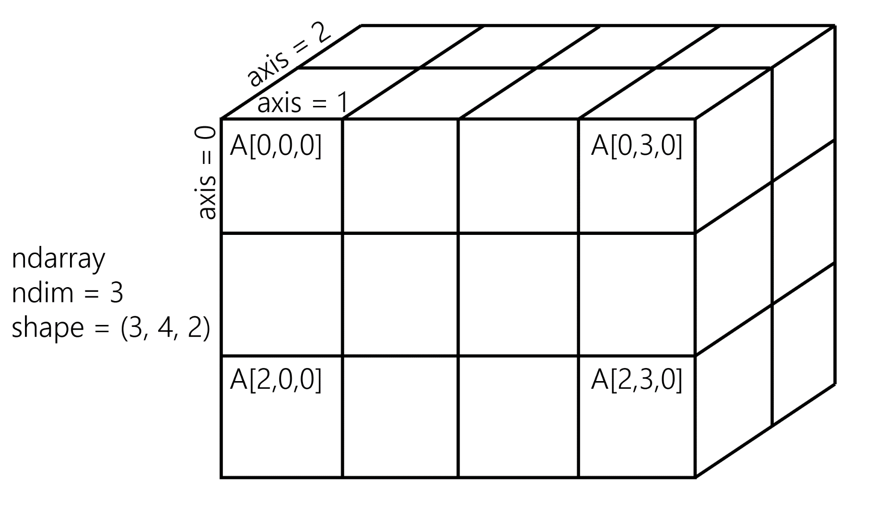
Numpy -3d

Slide 11
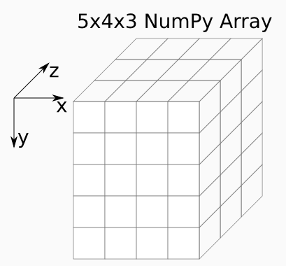
Numpy 3d

Slide 12
Numpy 3d

Slide 13
Loading Data
1
Load 2-d wine data

Slide 14
Loading Data
2
PythonNumpyHands-On-Training
  Load the image data, 3D data
3
classifying-movie-reviews
  Sentiment analysis
  Load the image data, 3D data

Slide 15
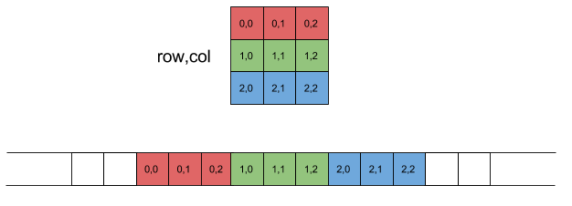
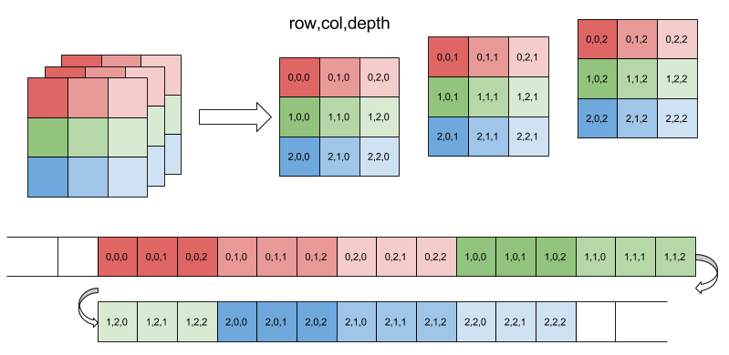

Slide 16
End

Slide 17
3-D Data
Panel data can be represented in three dimensions. Data that tracks attributes of a cohort (group) of individuals over time could be structured as (respondents, dates, attributes). The 1979 National Longitudinal Survey of Youth follows 12,686 respondents over 27 years.
Assuming that you have ~500 directly asked or derived data points per individual, per year, this data would have shape (12686, 27, 500) for a total of 177,604,000 data points.

Slide 18
4-D data
Color-image data for multiple images is typically stored in four dimensions. Each image is a three-dimensional array of (height, width, channels), where the channels are usually red, green, and blue (RGB) values. A collection of images is then just (image_number, height, width, channels). One thousand 256x256 RGB images would have shape (1000, 256, 256, 3). (An extended representation is RGBA, where the A–alpha–denotes the level of opacity.)

Slide 19
