Slide 1

Charts case-study
Data visualization

Slide 2
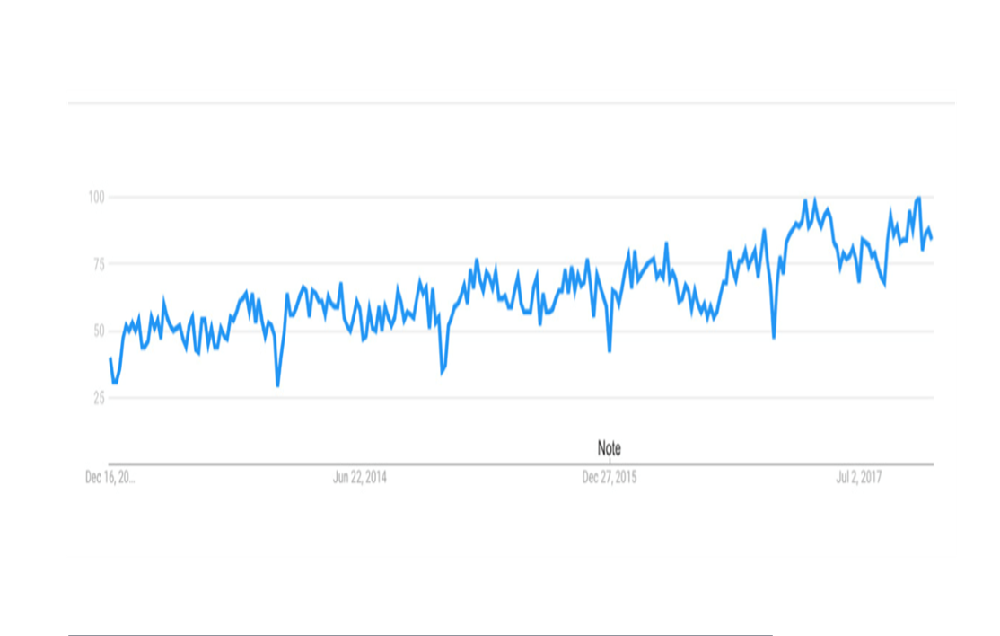
What is data visualization ?
Data visualization refers to showcasing data, numbers, and statistics through images and charts.
When you display data visually, you’ll be able to more easily tease out meaningful patterns from a set of otherwise indecipherable numbers, and it makes it easier to draw conclusions and make informed decisions.
Interest over time
This chart shows how many people searched for the term “data visualization” in Google over a five-year period
Notes:
PAGE NO. 4

Slide 3
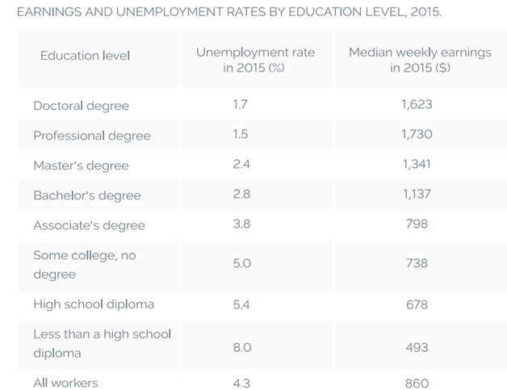
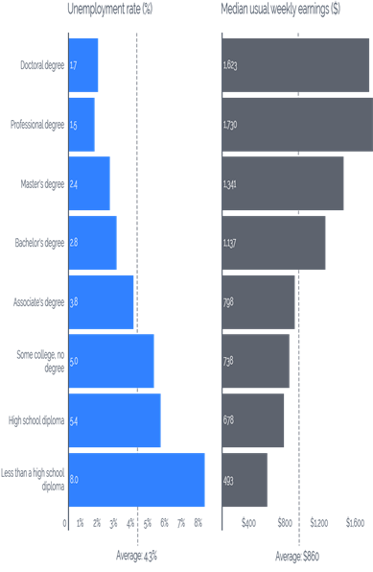
Why is data visualization important?
According to SH!FT Disruptive Learning, we process visuals 60,000 times faster than text.
Take a look at the two images below. Both images represent the exact same number, but one of them is displayed in a data table, and the other is a visualization of that data in a bar chart. Which is easier to interpret?
Notes:
PAGE NO. 5 to 7

Slide 4






Four data types
1. Quantitative
2. Discrete
3. Continuous
4. Categorical
Quantitative data can be counted or measured, and all values are numerical.
Discrete data is numerical data with a finite number of possible values. (For example, the number of employees in an office.)
Continuous data is measured and has a value that lies within a range. (For example, rainfall in a year.)
Categorical data can be sorted according to group or category. (For example, types of products sold.)
Notes:
PAGE NO. 10

Slide 5
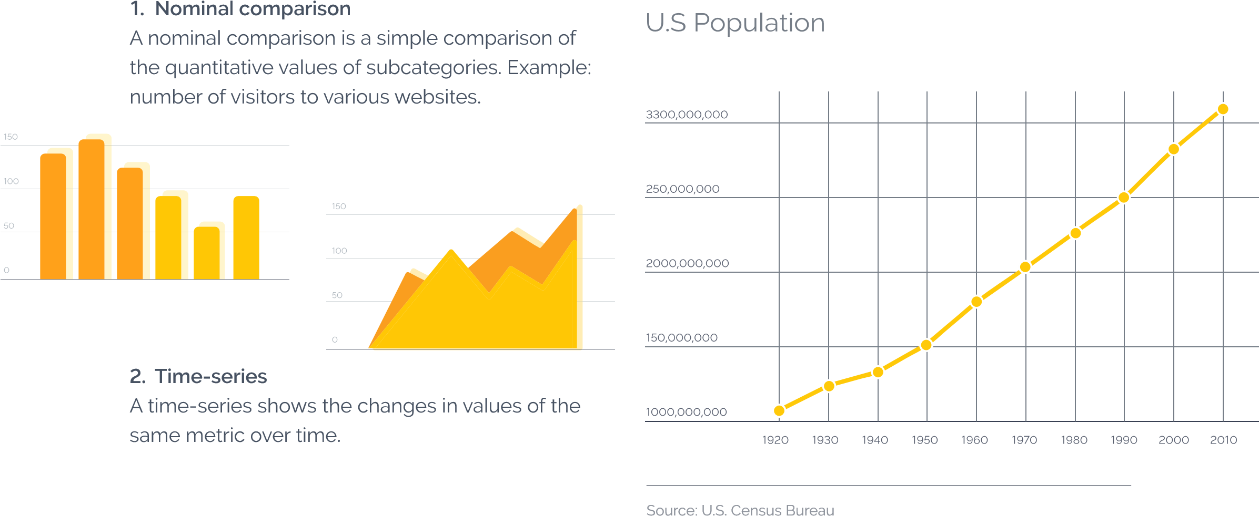
7 DATA RELATIONSHIPS
1. Nominal comparison
2. Time-series
A nominal comparison is a simple comparison of the quantitative values of subcategories.
Example: number of visitors to various websites.
A time-series shows the changes in values of the same metric over time.
Example: increase in U.S. population b/w 1920 and 2010.
Notes:
PAGE NO. 11

Slide 6
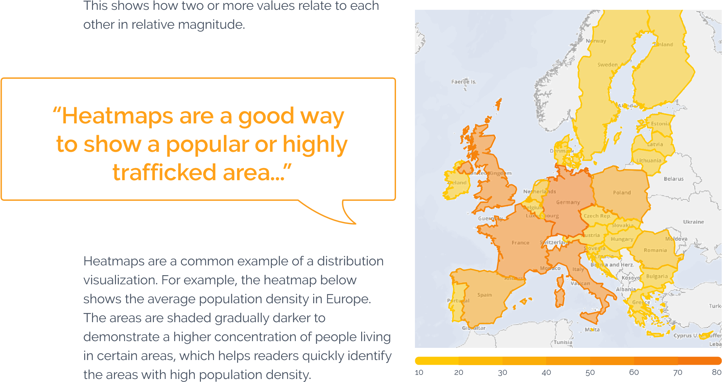
CONTINUE…
3. Correlation
4. Ranking
This data has two or more variables that may demonstrate a positive or negative correlation with each other.
This shows how two or more values relate to each other in relative magnitude.
Example: the Heat map below shows the average population density in Europe.
Notes:
PAGE NO. 12 & 13

Slide 7
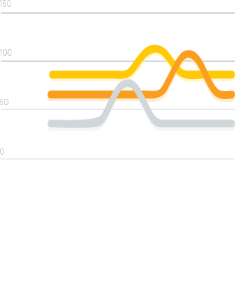
CONTINUE…
5. Deviation
6. Distribution
Deviation explores how data points relate to each other, and more specifically how far a given data point differs from the mean.
Example: tickets sold on rainy days versus regular days, or average spending over the holidays versus non-holidays.
This type of visualization shows data distribution often surrounding a central value.
Notes:
PAGE NO. 14

Slide 8
CONTINUE…
7. Part-to-whole
This shows a subset of data as compare to the larger whole.
Part-to-whole comparisons like the one below show the makeup of a group. To show this, you can use a tree map (as in the visualization below), a pie chart, a donut chart, or anything that shows the breakdown of a singular whole. It can be a good way of visualizing distribution of ages in a group, sources of revenue, or parts of a balanced diet.
Company breakdown (by department)
Notes:
PAGE NO. 14

Slide 9
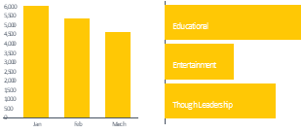
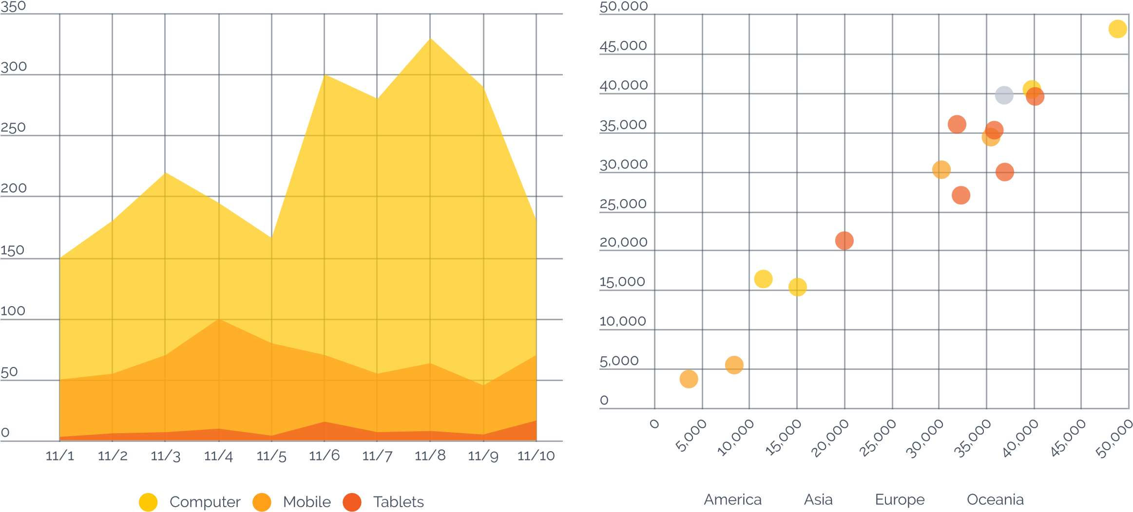
7 chart types
Bar chart 2. Area chart
3. Line chart 4. Scatter plot
Notes:
PAGE NO. 15 to17

Slide 10
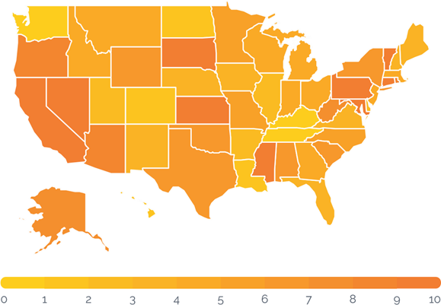
Continue…
Bubble chart 6. Heat map
7. Pie chart
J
Notes:
PAGE NO. 15 & 18

Slide 11
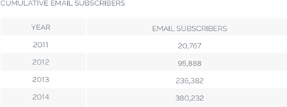
What story does the data tell?
For many people, the hardest part of visualizing data is looking at the raw numbers and figuring out how to use them to tell a story.
What is it that your team, your readers, or your audience is most curious about?
For example, let’s say your goal is to increase the number of subscribers to your business blog. Your primary metric, then, would be number of subscribers over time.
Let’s say you measured blog email subscribers from 2011–2014. During that time, your team employed a number of different tactics to increase email subscribers from the blog – and in the end, this is how your raw subscriber numbers shook out year-over-year:
From this table, it’s obvious that the no. of email subscribers from the blog is increasing over time. That’s a great start to your story …
Notes:
PAGE NO. 22 & 23

Slide 12
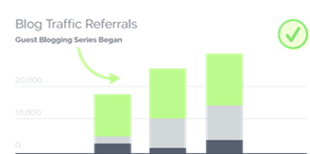
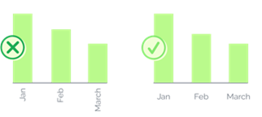
Is it designed well ?
Tip 1: Label your charts and graphs correctly. Tip 2: Call out or highlight important information.
Notes:
PAGE NO. 24

Slide 13
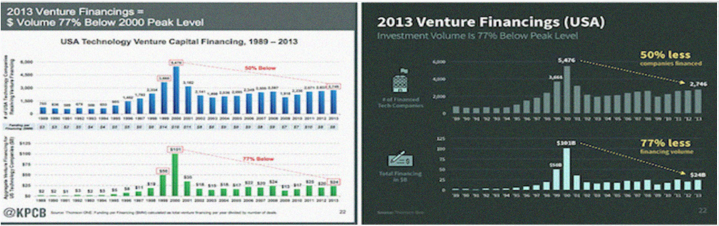



Continue…
Tip 3: Use consistent and attractive color schemes.
Analogous: Triadic:
Monochromatic: Complementary:
Notes:
PAGE NO. 25 & 26

Slide 14
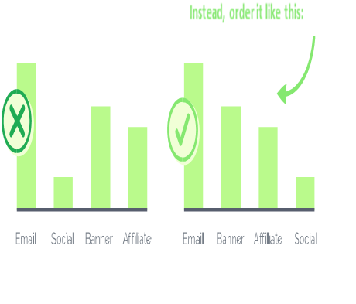
Continue…
Tip 4: Order your data sets logically. Tip 5: Stay away from 3D charts.
Tip 6: Choose appropriate data ranges.
76 - 77 76 - 80
78 - 81 81 - 85
82 - 90 86 - 90
90+ 91+
Angle
Notes:
PAGE NO. 27 & 28

Slide 15
Thank you
arunkg99@gmail.com
www.doitskills.com

