Slide 1
Logistic Regression logistic classification
Arunkumar Nair

Slide 2
Logistics Regression
Instead of predicting exactly 0 or 1, logistic regression generates a probability—a value between 0 and 1, exclusive.
For example, consider a logistic regression model for spam detection. If the model infers a value of 0.932 on a particular email message, it implies a 93.2% probability that the email message is spam.
More precisely, it means that in the limit of infinite training examples, the set of examples for which the model predicts 0.932 will actually be spam 93.2% of the time and the remaining 6.8% will not.

Slide 9
Case-Study Data-Change this case study to Diabetes Casestudy
Also refer to the PDF Print out by Keshav Dhandania
We are provided a sample of 1000 customers.
We need to predict the probability whether a customer of a Particular Age will buy (y) a particular magazine or
not.
As we’ve a categorical outcome variable, we’ll use logistic regression.

Slide 10
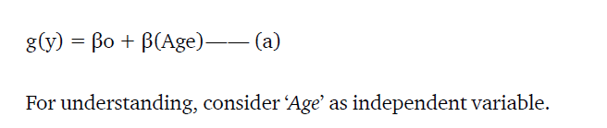
Linear to Logistic – (a)
To start with logistic regression, first write the simple linear regression equation with dependent variable enclosed in a link function:
Y = c + m X

Slide 11
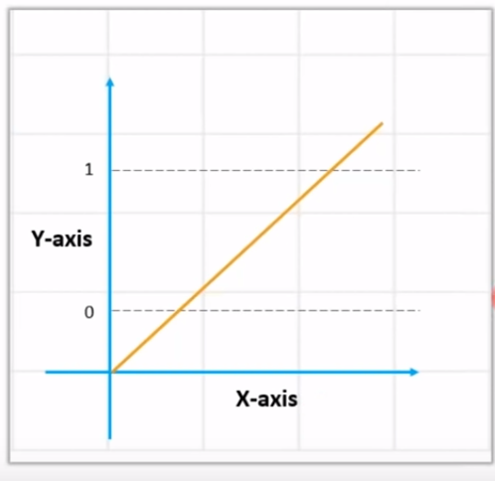
Linear Regression
+ infinity
- infinity

Slide 12
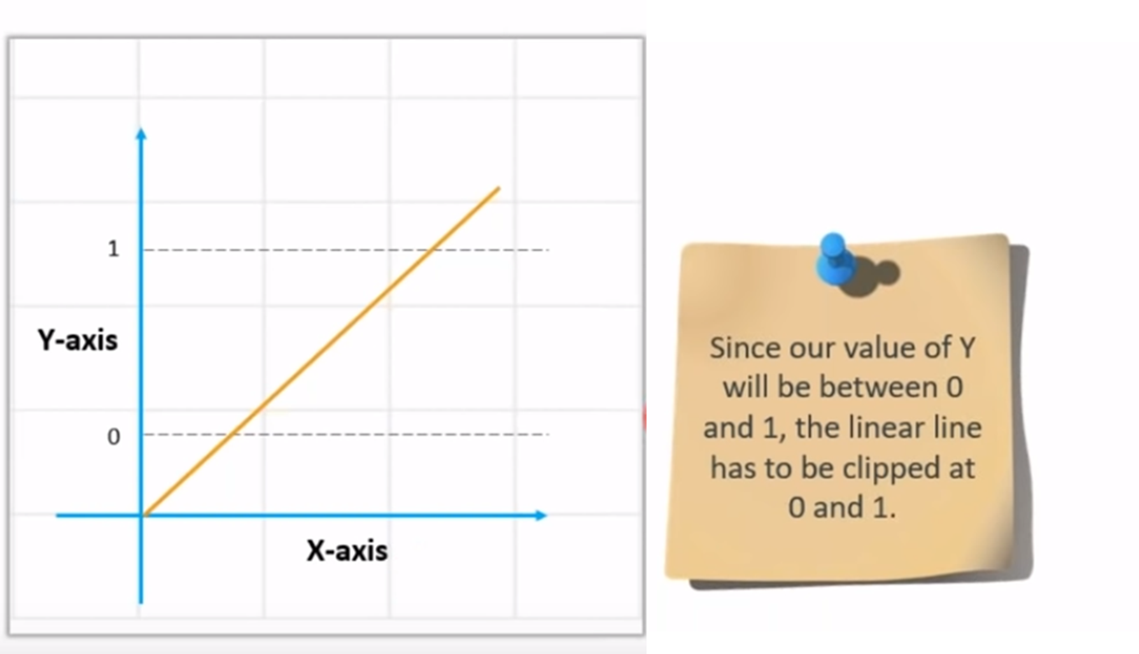
Linear regression equation: y = β0 + β1X1 + β2X2 …. + βnXn

Slide 13
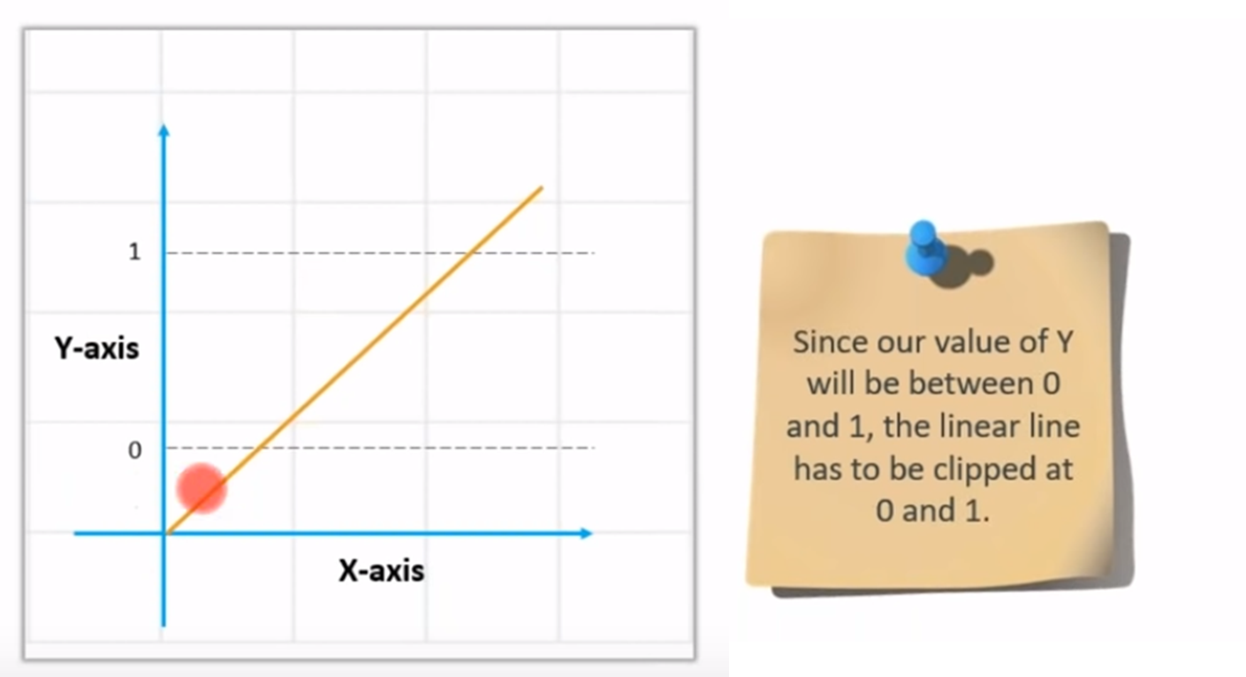
Value of Y – between 0 and 1

Slide 14
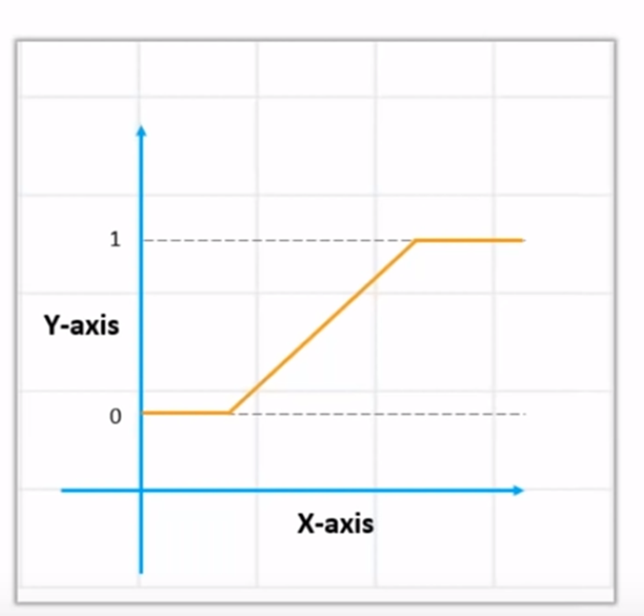
How to get the value of 0 and 1

Slide 15
How to get the value of 0 and 1?
Use Sigmoid
We Apply sigmoid function on the linear regression equation to get the S-curve so that it lies between 0 and 1
Sigmoid function: p = 1 / 1 + e^{-y}
A sigmoid function is a mathematical function/equation having a characteristic "S"-shaped curve or sigmoid curve.

Slide 16

Convert Linear to Logistics
Linear regression equation: y = β0 + β1X1 + β2X2 …. + βnXn
Sigmoid function: p = 1 / 1 + e^{-y}
y is replaced
Logistic Regression equation: p = 1 / 1 + e^{-(β0 + β1X1 + β2X2 …. + βnXn)}
Notes:
Note that (y) is also referred to as the log-odds because the inverse of the sigmoid states that (y) can be defined as the log of the probability of the "1" label (e.g., "dog barks") divided by the probability of the "0" label (e.g., "dog doesn't bark"):
y=log (p/1-p)

Slide 17
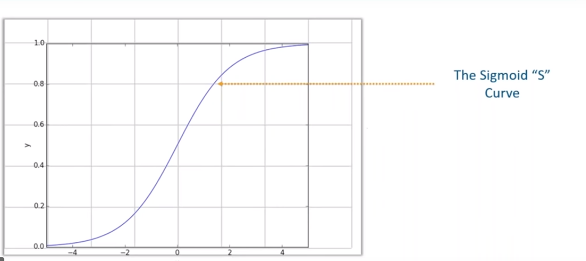
Sigmoid – S-curve

Slide 18
Sigmoid
Sigmoid curve converts any value from
-infinity to +infinity to (0 to 1)
Sigmoid will output:
‘0’ as x approaches −∞
‘1’ as x approaches +∞

Slide 19
Linear Regression
+ infinity
- infinity

Slide 20
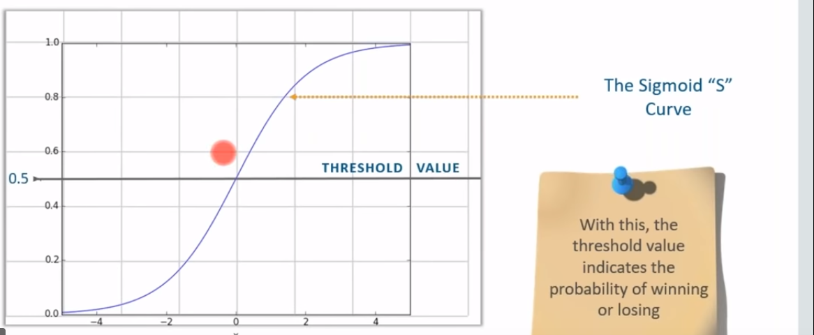
Probability values for the answers
The Threshold value
.8 becomes 1
.2 becomes 0

Slide 21
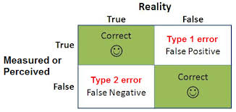

Slide 22
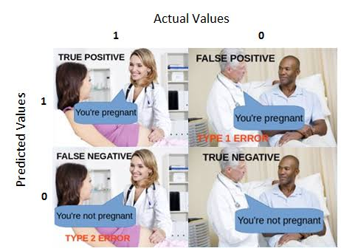
[[119, 11],
[ 26, 36]

Slide 23
Thanks
End

