Slide 1
Explain Log and Exp
Training
Notes:
logs

Slide 2
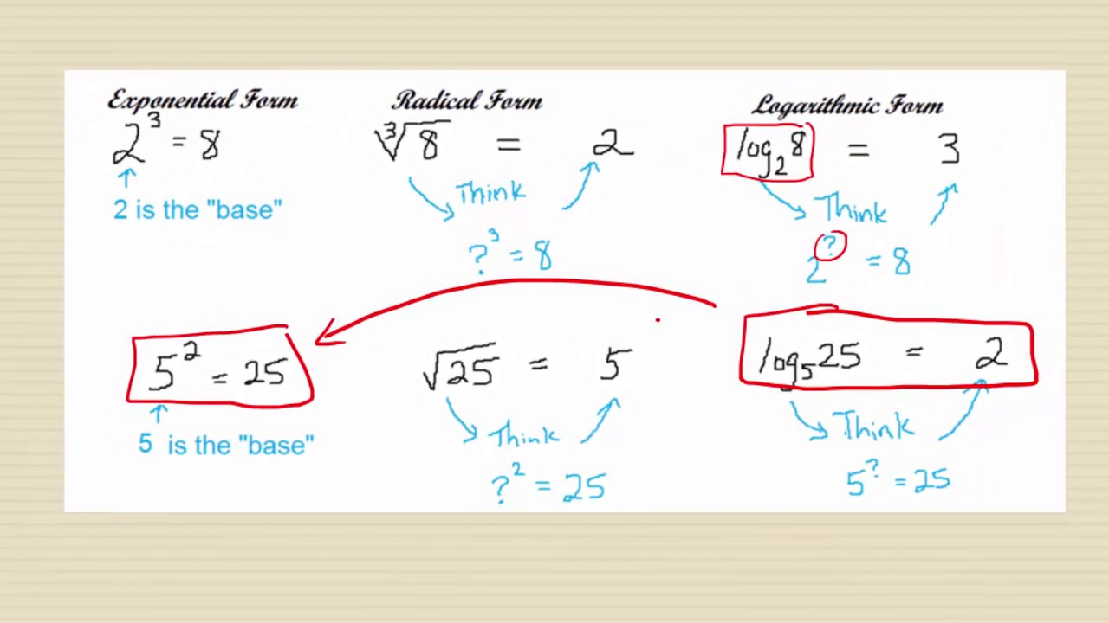
Log base 2 of 8 is 3
Log base 5 of 25 is 2

Slide 3
Log base 2 of 8 is 3
Log base 5 of 25 is 2
Power of 3
Log 3 1000 = 10
Log base 3 of 1000 is 3=10

Slide 4
Logarithms
Logarithms put numbers on a human-friendly scale.
Large numbers break our brains. Millions and trillions are "really big" even though a million seconds is 12 days and a trillion seconds is 30,000 years. It's the difference between an American vacation year and the entirety of human civilization.
The trick to overcoming "huge number blindness" is to write numbers in terms of "inputs" (i.e. their power base 10). This smaller scale (0 to 100) is much easier to grasp:
power of 0 = 10⁰ = 1 (single item)
power of 1 = 10¹ = 10
power of 3 = 10³ = thousand
power of 6 = 10⁶ = million
power of 9 = 10⁹ = billion
Notes:
Logs
https://byjus.com/maths/logarithm-table/#:~:text=In%20mathematics%2C%20the%20logarithm%20table,table%20is%20given%20in%20detail.

Slide 5
Why Logarithms
Logarithms count multiplication as steps
Logarithms describe changes in terms of multiplication: in the examples above, each step is 10x bigger. With the natural log, each step is "e" (2.71828...) times more.
When dealing with a series of multiplications, logarithms help "count" them, just like addition counts for us when effects are added.

Slide 6
What is E in log?
The natural logarithm of a number is its logarithm to the base of the mathematical constant e, where e is an irrational and transcendental number approximately equal to 2.718281828459. The natural logarithm of x is generally written as ln x, log_{e} x, or sometimes, if the base e is implicit, simply log x.
Log base 2 of 8 is 3

Slide 7
Logarithms
2 raised to which power equals 16?
The answer would be 4
This is expressed by the logarithmic equation log2​(16)=4
"log base two of sixteen is four

Slide 8
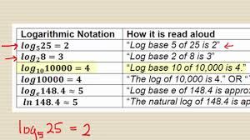

Slide 9
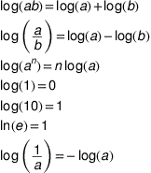
Some basic Log Formulas

Slide 15
Explain Log and Exp
Detailed
Notes:
logs

Slide 16
Logarithms
Logarithms put numbers on a human-friendly scale.
Large numbers break our brains. Millions and trillions are "really big" even though a million seconds is 12 days and a trillion seconds is 30,000 years. It's the difference between an American vacation year and the entirety of human civilization.
The trick to overcoming "huge number blindness" is to write numbers in terms of "inputs" (i.e. their power base 10). This smaller scale (0 to 100) is much easier to grasp:
power of 0 = 10⁰ = 1 (single item)
power of 1 = 10¹ = 10
power of 3 = 10³ = thousand
power of 6 = 10⁶ = million
power of 9 = 10⁹ = billion
Notes:
Logs
https://byjus.com/maths/logarithm-table/#:~:text=In%20mathematics%2C%20the%20logarithm%20table,table%20is%20given%20in%20detail.

Slide 17
Why Logarithms
Logarithms count multiplication as steps
Logarithms describe changes in terms of multiplication: in the examples above, each step is 10x bigger. With the natural log, each step is "e" (2.71828...) times more.
When dealing with a series of multiplications, logarithms help "count" them, just like addition counts for us when effects are added.

Slide 18
What is E in log?
The natural logarithm of a number is its logarithm to the base of the mathematical constant e, where e is an irrational and transcendental number approximately equal to 2.718281828459. The natural logarithm of x is generally written as ln x, log_{e} x, or sometimes, if the base e is implicit, simply log x.

Slide 19
Logarithms
2 raised to which power equals 16?
The answer would be 4
This is expressed by the logarithmic equation log2​(16)=4
"log base two of sixteen is four

Slide 21
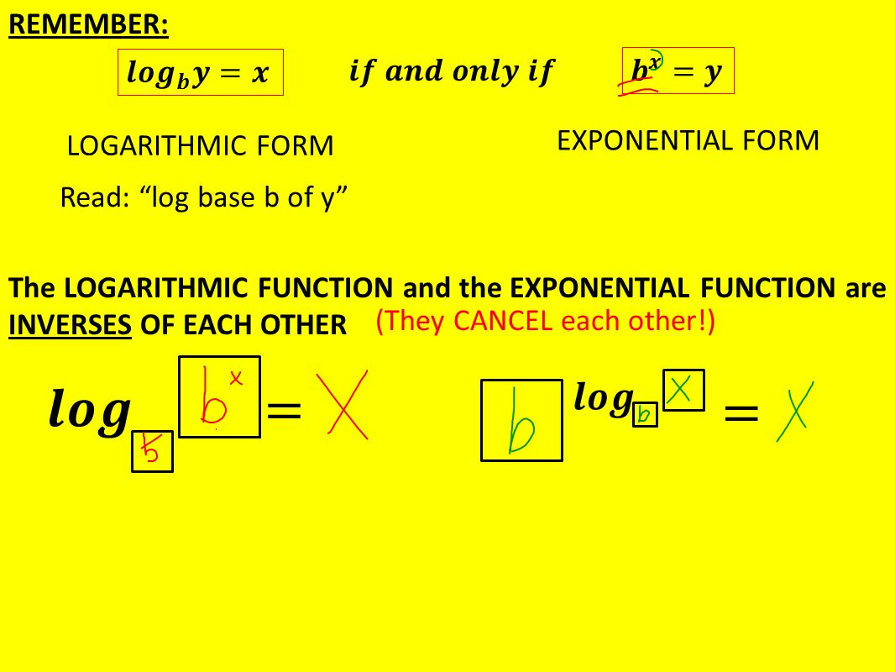
What is the meaning of this?
Explained in the next slide.
Need to understand it form Kaushik

Slide 22
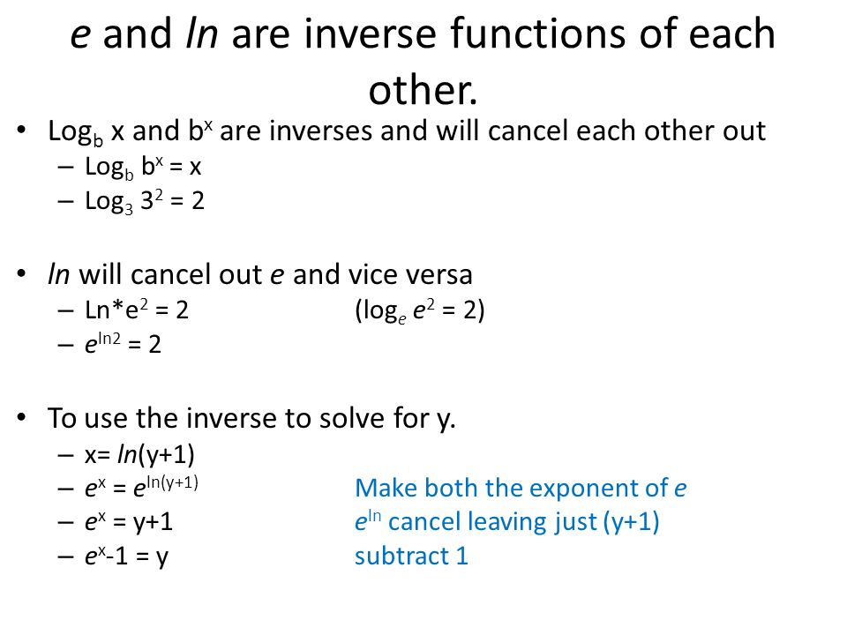

Slide 24
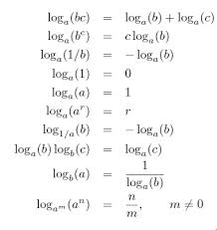

Slide 25
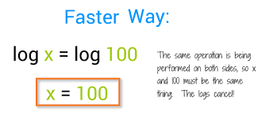

Slide 27
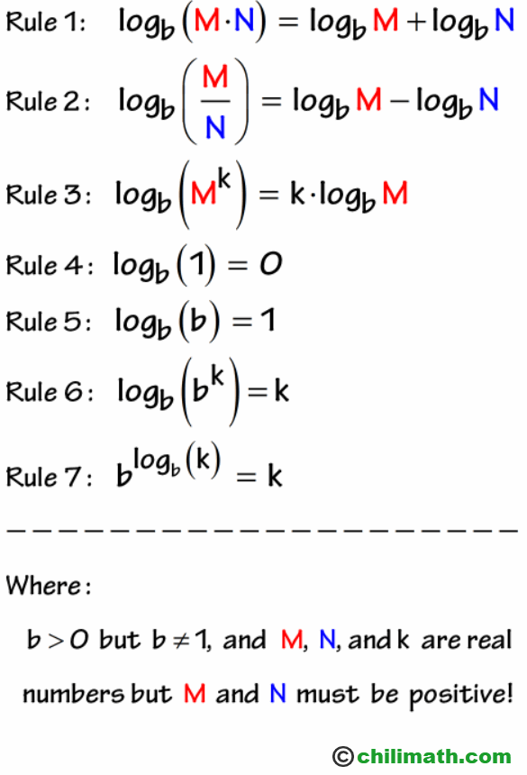

Slide 29
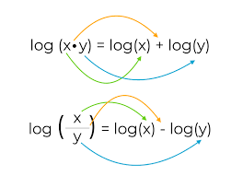

Slide 30
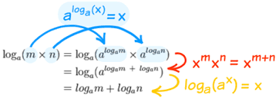

Slide 31
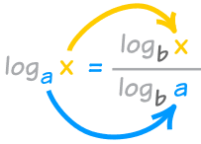

Slide 32
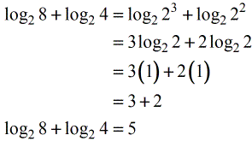

Slide 33
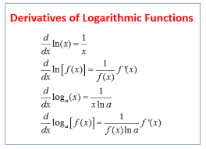

Slide 34
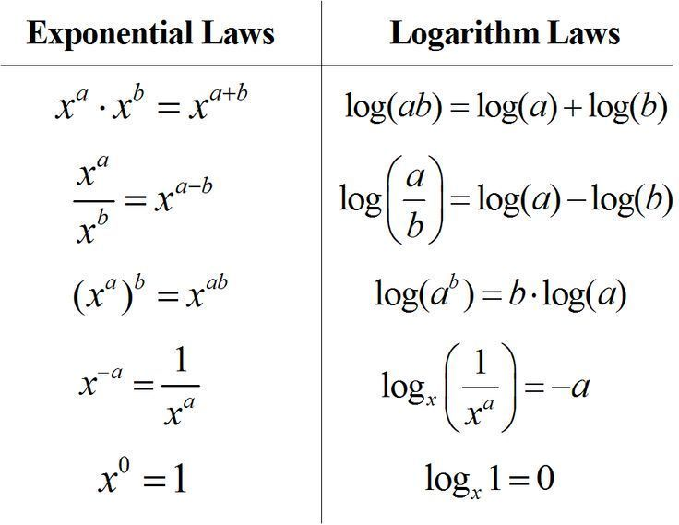

Slide 35
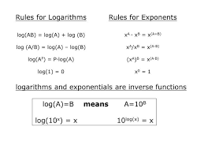

Slide 36
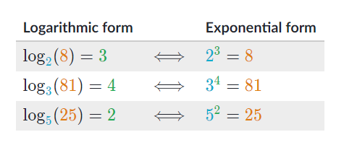

Logarithmic-Exponential

Slide 37
