Slide 1
Explain Log and Exp
Training
Notes:
logs

Slide 2
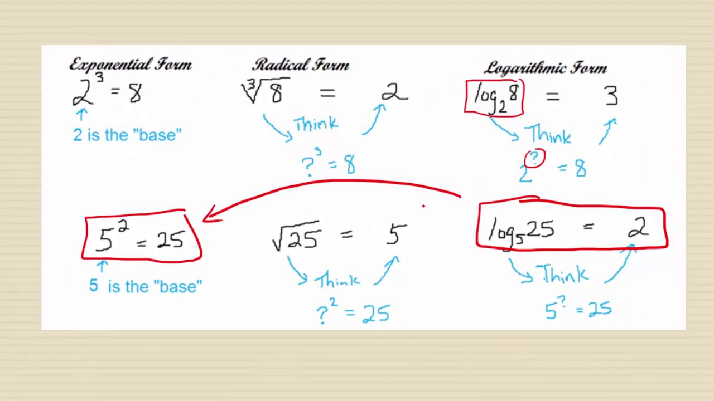
Log base 2 of 8 is 3
Log base 5 of 25 is 2

Slide 3
Log base 2 of 8 is 3
Log base 5 of 25 is 2
Power of 3
Log 3 1000 = 10
Log base 3 of 1000 is 3=10

Slide 4
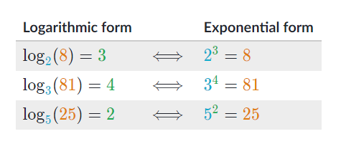
Logarithmic-Exponential

Slide 5
Logarithms
Logarithms put numbers on a human-friendly scale.
Large numbers break our brains. Millions and trillions are "really big" even though a million seconds is 12 days and a trillion seconds is 30,000 years. It's the difference between an American vacation year and the entirety of human civilization.
The trick to overcoming "huge number blindness" is to write numbers in terms of "inputs" (i.e. their power base 10). This smaller scale (0 to 100) is much easier to grasp:
power of 0 = 10⁰ = 1 (single item)
power of 1 = 10¹ = 10
power of 3 = 10³ = thousand
power of 6 = 10⁶ = million
power of 9 = 10⁹ = billion
Notes:
Logs
https://byjus.com/maths/logarithm-table/#:~:text=In%20mathematics%2C%20the%20logarithm%20table,table%20is%20given%20in%20detail.

Slide 6
Why Logarithms
Logarithms count multiplication as steps
Logarithms describe changes in terms of multiplication: in the examples above, each step is 10x bigger. With the natural log, each step is "e" (2.71828...) times more.
When dealing with a series of multiplications, logarithms help "count" them, just like addition counts for us when effects are added.

Slide 7
What is E in log?
The natural logarithm of a number is its logarithm to the base of the mathematical constant e, where e is an irrational and transcendental number approximately equal to 2.718281828459. The natural logarithm of x is generally written as ln x, log_{e} x, or sometimes, if the base e is implicit, simply log x.
Log base 2 of 8 is 3

Slide 8
Logarithms
2 raised to which power equals 16?
The answer would be 4
This is expressed by the logarithmic equation log2​(16)=4
"log base two of sixteen is four

Slide 9
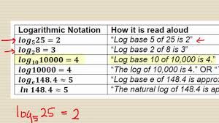

Slide 10
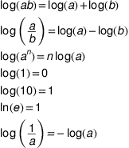
Some basic Log Formulas

