Slide 1
Logistic Regression/DT
CONFUSION MATRIX
Precison, Recall, F1-Score
Arunkumar Nair

Slide 2
MutliClass

Slide 3
Accuracy and Other Metrics
For a binary classification problem, we will know our positive class (like spam, fraud, has cancer, etc) and hence we can focus on the scores for the positive class (accuracy).
But, for a multiclass classification problem or a data that has class imbalance, accuracy metrics can be misleading. So we need to look at :
recall,
precision,
f1 scores,

Slide 4
Case-Study: Fruit Classification
We understand Accuracy, Recall, Precision, F1-Score with the following case study of fruit classification.
As an example, let’s assume that our model predicted the fruit types- Apple (A), Banana(B) and Custard apple(C) and the prediction data gave the confusion matrix.
Apple (A), Banana(B) and Custard apple(C):
Total number of observations in the data
(i.e., fruits) = 25
A=10
B=8
C=7

Slide 5
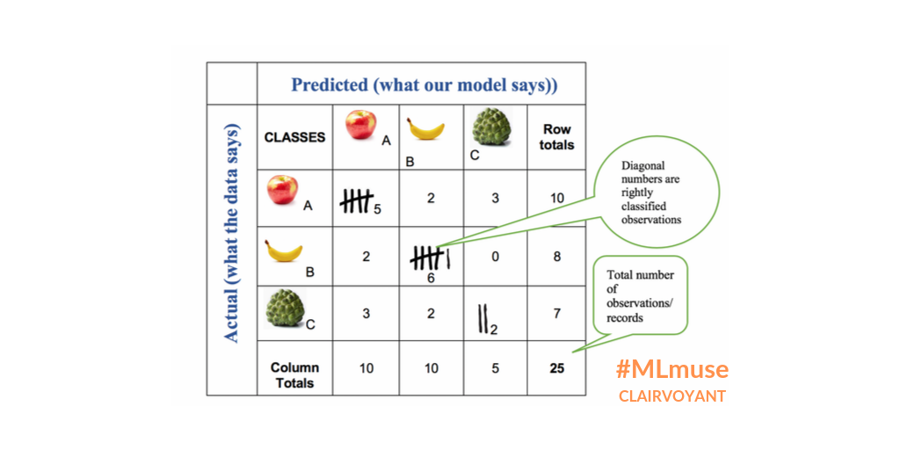
Fruit Classification :Confusion Matrix
Total number of observations in the data
(i.e., fruits) = 25
A=10
B=8
C=7

Slide 6
Fruit Classification :Confusion Matrix
Actuals
Predictions
Total number of observations in the data
(i.e., fruits) = 25
Fruits | Actuals | Predicted
A | 10 | 10
B | 8 | 10
C | 7 | 5

Slide 7
Fruit Classification :Confusion Matrix
Fruits | Actuals | Predicted
A | 10 | 10
B | 8 | 10
C | 7 | 5
Dataset: Apple (A), Banana(B) and Custard apple(C):
Total number of observations in the data (i.e., fruits) = 25
Number of A, B, C type fruits the data has = 10, 8, 7 respectively
Predicted Model saw more instances of Bananas (B = 10) , more than the (B=8) actually present in the data set. Custard apple saw (C=7) predictions, less than the (C=5) actually present in the data set.
The diagonal observations are the true positives of each class i.e., the number of times the model correctly identified A as A, B as B and C as C
All other non-diagonal observations are incorrect classifications made by the model
In the code example, let’s rebuild the same confusion matrix in python so that the metric values can be validated at each step.

Slide 8
Accuracy and Other Metrics
For a binary classification problem, we will know our positive class (like spam, fraud, has cancer, etc) and hence we can focus on the scores for the positive class (accuracy).
But, for a multiclass classification problem or a data that has class imbalance, accuracy metrics can be misleading. So we need to look at :
recall,
precision,
f1 scores,

Slide 9
Case-Study: Fruit Classification
We understand Accuracy, Recall, Precision, F1-Score with the following case study of fruit classification.
As an example, let’s assume that our model predicted the fruit types- Apple (A), Banana(B) and Custard apple(C) and the prediction data gave the confusion matrix.
Apple (A), Banana(B) and Custard apple(C):
Total number of observations in the data
(i.e., fruits) = 25
A=10
B=8
C=7

Slide 10
Fruit Classification :Confusion Matrix
Total number of observations in the data
(i.e., fruits) = 25
A=10
B=8
C=7

Slide 11
Fruit Classification :Confusion Matrix
Actuals
Predictions
Total number of observations in the data
(i.e., fruits) = 25
Fruits | Actuals | Predicted
A | 10 | 10
B | 8 | 10
C | 7 | 5

Slide 12
Fruit Classification :Confusion Matrix
Fruits | Actuals | Predicted
A | 10 | 10
B | 8 | 10
C | 7 | 5
Dataset: Apple (A), Banana(B) and Custard apple(C):
Total number of observations in the data (i.e., fruits) = 25
Number of A, B, C type fruits the data has = 10, 8, 7 respectively
Predicted Model saw more instances of Bananas (B = 10) , more than the (B=8) actually present in the data set. Custard apple saw (C=7) predictions, less than the (C=5) actually present in the data set.
The diagonal observations are the true positives of each class i.e., the number of times the model correctly identified A as A, B as B and C as C
All other non-diagonal observations are incorrect classifications made by the model
In the code example, let’s rebuild the same confusion matrix in python so that the metric values can be validated at each step.

Slide 13
Now Accuracy vs F1 Score
Accuracy is used when the True Positives and True negatives are more important while F1-score is used when the False Negatives and False Positives are crucial
Accuracy can be used when the class distribution is similar while F1-score is a better metric when there are imbalanced classes as in Fruits Classification example.
In most real-life classification problems, imbalanced class distribution exists and thus F1-score is a better metric to evaluate our model, along with accuracy.

Slide 15
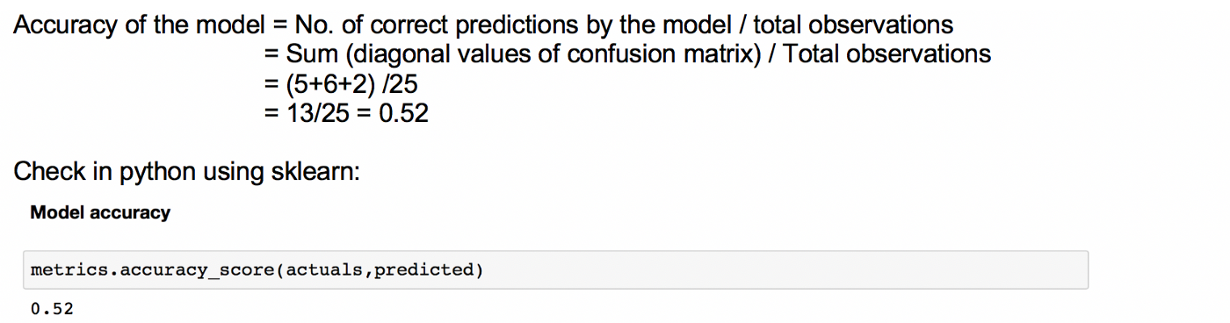
Accuracy:
Tells us how often the model can be correct.

Slide 16
Why Accuracy is not always Accurate
When there is a class imbalance, accuracy can be misleading too.
Let’s assume that we have a sample of 100 fruits of which 90 are apples and 5 are bananas and 5 are custard apples.
Even if our model predicts all the fruits as apples, the accuracy will be 90% while the truth is that our model is not actually doing a great job.

Slide 17
Hence, the need for other metrics:
Accuracy is calculated for the model as a whole but recall and precision are calculated for individual classes.
We use
Recall
Precision
F1 score
of a model for imbalanced data and multiclass classification problems.

Slide 18
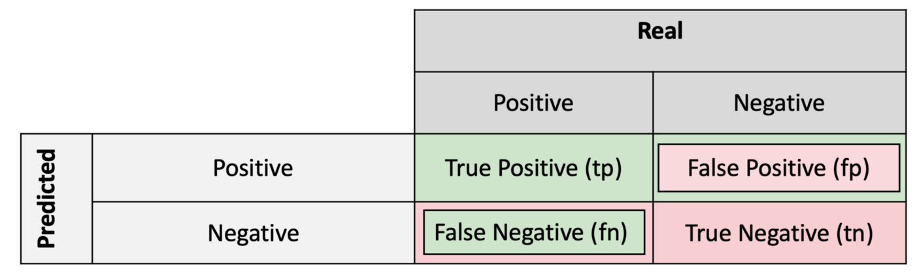



Precision — Out of all the examples that predicted as positive, how many are really positive?
positive predictive value
False Positive Rate
Recall — Out of all the positive examples, how many are predicted as positive?
Specificity — Out of all the people that do not have the disease, how many got negative results?
True Negative Rate (or Specificity)
Recall and Sensitivity are the same.
False Negative Rate

Slide 19
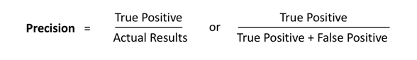
Precision — Out of all the examples that predicted as positive, how many are really positive?
positive predictive value
Recall — Out of all the positive examples, how many are predicted as positive?
Specificity — Out of all the people that do not have the disease, how many got negative results?
Recall and Sensitivity are the same.

Slide 20
Recall
Recall (also called True Positive Rate or Sensitivity):
As an example, let us calculate recall for class B.
Recall for B would be, from all the actual instances of class B (banana), how often it correctly predicts as B (banana)
Recall for B = out of the total Bs (bananas = 8 ) in the data, how many Bs did the model identify correctly (6).
So, it would be 6/8 = 0.75 (which is the same as in the classification report above for class B)

Slide 21
Recall
Recall (also called True Positive Rate or Sensitivity).
Recall calculates the percentage of actual positives a model correctly identified (True Positive).
We use Recall When the cost of a false negative is high.

Slide 22
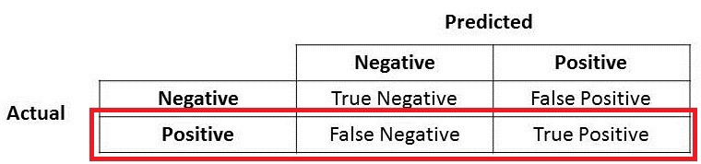
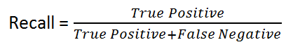
True Positive + False Negative = Total Actual Positive
Recall calculates how many of the Actual Positives our model capture through labeling it as Positive (True Positive). Applying the same understanding, we know that Recall shall be the model metric we use to select our best model when there is a high cost associated with False Negative.
For instance, in fraud detection or sick patient detection. If a fraudulent transaction (Actual Positive) is predicted as non-fraudulent (Predicted Negative), the consequence can be very bad for the bank
Similarly, in sick patient detection. If a sick patient (Actual Positive) goes through the test and predicted as not sick (Predicted Negative). The cost associated with False Negative will be extremely high if the sickness is contagious.

Slide 23
Precision:
Precision for class B is: how often is the model correct when it predicts as B?
As earlier, let’s calculate precision for class B.
Precision for B: out of the total observations predicted as Bs (10) by the model, how many are correct Bs (6). So, it would be 6/10 = 0.6

Slide 24
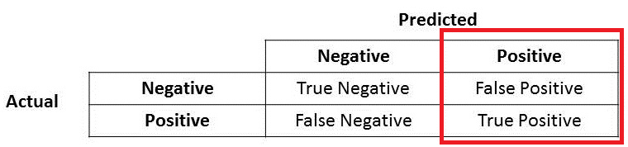
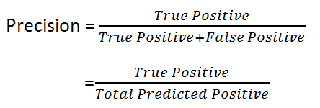
Precision:
True Positive + False Positive = Total Predicted Positive
Precision for class B is: how often is the model correct when it predicts as B?
Precision is a good measure to determine, when the costs of False Positive is high.

Slide 25
True Positive + False Positive = Total Predicted Positive
Precision talks about how precise/accurate your model is out of those predicted positive, how many of them are actual positive.
Precision is a good measure to determine, when the costs of False Positive is high. For instance, email spam detection. In email spam detection, a false positive means that an email that is non-spam (actual negative) has been identified as spam (predicted spam). The email user might lose important emails if the precision is not high for the spam detection model.

Slide 26
F1-Score
F1 score of class B will be
(2 x Recall x precision)/(Recall + Precision)
=0.75*0.6*2/(0.75+0.6) = 0.67

Slide 27
F1-Score
F1 Score is needed when you want to seek a balance between Precision and Recall. Right…so what is the difference between F1 Score and Accuracy then?

Slide 28
F1-Score
We have previously seen that accuracy can be largely contributed by a large number of True Negatives which in most business circumstances, we do not focus on much whereas False Negative and False Positive usually has business costs (tangible & intangible).
So F1 Score might be a better measure to use if we need to seek a balance between Precision and Recall AND there is an uneven class distribution (large number of Actual Negatives).

Slide 29
MicroAverages
Hence, the need for other metrics:
Accuracy is calculated for the model as a whole but recall and precision are calculated for individual classes.
We use macro or micro or weighted scores of
Recall
Precision
F1 score
of a model for multiclass classification problems.

Slide 30
Micro Averages
In the Micro-average method, you sum up the individual class’s true positives, false positives, and false negatives of the system for different sets and then apply them to get the score.

Slide 31
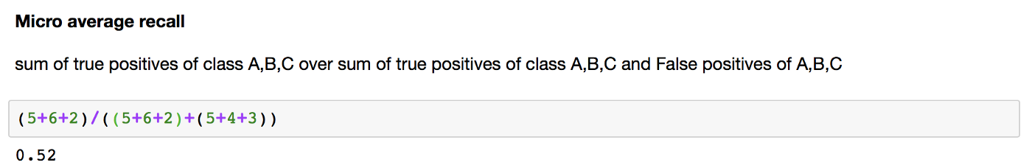
Micro Average Recall
For the fruit’s confusion matrix, micro-average recall score is calculated as below (same as in the classification report above):

Slide 32
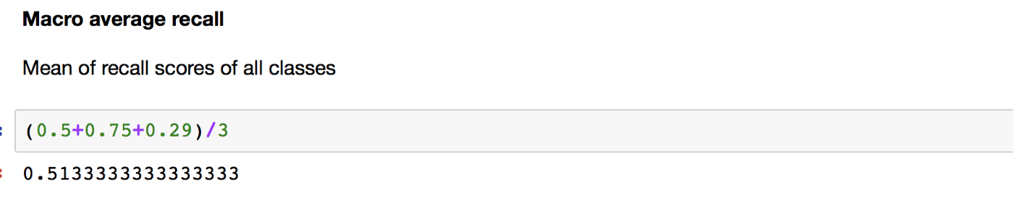
Macro Average Recall

Slide 33
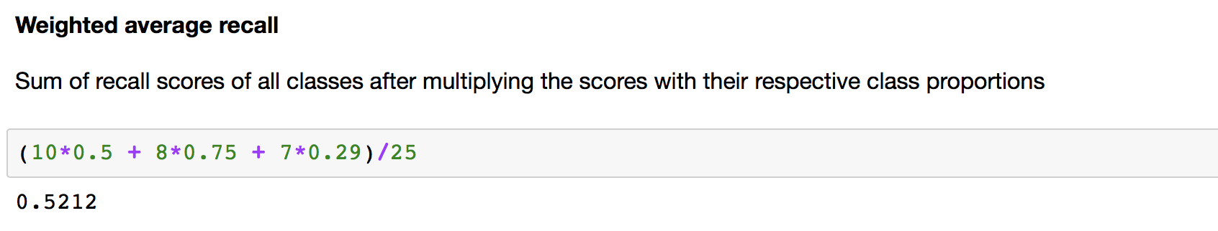
Weighted Average Recall

Slide 34
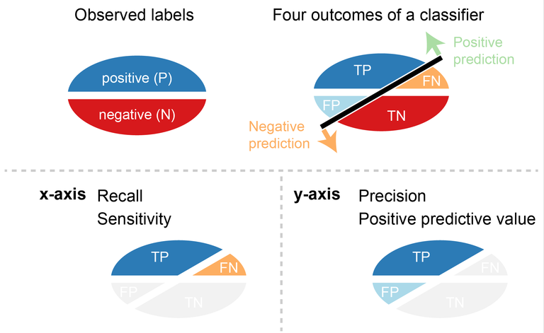

Slide 35
Thanks
End

Slide 36
ROC CURVES

Slide 37
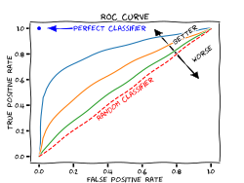

Slide 38
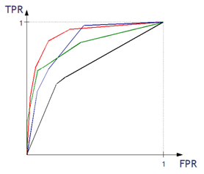
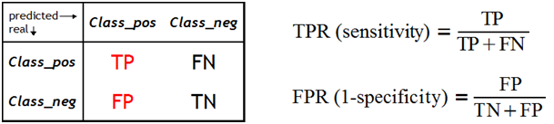
What is the ROC curve?
The ROC curve is one of the methods for visualizing classification quality, which shows the dependency between TPR (True Positive Rate) and FPR (False Positive Rate).
Notes:
http://algolytics.com/how-to-assess-quality-and-correctness-of-classification-models-part-4-roc-curve/
The more convex the curve, the better the classifier. In the example below, the “green” classifier is better in area 1, and the “red” classifier is better in area 2

Slide 39
How is the ROC curve created
We compute the values of the decision function.
We test the classifier for different alpha thresholds. Recall that alpha is the threshold of the estimated probability, above which an observation is assigned to one category (positive class) and below to the other category (negative class).
For each classification with one value of the alpha threshold we obtain a (TPR, FPR) pair, which corresponds to one point on the ROC curve.
For each classification with one value of the alpha threshold we also have the corresponding Confusion Matrix.
Notes:
http://algolytics.com/how-to-assess-quality-and-correctness-of-classification-models-part-4-roc-curve/
The more convex the curve, the better the classifier. In the example below, the “green” classifier is better in area 1, and the “red” classifier is better in area 2

Slide 40
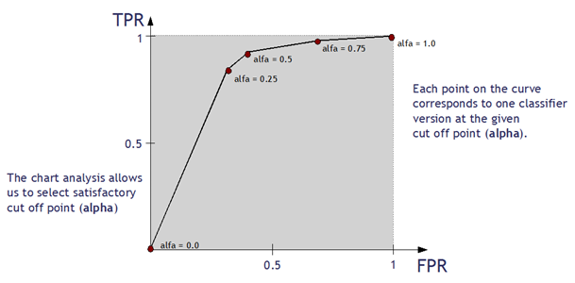
How is the ROC curve created
We compute the values of the decision function.
Notes:
http://algolytics.com/how-to-assess-quality-and-correctness-of-classification-models-part-4-roc-curve/
The more convex the curve, the better the classifier. In the example below, the “green” classifier is better in area 1, and the “red” classifier is better in area 2

Slide 41
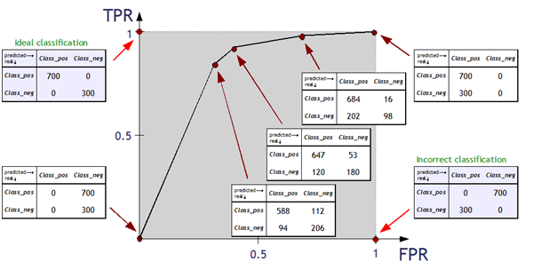
How is the ROC curve created
We compute the values of the decision function.
Notes:
http://algolytics.com/how-to-assess-quality-and-correctness-of-classification-models-part-4-roc-curve/
The more convex the curve, the better the classifier. In the example below, the “green” classifier is better in area 1, and the “red” classifier is better in area 2

Slide 42
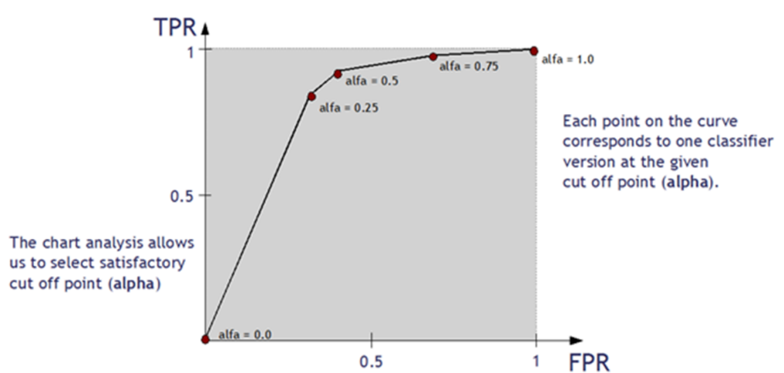
How is the ROC curve created
We compute the values of the decision function.
Notes:
http://algolytics.com/how-to-assess-quality-and-correctness-of-classification-models-part-4-roc-curve/
The more convex the curve, the better the classifier. In the example below, the “green” classifier is better in area 1, and the “red” classifier is better in area 2

Slide 43
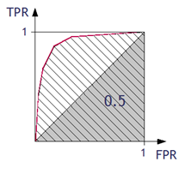
Assessing the classifier using ROC curve
Area under ROC Curve (AUC) coefficient
The higher the value of AUC coefficient, the better. AUC = 1 means a perfect classifier, AUC = 0.5 is obtained for purely random classifiers. AUC < 0.5 means the classifier performs worse than a random one.
Notes:
http://algolytics.com/how-to-assess-quality-and-correctness-of-classification-models-part-4-roc-curve/
The more convex the curve, the better the classifier. In the example below, the “green” classifier is better in area 1, and the “red” classifier is better in area 2
https://acutecaretesting.org/en/articles/roc-curves-what-are-they-and-how-are-they-used

Slide 44
Thanks
End

