Slide 1
9 pm EST Thursday 21 Nov 2024
Assignment:
1)Run the College Data set, Explain very line of code
2) How K-means does the cluster. If you have to create a cluster by yourself, will help of excel or manually how will you create .

Slide 2
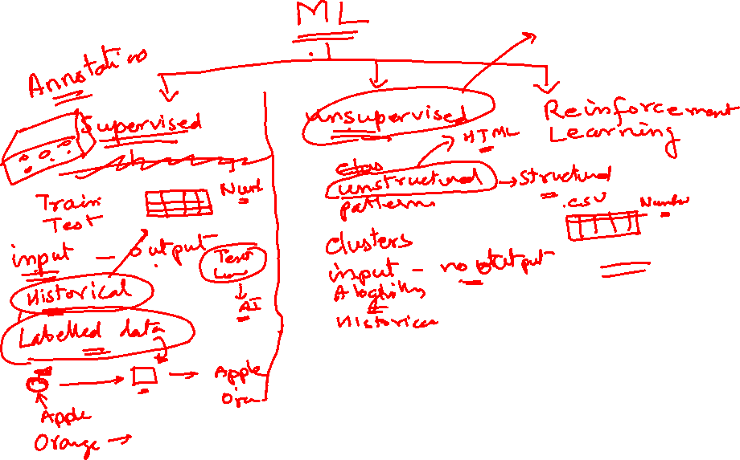

Slide 3
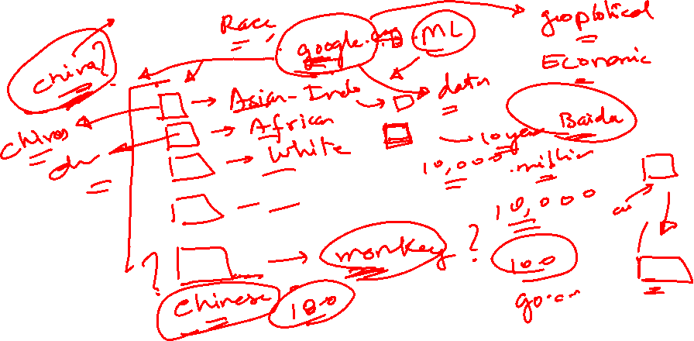

Slide 4
Holiday, Wednesday 20 Nov 2024

Slide 5
9 pm EST Thursday 21 Nov 2024
Assignment:
1)Run the College Data set, Explain very line of code
2) How K-means does the cluster. If you have to create a cluster by yourself, will help of excel or manually how will you create .

Slide 6
K-Means
By Arunkumar Nair
arunkg99@gmail.com
91-9890652675
https://www.linkedin.com/in/arunkumarnair/

Slide 7

K Means
k-means is one of the simplest unsupervised learning algorithms that solve the clustering problems.
The procedure follows a simple and easy way to classify a given data set through a certain number of clusters (assume k clusters). The main idea is to define k centers, one for each cluster.

Slide 8
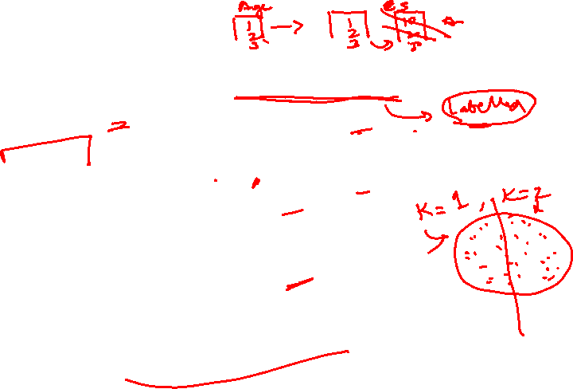
K-Means
The k-means algorithm is an unsupervised clustering algorithm. It takes a bunch of unlabeled points and tries to group them into “K” number of clusters.
Used unlabeled data (Data without defined categories or Group)
Data points are clustered based on similarities
The goal of this algorithm is to find groups in the data, with the number of groups represented by the variable K.

Slide 9
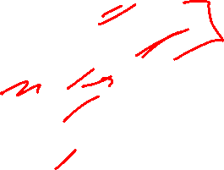
K-Means Uses Cases
K-Means is applied in
The K-means clustering algorithm is used to find groups which have not been explicitly labeled in the data and to find patterns and make better decisions.. Once the algorithm has been run and the groups are defined, any new data can be easily assigned to the most relevant group.
Customer Profiling:
market segmentation,
computer vision
Geo-statistics
Astronomy

Slide 10
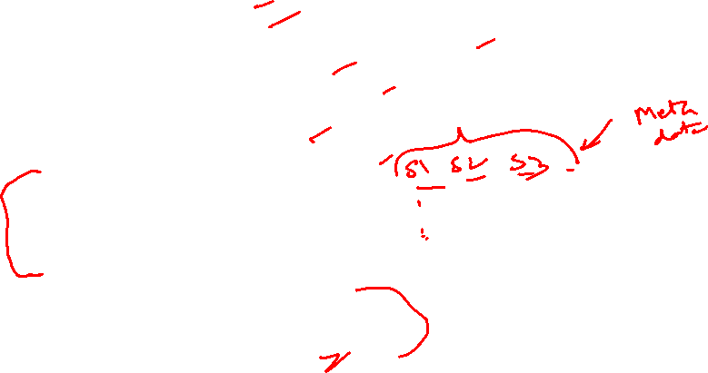
Common business cases where K-means is used
Behavioral segmentation:
  Segment by purchase history
  Segment by activities on application, website, or platform
  Define personas based on interests
  Create profiles based on activity monitoring
Inventory categorization:
  Group inventory by sales activity
  Group inventory by manufacturing metrics
Sorting sensor measurements:
  Detect activity types in motion sensors
  Group images
  Separate audio
  Identify groups in health monitoring
Detecting bots or anomalies:
  Separate valid activity groups from bots
  Group valid activity to clean up outlier detection

Slide 11
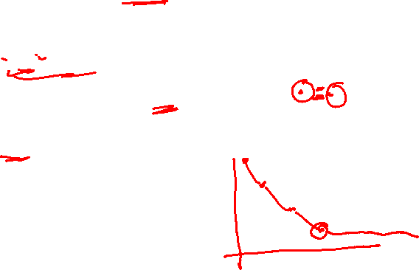
K-Means-How is works
K-means algorithm in data mining starts with a first group of randomly selected centroids, which are used as the beginning points for every cluster, and then performs iterative (repetitive) calculations to optimize the positions of the centroids
K-means is an iterative algorithm and it does two main steps:
1. Cluster assignment
2. Move centroid step.

Slide 12
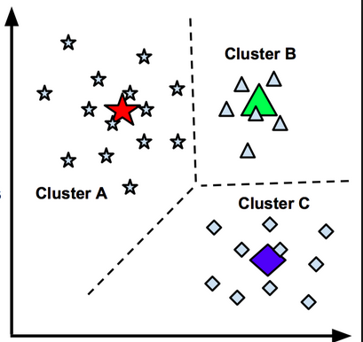
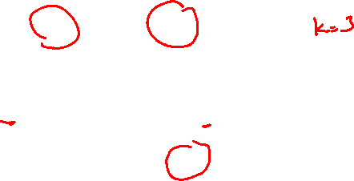
K=3 Clusters

Slide 13
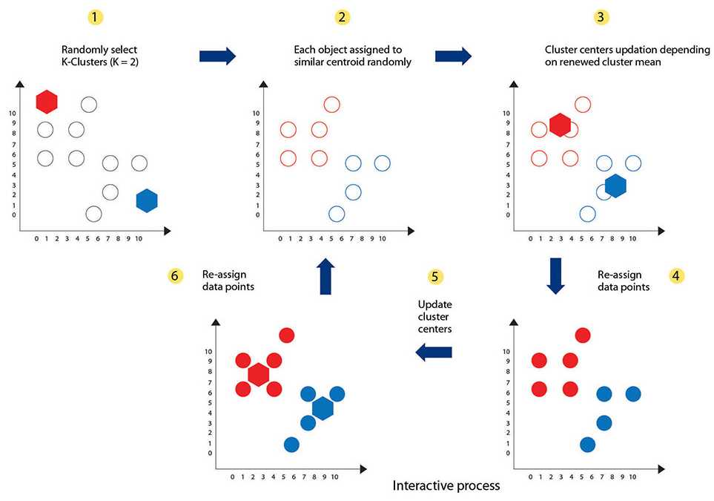
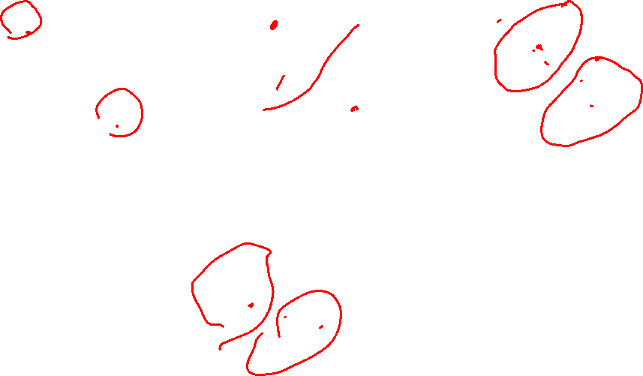
K=2 Clusters

Slide 14
K-Means-How is works

Slide 15
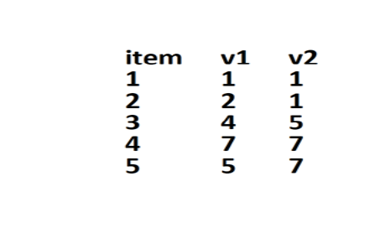
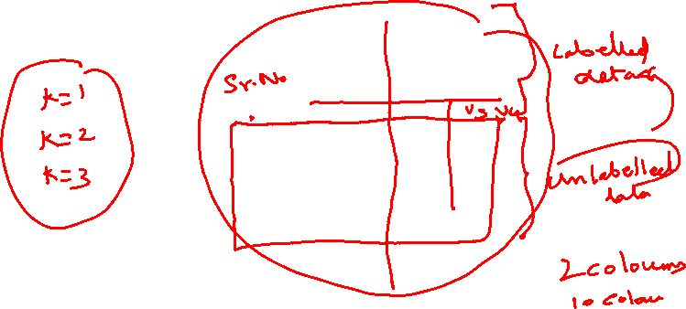
Data with No Answers
Age
Weight
App
Accept

Slide 16

Data with No Answers

Slide 17
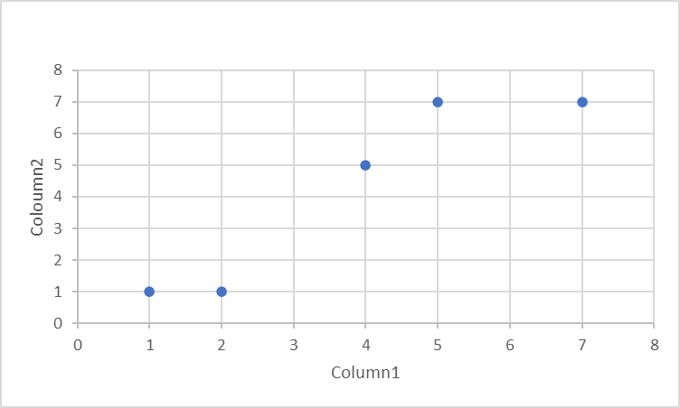
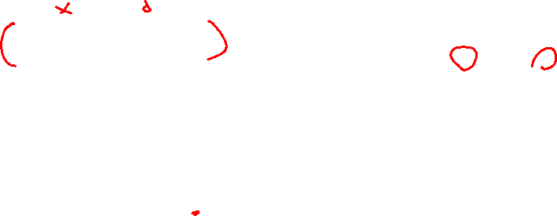
Plot a Graph

Slide 18
Plot a Graph with the Data

Slide 19
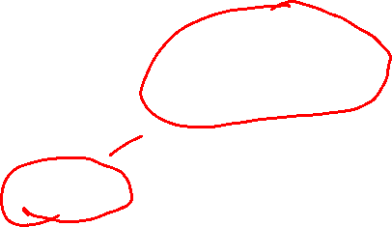
1. Cluster assignment
When K =2, which means let us create 2 clusters of data points.

Slide 20

1. Cluster assignment
First time the Algorithm creates 2 Random Clusters – A and B
B
A
Start with a Random Cluster, let us assign
Row 1,2,3 to Cluster A
Row 4,5 to Cluster B

Slide 21
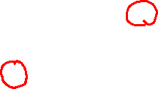
2. Compute the Centroid
The algorithm goes through the clusters and will compute the Centroid for Cluster A and Cluster B
*?
B
*?
A
What is the centroid of Cluster A and Cluster B?

Slide 22
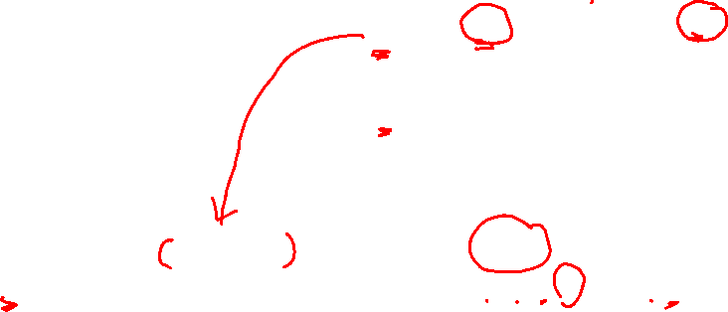
2. How to Compute the centroid for A, B
2.33
2.33
6
7
2.33,
2.33
6,
7
A= (1+2+4)/3=2.33, (1+1+5)/3=2.33
B= (7+5)/2=6, (7+7)/2=7

Slide 23
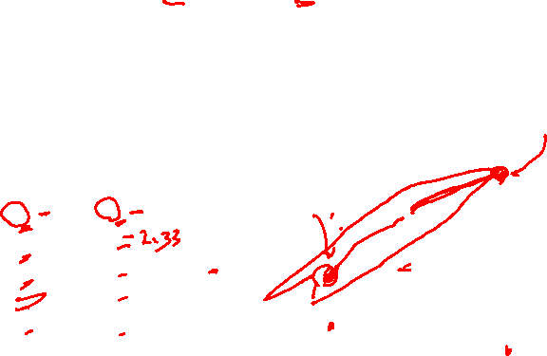
2. Compute the centroid and plot it on the Graph
Centroid values for Cluster A and Cluster B
*
B
*
A
(2.33, 2.33)
(6, 7)
A= (1+2+4)/3=2.33, (1+1+5)/3=2.33
B= (7+5)/2=6, (7+7)/2=7

Slide 24
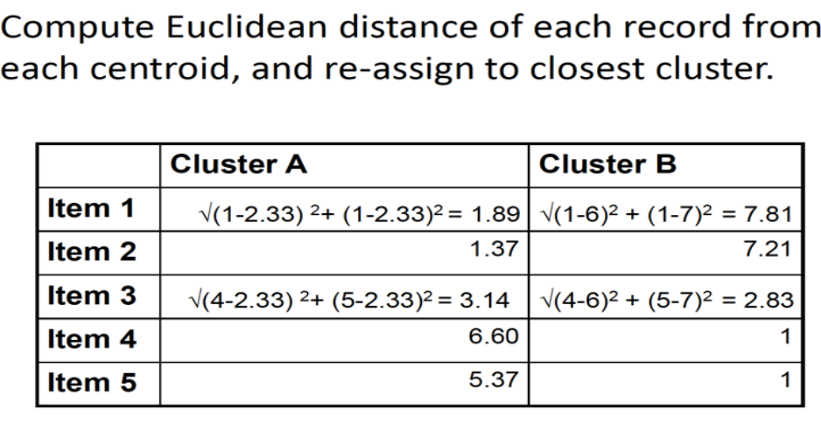
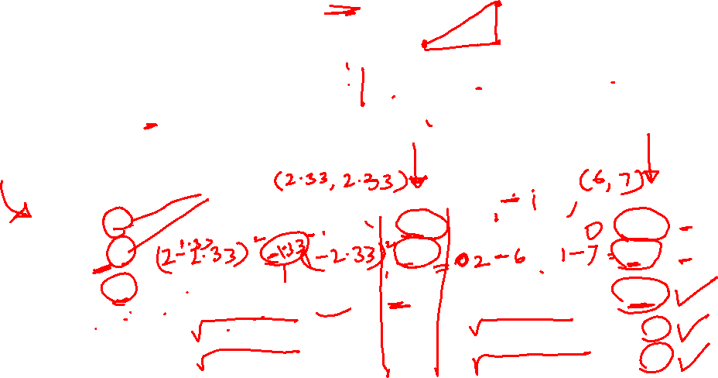
3. Measure the Euclidean Distances

Slide 25
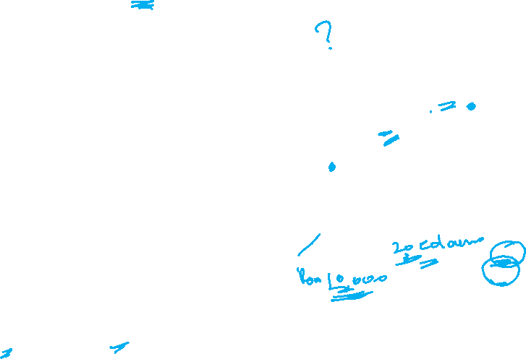
4. Reassign the data point to closest centroid.
Redraw or Rearrange the data and the Clusters
After calculating the Euclidean distance, the data point (3) is reassigned to the closest centroid, which is in cluster (B).
B
A
Recreate the Cluster, let us assign 3 to Cluster B
Row 1,2 to Cluster A
Row 3,4,5 to Cluster B

Slide 26
5. Re Compute the Centroid for the rearranged clusters
Recompute the centroid of the clusters with the modified data points
*?
B
*?
A

Slide 27
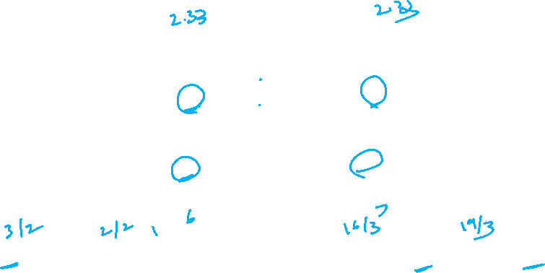
6. How to Compute the centroid for A, B
1.5
1
5.33
6.33
A= (1+2)/2=1.5, (1+1)/2=1
B= (4+7+5)/3=5.33, (5+7+7)/3=6.33

Slide 28

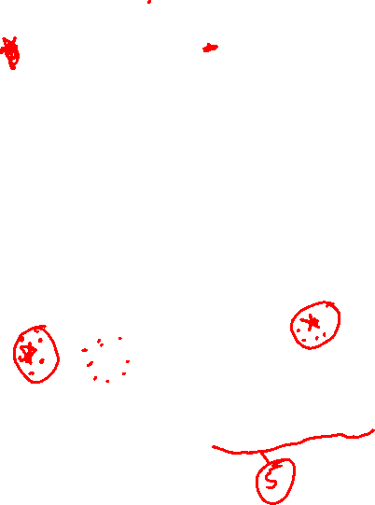
7. Plot the new Centroids on the graph
Recompute the centroid of the clusters with the modified data points
*
B
1.5
1
5.33
6.33
*
A
(1.5, 1)
(5.33, 6.33)
A= (1+2)/2=1.5, (1+1)/2=1
B= (4+7+5)/3=5.33, (5+7+7)/3=6.33

Slide 29
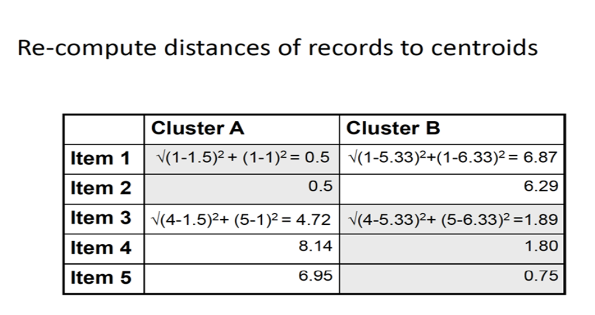
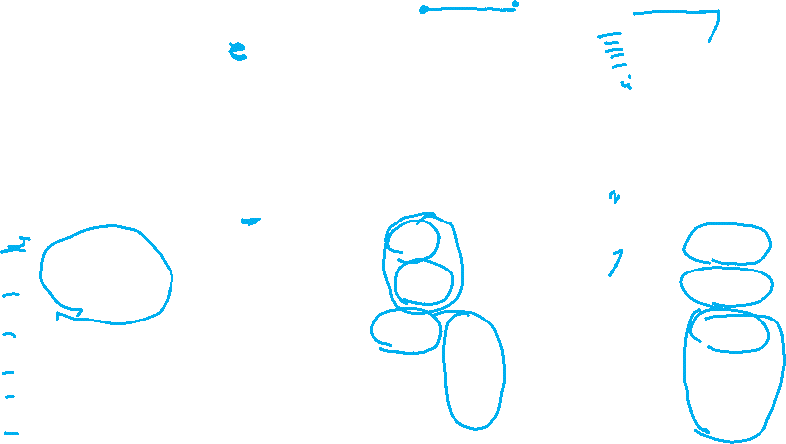
Re-Compute the Euclidean Distances from the centroids

Slide 30
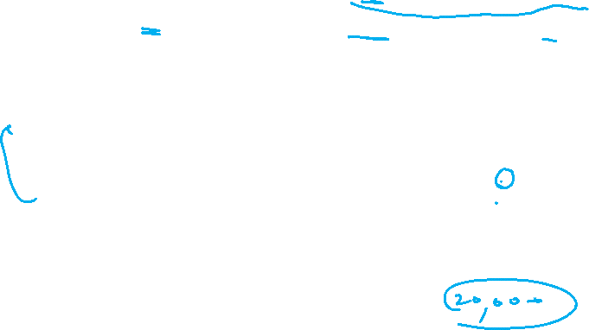
Repeat
This process is repeated until there is no change in the clusters distance. K is chosen randomly or by giving specific initial starting points by the user.
*
1.5
1
B
5.33
6.33
*
A

Slide 31
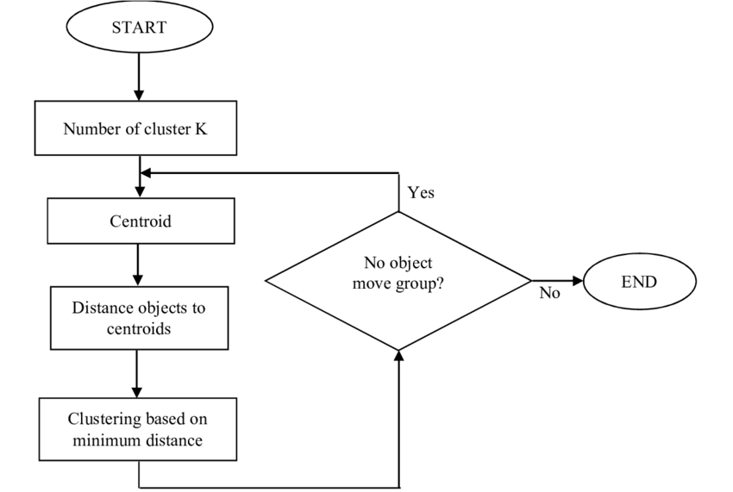
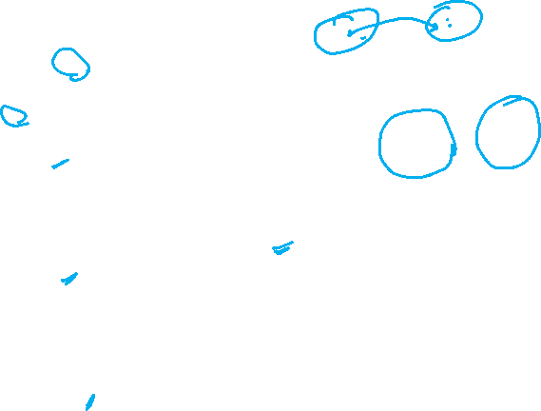

Slide 32
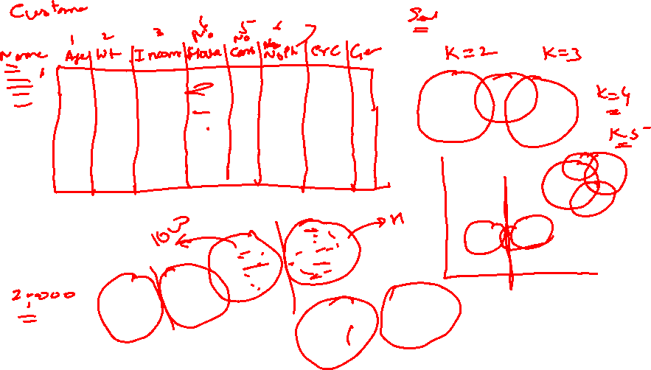

Slide 33
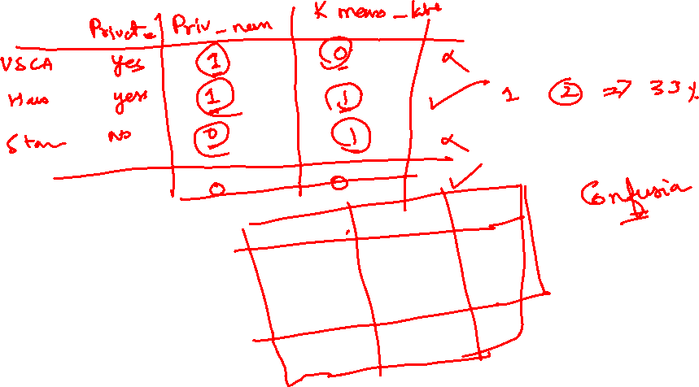
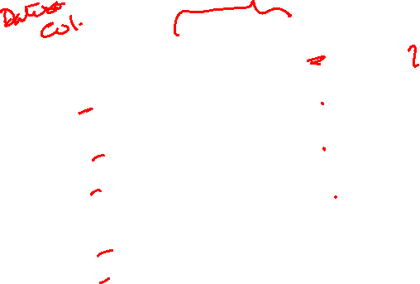

Slide 34
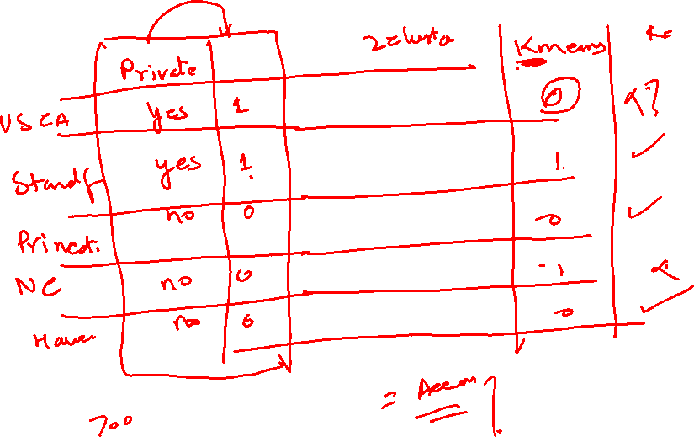

Slide 35
Thanks

Slide 36
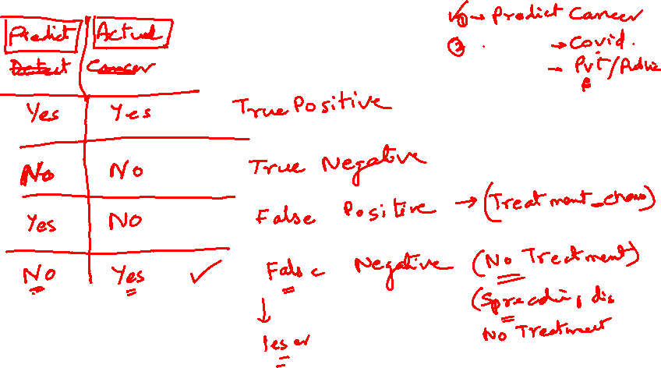
9 pm EST Monday 25 Nov 2024
Confusion matrix

Slide 37
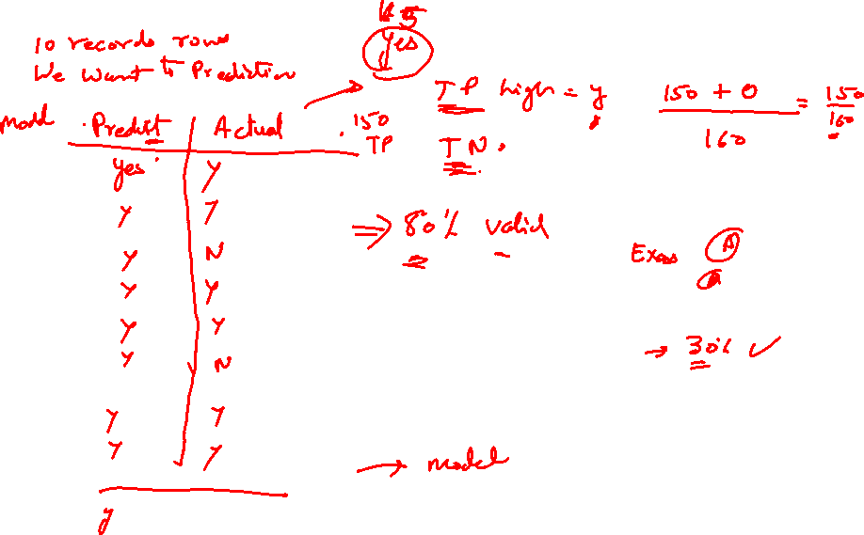

Slide 38
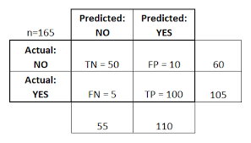
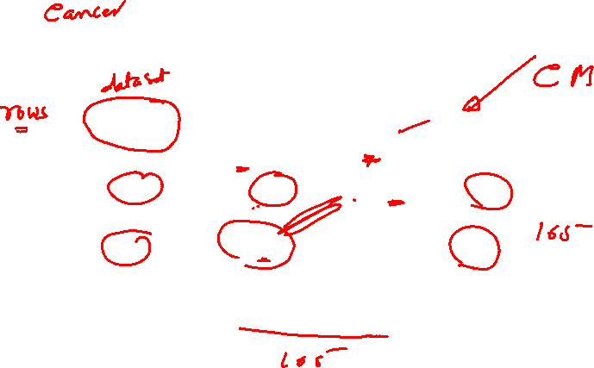

Slide 39
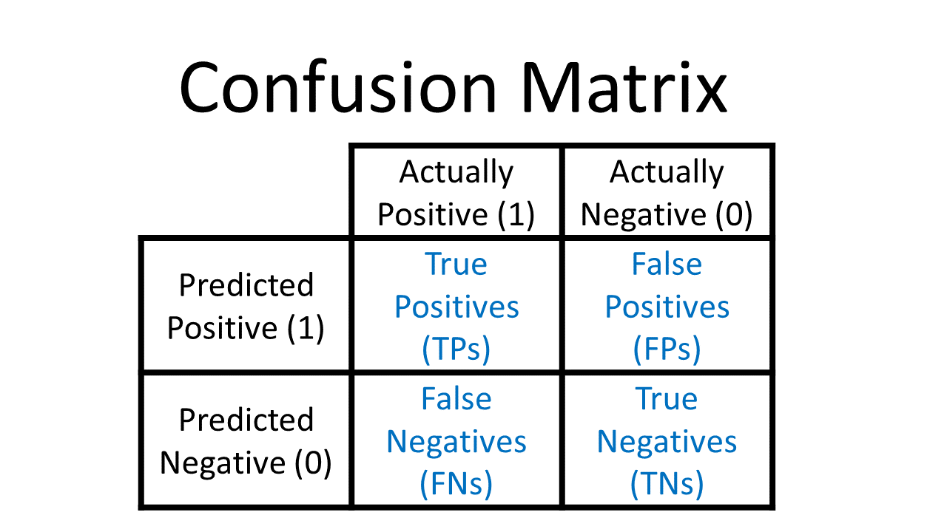

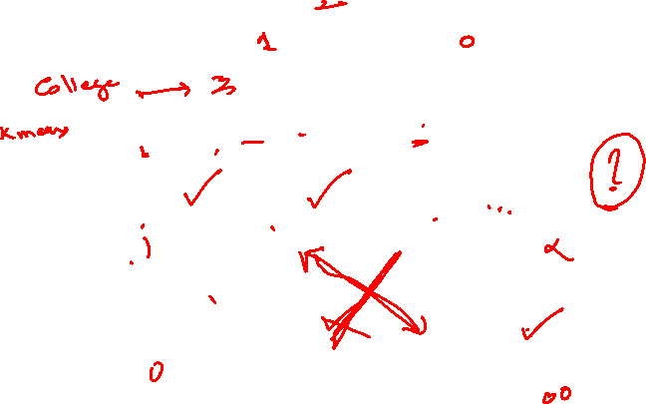

Slide 40
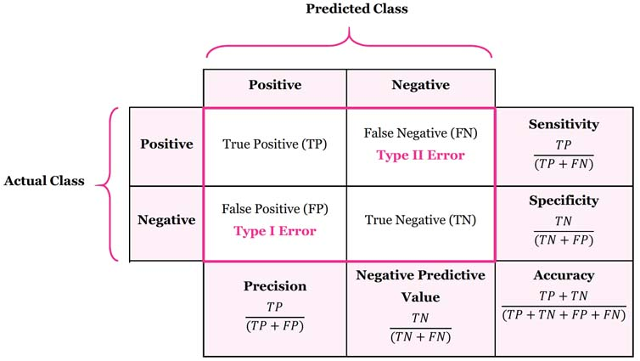
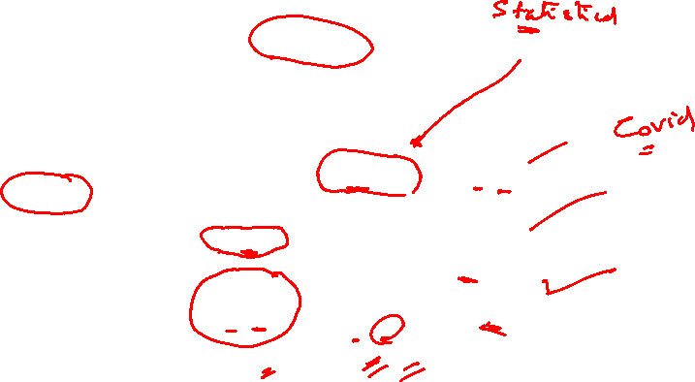

Slide 41
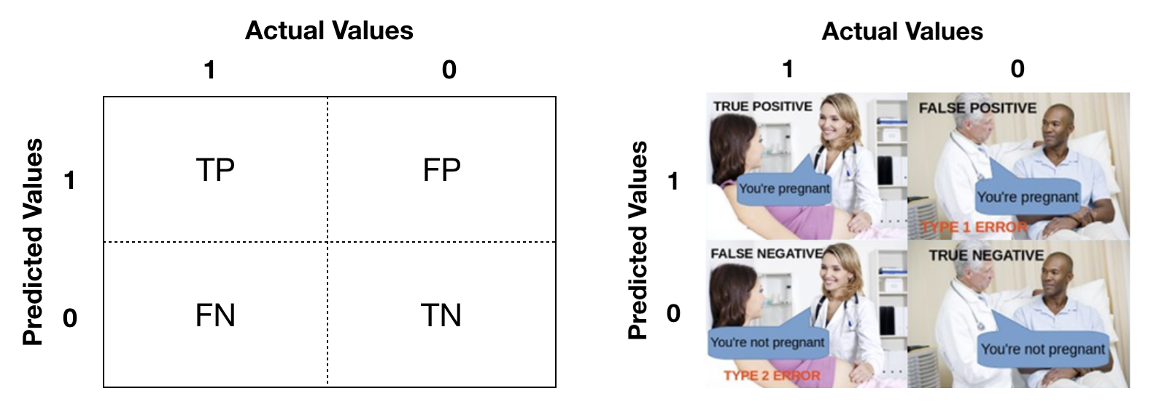
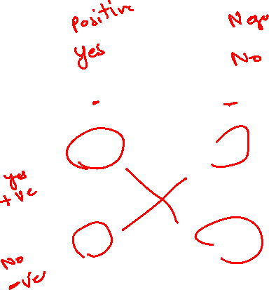

Slide 42
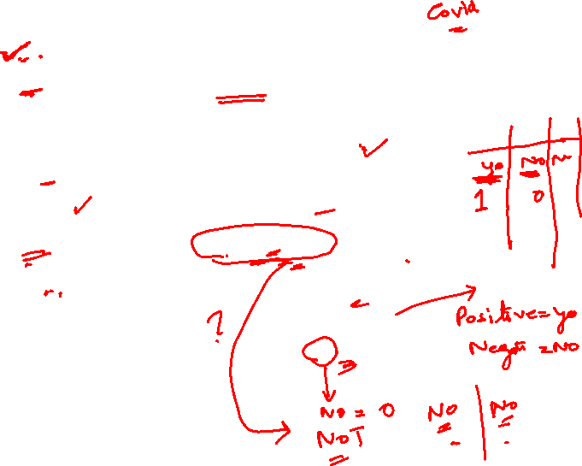

Slide 43
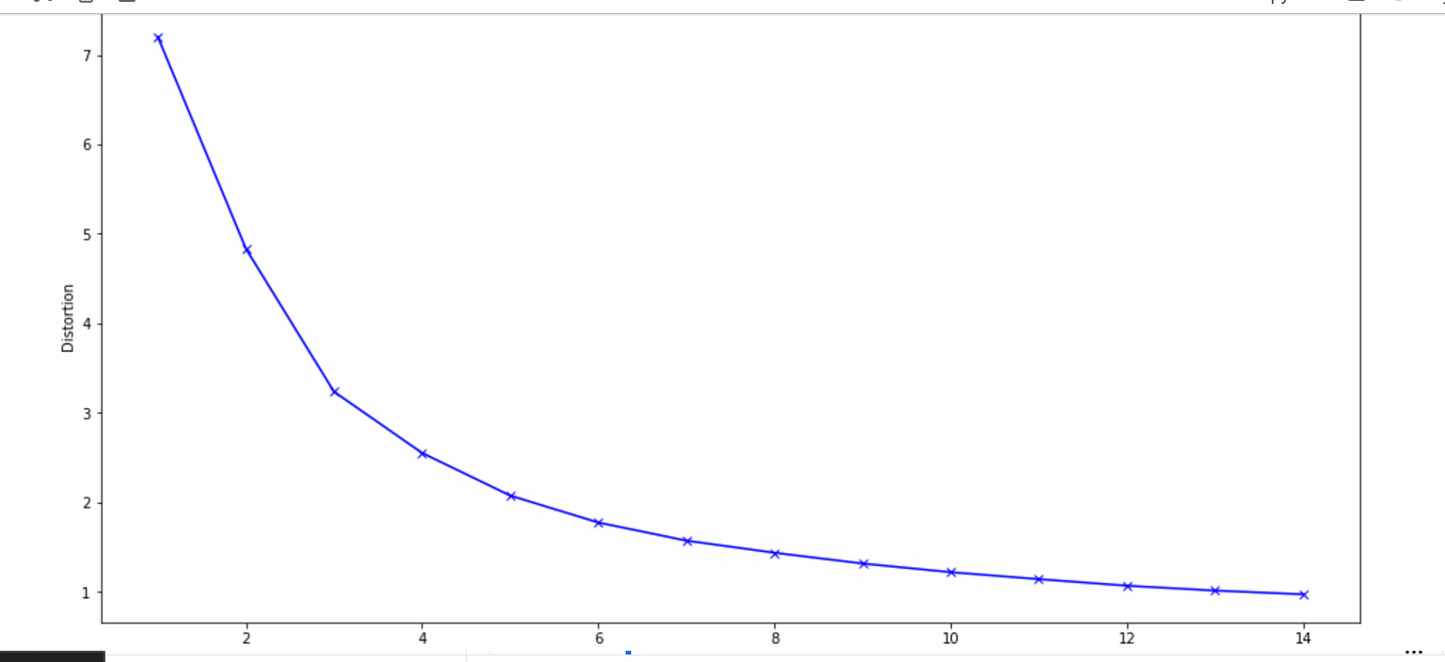
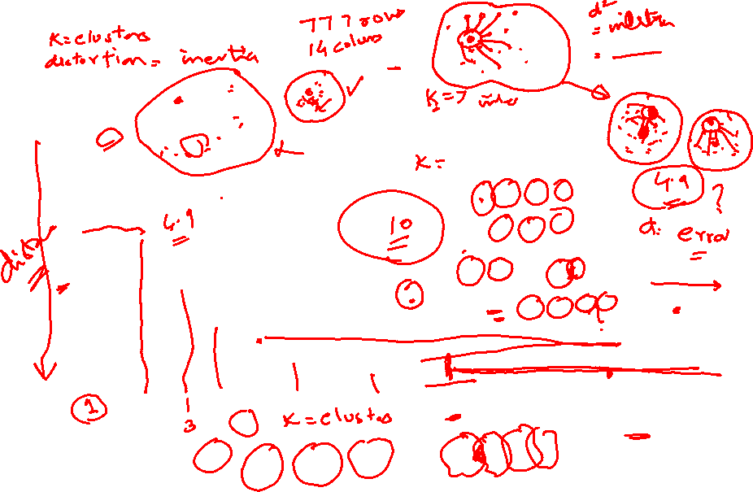

Slide 46
END

Slide 47
9 pm EST Monday 2 Dec 2024
Assignments
1)Mall
2)Predict Diabetes

Slide 48
9 pm EST Tuesday 3 Dec 2024
Assignments
1)Mall
2)Predict Diabetes
LOGISTIC REGRESSION

