Slide 1
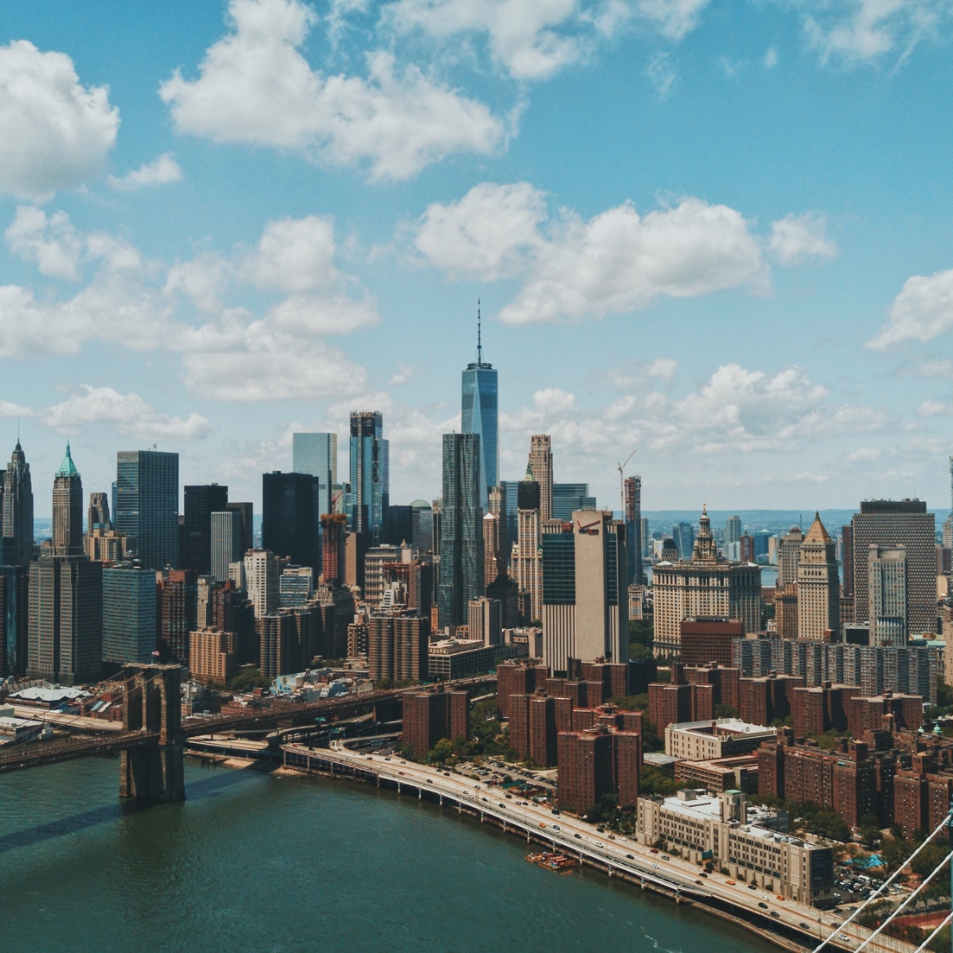
Machine Learning Use Cases
Learn easy. Enjoy Easy. Expertise easy
Notes:
Statistics: is that branch of mathematics which deals with gathering, interpreting, and organizing the information or data.
Descriptive statistics uses the data to provide descriptions of the population, either through numerical calculations or graphs or tables.
Inferential statistics makes inferences and predictions about a population based on a sample of data taken from the population in question.

Slide 2
Unsupervised Learning: Clustering

Slide 3

Things you will learn after this Session
Unsupervised Learning: Clustering
What is Clustering?
Use Case of Clustering
Types of Clustering

Slide 4

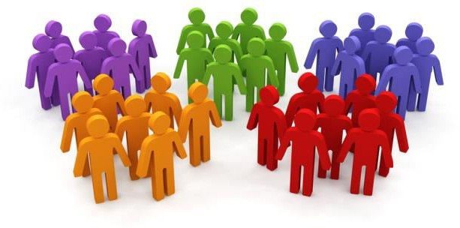
What is Clustering?
“Clustering is the process of dividing the datasets into groups, consisting of similar data-points”
Points in the same group are as similar as possible
Points in different group are as
dissimilar as possible

Slide 5
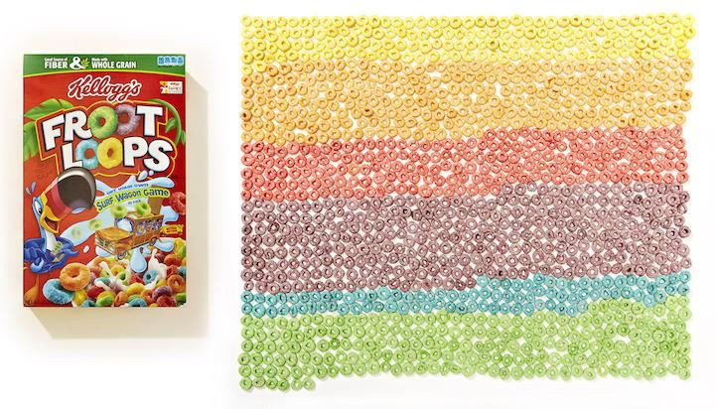
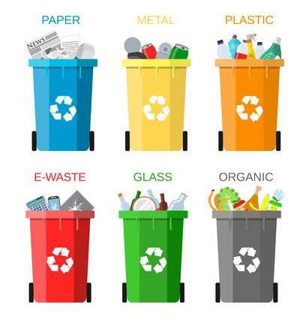
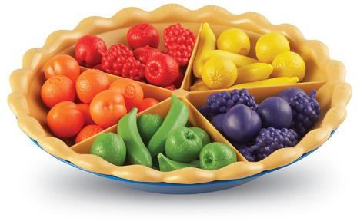
Example of Clustering
Example 1: Cluster of different colors of FROOT LOOPS
Example 2: Cluster of different colors of Fruits
Example 3: Cluster of
different types of Garbage

Slide 6
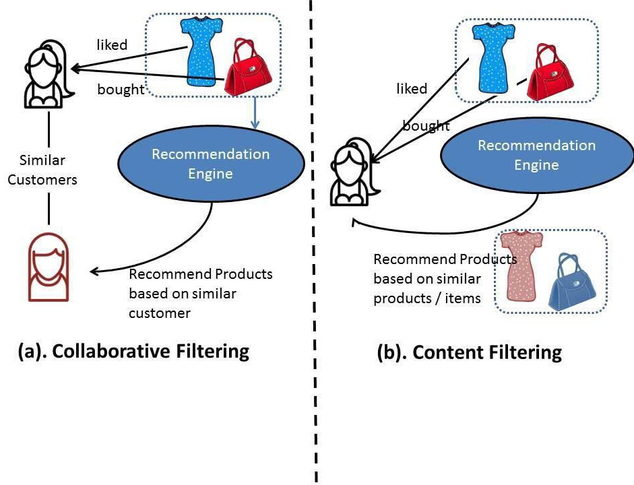


Use-case of Clustering

Slide 7


Where it is used?

Slide 8
Types of Clustring
Types of Clustering
Exclusive Clustering
Overlapping Clustering
Hierarchical Clustering

Slide 9

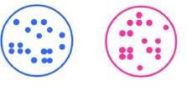
Types of Clustering
Exclusive Clustering
Each data object can only exist in one cluster
For Example: K-Means Clustering
Exclusive Clustering
Overlapping Clustering Hierarchical Clustering

Slide 10
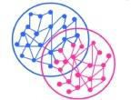
Types of Clustering
Overlapping Clustering
Allows data objects to be grouped in 2 or more clusters
For Example: Fuzzy/ C-Means Clustering
In Fuzzy clustering every data object belongs to every cluster
Exclusive Clustering
Overlapping Clustering Hierarchical Clustering

Slide 11
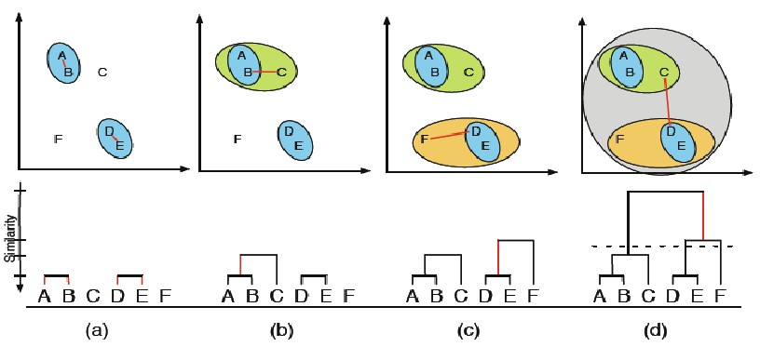
Types of Clustering
Hierarchical Clustering
Exclusive Clustering
Overlapping Clustering Hierarchical Clustering

Slide 12
Understanding K – Means Clustering

Slide 13
Things you will learn after this Session
Understanding K – Means Clustering
What is K – Means Clustering?
Where can you use it?
Step by step calculation of K-Means Clustering Algorithm

Slide 14
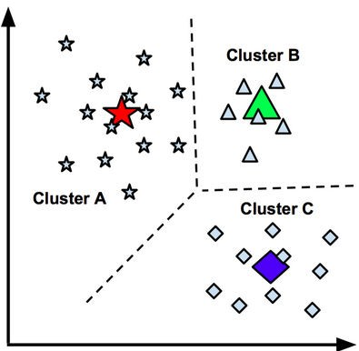
What is
K-means Clustering?
“K-Means is a clustering algorithm which focuses on grouping similar elements or data points into a cluster.”
NOTE: ‘K’ in K-Means represent the number of clusters

Slide 15
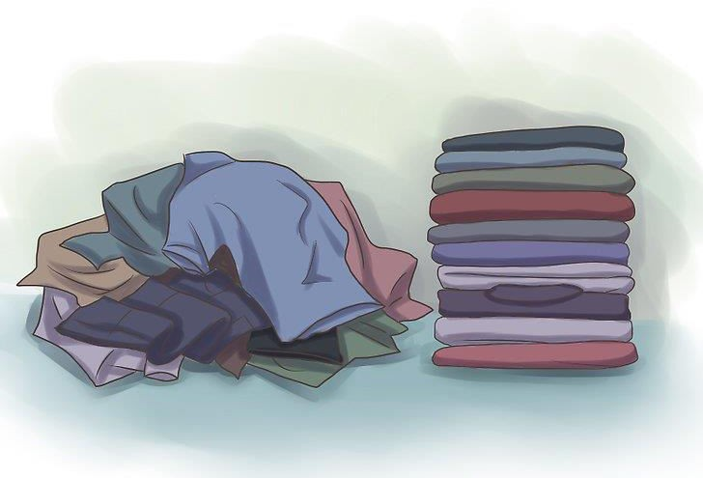
What is
K-means Clustering?
Pile of Laundry

Slide 16

Business Application of K-Means
Behavioural Segmentation
Inventory Categorization
Sorting sensor measurements
Detecting bots or anomalies

Slide 17












Understand
K-means Algorithm
Number of Clusters = 3

Slide 18














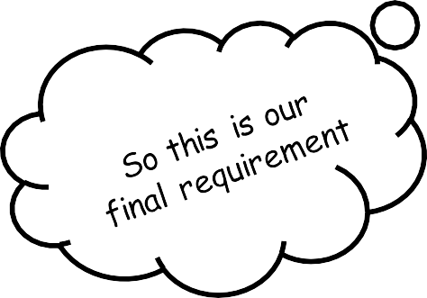
Understand
K-means Algorithm
Number of Clusters, K = 3

Slide 19







Understand
K-means Algorithm
Step 1: Select the number of clusters to be identified, i.e select a value for K =3 in this case
Step 2: Randomly select 3 distinct data point
Step 3: Measure the distance between the 1st
point and selected 3 clusters
Distance from point 1 to the blue cluster
Distance from point 1 to the red
Distance from point 1 to the purple cluster

Slide 20



Understand
K-means Algorithm
Step 4: Assign the 1st point to nearest cluster (red in this case).

Slide 21

Understand
K-means Algorithm
Step 5: Calculate the mean value including the new point for the red cluster

Slide 22
Understand
K-means Algorithm
Find to which cluster does point 2 belongs to, how?
Repeat the same procedure but measure the distance to the red mean
Add the point to the nearest cluster
Distance of 2nd point to the red cluster
Distance of 2nd point to the blue
cluster
Distance of 2nd point to the purple cluster

Slide 23

Understand
K-means Algorithm
Calculate the cluster mean including the new point

Slide 24
Understand
K-means Algorithm
Find to which cluster does point 3 belongs to, how?
Repeat the same procedure but measure the distance from the new red mean

Slide 25

Understand
K-means Algorithm
Measure the distance and add the 3rd point to the cluster(red) having the minimum distance

Slide 26

Understand
K-means Algorithm
Calculate the new cluster mean using the new point

Slide 27

Understand
K-means Algorithm
Measure the distance
Assign the point to the nearest cluster
Calculate the cluster mean using the new point
To which cluster does this point belongs to?
REPEAT THE STEPS AGAIN…

Slide 28
Understand
K-means Algorithm
Measure the distance
Assign the point to the nearest cluster
Calculate the cluster mean using the new point

Slide 29

Understand
K-means Algorithm
Measure the distance
Assign the point to the nearest cluster
Calculate the cluster mean using the new point

Slide 30
Understand
K-means Algorithm
Measure the distance from the cluster mean (centroids)
Assign the point to the nearest cluster
Calculate the cluster mean using the new point
To which cluster does this point belongs to?
REPEAT THE SAME STEPS UNTILL ALL THE
CLUSTERS ARE ASSIGNED…

Slide 31

Understand
K-means Algorithm
Measure the distance from the cluster mean (centroids)
Assign the point to the nearest cluster
Calculate the cluster mean using the new point
Since the point is located closet to blue cluster

Slide 32
Understand
K-means Algorithm
Measure the distance from the cluster mean (centroids)
Assign the point to the nearest cluster
Calculate the cluster mean using the new point

Slide 33
Understand
K-means Algorithm
Since all of these points are located closet to blue cluster so all of them will be assigned to blue cluster

Slide 34
























Understand
K-means Algorithm
Result from 1st iteration
Original/Expected Result

Slide 35
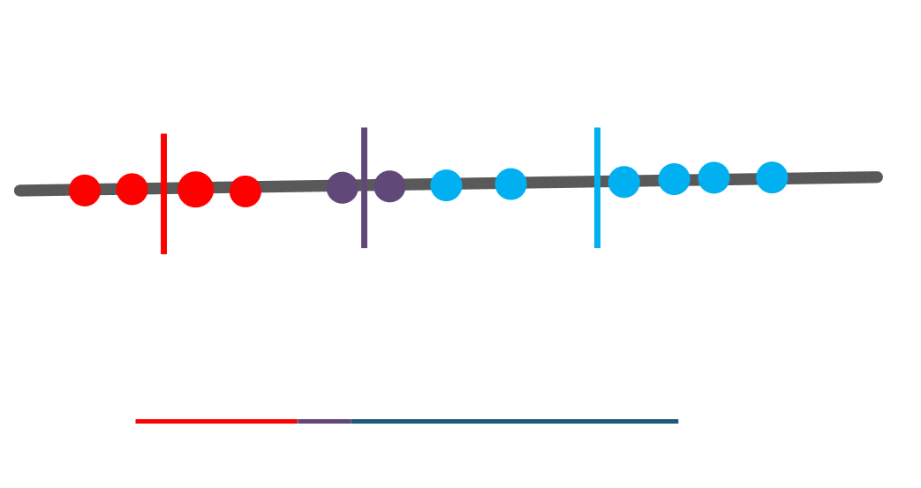
Understand
K-means Algorithm
Total variation within the Cluster
According to the K-Means Algorithm it iterates over again and again unless and until the data points within each cluster stops changing

Slide 36
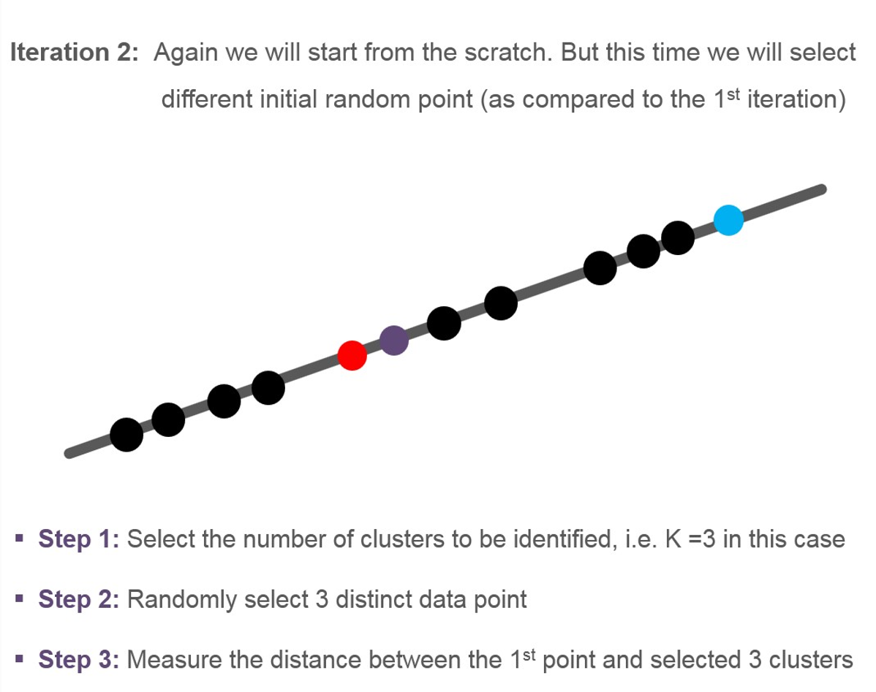
Understand
K-means Algorithm

Slide 37
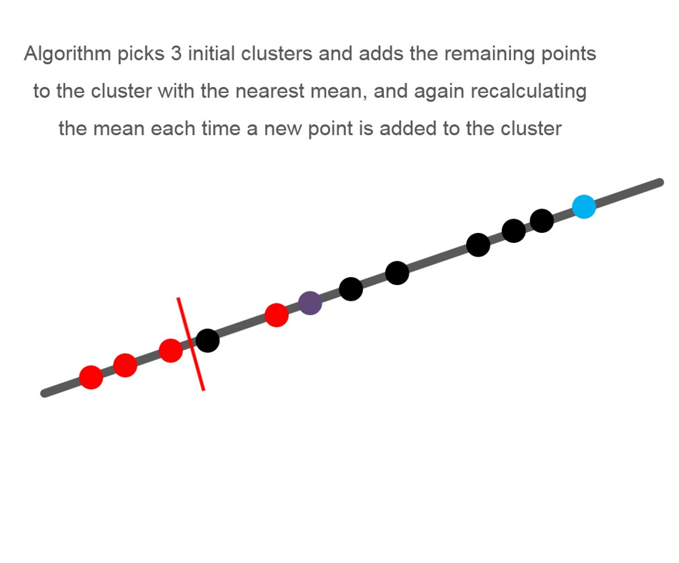
Understand
K-means Algorithm

Slide 38












Understand
K-means Algorithm
Algorithm picks 3 initial clusters and adds the remaining points to the cluster with the nearest mean, and again recalculating the mean each time a new point is added to the cluster

Slide 39






Understand
K-means Algorithm
Algorithm picks 3 initial clusters and adds the remaining points to the cluster with the nearest mean, and again recalculating the mean each time a new point is added to the cluster

Slide 40












Understand
K-means Algorithm
Algorithm picks 3 initial clusters and adds the remaining points to the cluster with the nearest mean, and again recalculating the mean each time a new point is added to the cluster
Total variation within the cluster

Slide 41











Understand
K-means Algorithm
Iteration 3: Again we will start from the scratch and select different initial random point (as compared to 1st and 2nd iteration)
Pick 3 initial clusters

Slide 42












Understand
K-means Algorithm
Cluster remaining points

Slide 43












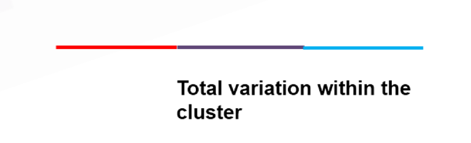
Understand
K-means Algorithm
Finally sum the variation within each cluster

Slide 44

Understand
K-means Algorithm
Finally sum the variation within each cluster
1st Iteration
2nd Iteration
3rd Iteration

Slide 45
Understand
K-means Algorithm
But how to find the value of ‘K’?

Slide 46











Understand
K-means Algorithm
How to find the value of ‘K’?
In the previous scenario k = 3 was known, but what-if
we don’t know the exact value of k?

Slide 47












Understand
K-means Algorithm
For finding the value of k, you will use hit and trail method, starting from K = 1
K=1 is the worst case scenario, even you cross-verify it with its total variation(all red)

Slide 48










Understand
K-means Algorithm
Now try with K = 2
K=2 is still better then K = 1 (Total Variation)
K = 1
K = 2

Slide 49



Understand
K-means Algorithm
Now try with K = 3
K=3 is still better then K = 2 (Total Variation)
K = 1
K = 2
K = 3

Slide 50









Understand
K-means Algorithm
Now try with K = 4
Every time you increase the cluster the variation decreases
If no. of clusters = no. of data points then in that case the variation = 0
K=4 is still better then K = 3 (Total Variation)
K = 1
K = 2
K = 3
K = 4

Slide 51
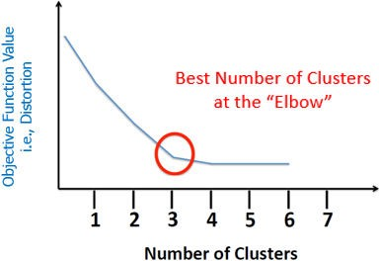
Understand
K-means Algorithm
Finally

Slide 52






Understand
K-means Algorithm
Now what if we have our data plotted on the X and Y axis
Y-Axis
X-Axis

Slide 53
Understand
K-means Algorithm
Similarly, pick initial 3 random points..
Y-Axis
X-Axis

Slide 54



Understand
K-means Algorithm
We will be using the Euclidean distance (in 2D its same as that of a Pythagorean Theorem)
p
ℎ² = 𝑝² + 𝑏²
b
Y-Axis
X-Axis

Slide 55
Understand
K-means Algorithm
Again assign the point to the nearest cluster
Y-Axis
X-Axis

Slide 56

Understand
K-means Algorithm
Finally calculate the centroid (mean of cluster) including the new point
Y-Axis
X-Axis

Slide 57





Understand
K-means Algorithm
Finally in first iteration you get something like this…again you have to iterate this process to get the final cluster
Y-Axis
X-Axis

Slide 58
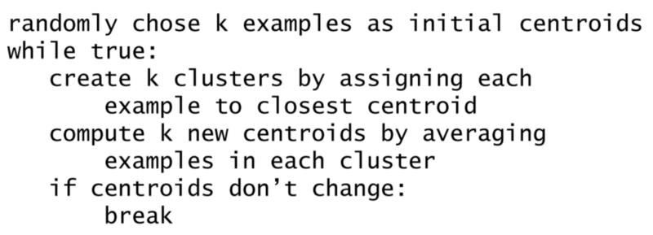
Understand
K-means Algorithm
Summarizing the K-Means Algorithm

Slide 59
K-Means Clustering: Demo

Slide 60
Things you will learn after this Session
K-Means Clustering: Demo
K – Means Clustering using Python
K – Means Clustering using sklearn

Slide 61
QUIZ

Slide 62
Quiz 1
What is the minimum no. of variables/ features required to perform clustering?
A
0
B
1
C
2
D
3

Slide 63
Answer 1
What is the minimum no. of variables/ features required to perform clustering?
A
0
B
1
C
2
D
3

Slide 64
Quiz 2
In which of the following cases will K-Means clustering fail to give good results?
A
Data points with outliers
B
Data points with different densities
C
Data points with non-convex shapes
D
All of the above

Slide 65
Answer 2
In which of the following cases will K-Means clustering fail to give good results?
A
Data points with outliers
B
Data points with different densities
C
Data points with non-convex shapes
D
All of the above

Slide 66
Quiz 3
Assume, you want to cluster 7 observations into 3 clusters using K-Means clustering algorithm. After first iteration clusters, C1, C2, C3 has following observations:
C1: {(2,2), (4,4), (6,6)}
C2: {(0,4), (4,0)}
C3: {(5,5), (9,9)}
What will be the cluster
centroids if you want to proceed for second iteration?
A
C1: (4,4), C2: (2,2), C3: (7,7)
B
C1: (6,6), C2: (4,4), C3: (9,9)
C
C1: (2,2), C2: (0,0), C3: (5,5)
D
None of these

Slide 67
Answer 3
Assume, you want to cluster 7 observations into 3 clusters using K-Means clustering algorithm. After first iteration clusters, C1, C2, C3 has following observations:
C1: {(2,2), (4,4), (6,6)}
C2: {(0,4), (4,0)}
C3: {(5,5), (9,9)}
What will be the cluster
centroids if you want to proceed for second iteration?
A
C1: (4,4), C2: (2,2), C3: (7,7)
B
C1: (6,6), C2: (4,4), C3: (9,9)
C
C1: (2,2), C2: (0,0), C3: (5,5)
D
None of these

Slide 68
Quiz 4
Customer segmentation is an example of
A
Classification
B
Clustering
C
Association
D
None of the above

Slide 69
Answer 4
Customer segmentation is an example of
A
Classification
B
Clustering
C
Association
D
None of the above

Slide 70
Quiz 5
In K-Means, K stands for __________
A
Data sets
B
Number of clusters
C
Error function

Slide 71
Answer 5
In K-Means, K stands for __________
A
Data sets
B
Number of clusters
C
Error function

Slide 72
Thank you
arunkg99@gmail.com
www.doitskills.com

