Slide 1
K-Means
By Arunkumar Nair
arunkg99@gmail.com
91-9890652675
https://www.linkedin.com/in/arunkumarnair/

Slide 2
K Means
k-means is one of the simplest unsupervised learning algorithms that solve the clustering problems.
The procedure follows a simple and easy way to classify a given data set through a certain number of clusters (assume k clusters). The main idea is to define k centers, one for each cluster.

Slide 3
K Means
The k-means algorithm is an unsupervised clustering algorithm. It takes a bunch of unlabeled points and tries to group them into “K” number of clusters.
Used unlabeled data (Data without defined categories or Group)
Data points are clustered based on similarities
The goal of this algorithm is to find groups in the data, with the number of groups represented by the variable K.

Slide 4
K Means
K-Means is applied in
The K-means clustering algorithm is used to find groups which have not been explicitly labeled in the data and to find patterns and make better decisions.. Once the algorithm has been run and the groups are defined, any new data can be easily assigned to the most relevant group.
Customer Profiling:
market segmentation,
computer vision
Geo-statistics
Astronomy

Slide 5
Common business cases where K-means is used
Behavioral segmentation:
  Segment by purchase history
  Segment by activities on application, website, or platform
  Define personas based on interests
  Create profiles based on activity monitoring
Inventory categorization:
  Group inventory by sales activity
  Group inventory by manufacturing metrics
Sorting sensor measurements:
  Detect activity types in motion sensors
  Group images
  Separate audio
  Identify groups in health monitoring
Detecting bots or anomalies:
  Separate valid activity groups from bots
  Group valid activity to clean up outlier detection

Slide 6
K-means algorithm in data mining starts with a first group of randomly selected centroids, which are used as the beginning points for every cluster, and then performs iterative (repetitive) calculations to optimize the positions of the centroids
K-means is an iterative algorithm and it does two main steps:
1. Cluster assignment
2. Move centroid step.

Slide 7
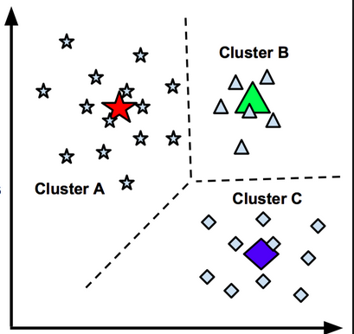
K=3 Clusters

Slide 8
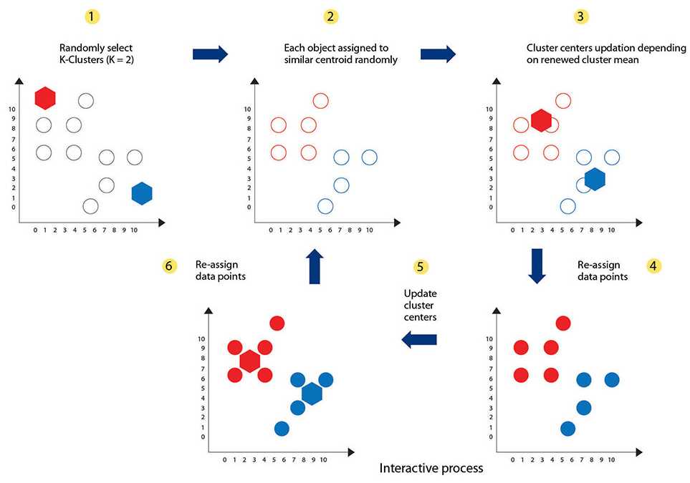
K=2 Clusters

Slide 9
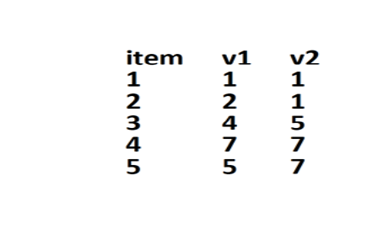
Data with No Answers
Age
Weight

Slide 10
Data with No Answers

Slide 11
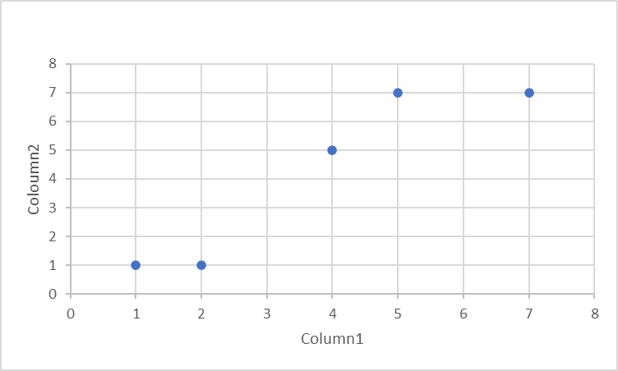
Data with No Answers

Slide 12
Data with No Answers

Slide 13
1. Cluster assignment
K =2, which means let us create 2 clusters of data points.

Slide 14
1. Cluster assignment
First time the Algorithm creates 2 Random Clusters – A and B
B
A
Start with a Random Cluster, let us assign
Row 1,2,3 to Cluster A
Row 4,5 to Cluster B

Slide 15
2. Compute the Centroid
The algorithm goes through the clusters and will compute the Centroid for Cluster A and Cluster B
*?
B
*?
A
What is the centroid of Cluster A and Cluster B?

Slide 16
2. Compute the centroid for A, B
2.33
2.33
6
7
2.33,
2.33
6,
7
A= (1+2+4)/3=2.33, (1+1+5)/3=2.33
B= (7+5)/2=6, (7+7)/2=7

Slide 17
2. Compute the centroid
Centroid values for Cluster A and Cluster B
*
B
*
A
(2.33, 2.33)
(6, 7)
A= (1+2+4)/3=2.33, (1+1+5)/3=2.33
B= (7+5)/2=6, (7+7)/2=7

Slide 18
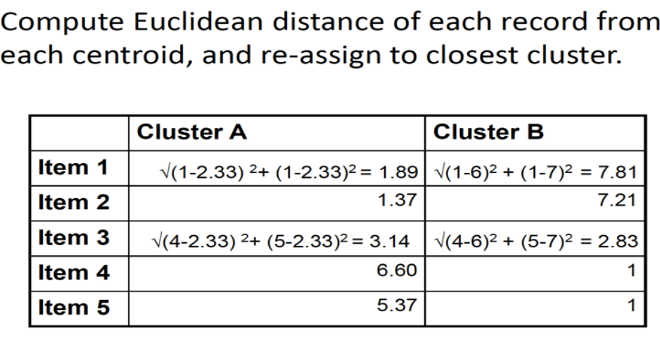
3. Measure the Distances

Slide 19
4. Reassign the data point to closest centroid.
Recreate the Clusters
After calculating the Euclidean distance, the data point (3) is reassigned to the closest centroid, which is in cluster (B).
B
A
Recreate the Cluster, let us assign 3 to Cluster B
Row 1,2 to Cluster A
Row 3,4,5 to Cluster B

Slide 20
5. Re Compute the Centroid
Recompute the centroid of the clusters with the modified data points
*?
B
*?
A

Slide 21
6. Compute the centroid for A, B
1.5
1
5.33
6.33
A= (1+2)/2=1.5, (1+1)/2=1
B= (4+7+5)/3=5.33, (5+7+7)/3=6.33

Slide 22
7. Re Compute the Centroid
Recompute the centroid of the clusters with the modified data points
*
B
1.5
1
5.33
6.33
*
A
(1.5, 1)
(5.33, 6.33)
A= (1+2)/2=1.5, (1+1)/2=1
B= (4+7+5)/3=5.33, (5+7+7)/3=6.33

Slide 23
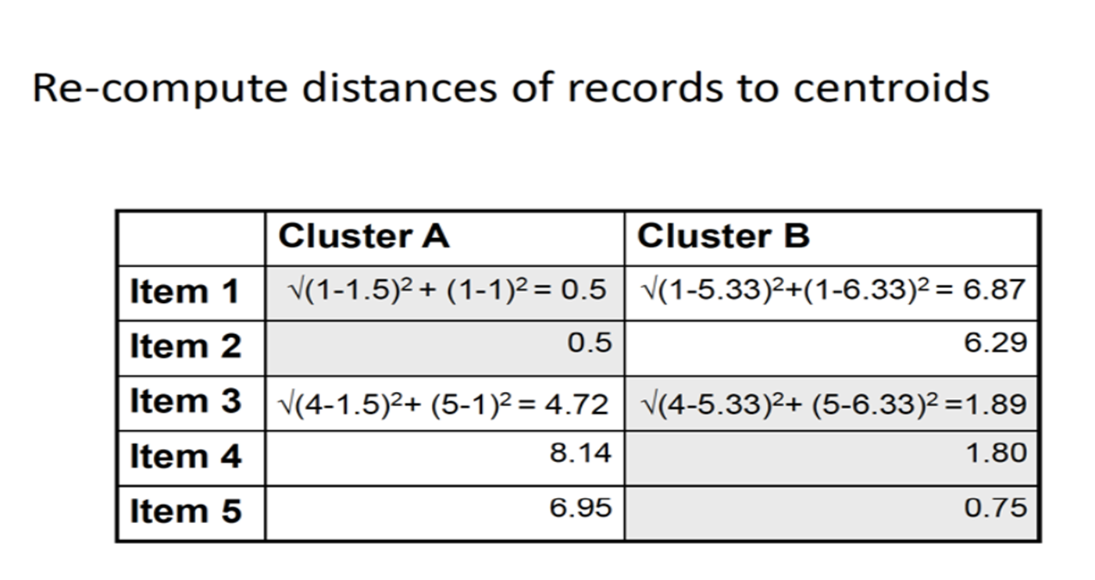
Re-Compute the Centroids

Slide 24
Repeat
This process is repeated until there is no change in the clusters. K is chosen randomly or by giving specific initial starting points by the user.
*
1.5
1
B
5.33
6.33
*
A

Slide 25
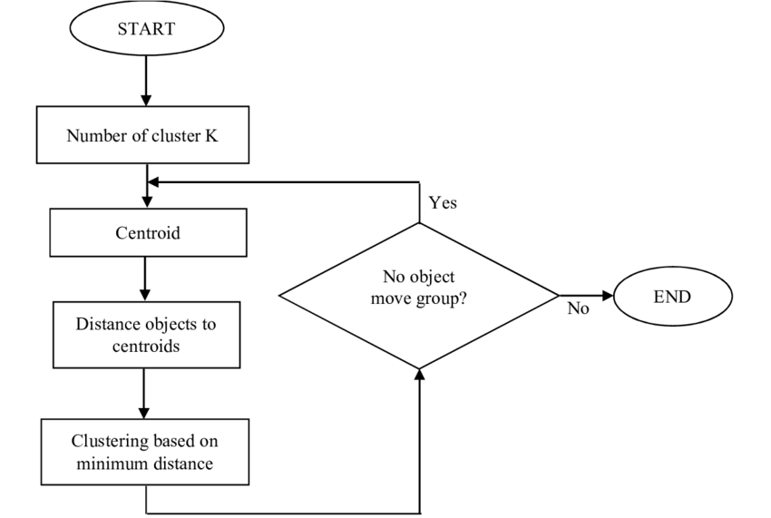

Slide 26
K Means Elbow metho

Slide 27
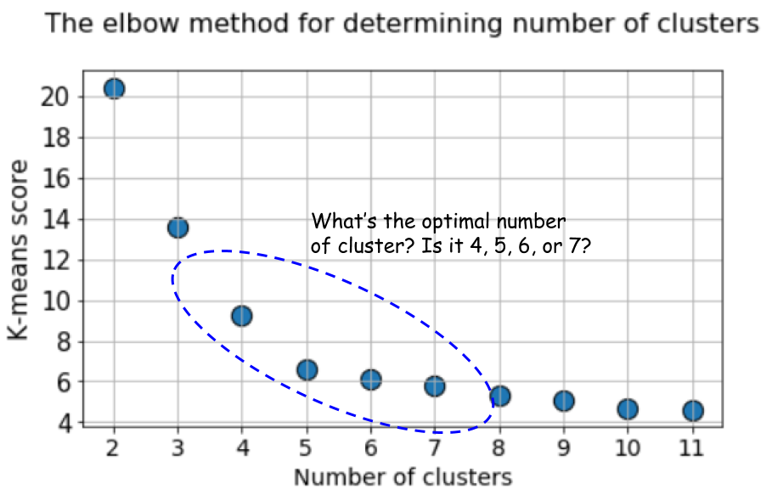

Slide 28
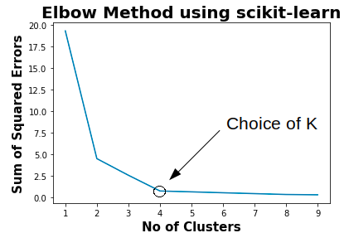
K-means Elbow

Slide 29
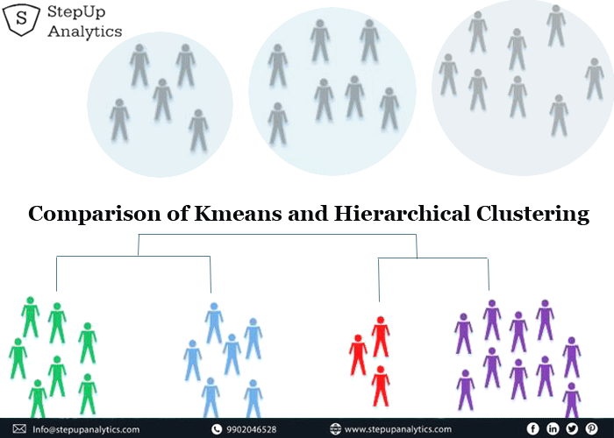

Slide 30
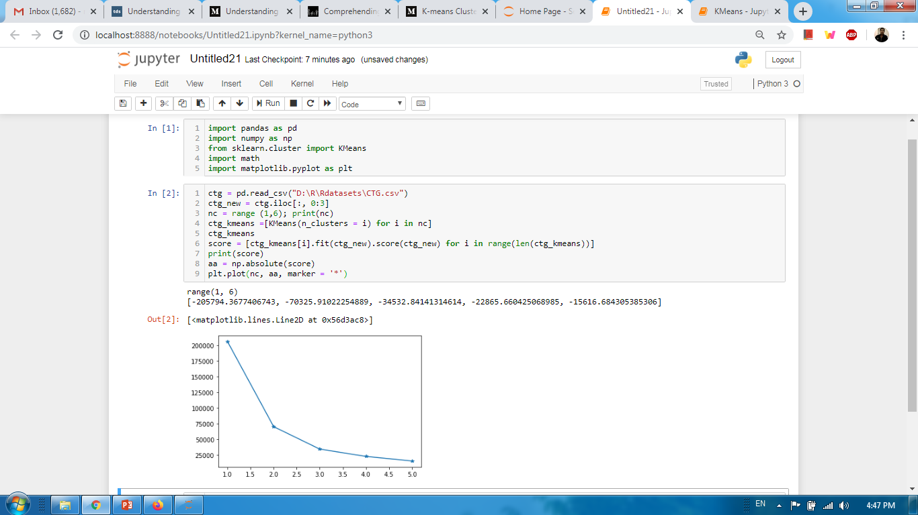
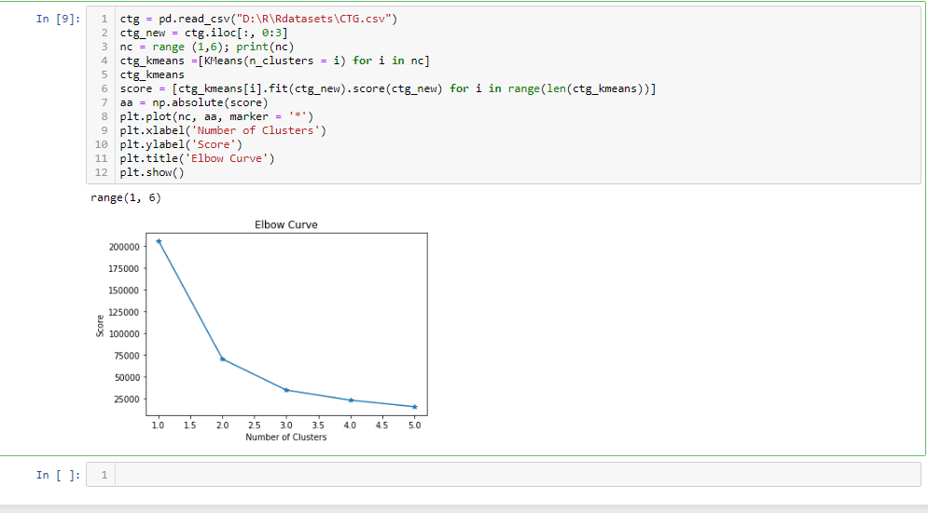
Implementation using python

Slide 31
Thanks

