Slide 1
K-Means
By Arunkumar Nair
arunkg99@gmail.com
91-9890652675
https://www.linkedin.com/in/arunkumarnair/

Slide 2
K Means
k-means is one of the simplest unsupervised learning algorithms that solve the clustering problems.
The procedure follows a simple and easy way to classify a given data set through a certain number of clusters (assume k clusters). The main idea is to define k centers, one for each cluster.

Slide 3
K Means
The k-means algorithm is an unsupervised clustering algorithm. It takes a bunch of unlabeled points and tries to group them into “K” number of clusters.
Used unlabeled data (Data without defined categories or Group)
Data points are clustered based on similarities
The goal of this algorithm is to find groups in the data, with the number of groups represented by the variable K.

Slide 4
K Means
K-Means is applied in
The K-means clustering algorithm is used to find groups which have not been explicitly labeled in the data and to find patterns and make better decisions.. Once the algorithm has been run and the groups are defined, any new data can be easily assigned to the most relevant group.
Customer Profiling:
market segmentation,
computer vision
Geo-statistics
Astronomy

Slide 5
Common business cases where K-means is used
Behavioral segmentation:
  Segment by purchase history
  Segment by activities on application, website, or platform
  Define personas based on interests
  Create profiles based on activity monitoring
Inventory categorization:
  Group inventory by sales activity
  Group inventory by manufacturing metrics
Sorting sensor measurements:
  Detect activity types in motion sensors
  Group images
  Separate audio
  Identify groups in health monitoring
Detecting bots or anomalies:
  Separate valid activity groups from bots
  Group valid activity to clean up outlier detection

Slide 6
K-means algorithm in data mining starts with a first group of randomly selected centroids, which are used as the beginning points for every cluster, and then performs iterative (repetitive) calculations to optimize the positions of the centroids
K-means is an iterative algorithm and it does two main steps:
1. Cluster assignment
2. Move centroid step.

Slide 7
Cluster Assignment Step
In Assignment step each observation is assign to the cluster with the nearest mean (with the least squared Euclidean distance). Every data point is assigned to find the closest center, through this step the sum of the distances of all such assignments is minimized.

Slide 8
Move centroid step
This step is essential because the initial centroids were chosen arbitrarily, the model updates them with new cluster values. The new value might or might not occur in the dataset, in fact, it would be a coincidence if it does. This is because the updated cluster centroid is the average or the mean value of all the data points within that cluster.

Slide 9
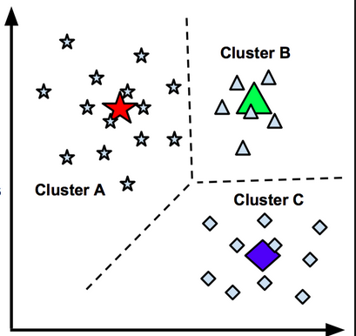
K=3 Clusters
Let’s understand it with a simple 2D example ;
Imaging we have these Some data points in the following figure and want to assign them into three clusters. Then the centroid will be chosen with the similarity in data points

Slide 10
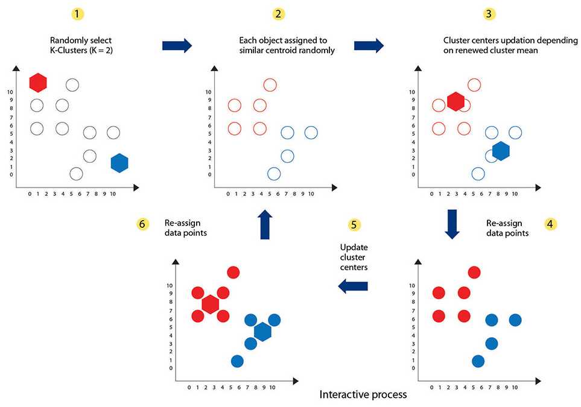
The pictorial explanation of assigning cluster and centroid.
K=2 Clusters

Slide 11
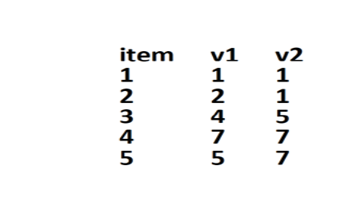
Data with No Answers
Age
Weight

Slide 12
Data with No Answers

Slide 13
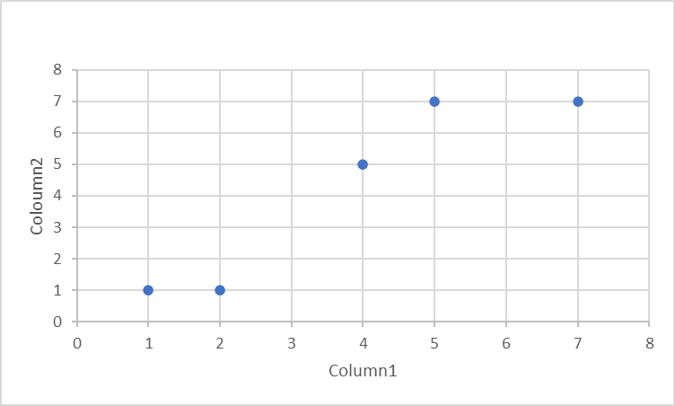
Data with No Answers

Slide 14
Data with No Answers

Slide 15
1. Cluster assignment
K =2, which means let us create 2 clusters of data points.

Slide 16
1. Cluster assignment
First time the Algorithm creates 2 Random Clusters – A and B
B
A
Start with a Random Cluster, let us assign
Row 1,2,3 to Cluster A
Row 4,5 to Cluster B

Slide 17
2. Compute the Centroid
The algorithm goes through the clusters and will compute the Centroid for Cluster A and Cluster B
*?
B
*?
A
What is the centroid of Cluster A and Cluster B?

Slide 18
2. Compute the centroid for A, B
2.33
2.33
6
7
2.33,
2.33
6,
7
A= (1+2+4)/3=2.33, (1+1+5)/3=2.33
B= (7+5)/2=6, (7+7)/2=7

Slide 19
2. Compute the centroid
Centroid values for Cluster A and Cluster B
*
B
*
A
(2.33, 2.33)
(6, 7)
A= (1+2+4)/3=2.33, (1+1+5)/3=2.33
B= (7+5)/2=6, (7+7)/2=7

Slide 20
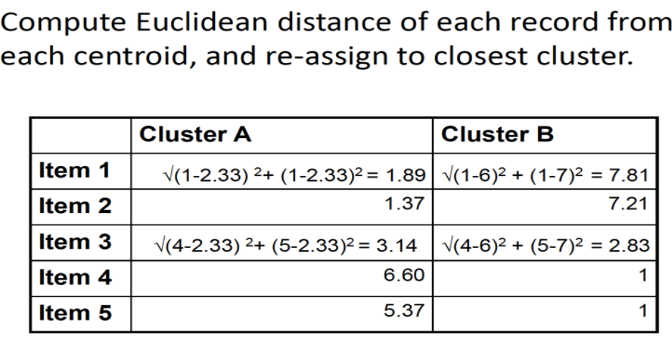
3. Measure the Distances

Slide 21
4. Reassign the data point to closest centroid.
Recreate the Clusters
After calculating the Euclidean distance, the data point (3) is reassigned to the closest centroid, which is in cluster (B).
B
A
Recreate the Cluster, let us assign 3 to Cluster B
Row 1,2 to Cluster A
Row 3,4,5 to Cluster B

Slide 22
5. Re Compute the Centroid
Recompute the centroid of the clusters with the modified data points
*?
B
*?
A

Slide 23
6. Compute the centroid for A, B
1.5
1
5.33
6.33
A= (1+2)/2=1.5, (1+1)/2=1
B= (4+7+5)/3=5.33, (5+7+7)/3=6.33

Slide 24
7. Re Compute the Centroid
Recompute the centroid of the clusters with the modified data points
*
B
1.5
1
5.33
6.33
*
A
(1.5, 1)
(5.33, 6.33)
A= (1+2)/2=1.5, (1+1)/2=1
B= (4+7+5)/3=5.33, (5+7+7)/3=6.33

Slide 25
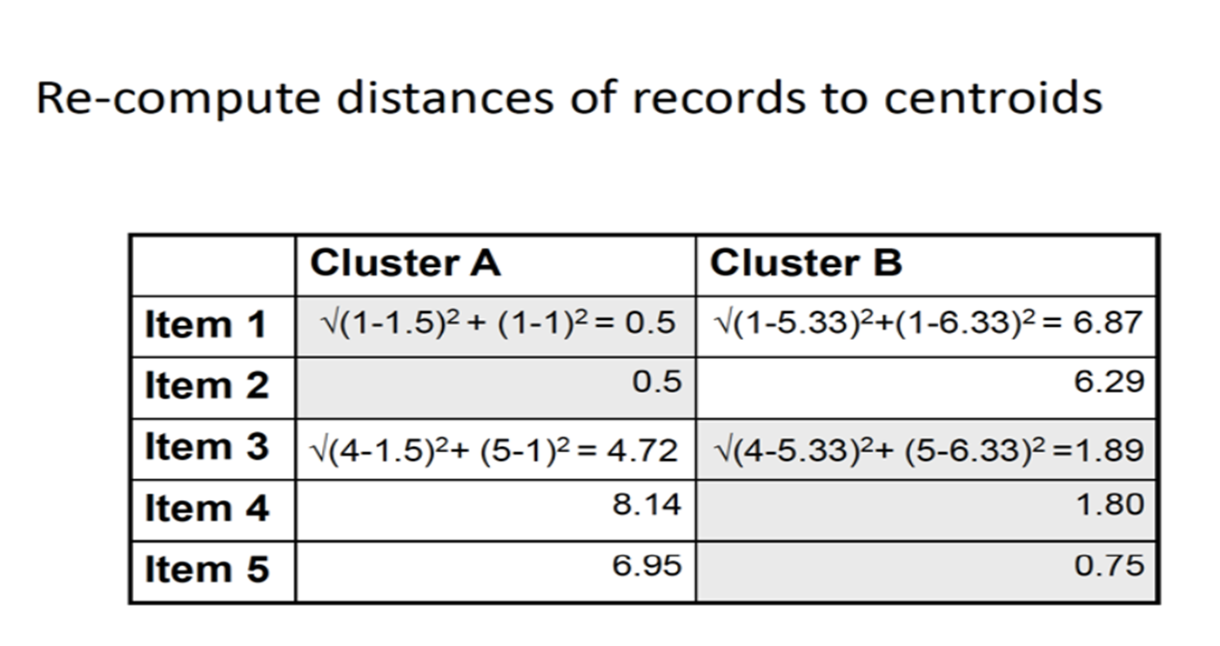
Re-Compute the Centroids

Slide 26
Repeat
This process is repeated until there is no change in the clusters. K is chosen randomly or by giving specific initial starting points by the user.
*
1.5
1
B
5.33
6.33
*
A

Slide 27
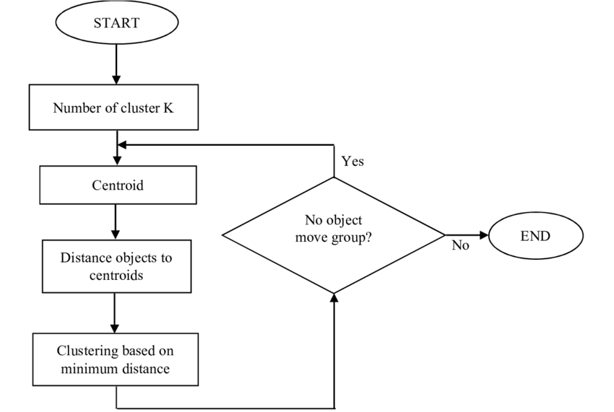

Slide 28
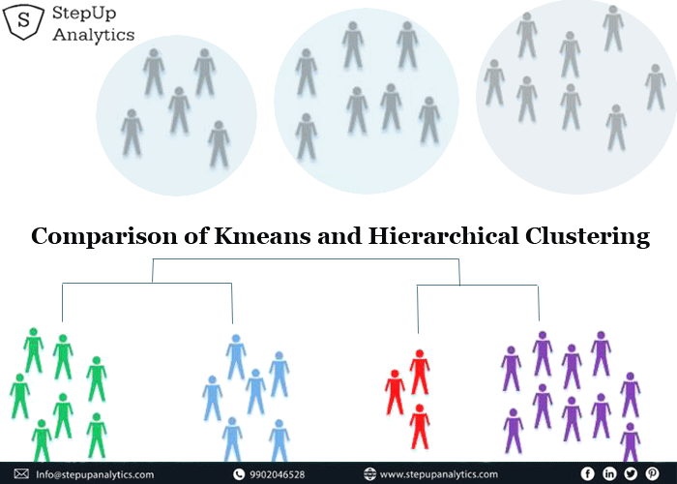

Slide 29
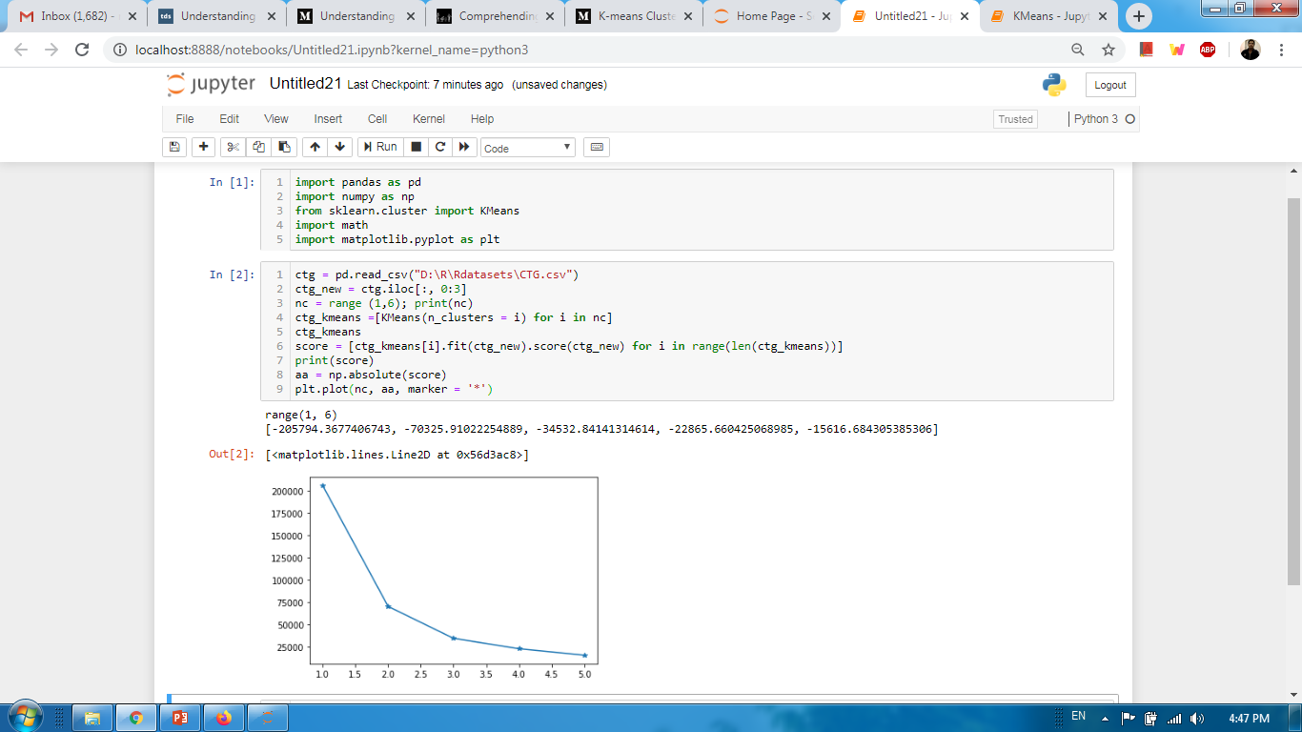
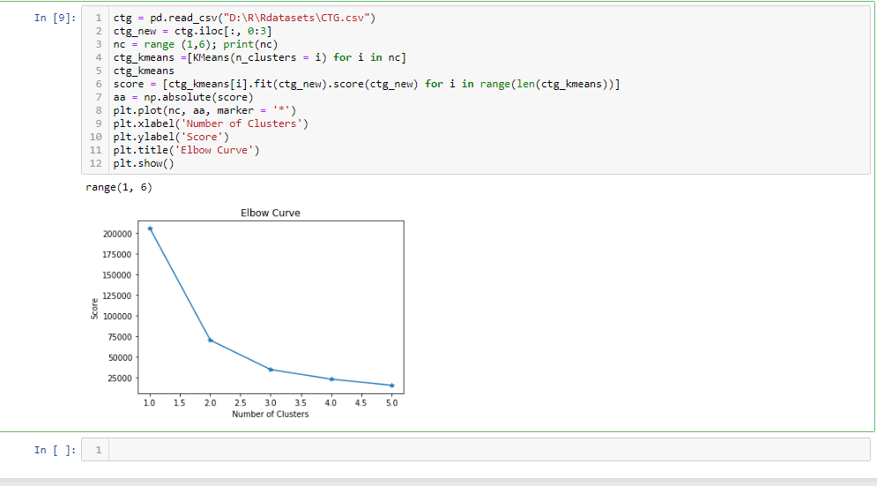
Implementation using python

Slide 30
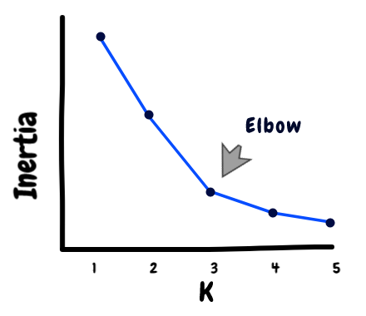
How many clusters
The Elbow method is used to decide the number of cluster. The idea behind good clustering is having a small value of inertia, and small number of clusters.
The value of inertia decreases as the number of clusters increase. So, its a trade-off here. The elbow point in the elbow graph is a good choice because after that the change in the value of inertia isn’t significant.

Slide 31
Thanks

