Slide 1
hierarchical-clustering

Slide 2
Data
Notes:
https://www.analyticsvidhya.com/blog/2019/05/beginners-guide-hierarchical-clustering/

Slide 3
√(10-7)^2 = √9 = 3
√(10-28)^2 = √324 = 18
Data
Proximity Matrix
ID | 1 | 2 | 3 | 4 | 5
1 | 0 | 3 | 18 | 10 | 25
2 | 3 | 0 | 21 | 13 | 28
3 | 18 | 21 | 0 | 8 | 7
4 | 10 | 13 | 8 | 0 | 15
5 | 25 | 28 | 7 | 15 | 0

Slide 4

Step 1: Assign all the data points to an individual cluster
Data
10 7 28 20 35
Step 1: Check the smallest distance proximity matrix and merge the data points
Proximity Matrix
ID | 1 | 2 | 3 | 4 | 5
1 | 0 | 3 | 18 | 10 | 25
2 | 3 | 0 | 21 | 13 | 28
3 | 18 | 21 | 0 | 8 | 7
4 | 10 | 13 | 8 | 0 | 15
5 | 25 | 28 | 7 | 15 | 0

Slide 5
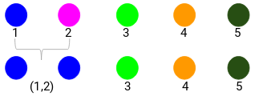
Data
10 7 28 20 35
Step 2: Check the smallest distance proximity matrix and merge the data points.
We have taken the maximum of the two marks (7, 10) (1,2) to replace the marks for this cluster.
You can also take minimum, average.
Proximity Matrix
Data
ID | 1 | 2 | 3 | 4 | 5
1 | 0 | 3 | 18 | 10 | 25
2 | 3 | 0 | 21 | 13 | 28
3 | 18 | 21 | 0 | 8 | 7
4 | 10 | 13 | 8 | 0 | 15
5 | 25 | 28 | 7 | 15 | 0
Product | Sales
(1,2) | 10
3 | 28
4 | 20
5 | 35
7,10

Slide 6
10 7 28 20 35
Step 2
ID | 1 | 2 | 3 | 4 | 5
1 | 0 | 3 | 18 | 10 | 25
2 | 3 | 0 | 21 | 13 | 28
3 | 18 | 21 | 0 | 8 | 7
4 | 10 | 13 | 8 | 0 | 15
5 | 25 | 28 | 7 | 15 | 0
Product | Sales
(1,2) | 10
3 | 28
4 | 20
5 | 35
7,10
Re Calculate the Proximity Matrix
ID | 1,2 | 3 | 4 | 5
1,2 | 0 | 18 | 10 | 25
3 | 18 | 0 | 8 | 7
4 | 10 | 8 | 0 | 15
5 | 25 | 7 | 15 | 0

Slide 7
10 7 28 20 35
Step 2
ID | 1 | 2 | 3 | 4 | 5
1 | 0 | 3 | 18 | 10 | 25
2 | 3 | 0 | 21 | 13 | 28
3 | 18 | 21 | 0 | 8 | 7
4 | 10 | 13 | 8 | 0 | 15
5 | 25 | 28 | 7 | 15 | 0
Product | Sales
(1,2) | 10
3 | 28
4 | 20
5 | 35
7,10
Re Calculate the Proximity Matrix
ID | 1,2 | 3 | 4 | 5
1,2 | 0 | 18 | 10 | 25
3 | 18 | 0 | 8 | 7
4 | 10 | 8 | 0 | 15
5 | 25 | 7 | 15 | 0

Slide 8
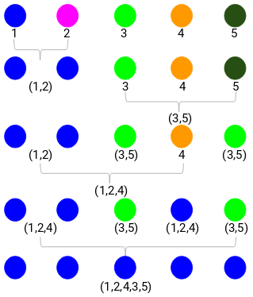
Step 2: Check the smallest distance proximity matrix and merge the data points.
ID | 1 | 2 | 3 | 4 | 5
1 | 0 | 3 | 18 | 10 | 25
2 | 3 | 0 | 21 | 13 | 28
3 | 18 | 21 | 0 | 8 | 7
4 | 10 | 13 | 8 | 0 | 15
5 | 25 | 28 | 7 | 15 | 0
Product | Sales
(1,2) | 10
3 | 28
4 | 20
5 | 35
7,10
Re Calculate the Proximity Matrix
ID | 1,2 | 3 | 4 | 5
1,2 | 0 | 18 | 10 | 25
3 | 18 | 0 | 8 | 7
4 | 10 | 8 | 0 | 15
5 | 25 | 7 | 15 | 0
3
7

Slide 9
Step 2: Check the smallest distance proximity matrix and merge the data points.
ID | 1 | 2 | 3 | 4 | 5
1 | 0 | 3 | 18 | 10 | 25
2 | 3 | 0 | 21 | 13 | 28
3 | 18 | 21 | 0 | 8 | 7
4 | 10 | 13 | 8 | 0 | 15
5 | 25 | 28 | 7 | 15 | 0
Product | Sales
(1,2) | 10
3 | 28
4 | 20
5 | 35
7,10
Re Calculate the Proximity Matrix
ID | 1,2 | 3 | 4 | 5
1,2 | 0 | 18 | 10 | 25
3 | 18 | 0 | 8 | 7
4 | 10 | 8 | 0 | 15
5 | 25 | 7 | 15 | 0
3
7

Slide 10
Step 2: Check the smallest distance proximity matrix and merge the data points.
ID | 1 | 2 | 3 | 4 | 5
1 | 0 | 3 | 18 | 10 | 25
2 | 3 | 0 | 21 | 13 | 28
3 | 18 | 21 | 0 | 8 | 7
4 | 10 | 13 | 8 | 0 | 15
5 | 25 | 28 | 7 | 15 | 0
Product | Sales
(1,2) | 10
3 | 28
4 | 20
5 | 35
7,10
Re Calculate the Proximity Matrix
ID | 1,2 | 3 | 4 | 5
1,2 | 0 | 18 | 10 | 25
3 | 18 | 0 | 8 | 7
4 | 10 | 8 | 0 | 15
5 | 25 | 7 | 15 | 0
Product | Sales
(1,2) | 10
(3,5) | 35
4 | 20
3
ID | 1,2 | 3,5 | 4
1,2 | 0 | 25 | 20
3,5 | 25 | 0 | 15
4 | 10 | 15 | 0
7

Slide 11
ID | 1 | 2 | 3 | 4 | 5
1 | 0 | 3 | 18 | 10 | 25
2 | 3 | 0 | 21 | 13 | 28
3 | 18 | 21 | 0 | 8 | 7
4 | 10 | 13 | 8 | 0 | 15
5 | 25 | 28 | 7 | 15 | 0
Product | Sales
(1,2) | 10
3 | 28
4 | 20
5 | 35
7,10
Re Calculate the Proximity Matrix
ID | 1,2 | 3,5 | 4
1,2 | 0 | 25 | 20
3,5 | 25 | 0 | 15
4 | 10 | 15 | 0
Product | Sales
(1,2) | 10
(3,5) | 35
4 | 20
3
ID | 1,2 | 3 | 4 | 5
1,2 | 0 | 18 | 10 | 25
3 | 18 | 0 | 8 | 7
4 | 10 | 8 | 0 | 15
5 | 25 | 7 | 15 | 0
7
Product | Sales
(1,2,4) | 20
(3,5) | 35
ID | 1,2,4 | 3,5
1,2,4 | 0 | 15
3,5 | 15 | 0

Slide 12
ID | 1 | 2 | 3 | 4 | 5
1 | 0 | 3 | 18 | 10 | 25
2 | 3 | 0 | 21 | 13 | 28
3 | 18 | 21 | 0 | 8 | 7
4 | 10 | 13 | 8 | 0 | 15
5 | 25 | 28 | 7 | 15 | 0
Product | Sales
(1,2) | 10
3 | 28
4 | 20
5 | 35
7,10
Re Calculate the Proximity Matrix
ID | 1,2 | 3,5 | 4
1,2 | 0 | 25 | 20
3,5 | 25 | 0 | 15
4 | 10 | 15 | 0
Product | Sales
(1,2) | 10
(3,5) | 35
4 | 20
3
ID | 1,2 | 3 | 4 | 5
1,2 | 0 | 18 | 10 | 25
3 | 18 | 0 | 8 | 7
4 | 10 | 8 | 0 | 15
5 | 25 | 7 | 15 | 0
7
Product | Sales
(1,2,4) | 20
(3,5) | 35
ID | 1,2,4 | 3,5
1,2,4 | 0 | 15
3,5 | 15 | 0

Slide 13
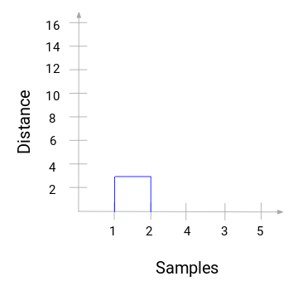
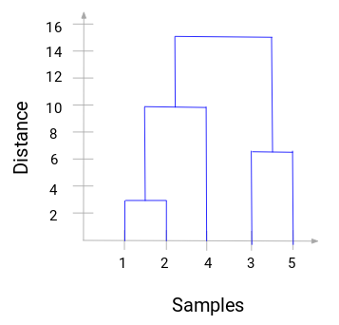
Dendogram
3
15
7
10
10
3
7
15
3
1)We started by merging ROW 1 and 2 = 3and the distance between these two samples was 3 (refer to the first proximity matrix in the previous section). Let’s plot this in the dendrogram:
2)We started by merging Row 3 and 5 =7
3)We started by merging Row (1,2) and 4 =10

Slide 14
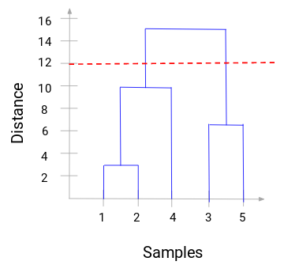
The number of clusters will be the number of vertical lines which are being intersected by the line drawn using the threshold. In the above example, since the red line intersects 2 vertical lines, we will have 2 clusters. One cluster will have a sample (1,2,4) and the other will have a sample (3,5).
Cluster
1 Cluster -1,2,4

