Slide 1
hierarchical-clustering

Slide 2
Data
Notes:
https://www.analyticsvidhya.com/blog/2019/05/beginners-guide-hierarchical-clustering/

Slide 3
√(10-7)^2 = √9 = 3
√(10-28)^2 = √324 = 18
Data
Proximity Matrix
ID | 1 | 2 | 3 | 4 | 5
1 | 0 | 3 | 18 | 10 | 25
2 | 3 | 0 | 21 | 13 | 28
3 | 18 | 21 | 0 | 8 | 7
4 | 10 | 13 | 8 | 0 | 15
5 | 25 | 28 | 7 | 15 | 0

Slide 4

Step 1: Assign all the data points to an individual cluster
Data
10 7 28 20 35
Step 1: Check the smallest distance proximity matrix and merge the data points
Proximity Matrix
ID | 1 | 2 | 3 | 4 | 5
1 | 0 | 3 | 18 | 10 | 25
2 | 3 | 0 | 21 | 13 | 28
3 | 18 | 21 | 0 | 8 | 7
4 | 10 | 13 | 8 | 0 | 15
5 | 25 | 28 | 7 | 15 | 0

Slide 5
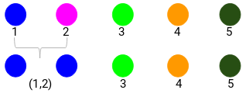
Data
10 7 28 20 35
Step 2: Check the smallest distance proximity matrix and merge the data points.
We have taken the maximum of the two marks (7, 10) (1,2) to replace the marks for this cluster.
You can also take minimum, average.
Proximity Matrix
Data
ID | 1 | 2 | 3 | 4 | 5
1 | 0 | 3 | 18 | 10 | 25
2 | 3 | 0 | 21 | 13 | 28
3 | 18 | 21 | 0 | 8 | 7
4 | 10 | 13 | 8 | 0 | 15
5 | 25 | 28 | 7 | 15 | 0
Product | Sales
(1,2) | 10
3 | 28
4 | 20
5 | 35
7,10

Slide 6
Data
10 7 28 20 35
Step 2: Check the smallest distance proximity matrix and merge the data points.
We have taken the maximum of the two marks (7, 10) (1,2) to replace the marks for this cluster.
You can also take minimum, average.
Proximity Matrix
Data
Product | Sales
(1,2) | 10
3 | 28
4 | 20
5 | 35
7,10

Slide 8
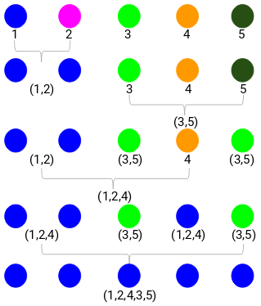

Slide 9
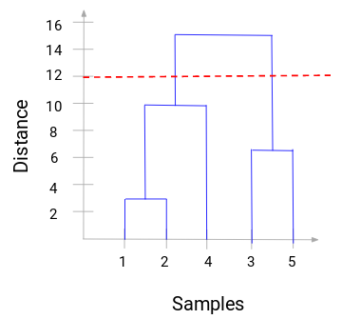
Dendogram
Cluster
1 Cluster -1,2,4

