Slide 1
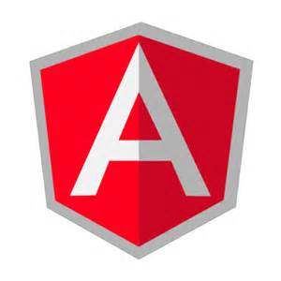
Presented by
Beginning Angular JS
T.Manimala(494914)

Slide 2
Agenda
Topics to be covered
Introduction to AngularJS
Directives
Angular Expressions
Scope
Data Binding
Controllers
Filters
Services
Form Validation
Routing

Slide 3
What is AngularJS?
AngularJS is a clientside JavaScript framework for dynamic web apps.
Miško Hevery, a Google employee, started to work with AngularJS in 2009.
AngularJS version 1.0 was released in 2012.
AngularJS officially supported by Google
AngularJS is perfect for Single Page Applications (SPAs).

Slide 4
SPA

Slide 5
Directives
Extend HTML with new attributes called Directives.
AngularJS has a set of built-in directives which offers functionality to your applications.
AngularJS allows you to create a custom directives.
ng- prefix used in all Angular built in directives.

Slide 6
Angular Directives
ng-app directive initializes an AngularJS application.
ng-init directive initializes application data.
ng-model directive binds the value of HTML controls (input, select, text area) to application data.
ng-bind directive, which will bind the innerHTML of the element to the specified model property
ng-controller directive defines the application controller.
ngShow / ngHide directive shows or hides the given HTML element based on the expression provided in it.

Slide 7
Angular Directives
ng-model directive adds/removes the following classes, according to the status of the form field:
ng-empty
ng-not-empty
ng-touched
ng-untouched
ng-valid
ng-invalid
ng-dirty
ng-pending
ng-pristine

Slide 8
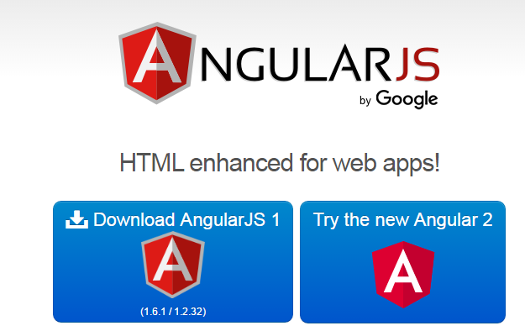
Startup AngularJS
Go to https://angularjs.org/

Slide 9
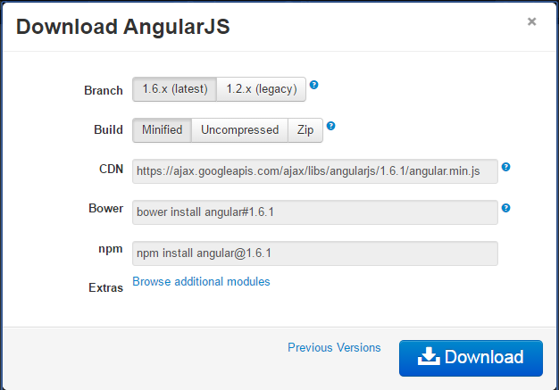
Download AngularJS

Slide 10
Sample AngularJS
<!doctype html>
<html ng-app="">
<head>
<title>Angular - Basic Directives</title>
<script src="angular.js"></script>
</head>
<body>
<div ng-init="firstName='John'">
<p>The name is <span ng-bind="firstName"></span></p>
</div>
</body>
</html>

Slide 11
Data Binding
<!doctype html>
<html ng-app="">
<head>
<title>Angular - Directives</title>
<script src="angular.js"></script>
<link rel="stylesheet" href="style.css"></link>
</head>
<body>
<div class="wrapper">
<h1>Examples of angular directives</h1>
<h2>Using ng-bind directive</h2>
<p>HAPPY NEW YEAR <input type="text" ng-model="name"></p>
<p ng-bind="name"></p>
</div>
</body>
</html>

Slide 12
Angular Expressions
AngularJS binds data to HTML using Expressions.
AngularJS expressions can be written inside double braces:
{{ expression }}.
AngularJS expressions can also be written inside a directive: ng-bind.
AngularJS expressions are much like JavaScript expressions: They can contain literals, operators, and variables.
AngularJS expressions can be written inside HTML.
AngularJS expressions do not support conditionals, loops, and exceptions, while JavaScript expressions do.
AngularJS expressions support filters

Slide 13
Scope
Scope is an object that refers to the application model.
It is an execution context for expressions.
This is dependency injection that’s built into AngularJS.
Every application has a single root scope. All other scopes are descendant scopes of the root scope. Scopes provide separation between the model and the view, via a mechanism for watching the model for changes.
app.run(function($rootScope) { $rootScope.color = 'blue'; });

Slide 14
Data Binding
Data-binding in Angular apps is the automatic synchronization of data between the model and view components.
The way that Angular implements data-binding lets you treat the model as the single-source-of-truth in your application.
The view is a projection of the model at all times.
When the model changes, the view reflects the change, and vice versa.
Because of the immediate synchronization of the model and the view, the controller can be completely separated from the view, and simply concentrate on the model data.

Slide 15
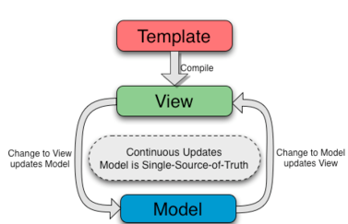
Two way data-binding

Slide 16
Two way data-binding
First the template (which is the un compiled HTML along with any additional markup or directives) is compiled on the browser.
The compilation step produces a live view.
Any changes to the view are immediately reflected in the model, and any changes in the model are propagated to the view.

Slide 17
Controllers
In Angular, a Controller is defined by a JavaScript constructor function.
AngularJS controllers control the data of AngularJS applications.
AngularJS controllers are regular JavaScript Objects.
ng-controller directive defines the application controller.
Angular will instantiate a new Controller object, using the specified Controller's constructor function.

Slide 18
Filters
Filters format the value of an expression for display to the user.
They can be used in view templates, controllers or services.
Angular comes with a collection of built-in filters, but it is easy to define your own as well
Filters can be added to expressions by using the pipe character |, followed by a filter.

Slide 19
Filters
currency Format a number to a currency format.
date Format a date to a specified format.
filter Select a subset of items from an array.
json Format an object to a JSON string.
limitTo Limits an array/string, into a specified number of elements/characters.
lowercase Format a string to lower case.
number Format a number to a string.
orderBy Orders an array by an expression.
uppercase Format a string to upper case.

Slide 20
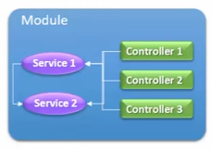
Services
In AngularJS, a service is a function, or object, that is available for, and limited to, your AngularJS application.
Services can be utilities or Business logic units.
Services – A special unit of code which can be used across different controllers.
We have multiple services used by multiple controllers.
Services can work other services too.

Slide 21
Built-in Services
$location service has methods which return information about the location of the current web page
$http service makes a request to the server, and lets your application handle the response.
$timeout service is AngularJS' version of the window.setTimeout function.
$interval service is AngularJS' version of the window.setInterval function.

Slide 22
Input State
AngularJS is constantly updating the state of both the form and the input fields.
Input fields have the following states:
$untouched The field has not been touched yet
$touched The field has been touched
$pristine The field has not been modified yet
$dirty The field has been modified
$invalid The field content is not valid
$valid The field content is valid
They are all properties of the input field, and are either true or false.

Slide 23
Form State
Forms have the following states:
$pristine No fields have been modified yet
$dirty One or more have been modified
$invalid The form content is not valid
$valid The form content is valid
$submitted The form is submitted
They are all properties of the form, and are either true or false.

Slide 24
Routing in AngularJS
If you want to navigate to different pages in your application, but you also want the application to be a SPA (Single Page Application), with no page reloading, you can use the ngRoute module.
The ngRoute module routes your application to different pages without reloading the entire application.

