Slide 1
SECTZG629T : Dissertation CONTEXT AND COMPONENT DEPENDENCY INJECTION
Final Report

Slide 2
Arun Raj
2013HZ78275
Cognizant Technology Solutions

Slide 3
Problem definition
The Enterprise applications uses external configuration files to configure the application so that application re-deployment can be avoided for any business change and to save down time . But what about distributed systems?
In the case of distributed systems with different configurations, the changes has to be done on each and every servers which is a tedious task and can be highly erroneous.
There is no framework available presently to solve this problem.

Slide 4
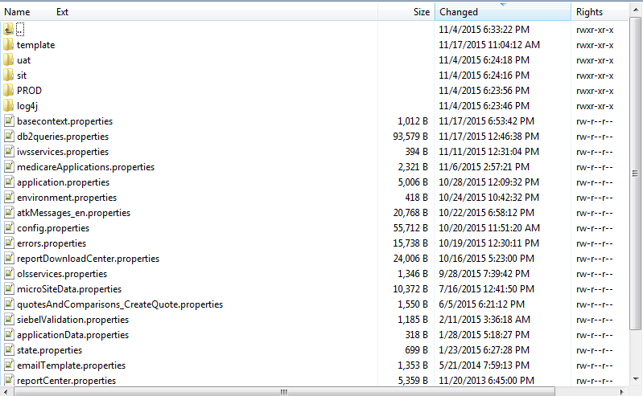
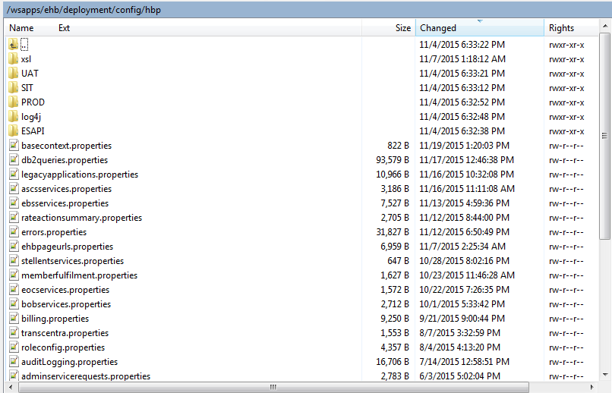
Problem definition
Sample configuration files in an enterprise application:

Slide 5
Objective & Scope
To develop a framework that does the following tasks
Makes content distribution easier by creating a single repository for all external configurations
Hot deploy the changes that will affect all servers at the same time and give up to 100% uptime
Supports automatic configuration for different users based upon the user’s selected location, language
Utilize a cache framework to make the application faster and avoid frequent DB hits
Makes the development easier so that the they can focus on the business rather than the user’s chosen configurations

Slide 6
Project Plan
Stage | Purpose | Activities | Status | Deliverable
Stage 1 | Define Scope of Dissertation Define Requirements | Elicitation of Business Process | 100% | Preliminary Report
 |  | Define software requirements (SRS) Functional. Functional requirements in use case format Non-functional requirements | 100%
Stage 2 | Propose Solution Detailed design for the proposed Solution | Proposed Solution High level design Technical Requirement – Software & Hardware for development and production implementation | 100% | Mid Review report
 |  | Detailed design Control flow Data flow Development & Testing considerations | 100%
Stage 3 | QA and Documentation | Testing Development & Unit testing Functional testing & assessment | 100% | Final review Report
 |  | Define future extensibility opportunities | 100%

Slide 7
CCDI
Context & Component dependency Injection [CCDI] is a spring based customized dependency injection framework for highly scalable applications.
Supports Server based dependency injection.
Can act as a theme engine
CCDI is a key-value pair framework which is capable of resolving different types of content based on the request. The main resolvers used in CCDI are :
PropertyValueResolver
EnvironmentEntryResolver
VerbiageTextResolver
ValidatorRulesetResolver
Placeholder

Slide 8
CCDI Content Resolvers
PropertyValueResolver
Property is used where ever there is no change in the configurations across different servers
Property property = propertyValueResolver.resolveProperty(contexts, name);
String output = property.getValue();
EnvironentEntryResolver
Used when the configurations changes depends on the server
EnvironmentEntry environment = environmentEntryResolver.resolveEnvironmentEntry(contexts, key);
String output = environment.getValue();
Environment entries are saved in the below format:
[newyork: select * from table_ny where user=:user][california: select * from table_ca where user=:user][virginia: select * from table_va where user=:user]

Slide 9
CCDI Content Resolvers
VerbiageTextResolver
Used to resolve HTML elements based upon the server
Verbiage verbiage = verTxtResolver.resolveText(contexts, key);
String output = verbiage.getText();
ValidatorRulesetResolver
For regex operations used for validation purposes
Validator validator = valRulResolver.resolveRuleset(contexts, action);
String output = validator.getValue();
Placeholder
Used for autowiring in the spring context.
Can be accessed via Spring’s EL tags ${…}

Slide 10
Tools & Technologies Used
Java 1.6
Spring 3
Spring Integration
Apache Maven
IBM Dynacache
Dozer mapper
Oracle express database
IBM Websphere application server
Eclipse Luna

Slide 11
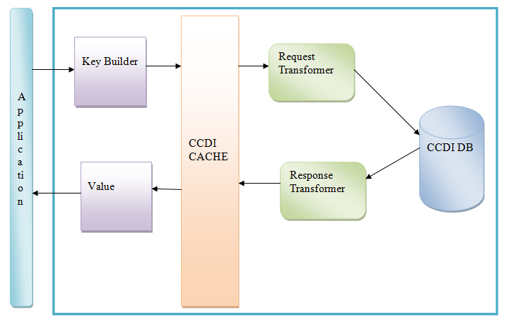
Solution Archetecture

Slide 12
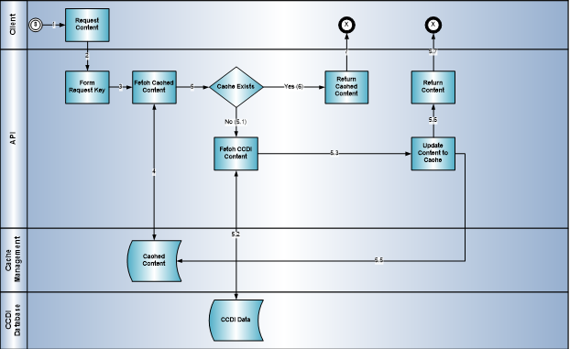
Flow Diagram

Slide 13
CCDI DB
CCDI uses a backend DB for external configuration
3 Tables
CNTXT – Stores the user context information such as user region, last login etc.
CMPNT_ATRB – The key is stored in this table
ATRB_VALUE : column where the input key is stored
CMPNT – The value is stored in this table
CMPNT_TYPE_CD: type of the component. eg. Property, environment etc.
CNTXT_TXT : Value is stored in this column

Slide 14
How to implement CCDI in any application
Import the following jars to the applicaition
BITS-CCDI.jar
BITS-CCDI-CORE.jar
Spring config xml
Must have <context:annotation-config /> tag
Must add <context:component-scan base-package="com.bits.ms" /> in the config xml
Must import <import resource="classpath:/spring/ccdi-root-context.xml" />
Cache configuration
Need to configure the following cache in the server
ccdiPropertyCache
ccdiEnvCache
ccdiVerbiageCache
ccdiValidatorCache

Slide 15
Benefits of this implementation
Hot deployable configurations
Cache service for performance and reliability
Highly scalable
Less configuration required to use the framework
Can be applied for any spring application
The framework can be customized to run in any application server

Slide 16
Conclusion
CCDI is a light weight, fast key-value pair framework that can act as a horizontal layer for any application to get the context and related dependencies depending on the server and user configuration.

Slide 17
Limitations & Future Extensibility
Currently the application is configured to use IBM Websphere application server because it has built in cache system
The framework has to be customized to run in any application server with out manual configurations
Need to support more cache frameworks such as EH cache
More resolvers can be added depending on the business requirements

Slide 18
Demo Application- Architecture
Main Server
Server Location 1
CCDI
CCDI Database
Server Location 2
Server Location 3

Slide 19
Thank you

