Slide 1
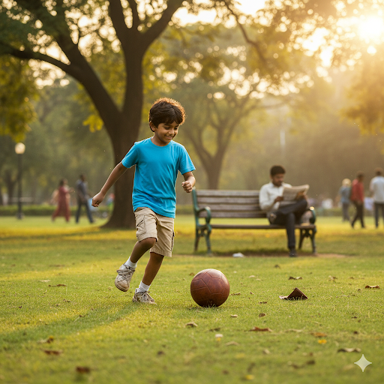
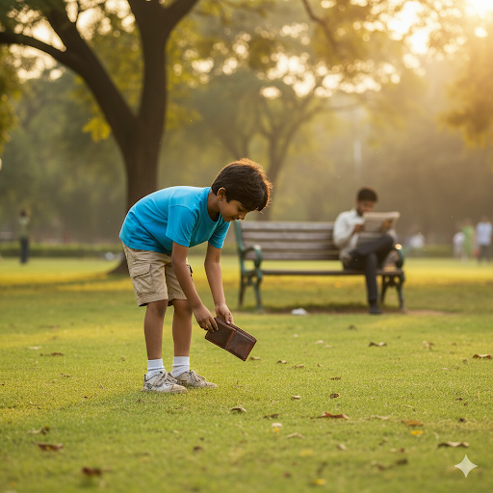
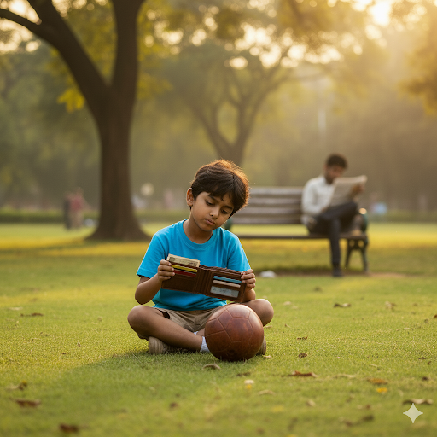

Honesty is the Best Policy
Yugan, a 7-year-old boy in a bright blue t-shirt and shorts, is intently playing football in a sunny park in Mogappair Park. The vibrant green grass is visible, and in the background, there are a few trees and a typical park bench. He's in mid-stride, about to kick the ball.
One sunny afternoon, while chasing the ball near a bench, he noticed a brown wallet lying on the ground.
1
Curious, he picked it up and peeked inside. There was some cash, a driver’s license, and a few cards. Yugan knew it must belong to someone. For a moment, he thought:"What if I keep the money and buy the toy car I always wanted?"But then he remembered what his teacher always said:“Honesty is the best policy. Doing the right thing makes you truly rich.”
2
3
So, Yugan ran to his father, who was sitting nearby, and showed him the wallet. Together, they looked at the ID card and found the owner’s address. They went to the man’s house and returned it. The man, surprised and emotional, said:"You are a very honest boy. Not many would do this."
Yugan felt proud inside. That day, he learned that being honest gave him more happiness than any toy could.
4

