Slide 1



Data Center Offering
DCO with Container as a Service
May 2015

Slide 2
Disclaimer
Internal Use Only
This document and the information contained herein are proprietary to Accenture. This document, either in whole or in part, may not be reproduced in any form or by any means without Accenture’s prior written permission. This document provides no warranties with respect to the offerings described within. Any third-party names, trademarks and copyrights contained in this document are the property of their respective owners.

Slide 3
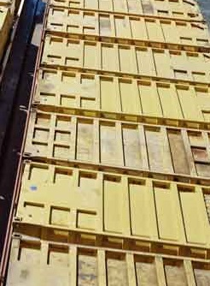
Application Container are the next level of Data Center Optimizations cleaning up the Hardware Footprint, reducing Resources and being able to be moved between Private and Public Cloud
Container for the Data Center
Container like Docker or Rocket allow easily to create lightweight, portable, self-sufficient workloads from any application which are independent of hardware, language, framework, packaging system and hosting provider.
  Containers are built once and can be run on any infrastructure – on premise, or on any cloud provider
  Orchestration tools provides the capabilities to build, run and operate containers
  Container can start in seconds are can easily be pre-packaged
  Enables Continuous Integration by streamlining the creation of new application environments, and Continuous Delivery by allowing containers to run unmodified across environments

Slide 4


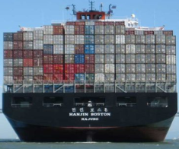
Containers supporting the portable Application-level Packaging in Enterprise Environments based on Linux
  Container can be used for optimizing Data Center resources as well as open new approaches to handle Hybrid cloud
  Covering OS level virtualization built on virtual or bare metal Linux instances to drive application workloads.
  Independent of hardware language, framework, packaging system and hosting provider it drives workloads
  Process isolation from other containers enables security but gives flexibility in sharing host resources
  Easy to maintain on OS and packaged solution level while decreasing OS and Patching needs
Application
Local Dependencies
Configuration, resources, etc.
Build container
Private Cloud
Public Cloud
Bare-metal Cloud

Slide 5
Container Architectures are Changing the Data Center Structure today for Lightweight Applications but growing also into other Eco Systems
Data Center Optimization
Applications are also going to transform from legacy multi tier into lightweight multi node eco systems. This also influences the data center needs from heavy Unix or x86 workloads into application container.
Application Evolution
Efficiency
Physical Server (s)
Virtual Server (s)
Application Container (s)
Physical
VMs
Reduction hypervisor overhead and license cost
Reduction of OS level license and maintenance cost
Higher efficiencies in OS and middleware administration
Reduction of server sprawl
Deployed in Seconds
Additional orchestration necessary
Today only available for Linux
Physical
Reduction of x86 server hardware
Lower carbon footprint
Higher utilization rates
Higher efficiency, Admin ration
Deployed in minutes
Additional hypervisor cost
Physical
Time/Maturity

Slide 6
Containers are Changing the way to plan the Data Center work from Today to Tomorrow
Container Maturity is growing into Enterprise Eco Systems
Application Stages based on
large Hardware volumes
Todays optimized OS Level Structure
in use of Hypervisor and reduced HW
Optimized on HW, Hypervisor and OS level
Production
VM
VM
VM
VM
VM
VM
VM/HW
Production
Production
Production
VM
VM
VM
VM
VM
VM
TEST
VM
VM
VM
VM
VM
VM
VM/HW
TEST
TEST
Hypervisor Orchestrator
Container Orchestration – e.g. Kubernetes
TEST
VM
VM
VM
VM
VM
VM
DEV
VM
VM
VM
VM
VM
VM
VM/HW
DEV
DEV
DEV
VM
VM
VM
VM
VM
VM
Reduced Hardware footprint optimized in utilization, power consumption, climate
Additional optimization on HW hosts, hypervisor and OS licenses as well as maintenance

Slide 7
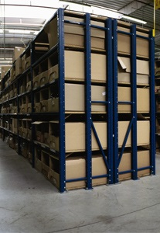
The Data Center optimization through container can be challenged especially for HTTP and Lightweight workloads
Optimization Sample
  Optimization of the Web farm or of the DMZ infrastructure based on Containers
  100 physical DMZ Server and 200 HTTP Server based on Apache/Linux are planned to be optimized
  The HTTP/HTTPS, Load balancing and Lightweight Apache Tomcat Java environments are moved to containers by Hardware only. But can also be done on virtual machines.
  Optimization criteria,
  Reduced hardware invest
  Reduced power/climate footprint
  Reduced Rack Unit needs
  Optimized DMZ structure
  Network Port Reduction
  No hypervisor license cost
  Reduced OS license cost
  Reduced OS level maintenance/
  Patching cost
Challenge,
Today limited Accenture references
Orchestration Integration
Orchestration License and
Enablement cost

Slide 8
Sample Reference Architecture and Capabilities by Docker
Orchestration
Resource Management
Orchestrate
Discover
Docker Cluster
Docker Node
Docker Node
Container/App
Docker Node
Container/App
Container/App
Service Discovery
Docker Registry
Docker
Discover, publish
Pull
Docker
Docker
Push
Linux Host
Linux Host
Storage & Persistence
Linux Host
Infrastructure Services
Name resolution
Container Monitoring
Security & Access Control
Container metrics
Networking
Hardware, Virtualization

Slide 9

















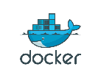
Docker Eco System
Supporting components
Platforms
etcd
Panamax.io
Consul
Tutum.co
Kubernetes
cAdvisor
Core extensions
Vendors & Infrastructure
nsenter
Fleet
Flannel
Weave

Slide 10
Why Accenture is the partner of choice?
Fast outcomes
In 6-9 months, we can help reduce the cost and complexity of your data center infrastructure without sacrificing capability and performance.
We help clients efficiently consolidate and migrate into more simplified and cost-effective data centers while preparing to transform to an Intelligent infrastructure—one that easily scales to support future growth and reduces time to market.
Transformation guidance
Scalable sourcing models
We recommend diverse sourcing models to scale the infrastructure to keep up with business demand—from renting capacity via cloud computing to outsourcing entire elements of your infrastructure—to speed execution and reduce costs.
Industrialized approach
Delivery is at the heart of what we do at Accenture. We combine industry, technology and business process innovations with an unmatched breadth and depth of industrialized delivery capabilities to help our clients achieve high performance. Our Global Delivery Network across 54-plus countries provides the world’s largest group of technology, business process and outsourcing professionals.
Proven tools and methodologies
We bring industrialized, field-tested delivery assets such as our data center migration workbench, data center cost reduction toolkit, server optimization workbench, storage transformation workbench and application migration factory to ensure quality and predictability.
Deep Experience
Our 17,000 Infrastructure Services professionals have served more than 1,000 clients across at least 40 industries, and on every leading platform, for more than 20 years.
Right Resources and Capabilities + Global Delivery Network
Our deeply skilled technologists use industry-leading practices to create a roadmap and navigate our client’s organization toward an optimized and agile data centers that reflects their unique business and processes. We have 3,000+ dedicated professionals across the globe and a strong global delivery network to support our implementation work at cost-effective rates and reduced risk

Slide 11
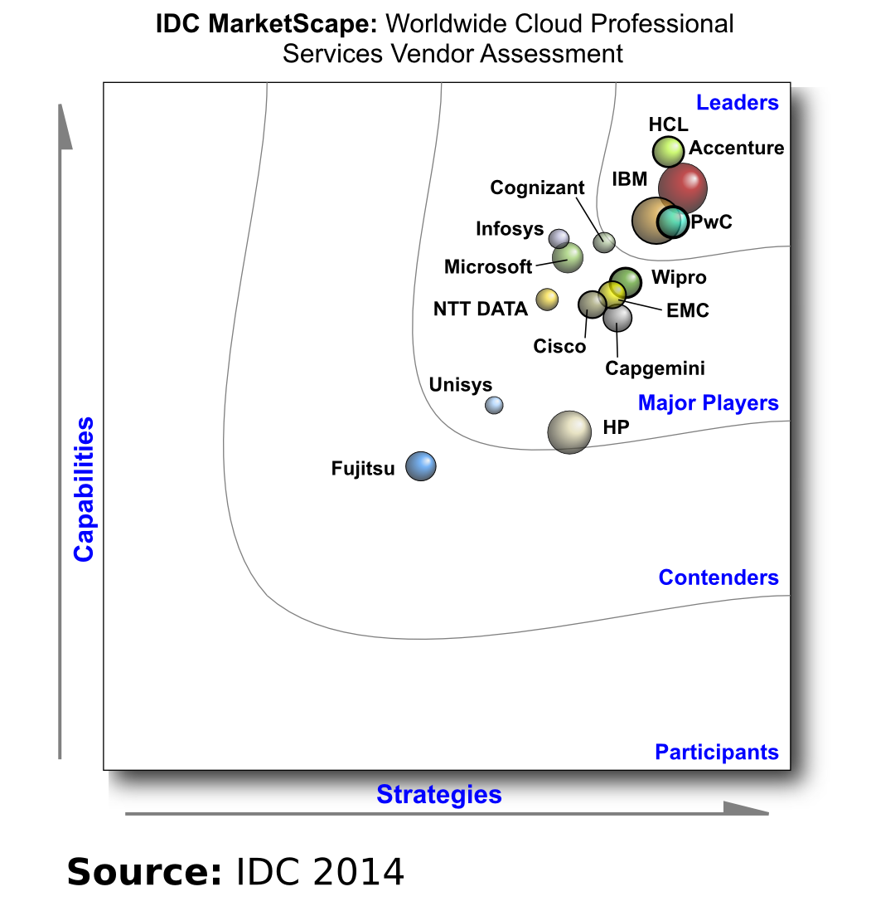
IDC MarketScape: Worldwide Cloud Professional Services 2014 Vendor Analysis positions Accenture as a Worldwide Leader in Cloud Professional Services
IDC analysis and buyer perception identifies Accenture as an IDC MarketScape Leader worldwide. Accenture continues to invest heavily in cloud, growing its business to more than 13,000 professionals, working on more than 8,000 projects, and surpassing $1.5 billion in revenue. As part of its three-year $400 million investment announced in April 2013, Accenture is continuing the ramp-up of its professional services capabilities, enriching its cloud ecosystem, launching new cloud-based software and business process services, and implementing cloud capabilities for Accenture's more than 293,000 people.
IDC’s evaluation is based on a comprehensive framework and set of parameters expected to be most conducive to success in providing cloud professional services during both the short term and the long term. A significant component of this evaluation is the inclusion of the perception of cloud professional services buyers of both the key characteristics and the capabilities of these providers.
Cloud Professional Services areas of strength:
According to IDC's 2013 Global Cloud Professional Services Buyer Perception Survey, clients highlighted Accenture to be most strong in the following areas:
Ability to provide functional insights and competence
Ability to manage risk
Ability to meet the project timeline
© Copyright IDC. Source: IDC MarketScape: Worldwide Cloud Professional Services 2014 Vendor Analysis by Gard Little and Chad Huston. August 2014.
Access the IDC reprint: http://idcdocserv.com/250238e_Accenture
IDC MarketScape vendor analysis model is designed to provide an overview of the competitive fitness of ICT suppliers in a given market. The research methodology utilizes a rigorous scoring methodology based on both qualitative and quantitative criteria that results in a single graphical illustration of each vendor’s position within a given market. The Capabilities score measures vendor product, go-to-market and business execution in the short-term. The Strategy score measures alignment of vendor strategies with customer requirements in a 3-5-year timeframe. Vendor market share is represented by the size of the circles. Vendor year-over-year growth rate relative to the given market is indicated by a plus, neutral or minus next to the vendor name.

Slide 12
Accenture is aiming to leverage its consulting capabilities to drive growth in infrastructure management
Caution: Requires permission to use externally
New! “Accenture carved out a separate dedicated infrastructure services. It is focusing on offering business service level agreements to client by combining infrastructure operations with business process services” (Source: Everest Global, Inc. Infrastructure Services – PEAK Matrix™ Assessment and Profile Compendium 2014. December 2014. EGR-2014-4-R-1301. To access report click here.)
New! “Accenture’s heritage in transformational engagement coupled with its significant push towards infrastructure services should assist enterprises in leveraging its offerings for wide variety of services.” (Source: Everest Global, Inc. Infrastructure Services – PEAK Matrix™ Assessment and Profile Compendium 2014. December 2014. EGR-2014-4-R-1301. To access report click here.)
New! “Accenture ITO strategy: Address increasing demand for cloud solutions by offering remote infrastructure management offerings that result in cost savings and improved efficiency.” (© TBR. 4Q14 Professional Services Business Quarterly: Accenture. 14 January 2015.)
New! “As a business/application-oriented vendor, Accenture historically partnered for provision of IT infrastructure management services components and provided consulting services to organizations looking to outsource. Having avoided IT infrastructure management services, Accenture now offers IT “transformational” outsourcing, with IT infrastructure management being minor elements of the outsourcing service. The Thomas Cook contract is an example of a deal where Accenture’s outsourcing service includes an IT infrastructure management component.” (© NelsonHall. Key Vendor Assessment of Accenture. December 2014.)
New! “Accenture is not targeting major IT infrastructure management contracts requiring asset management, but rather deals involving remote services and/or cloud services. It is not generally interested in acquiring IT assets in ITO deals, positioning this as a means by which clients retain control and flexibility. Accenture highlights its vendor independence as a differentiator in infrastructure management, positioning it as neutral and objective when advising on technologies” (© NelsonHall. Key Vendor Assessment of Accenture. December 2014.)

Slide 13
Accenture is a leader and strong transformational player in infrastructure outsourcing
Caution: Requires permission to use externally
New! “Accenture, a leader, The Forrester Wave™: Global Infrastructure Outsourcing”
New! “Accenture possesses great strengths in applications services, infrastructure services, and transformational services. Historically, Accenture has avoided asset-heavy deals and has preferred to embrace its asset-light philosophy, but the company is now seeking to increase its competitiveness in standalone infrastructure outsourcing engagements.”
New! “Leadership in cloud orchestration and brokering is another focus, which is the rationale for the firm's significant investments in its Accenture Cloud Platform, a vehicle for integration and service orchestration across various cloud models, including private cloud solutions available from its partners. Accenture enthusiastically touts its partnership with IPsoft for automated infrastructure support services.”
New! “It is also seeking to serve as the role of service integrator in infrastructure engagements. Generally an asset-light provider, Accenture thrives on transformational engagements. Accenture's distribution of staff and clients is well-balanced and a source of strength for the supplier.”
(© The Forrester Wave™: Global Infrastructure Outsourcing, Q1 2015; January 13, 2015)
New! “TBR believes Accenture will sustain its growth momentum through FY15 as it offers price-competitive outsourcing services supported by investments in cognitive computing. During CY4Q14 Accenture deepened its relationship with Remote Infrastructure Management vendor IPSoft, implementing IPSoft’s artificial intelligence (AI)-based software agent Amelia to provide backend operation support to a couple of its existing clients. We expect leveraging Amelia in existing and future engagements will provide Accenture with pricing agility while delivering to scale.” (© TBR. 4Q14 Professional Services Business Quarterly: Accenture. 14 January 2015.)

Slide 14
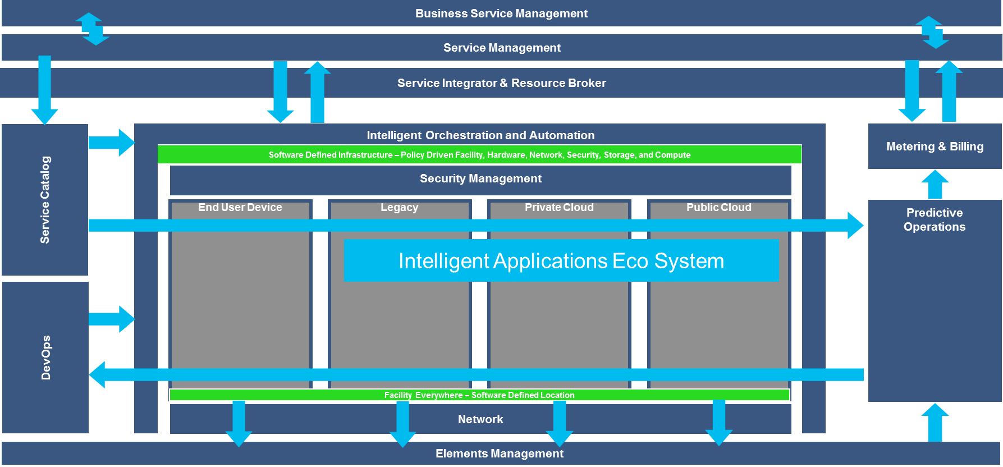
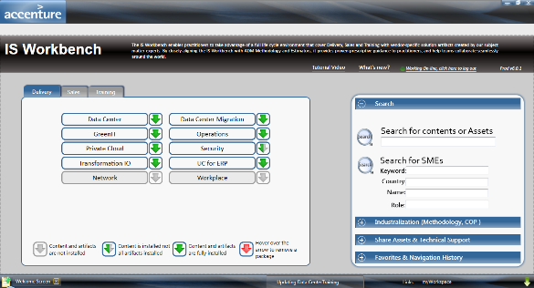
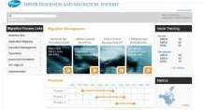
Accenture uses tested assets and project accelerators to enable Data Center development in an efficient, yet robust, manner
Intelligent Infrastructure Assets and Demo including Private and Public Cloud
Our Agile IT architecture and reference models provide strategy, architecture and demonstration assets that demonstrate Accenture’s leadership is incorporating technology trends such as virtualization, automation and integration into a service oriented, business aligned DC capability
Infrastructure Workbench
Recently revised release of the Data Center Migration Methods and supporting assets to provide the latest in Migration experience, further industrializing our capabilities and improving our predictability in DC migrations.
Accelerate for Data Center & Cloud (eMPIR)
Accenture tool under pilot use in client migrations that aids in planning, executing and reporting upon the progress of migrations. Using inventory data on systems and applications, this tool associates these assets to actively ensure dependencies are managed, the migration execution is planned, and the migration activities are clearly reported in a multi-user platform.
Application Migration Factory
A set of tools that aids in mapping and migrating applications as part of a data center move. This proven tool consists of a package of questionnaires to collect business and application data, means to associate, plan, and execute application migrations via an Access database tool, and methods and reports to govern the process.

Slide 15
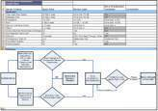
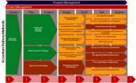
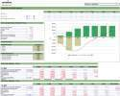
…that helps to industrialize and ensure high quality and predictability
Server Optimization Workbench Industrialized assets that help clients rapidly and efficiently virtualize their server compute by consolidating, migrating and transforming their server compute capability as part of the cloud infrastructure journey
Storage Transformation Workbench Industrialized assets that transform clients to a tiered storage environment reducing costs while improving agility of use in a cloud infrastructure
Data Center Cost Reduction Toolkit A proven toolkit of assessment, value trees, benchmarks and reports that aid in identifying cost take out opportunities within data centers.

Slide 16
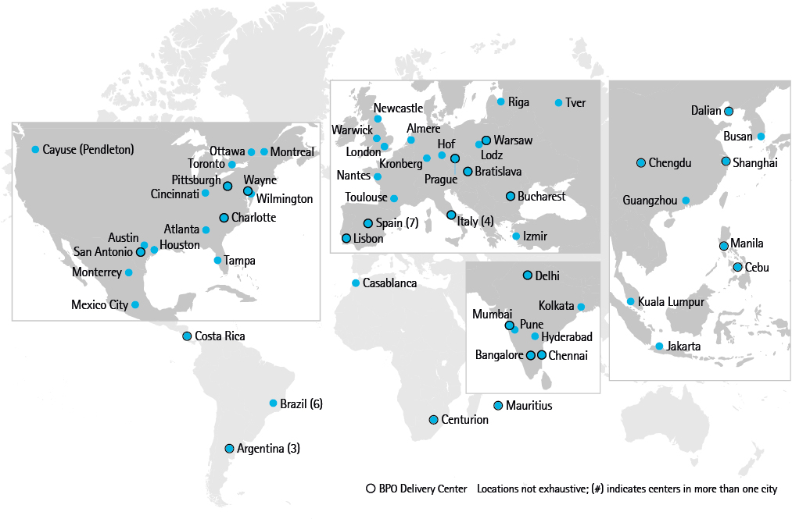
Accenture Global Delivery Network provides capabilities and support 24/7
With 330,000 professionals in more than 50 centers, Accenture offices and client locations, the Accenture Global Delivery Network is the largest and most diversified group of management consulting, technology and business process outsourcing professionals in the world

Slide 17













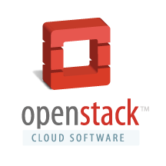




An Data Center Alliance ecosystem that amplifies our capabilities
(non-exhaustive)
Accenture carefully assesses the technology provider landscape, and forms strategic partnerships that bring world-class technology to our clients. Based on client’s individual needs, we provide technology solutions to help them solve their most pressing business concerns.
Open Source

Slide 18
Key Contacts
For additional information on Accenture’s Data Center Optimization offering, please contact one of the following individuals:
Michael Malke
Data Center Offering Lead
michael.malke@accenture.com
Sean Peterson
T&OD Chief Architect
sean.d.peterson@accenture.com
Sabino Prizio
Global Data Center Practice Lead
sabino.prizio@accenture.com
Larry Socher
Global Infrastructure Origination & Enablement
larry.m.socher@accenture.com
Jack Sepple
Global Infrastructure Consulting Global Lead
john.s.sepple@accenture.com

Slide 19
Regional Data Center Contacts
For additional information on Accenture’s Data Center Optimization, please contact one of the following individuals by Geography:
North America
John F. Esbenshade john.f.esbenshade@accenture.com
EALA
Nordics
Rosengren, Nicolas nicolas.rosengren@accenture.com
ASG
Markus Jung markus.jung@accenture.com
UK/I
Simpkin, Matthew matthew.simpkin@accenture.com
Gallia
Hendrikx, Luc luc.hendrikx@accenture.com
IGEM
Andreani, Corrado corrado.andreani@accenture.com
Mercolino, Stefano stefano.mercolino@accenture.com
SPAI
Mingo, Julio julio.mingo@accenture.com
Latin America
Lameda, Luciano luciano.lameda@accenture.com
APAC
APAC
Cheng, Michael michael.cheng@accenture.com
Greater China
Chen, Zhentao zhentao.chen@accenture.com
India
Nair, Ramesh ramesh.nair@accenture.com
Japan
Shiraishi, Yoshiyasu yoshiyasu.shiraishi@accenture.com
ANZ
Eadie, Duncan R. duncan.r.eadie@accenture.com
ASEAN
Groleau, Romain romain.groleau@accenture.com
IDC Data Center CoE
Shastri, Seetabai G. seetabai.g.shastri@accenture.com
Kuttappan, Shaju shaju.kuttappan@accenture.com
Ponnuswamy, Jay jay.ponnuswamy@accenture.com

