Slide 1
FY15 Europe Technology Architecture Workshop
April 27 – 29, 2015
State of the container nation

Slide 2
Agenda
What is Docker?
Use cases
The container stack
Capability Model
Risks and Limitations
What is Accenture doing?

Slide 3
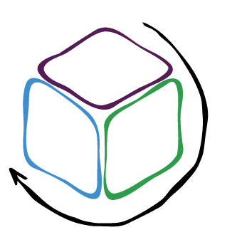
What is Docker?

Slide 4
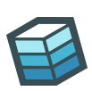
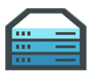

What is Docker?
Docker allows one to easily create lightweight, portable, self-sufficient containers from any application which can run on Linux kernel, and which are independent of hardware, language, framework, packaging system and hosting provider
Build
Ship
Run

Slide 5
Virtualization Types
Type 1 Hypervisor
Type 2 Hypervisor
OS-level virtualization
(“containers”)
Desktop virtualization
Application virtualization
App
App
App
App
Guest OS
Guest OS
App
App
App
App
App
App
Guest OS
Guest OS
Hypervisor
Container engine
Display server
Sandbox
Sandbox
Hypervisor
Host OS
Host OS
Host OS
Host OS
Host Hardware
Host Hardware
Host Hardware
Host Hardware
Host Hardware
The hypervisor runs directly on the CPU | The hypervisor runs on top of another operating system, as a normal process | Multiple isolated instances within a single OS kernel | The desktop environment as well as the application environment is separated from the physical client that is used to access it | Applications are run in their own sandboxes, with limited privileges, within a single kernel
VMware ESXi, KVM, Xen | VirtualBox | Solaris Containers, FreeBSD jails, LXC, Docker, Rocket, Warden | XenDesktop, Remote Desktop Services | XenApp, Microsoft App-V
Notes:
Source: Wikipedia, http://en.wikipedia.org/wiki/Hypervisor

Slide 6
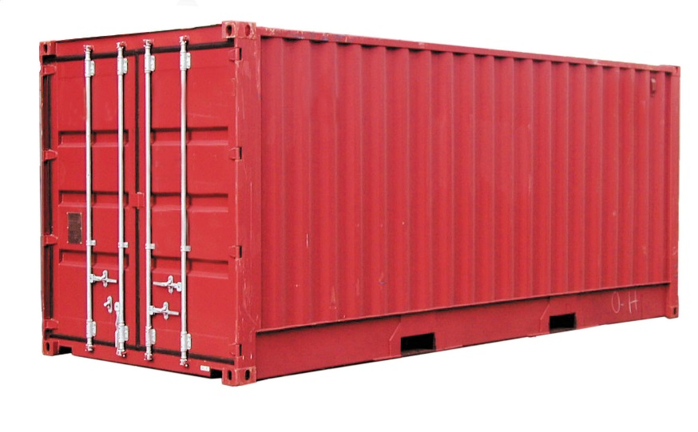
Containers vs. Virtual Machines
Docker and Virtual Machines are not competing technologies, but address different layers – virtualization technologies encapsulate an entire operating system while containers abstract applications (containers) from the operating system
 | Containers | Virtual Machines
Kernel support | All containers share the host kernel | Guests can run independent versions
Isolation | Independent processes via Linux namespaces | Independent kernel
Security | Compromised container can potentially compromise host | Compromise guest cannot compromise host
Startup | Start as fast as native (un-containerized) processes | Guest must boot first, then process
Creation | Dockerfiles | OS/disk images
Migration | Not supported | Supported (eg vMotion)
Scalability | 10-100s per host | 10s per host
Resource sharing | Processes can share memory, file caches, etc | Limited

Slide 7
Docker Use Cases

Slide 8
Docker Use Cases
“Package once, run everywhere”
Package entire applications as containers including system-level dependencies such as custom userland tooling and libraries
Improved infrastructure usage
Increased granularity for infrastructure resource utilization
Immutable infrastructure
Immutable infrastructure is based on components that are built and replaced as part of every release, instead of in-place updates

Slide 9
Docker Use Cases
Application isolation
Maintain applications fully isolated even when running in the same host
Continuous Integration and Deployment
Integrated with CI/CD tooling to quickly provision lightweight environments for automated testing
Provision and boot lightweight application environments in a matter of seconds
Increased developer productivity
Simplified full-stack configurations for local development
Run the same components in a local environment, test server or production infrastructure

Slide 10
The container stack

Slide 11
The container stack
Workflow
Orchestration
Clustering
Container Engine
Operating System
Virtual Machines
Physical Machines
Source: https://twitter.com/gabrtv/status/539805332432637952

Slide 12
Physical & Virtual Machines
Workflow
Orchestration
Clustering
Container Engine
Operating System
Virtual Machines
Physical Machines
Containers run independently of the hardware, virtual machine and IaaS provider
Commonly run on virtualized infrastructure

Slide 13
Operating System – Container operating systems
Workflow
Orchestration
Clustering
Container Engine
Operating System
Virtual Machines
Physical Machines
Docker runs on any modern Linux operating system but container-oriented operating systems are tailored to act as container hosts
Minimal footprint – more resources available to run containers
More secure, as they only run a very limited of services in the host to minimize attack surface
Safe updates with atomic OS updates with rollback support
CoreOS is a relatively mature alternative, Red Hat Atomic Host will power Open Shift v3 and Ubuntu is working on Snappy

Slide 14
Container Engine – The Docker Engine
Workflow
Orchestration
Clustering
Container Engine
Operating System
Virtual Machines
Physical Machines
Docker is a container engine implementation that is built on existing Linux kernel technologies
Namespaces provide isolation between processes so that they cannot “see” resources in another namespace, e.g. PID numbers, network, IPC, user namespaces
Cgroups is a Linux kernel feature that allows to limit, account and isolate computing resource usage (CPU, memory, I/O, etc) of process groups
Linux Containers (LXC) are an operating system-level virtualization technology that is part of the standard Linux kernel, and that allows to run multiple isolated Linux instances within a single host
The Docker Image Specification defines how Docker images should be implemented; Docker is currently the only known implementation
User space
Docker
LXC
Kernel
cgroups, namespaces
Notes:
Cgroups is a Linux kernel feature that allows to limit, account and isolate computing resource usage (CPU, memory, I/O, etc) of process groups and provide:
Group-wide enforcement of resource limits, e.g. memory
Group CPU prioritization
Accounting of resource consumption by groups
Checkpointing (freezing) and restarting groups
Linux Containers (LXC) are an operating system-level virtualization technology that is part of the standard Linux kernel, and that allows to run multiple isolated Linux instances within a single host
Built as an API on top of cgroups
LXC provides an isolated environment within the kernel, as close as possible as a standard Linux installation but without the need for a separate kernel
Can be seen as an intermediate solution between chroot and virtual machines

Slide 15
Container Engine – Rocket
Workflow
Orchestration
Clustering
Container Engine
Operating System
Virtual Machines
Physical Machines
Rocket is CoreOS’ attempt to define a App Container specification as well as a reference container engine implementation
App Container (appc) is a well-specified and community developed specification that defines an image format, runtime environment and discovery mechanism for application containers
Rocket is also the reference implementation; designed to be a lightweight container engine as opposed to a “platform”
Addresses some of the most salient concerns with Docker’s current implementation:
The Rocket runtime does spawns unprivileged processes to run containers, as opposed to Docker’s privileged “superdaemon”
Decentralized app container storage
App container signatures
Modular

Slide 16
Clustering
Workflow
Orchestration
Clustering
Container Engine
Operating System
Virtual Machines
Physical Machines
Clustering enables applications to be deployed to a fleet of Docker hosts
Additional capabilities may be provided
Cluster resource management and scheduling
Registration and discovery
Networking

Slide 17
Clustering – Docker Swarm
Workflow
Orchestration
Clustering
Container Engine
Operating System
Virtual Machines
Physical Machines
Swarm provides native clustering for scheduling and executing Docker container workloads for distributed applications on any infrastructure
Automatically optimizes of workload placement based on resource utilization
Works transparently with any Docker API client
Upon host failure, automatically rebalances workloads to provide HA / fault tolerance
Standard and custom constraints enable complex placement optimizations
Only provides a naïve scheduler, but the backend API enables interoperability with other clustering solutions such as Mesos and Kubernetes
Swarm

Slide 18
Clustering – Kubernetes
Workflow
Orchestration
Clustering
Container Engine
Operating System
Virtual Machines
Physical Machines
Kubernetes is Google’s open source container cluster manager, built on Docker and encapsulates Google’s experience with running containers at a scale
Released by Google as an open source project in July 2014, currently nearing 1.0 release
Provides a declarative format to define application stacks, and an external API to programmatically interact with Kubernetes components
Designed to run on Google infrastructure (Google Container Engine) but can also run on other platforms

Slide 19
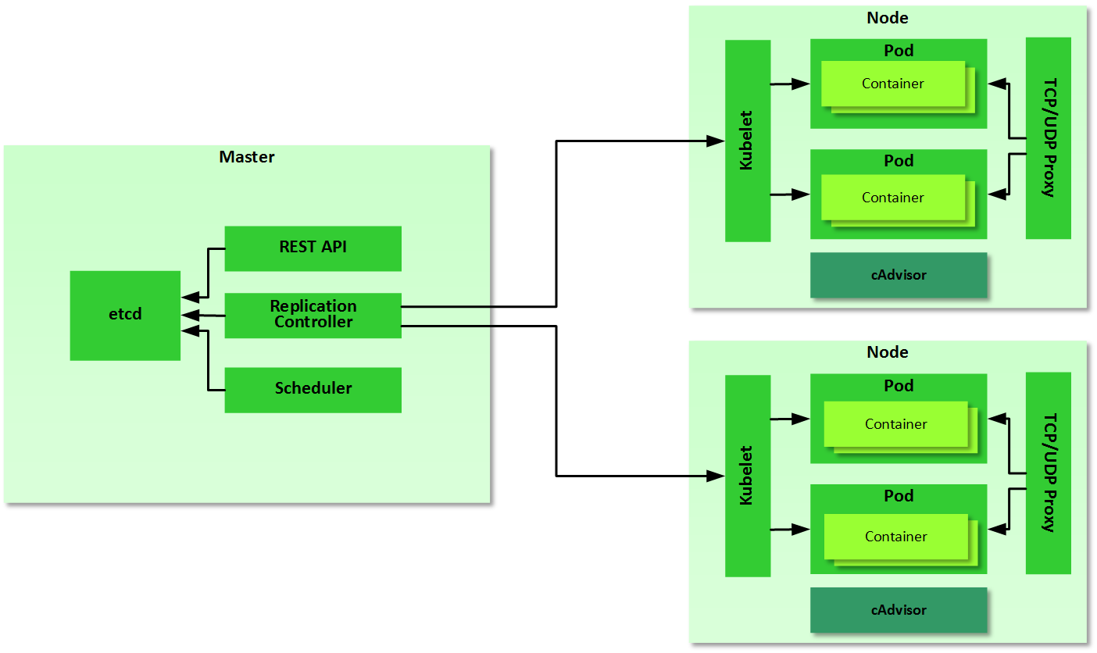
Kubernetes
Workflow
Orchestration
Clustering
Container Engine
Operating System
Virtual Machines
Physical Machines
Kubernetes provides higher-level organizational constructs to support common distributed application deployment patterns
Kubernetes builds on top of Docker to provide:
Pods as a group of containers that are scheduled and deployed together
Container replication via the Replication Controller
Private cross-container networking – each pod gets its own IP
Service discovery with labels
Load balancing
Management APIs

Slide 20
Clustering – Mesos
Workflow
Orchestration
Clustering
Container Engine
Operating System
Virtual Machines
Physical Machines
Apache Mesos is an open source cluster manager that abstracts computing resources from physical/VM instances, enabling highly-available and fault-tolerant distributed systems
Treats a cluster of nodes as one big computer
Provides capabilities for application scheduling, scaling, fault-tolerance, and self-healing
Can natively schedule Docker containers
Docker is developing integration between Swarm and Mesos, so that Swarm can use Mesos’ more advanced scheduling algorithms

Slide 21
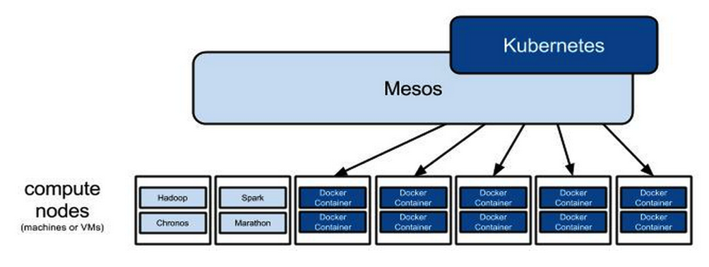
Orchestration – Mesos + Kubernetes, Swarm + Kubernetes
Workflow
Orchestration
Clustering
Container Engine
Operating System
Virtual Machines
Physical Machines
Kubernetes as a Swarm scheduler
Currently being developed by Docker
Kubernetes as a Mesos framework
Kubernetes provides services such as Pods, service discovery using labels, and replication control.
Mesos handles elastic sharding for Pods and resource sharing between other frameworks in the datacenter
As of writing, this is still a work in progress

Slide 22
Docker Compose
Workflow
Orchestration
Clustering
Container Engine
Operating System
Virtual Machines
Physical Machines
Rapidly compose any multi-container distributed application that is completely independent of the underlying infrastructure
Compose app and express dependencies between containers through a simple declarative YAML file
Does not currently work with Docker Swarm because of networking limitations in Docker
Load balancer
App Servers
Database

Slide 23
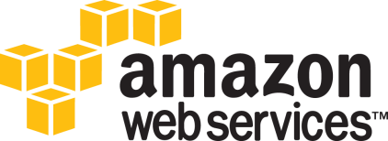



Workflow – Traditional PaaS
Workflow
Orchestration
Clustering
Container Engine
Operating System
Virtual Machines
Physical Machines
AWS Elastic Beanstalk can deploy applications from Docker containers
Amazon’s Container Service is Amazon’s lightweight container-PaaS, but is currently not generally available
Uses its own container implementation Warden
Cloud Foundry Diego will provide Docker integration and orchestration support
Doesn’t presently support Docker, but OpenShift v3 is re-architected to combine Docker and Kubernetes
Google Container Engine is Google’s Kubernetes-based container platform running on Google’s infrastructure

Slide 24
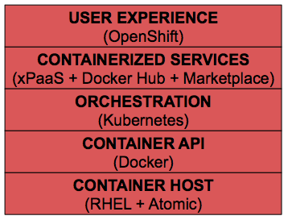

Docker and Kubernetes on OpenShift v3
Workflow
Orchestration
Clustering
Container Engine
Operating System
Virtual Machines
Physical Machines
OpenShift v3 is a complete migration of OpenShift to Docker and Kubernetes
Kubernetes at the heart of v3, responsible for resource allocation, orchestration and service scaling
OpenShift manages the lifecycle of applications and Kubernetes Master runs on OS broker and Nodes as hosts/minions
Uses Red Hat Atomic as the host operating system
Can run PaaS workloads as well as containerized workloads

Slide 25
Workflow – Docker-based PaaS
Workflow
Orchestration
Clustering
Container Engine
Operating System
Virtual Machines
Physical Machines
Lightweight Docker-based and Docker-oriented “micro-PaaS” are starting to emerge
Deis
Flynn

Slide 26
Accenture Docker Capability Model

Slide 27
Docker Capability Model
Accenture’s capability model outlines the basic capabilities that are desirable in a Docker-based infrastructure

Slide 28
Sample Reference Architecture with “best of breed” components
CoreOS as the host operating system
Kubernetes for cluster management and application deployment
ELK stack with logspout for log aggregation
cAdvisor for container metrics
Jenkins for container build
Docker registry for container storage

Slide 29
Example – Best of breed
Selecting best of “best of breed” addresses most capabilities, but not all

Slide 30
The not-so-good

Slide 31
The not-so-good
The Docker ecosystem is rapidly evolving and can be confusing for clients, and for us
Docker Inc have reacted very slowly to plug some of the functionality gaps, e.g. networking only now being worked on, and products like Swarm are still in beta
There’s no single platform/product/offering that provides all defined capabilities at the moment
Very fine-grained container security via AppArmor/SELinux is still difficult
Limited internal references at Accenture
Docker is still a small company

Slide 32
Building good containers

Slide 33
Think small, think micro
Smaller container size you have, more containers you can run
Avoid installing build tools (build tools and runtimes takes lot of space)
Always clean up (don’t leave files intemp directories, package cache)
Base Images | Size (MB)
fedora:21 | 233
centos | 215
ubuntu:14.04 | 188
debian:7.8 | 78
busybox | 2.5

Slide 34
Data only containers
Move user data into data-only container
BEWARE: you cannot make snapshots of volumes (you cannot use Docker registry for user data backups)
Volumes can be used as ephemeral disk for containers
db-container
FROM mysql EXPOSE 3306
user-data
FROM scratch VOLUME /var/lib/mysql
volumes-from

Slide 35
Best practices
Tag version numbers
Use environment variables to customize container
Use builder containers to keep build artifacts outside
Use private Docker registry

Slide 36
What is Accenture doing?

Slide 37
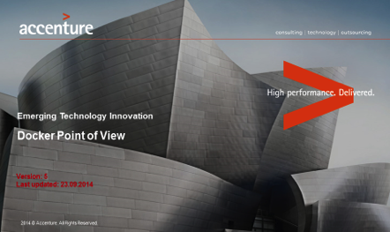
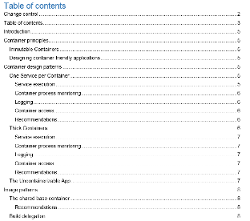
What is Accenture doing about Docker?
Docker POV
Docker patterns & Implementations
Capability Model
Reference Architectures
Docker at CA&PS Community of Practice
http://go.accenture.com/docker

Slide 38
Docker on the Accenture Cloud Platform
Docker blueprint and DevOps Model Office (which heavily leverages Docker) will be available on ACP during April 2015
Docker as a Service available as beta on ACP in late Summer 2015

Slide 39
Experience and References
Several Accenture projects are either POC-ing or in non-production mode with Docker
ATA Emerging Technologies, CA&PS and DevOps have resources with hands-on experience, and are currently training more resources
Mutual NDA in place with Docker, with the possibility to use Docker for architecture reviews, SME support or joint delivery

Slide 40
Conclusion

Slide 41
Conclusion
Docker as a container engine is ready for production workloads, and should be considered as the preferred deployment target for new applications
Can greatly simplify Continuous Integration and Deployment, optimize infrastructure usage, and generally make it easier to build applications out of smaller building blocks that can run on any infrastructure
There are some capability gaps that clients can currently fill with a combination of third party components, or wait for Docker to address
We expect many of the PaaS vendors to converge towards Docker-based or Docker-enabled solutions

Slide 42
Workflow
Orchestration
Clustering
Container Engine
Operating System
Virtual Machines
Physical Machines
Workflow
Orchestration
Clustering
Container Engine
Operating System
Virtual Machines
Physical Machines

