Slide 1
Chef Factory

Slide 2
Agenda
Business Value
Build and Deployment Automation
Chef Factory
What are the benefits?
What is the Operating Model?
DCSC Tools Blueprint
Continuous Delivery Pipeline
What Assets we do already have…
Why Accenture
Contact us
Appendix: Success Stories

Slide 3
Business Value
DevOps uses automation techniques to optimize collaboration across development and operations, enabling faster, more predictable and more frequent deployments to market. The benefits of using a DevOps approach as are follows:
10% - 20% Cost Reduction across delivery - Reduction in operational cost for running applications and reduction in total cost of change for new development and maintenance
Up to 50% increase of Speed to Market – Reduction in software delivery cycle times by streamlining and automating the delivery lifecycle
Predictable Quality by reducing defects in later test phases by 30% – via increased level of quality control, predictable processes and earlier detection of problems
Fast Feedback – providing new features to the customer within hours to days
Provides response to rapidly evolving Digital world
Tools such as Chef allow the automation of the Build and Deployment of the infrastructure and applications in your environment, a key part of the DevOps process.

Slide 4
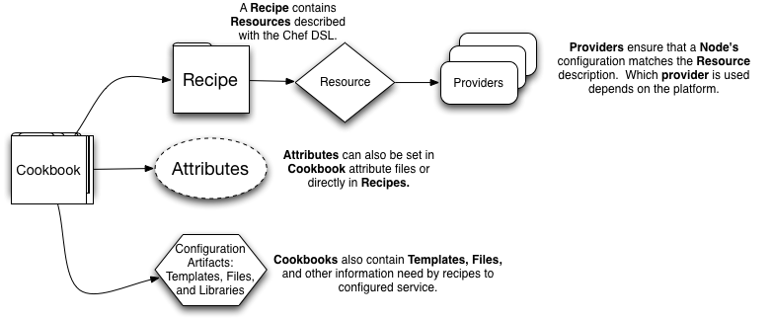
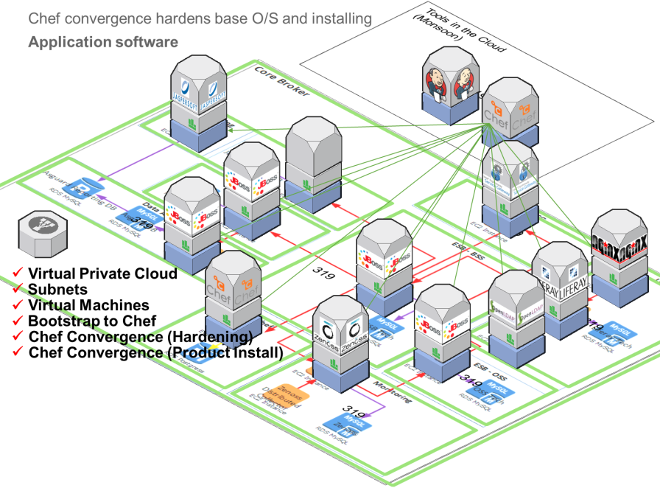
Build and Deployment Automation
Tools such as Chef, Docker, Puppet, Ansiable or Salt are Open Source Configuration Management Software that enable Build and Deploy automation
What is Chef?
Chef is an open-source automation framework, that uses ‘cookbooks’ to describe infrastructure as code.
What does Chef do?
Chef provides a flexible framework to enable rapid automated infrastructure and application deployment and configuration into physical, virtual, or cloud locations, consistently and at scale. This enables delivery of programmatic Infrastructure as a Service (IaaS).
How does Chef work?
Chef utilises defined ‘cookbooks’ (collections of ‘recipes’), that compose the source code,and applies the specified scripts and configuration to achieve the target deployment state.
Chef provides a flexible model for reuse.
Infrastructure deployments and configuration are:
Programmable
Versionable
Deployable
Testable
Repeatable
Consistent

Slide 5
Chef Factory - What are the benefits?
Chef Factory can help you to automate the Build and Deployment of the infrastructure and applications in your environment. Leveraging DevOps and using a delivery factory with established methodology, tools and process enables us to rapidly assist clients in establishing their own Continuous Delivery pipeline.
Benefits
Business Agility
Pre configurable environments and tooling facilitate rapid deployment – increasing Speed to Market
Cost Effective
Increased speed and reduced time of environment configuration and provisioning
Increased efficiency of development and test teams
Improved Quality
Enabler for automation - Continuous Integration and Continuous Delivery
Consistency of environment and application deployment
Risk Reduction
Rapid deployment and roll out of updates and patches
Standardised, Repeatable & Industrialised
CHALLENGES
Accenture Skills & Methodology
Chef Factory
Accenture Tools in the Cloud

Slide 6
Chef Factory - What is the Operating Model?
Chef is a key enabler of DevOps and IaaS for a number of DevOps Control Service (DCS) engagements. Our build and deployment automation factory develops cookbooks in an industrialised and low-cost manner. The factory leverages Continuous Integration and a number of FOSS tools to allow us to analyse and automatically test and verify our code.
Projects
Deployed DevOps Resource
Requirements
Design DevArch
Capability implementation
Training/Coaching
KPI & Service
Sales & SME
Mobilisation
DevOps “As a Service”
UK
LatAM DC
Dedicated
IDC
Shared
PDC
Automation Requirements
Tooling
Automation Requirements
Tooling
Build and Deployment Automation Factory
CHEF FACTORY
Assets Library
Monsoon
“Location”+DC stands for Delivery Centre
Global Shared Service
Local DCS Team
Our Operating Model is proven, simple and effective. Following the initial sales phase, we mobilise a team of specialists that assesses your environments, consider your requirements as well as industry and technical innovation. They will implement and develop tools and assets, engaging with the Chef Factory.
The Mobilisation team will ensure knowledge transfer and coaching of processes to your team. Once the deliverables are rolled out, support can be provided by DCS “as a Service”, being able to engage and use the Chef Factory “as a Service” when required.
Chef is well suited to Cloud deployments utilising an agile methodology but also supports on premise deployments as well as other delivery methodologies.

Slide 7

Chef Factory Tools Blueprint
The list of Tools currently supported by Chef Factory are:
Infrastructure and Service Monitoring
Infrastructure Automation Framework
Infrastructure Automation Framework
Infrastructure As A Service / As a Code
Infrastructure and Service Monitoring
Chef ✓ Tools in the Cloud✓
Infrastructure and Service Monitoring
Automated Testing
Build
Service Asset and Configuration Management
Nagios ✓ ELK Stack ✓
Run
Software Configuration Management
Code Repository and Viewers
Automated Testing
GIT ✓ GitBlit ✓
Gerrit ✓
Automated Build and Deployment
(CHEF)
Automated Development Environment
Artefact Management
Automated Test Execution
Jenkins Repository ✓
Selenium ✓ TestKitchen ✓
ServerSpec ✓
Automated Solution Quality
Automated Development Environment
Integrated Development Environment (IDE)
Sublime Text 2 ✓
Automated Build and Deployment
Automated Build / Continuous Integration Server
Automated Solution Quality
Jenkins ✓ SpiceWeasel ✓
Automated Code / Configuration Review / Build Quality Dashboard
Automated Deployment / Continuous Delivery
Sonar ✓ FoodCritic ✓ Robocop ✓
Jenkins ✓ SpiceWeasel ✓

Slide 8


Continuous Delivery Pipeline
Chef Factory supports Continuous Delivery, enabling the Build, Deploy and Testing processes to be fully automated.
All changes commited to GIT after peer review
Code analysis/review via Sonar / Gerrit / Foodcritic or Robocop
Changes loaded to Chef Server via Jenkins / Spiceweasel
Automated testing via Selenium,
Test Kitchen or ServerSpec
Manual Peer Review
Load changes into GIT
Code Analysis
Package Build
Deploy Build to Build Sandbox
Automated Testing
Deploy Build to QA
Process
Continuous Integration / Continuous Delivery driven by Jenkins or Spiceweasel
IDE commits
Unit Test
QA & Publish
Assembly Test
Integration Test
Performance Test
PreProduction
Production
Environments
Developer makes changes
Commit to Development Branch
Merge to Release Branch
Merge to Master Branch
CM
TOOL: Git
CM
TOOL: Git
CM
TOOL: Git
START
Note: Pipeline is illustrative. Additional tooling could be used, as per the Chef Factory Tools Blueprint.

Slide 9
What assets do we already have…
The team has currently developed 100+ assets covering automated installation and configuration and Monsoon wrappers for key technologies and products:
Java
Python
Jenkins
Sonar
Selenium
Nagios
And more
Detailed Assets Portfolio could be found in the Appendix.

Slide 10

Why ?
Accenture is a global management consulting, technology services and outsourcing company, with approximately 275,000 people serving clients in more than 120 countries.
Accenture collaborates with clients to help them become high-performance businesses and governments.
Skilled People
Global Model
(lower cost)
Team with proven DevOps experience in large- scale complex engagements.
Accenture Internal Technology Architecture certification
Technical and Management certification promoted
Contributors in DevOps community
Proven
Continuous Delivery
model
Global model drives lower cost by encouraging the use of industrialised processes and tools.
100% coverage of world time-zones providing core industry knowledge and specialist skillsets.
Managed services optimises productivity and reduce cost to serve
Existing
Cookbooks
Assets
Tightly related to Agile methodology, Continuous Delivery is now emerging as major trend in the software development industry.
The Chef Factory has proven experience supporting projects using Chef and similar tools that allow Continuous Delivery
Relationship
with Chef
The number of existing cookbooks developed by the Accenture Chef Factory is continuously increasing.
Cookbooks and Recipes are developed in an industrialised / low-cost way
Flexible model for reuse
We are part of the Chef open-source community, contributing back a number of fixes and enhancements to recipes and addressing technologies such as Hybris, JBoss, WebSphere, Liferay

Slide 11
Service Lines
Service Lines | Offering | Typical Deployment
Infrastructure as code | Custom configuration and Chef recipes to deliver Infrastructure as code: Permissions, configurations, etc. | Low to medium complexity Pay per hour
Tools Implementation | Custom configuration and Chef recipes to integrate tools including into environments. | Low to medium complexity Pay per hour
Continuous Integration/Continuous Delivery Implementation | Custom configuration and Chef recipes to deliver configuration to automate the infrastructure and tools necessary for Continuous Integration and Continuous Delivery. | Low to medium complexity Pay per hour
Chef “as a Service” | Provision of Chef infrastructure required to run cookbooks. Note that the target infrastructure would be provisioned by ACP | Low to medium complexity Pay per hour
Support for Chef & Tools in the Cloud (provided via DCSC) | Support through DCSC 1:Many Shared service can be tailored to meet project needs including: Deployment Control & Automation Infrastructure Management Configuration management Implementation and support services throughout the duration of the development and test effort | Medium to high complexity Medium term mobilisation

Slide 12



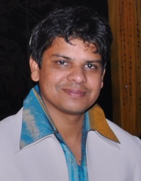
Who to contact
Chef Factory leadership team:
Contact: dcsc.chef-factory@accenture.com
You can also follow us on yammer - DCS - Chef
Hitesh Joshi – Hitesh has been with Accenture 9.5 years and has worked across nearly all of the stages of the Software Delivery Life Cycle: from Design to Development, Test, Performance Engineering, Architecture, DevOps and Delivery Management.
Hitesh is based in London and currently works within DevOps for DCSC and the Accenture Cloud Platform (ACP), owning delivery of Chef automation to a variety of clients.
Sandeep Rathod – Sandeep has over 12 years of experience in leading and managing complex transformation projects. Has successfully led cross functional teams with diverse technical backgrounds in multi-vendor environments for AM and SI projects. He has played various roles involving project and delivery management, onshore - offshore co-ordination, technical architecture, delivery life cycle from design to deploy. Sandeep is based in Pune and has been with Accenture for over 10 years, engaged on large-scale engagements across different industries.

Slide 13
Appendix
Chef Factory

Slide 14
Success Story: Scandinavian Retailer
PROJECT CONTEXT
SERVICES PROVIDED
Scandinavian Retailer using Chef Factory and DCSC
Project characteristics:
Systems Integration programme creating new applications to enhance existing multi-channel retail capabilities.
Varied technologies including : Adobe CQ5, Hybris and Jboss.
Complex multi-release, multi-production environment requirements.
Chef Factory & DCSC
Automated environment creation - Infrastructure as code
Tooling design integration and implementation
Automated application delivery
Ongoing tooling support
Industrialised delivery from the outset: continuous integration, automated testing, automated quality gates.
Tools in the Cloud
Chef and Git configuration management
Jenkins continuous integration
Rational Jazz application lifecycle management
Sonar for code quality analysis
Gerrit for automated peer review
OUTCOMES
CLIENT TESTIMONY
From “nothing” to code being automatically pulled from version control, built and deployed into automatically created development/test environments within 6 weeks.
Traceability captured from Requirements to Delivery tasks, Requirements to Test Cases, Code to Delivery Work and Defects, etc.
DCSC automated Continuous Integration which has produced over 5000 builds
90-man days have been saved for manual builds/deployments over 6 months
Over 135,000 Lines of Code have been analysed using automatic code analysis which has helped improved rule compliance by 10%
Implementing Source Control Management with Git has allowed the project to complete over 7000 code commits
“My experience so far with DCSC has been fantastic! The DCSC team has setup a solid foundation of tools
which have allowed us to be successful throughout the development phase.”
“The training and support we have received from DCSC has also been top notch and extremely thorough.”
“Even when we faced issues, the response time from DCSC has been phenomenal and we have never been truly blocked on anything due to their fast turnaround.”
“I would gladly work with DCSC and their infrastructure again in the future.”

Slide 15
Success Story: UK Retailer
PROJECT CONTEXT
SERVICES PROVIDED
UK Retailer using Chef Factory and DCSC
Project characteristics:
Systems Integration programme creating new applications to deliver integrated B2C and B2B services.
Varied technologies including : Spring, SOLR, DB2, Tibco.
Complex multi-release, multi-production environment requirements.
Chef Factory & DCSC
Automated environment creation - Infrastructure as code
Tooling design integration and implementation
Automated application delivery
Ongoing tooling support
Industrialised delivery from the outset: continuous integration, automated testing, automated quality gates.
Tools in the Cloud
Accenture Cloud Platform
Chef and Git configuration management
Jenkins continuous integration
Rational Jazz application lifecycle management
Sonar and Selenium for code quality analysis
OUTCOMES
CLIENT TESTIMONY
From “nothing” to code being automatically pulled from version control, built and deployed into automatically created development/test environments within 6 weeks.
Traceability captured from Requirements to Delivery tasks, Requirements to Test Cases, Code to Delivery Work and Defects, etc.
Savings in 2013
$303k USD saved Build and Deployment effort
$1051k USD saved testing effort
Estimated savings by end of 2015
$1628k USD saved Build and Deployment effort
$7.6M USD saved testing effort
“Being able to bring in this kind of “black belt” expertise was one of the reasons I recommended Accenture over the competition.”
“It’s quite an achievement (and very refreshing) to have delivered so much in such a short space of time.”
“I’ve worked in IT long enough to know that the success of a project is usually dictated by the way it launches standards, patterns, desktops, tools, repositories etc. Mark’s guys have done a great job in defining and building the working environments and processes around build that has led to a fantastic iteration 1.”

Slide 16
What assets do we already have…
Cookbook Name | Originating Project
acp_acs_antivirus | ACP
acp_acs_backup | ACP
acp_acs_governor | ACP
acp_acs_monitoring | ACP
acp_admin_users | ACP
acp_api_proxy | ACP
acp_hardening | ACP
acp_jaspersoft | ACP
acp_vmware | ACP
acp_yum | ACP
acp_zenoss | ACP
acp-mysql | ACP
apt | ACP
ark | ACP
aws | ACP
bluepill | ACP
bootstrap | ACP
build-essential | ACP
chef-client | ACP
chef_handler | ACP
chef_proxy | ACP
clone | ACP
commands | ACP
cron | ACP
database | ACP
diskpart | ACP
dmg | ACP
Cookbook Name | Originating Project
enstratus | ACP
erlang | ACP
git | ACP
hosts | ACP
iptables | ACP
java | ACP
line | ACP
logrotate | ACP
manage-common | ACP
manage-networks | ACP
manage-storage | ACP
manage-users | ACP
manage-vpn-access | ACP
maven | ACP
mysql | ACP
nginx | ACP
nscd | ACP
ohai | ACP
openldap | ACP
openssh | ACP
openssl | ACP
patching | ACP
postgresql | ACP
powershell | ACP
provisioning | ACP
pvp_setup | ACP
rabbitmq | ACP

Slide 17
What assets do we already have…
Cookbook Name | Originating Project
rabbitmq_ssl | ACP
rhn | ACP
rsyslog | ACP
runit | ACP
symantec-antivirus | ACP
tomcat | ACP
windows | ACP
windows-reaper-test | ACP
wsus | ACP
xfs | ACP
yum | ACP
yum-epel | ACP
yum-erlang_solutions | ACP
zenoss-monitoring | ACP
7-zip | Monsoon
ant | Monsoon
apache2 | Monsoon
apt | Monsoon
ark | Monsoon
artifact | Monsoon
aws | Monsoon
bluepill | Monsoon
build-essential | Monsoon
chef-client | Monsoon
chef_handler | Monsoon
cron | Monsoon
database | Monsoon
dmg | Monsoon
Cookbook Name | Originating Project
git | Monsoon
hostsfile | Monsoon
iptables | Monsoon
java | Monsoon
jenkins | Monsoon
logrotate | Monsoon
maven | Monsoon
mediawiki | Monsoon
minitest-handler | Monsoon
monsoon_alpj_template | Monsoon
monsoon_aowp_template | Monsoon
monsoon_framework_libraries | Monsoon
monsoon_gerrit | Monsoon
monsoon_git | Monsoon
monsoon_java | Monsoon
monsoon_jenkins | Monsoon
monsoon_maven | Monsoon
monsoon_mediawiki | Monsoon
monsoon_mysql | Monsoon
monsoon_nexus | Monsoon
monsoon_npm | Monsoon
monsoon_phabricator | Monsoon
monsoon_sfdc_template | Monsoon
monsoon_sonar | Monsoon
ms_dotnet4 | Monsoon
mysql | Monsoon
nexus | Monsoon
nginx | Monsoon
npm | Monsoon
ohai | Monsoon

Slide 18
What assets do we already have…
Cookbook Name | Originating Project
openssl | Monsoon
phabricator | Monsoon
php | Monsoon
postgresql | Monsoon
python | Monsoon
rsyslog | Monsoon
runit | Monsoon
service_discovery | Monsoon
silverware | Monsoon
sonar | Monsoon
ssl_certificates | Monsoon
vc2010 | Monsoon
windows | Monsoon
xfs | Monsoon
xml | Monsoon
yum | Monsoon
aws | SAP
chef_handler | SAP
diskpart | SAP
java | SAP
openssl | SAP
powershell | SAP
sap | SAP
windows | SAP
addsudouser | ADD
ark | ADD
aws | ADD
aws_store | ADD
boost | ADD
build-essential | ADD
data_node | ADD
Cookbook Name | Originating Project
database | ADD
edge_node | ADD
env_setup | ADD
hadoop_cluster_manager | ADD
hive_mysql | ADD
hostfile_update | ADD
java | ADD
jdk_setup | ADD
line | ADD
mahout | ADD
mysql | ADD
mysql-chef_gem | ADD
openr | ADD
openssl | ADD
postgresql | ADD
python | ADD
revor | ADD
scala | ADD
set_recipe | ADD
sudo | ADD
tableau | ADD
talend | ADD
xfs | ADD
yum | ADD
yum-cdh | ADD
yum-epel | ADD
yum-hdp | ADD
yum-mysql-community | ADD
yum-pgdg | ADD

