Slide 1
People, Process & Tools – The Essence of DevOps
Richard Campbell
@richcampbell

Slide 2
Richard Campbell
Background
First laid hands on a microcomputer in 1977, it’s been all downhill from there
Spent the last fifteen years helping companies scale software on a variety of platforms
Currently
Post-Startup Sale Decompression
Organizer of DevIntersection
Rabid Podcaster

Slide 3



Podcasts
For .NET Developers
First published 2002
Two shows a week
860 episodes in the archive
For IT Pros
First published 2007
Once a week
310 episodes in the archive
For Tablet Developers
First Published 2011
Once a week
78 episodes so far

Slide 4
The Essence of DevOps
Better Software, Faster
Movement Comes from Open Source
When Development and Operations Synergize
Covers the *entire* Application LifeCycle

Slide 5

The Whole Application LifeCycle
Requirements
Product backlog
Define
Ideation
Measure
Actionable learning
Implement
Monitor
Develop
Idea to working software
Operate
Working software in production
Value realization
OPS backlog
Working software shared artifacts

Slide 6
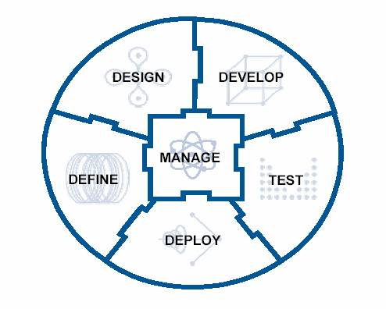
The Whole Application LifeCycle

Slide 7
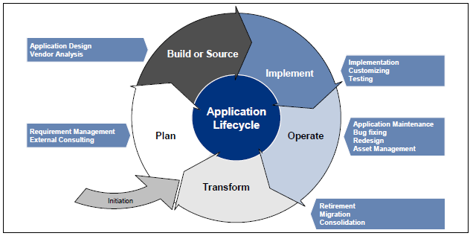
The Whole Application LifeCycle

Slide 8
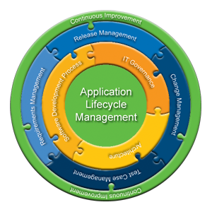
The Whole Application LifeCycle

Slide 9
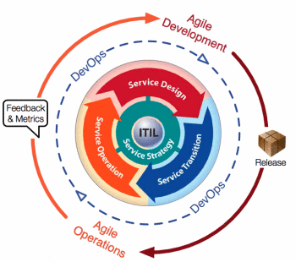
The Whole Application LifeCycle

Slide 10
The Whole Application LifeCycle
Everyone who influences the success of the application
Everyone
No really, everyone

Slide 11
Success = Quality
What is quality software?
Does what it’s supposed to do
Is “easy to use”
Responsive to the tasks it is given
Is “observable” – you can tell what it’s up to

Slide 12
Why DevOps Now?
Technological Advancements
Virtualization/Cloud
Commodization of Infrastructure
Change Management Has Improved
Easier to change, faster to compensate
Technology is no longer just a competitive advantage
It’s a necessity

Slide 13

The Essence of DevOps
“Do painful things more frequently, so you can make it less painful…”
Adrian Cockcroft, Architect, NetFlix

Slide 14

You Don’t Choose Chaos Monkey, Chaos Monkey Chooses You!

Slide 15
The Essence of DevOps
We are all responsible for the success of our software
Success can only be measured with the entire cycle
We live and die together

Slide 16
The First Way – Systems Thinking
Understand the entire flow of work
Seek to increase the flow of work
Stop problems early and often
Don’t let them flow downstream
Keep everyone thinking globally
Deeply understand your systems

Slide 17
Defining Work and Make It Visible
Business Projects
The new inventory system
Internal IT Projects
Deployment Automation
Changes
Database Performance Tuning
Unplanned Work
Web Site Outage

Slide 18
One Step Environment Creation
Need a common environment build process
For development, qa and production
The environment will evolve as development proceeds
The longer you wait to have a common environment build process, the harder it is to create one

Slide 19
The First Way Goals
One source of the truth
Code, environment and configuration in one place
Consistent release process
Automation is essential (one click)
Decreasing cycle times, Faster release cadence

Slide 20
The Second Way – Feedback Loops
Understanding and responding to the needs of all customers (internal and external)
Shorten and amplify all feedback loops
With feedback comes quality

Slide 21
Crossteam Connections
Development is embedded in the Ops incident escalation process
Dev and Ops collaborate on post-mortems and root cause analysis
Monitoring and metrics become essential

Slide 22
A Word about Metrics
Avoid vanity metrics
Giving you numbers that make happy noises
Real metrics are actionable
What do you do when it goes up?
What do you do when it goes down?
Real metrics reflect business, not technology

Slide 23
Automating Feedback Loops
Capture as much data as possible at the incident
Avoid interpretation
The issue becomes the data, not the people who gathered it

Slide 24
Second Way Goals
Defects and performance issues fixed faster
Ops and InfoSec user stories appear as part of the application
Everyone is communicating better
More work getting done

Slide 25
The Third Way – Synergy
Consistent process and effective feedback result in agility
Now use that agility to experiment
You only learn from failure
So fail often, but recover quickly

Slide 26
Break Things Before Production
Consistency in code, environments and configuration
ASSERTs to catch misconfigurations and inconsistencies
Static code analysis, and testing become part of the continuous integration and deployment

Slide 27
Battling Technical Debt
Allocate 20% of cycles to technical debt reduction
Before you end up allocating 100%
Remember they’re still visible stories with measurable metrics

Slide 28
Fighting Against One Right Way
Rapid cycling encourages experimentation
Every feature can be split-tested
Use Metric Driven Development
If you can’t tell which test is better, what’s the point?

Slide 29
Third Way Goals
Ability to anticipate, even define new business needs through visibility in the systems
Ability to test and optimize new business opportunities in the system while managing risk
Joy

Slide 30
The Essence of DevOps
Better Software, Faster
Pride in the Software You Build and Operate
Ability to Identify, Respond and Improve Business Needs

Slide 31
Resources
Visible Ops Handbook (Gene Kim)
The Phoenix Project (Gene Kim)
Web Operations (Allspaw/Robbins)
Continuous Delivery (Humble/Farley)
Lean Startup (Eric Reis)

