Slide 1
Current MODIS Data System:
Processing, Archiving and Distribution
Shaida Johnston
July 13, 2004

Slide 2
Contents
Overview of MODIS data system
What are the current MODIS products?
Where are MODIS products processed?
Which data products are in the MODIS archives?
Through what mechanisms are MODIS data distributed?
What tools and services are available to MODIS data users?
Who can one contact with questions?
Acronym list

Slide 3
MODIS Data Flow
DAACs
LP DAAC
Archive &
Distribute
Land Data
Terra
Aqua
GES DAAC
GMAO
GMAO
Data
Ingest
GMAO Data
GMAO &
Ancillary Data
EDOS
Process L0
L2+
Data
410 GB
GES DAAC
Ingest L0,
Archive &
(Re)Process
L1
MODAPS
Archive &
Distribute L1,
Ocean SST,
Atmosphere L2+
and GMAO,
ancillary data
L0 Data
72 GB
L1 Data
220 GB
(Re)Process
L2+
Data Products
NOAA
& FDD
Ancillary
Data
QA
Metadata
Update
L1,
L2+
Data
QA
Metadata
Update
L1
Data
NOAA/
Bent Pipe
at GSFC
MCST
Calibration & L1 Validation
SCFs
L2+
Validation
NSIDC DAAC
Archive &
Distribute
Snow & Ice
BU(2)
UCSB
UMD(3)
GSFC(3)
UMiami
SeaWiFS/OCDPS
Process, Archive & Distribute
Aqua Ocean Color
RT Users
Data volumes represent forward processing
of 1 MODIS instrument (1x) per day
Ocean Color Products

Slide 4
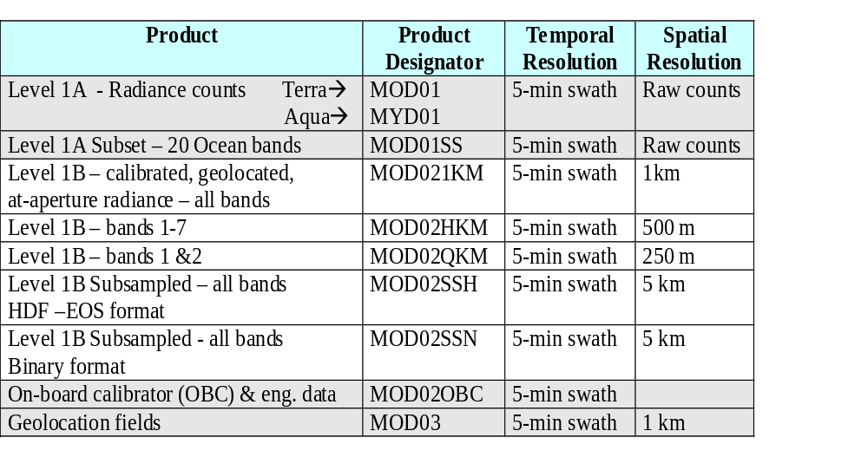
Current Products - Level 1

Slide 5
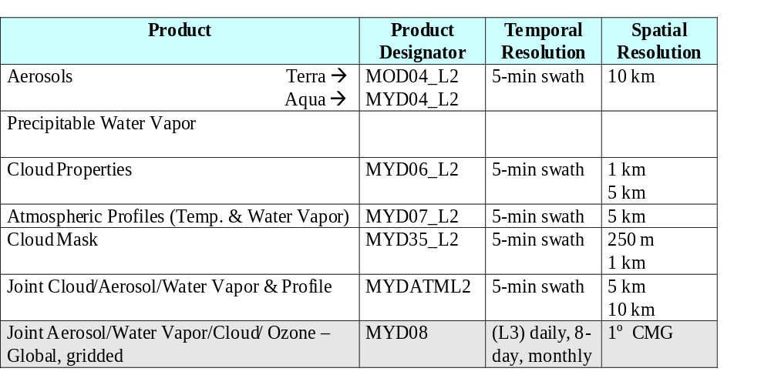
Current Products - Atmosphere

Slide 6
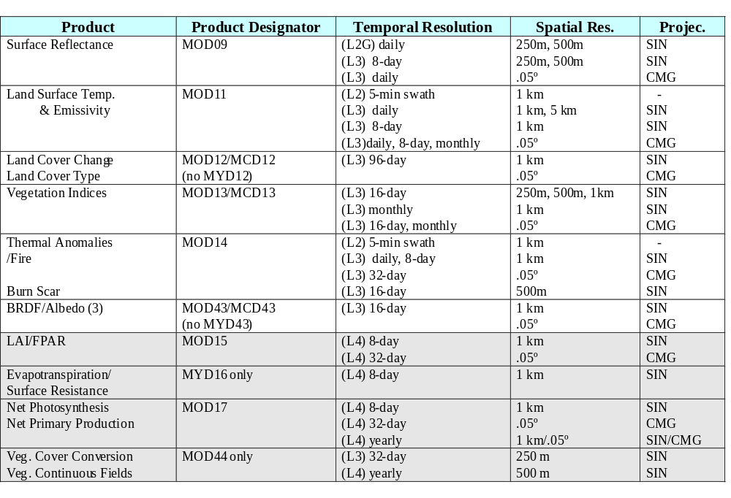
Current Products - Land

Slide 7
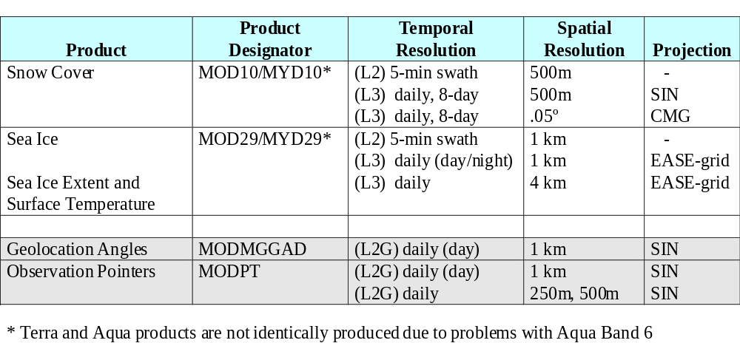
Current Products - Cryosphere
& Intermediate Land

Slide 8
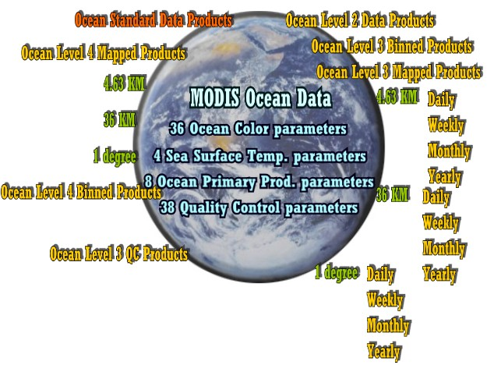
Terra Ocean Products
Feb. 2000 - Jan. 2004
*
*
* Feb. 2004 - Present

Slide 9
Ocean (Standard) Product Parameters
1 nLw_412/Normalized water-leaving radiance at 412 nm
nLw_443/Normalized water-leaving radiance at 443 nm
nLw_488/Normalized water-leaving radiance at 488 nm
nLw_531/Normalized water-leaving radiance at 531 nm
nLw_551/Normalized water-leaving radiance at 551 nm
nLw_667/Normalized water-leaving radiance at 667 nm
nLw_678/Normalized water-leaving radiance at 678 nm
Tau_869/Aerosol optical thickness at 869 nm
Eps_78/Epsilon of aerosol correction at 748 and 869nm
aer_model1/Aerosol model identification number 1
aer_model2/Aerosol model identification number 2
eps_clr_water/Epsilon of clear water aerosol correction at 531 and 667 nm
CZCS_pigment/Chlorophyll-a + pheopigment (fluorometric, empirical)
chlor_MODIS/Chlorophyll-a concentration (HPLC, empirical)
pigment_c1_total/Total pigment concentration (HPLC, empirical)
chlor_fluor_ht/Chlorophyll fluorescence line height
chlor_fluor_base/Chlorophyll fluorescence baseline
chlor_fluor_effic/Chlorophyll fluorescence efficiency
susp_solids_conc/Total suspended matter concentration in ocean
cocco_pigmnt_conc/Pigment concentration in coccolithophore blooms
cocco_conc_detach/Detached coccolithophore concentration
calcite_conc/Calcite concentration
K_490/Diffuse attenuation coefficient at 490 nm
phycoeryth_conc/Phycoerythrobilin concentration*
25 phycou_conc/Phycourobilin concentration
chlor_a_2/Chlorophyll-a concentration (SeaWiFS analog - OC3M)
chlor_a_3/Chlorophyll-a concentration (semianalytic)
Ipar/Instantaneous photosynthetically available radiation
Arp/Instantaneous absorbed radiation by phytoplankton for fluorescence
absorp_coef_gelb/Gelbstoff absorption coefficient at 400 nm
chlor_absorb/ Phytoplankton absorption coefficient at 675 nm
tot_absorb_412 /Total absorption coefficient at 412 nm
tot_absorb_443 /Total absorption coefficient at 443 nm
34 tot_absorb_488/Total absorption coefficient at 488 nm
35 tot_absorb_531/Total absorption coefficient at 531 nm
36 tot_absorb_551/Total absorption coefficient at 551 nm
37 SST (daytime), 11 µm
38 SST (daytime), 4µm
39 SST (nighttime), 11 µm
SST (nighttime), 4 µm
Angstrom_531/ Angstrom coefficient, 531-869 nm
* Not maintained

Slide 10
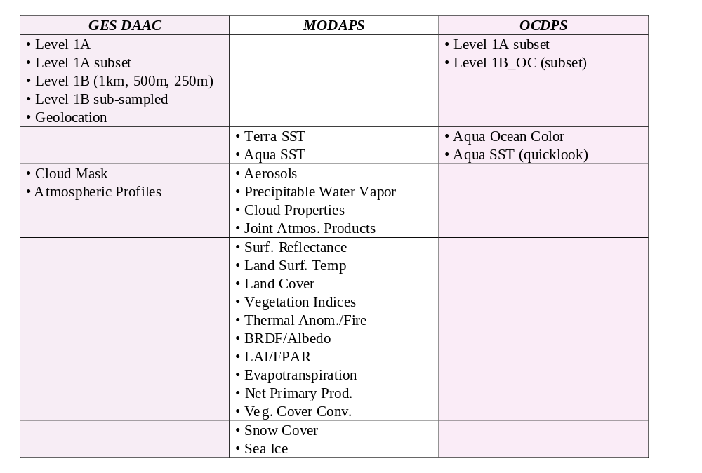
MODIS Data Processing
Level 1
Ocean
Atmosphere
Land
Cryosphere

Slide 11
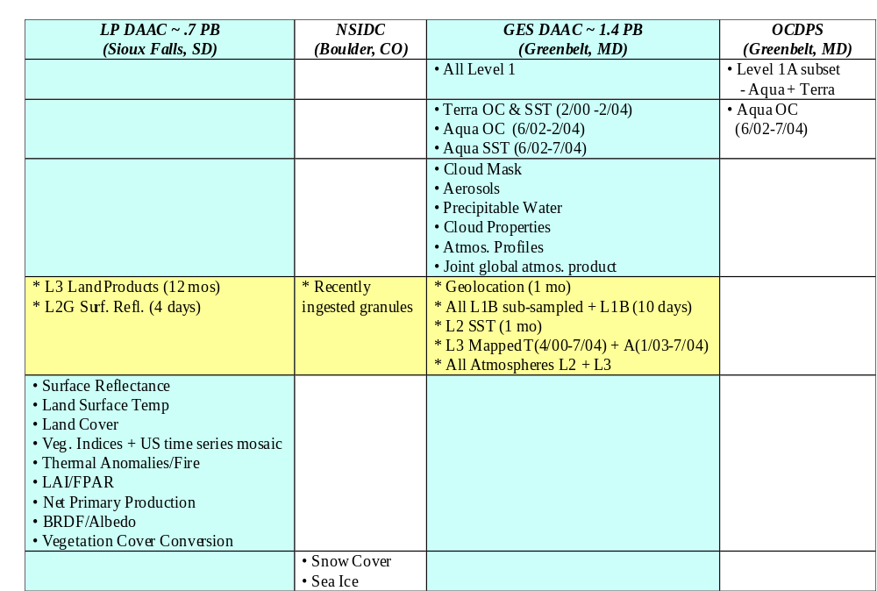
Archives of MODIS Data
Level 1
Ocean
Atmosphere
Data Pools*
Land
Cryosphere
*Data Pools are ‘rolling’ archives of fresh or high-interest data on disk

Slide 12
Product Collections
(Reprocessing Events)
2000
2001
2002
2003
2004
2005
2006
2007
2008
2009
Collection 1
Coll. 3
Collection 4
Collection 5
Collection 6
Collection 7
Terra
Aqua
Collection 3
Collection 4
Collection 5/Combined
Collection 6/Combined
Collection 7/Combined
Solid Color=Reprocessing
Dashed Color=Forward Processing
Dates represent Data Dates

Slide 13
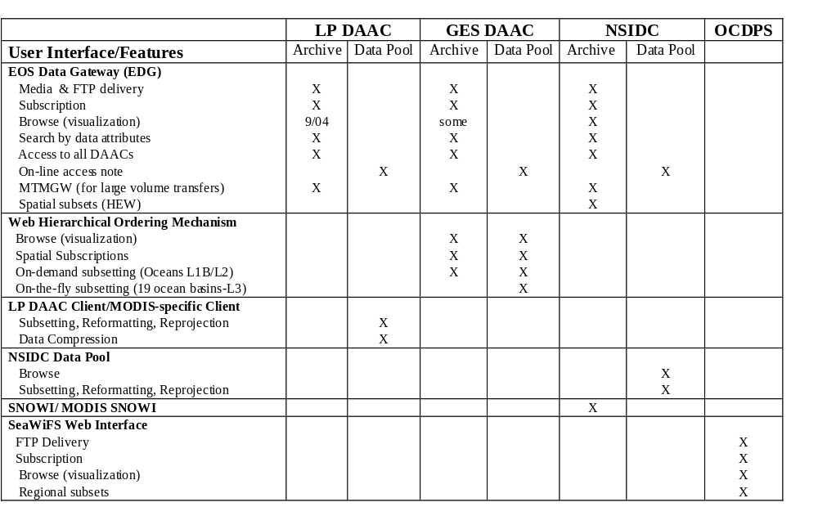
Distribution Mechanisms

Slide 14
In the Works
EOSDIS Clearing HOuse ECHO
  MODIS granules to populate by 8/04 at LP DAAC
Open Data Access Protocol (Open DAP, formerly DODS)
  L3 & L4 gridded data accessible
    http://daac.gsfc.nasa.gov/services/dods/DODS.html
  Supports subsetting
  Matlab and IDL Clients
MODIS On-line Visualization and Analysis System (MOVAS)
  On-line atmospheres data
  Emphasis on time series
  Subsetting capability
Near-Archive Data Mining (Experimental)

Slide 15
Data Tools Available for Users
        http://edcdaac.usgs.gov/datatools.asp
        http://nsidc.org/data/tools/
MODIS Reprojection Tool (MRT)
MODIS Land Data Operational Evaluation (LDOPE)
MODIS Swath Reprojection Tool (MRT Swath)
MODIS Atmospheres Tools
MODIS Swath-to-Grid Toolbox (MS2GT)
HDF-EOS to GeoTIFF Conversion Tool (HEG)
HEW Subsetting Appliance (HSA)

Slide 16
Data Access
EOS Data Gateway (EDG) - http://redhook.gsfc.nasa.gov/~imswww/pub/imswelcome/
NSIDC EDG: http://www.nsidc.org/~imswww/pub/imswelcome/
WHOM (for GES DAAC) - http://daac.gsfc.nasa.gov/data/
GES DAAC MODIS Data Support - http://daac.gsfc.nasa.gov/MODIS/
LP DAAC - http://edcdaac.usgs.gov/main.asp
Mosaic of MOIDS Veg. Indices - http://seamless.usgs.gov
NSIDC - http://nsidc.org/data/modis/
NSIDC data pool: http://www.nsidc.org/data/data_pool/
SNOWI: http://www.nsidc.org/data/snowi/
MODIS SNOWI: http://www.nsidc.org/data/modis_snowi/
Ocean Color - http://oceancolor.gsfc.nasa.gov

Slide 17
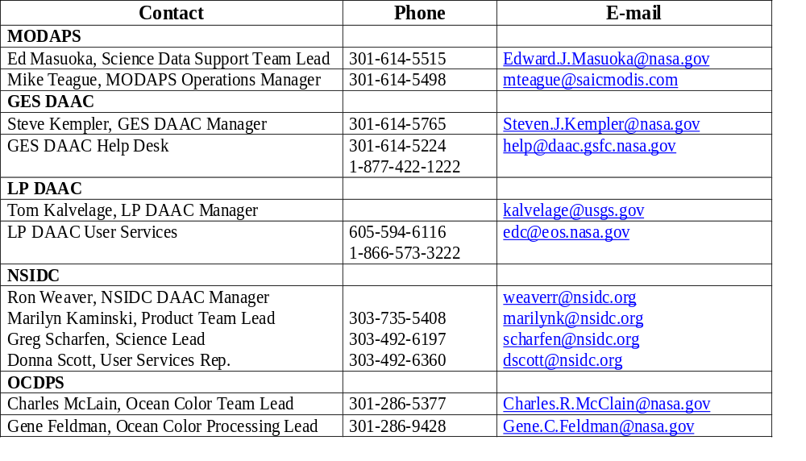
Contacts

Slide 18
Acronyms
BRDF - Bidirectional Reflectance Distribution Function
BU - Boston University
DAAC - Distributed Active Archive Center
ECHO - EOSDIS Clearing HOuse
ECS - EOSDIS Core System
EDG - EOS Data Gateway
EDOS - EOS Data Operations System
EOS - Earth Observing System
EOSDIS - Earth Observing System Data Information System
ESDIS - Earth Science Data and Information System (Project)
FDD - Flight Dynamics Division
FPAR - Fraction of absorbed Photosynthetically Active Radiation
FTP - File Transfer Protocol
GES DAAC - Goddard Earth Science DAAC
GMAO - Global Modeling and Assimilation Office
GSFC - Goddard Space Flight Center
HDF - Hierarchical Data Format
HEW - HDF-EOS Web-based subsetter
L0, L1, L2, L3, L4 - Level 0,1, 2, 3, 4 (processing levels)
LAI - Leaf Area Index
LDOPE - Land Data Operational Evaluation
LP DAAC - Land Processes DAAC
MCST - MODIS Characterizaton Support Team
MODAPS - MODIS Adaptive Processing System
MODIS - Moderate Resolution Imaging Spectroradiometer
MTMGW - Machine-to-Machine Gateway
NOAA - National Oceanographic and Atmospheric Administration
NSIDC - National Snow and Ice Data Center
OBC- On-board Calibrator
OC - Ocean Color
OCDPS - Ocean Color Data Processing System
QA - Quality Assurance
SCF - Science Computing Facility
SDST - Science Data Support Team
SST - Sea Surface Temperature
UCSB - University of California, Santa Barbara
UMD - University of Maryland
USGS - United States Geological Survey
WHOM - Web Hierarchical Ordering Mechanism

