Slide 1



NEWSPAGE LEVEREDGE (CHARM)
CHANGE & RELEASE MANAGEMENT

Slide 2

Change Advisory Board -Process scope
In scope:
All Application functionality changes should be against agreed requirements and designs
Solution components : Backoffice & Mobility
Out of Scope (as its SAAS Model)
Infra Changes – minor product/db version upgrades, application of patches, minor capacity enhancements (eg addition of virtual processing or storage capacity).

Slide 3
Pre cab process
Inputs
Requirement gathering and updating CR Log by Business Team.
Process
High Level Solutioining Review and Discussions (SME/Innovation Leads/ Deployment Leads)
Output
Complexity Determination and rough cut delivery estimation dates
Pass/Fail Decision for taking to CAB is evaluated.
Minutes of meeting shared along with Action points if any(before taking to CAB)
Approval and Signoff for Impact Analysis documents across Technologies/ Systems.
Impact Analysis and Systems impacted for the CR(Inputs PreRead Deck and Impact Analysis Documents- Solution Team).
Dependency & Impact on systems are reviewed.
Build Complexity - Technical/Functional Impact Review.
CR Prioritisation List.

Slide 4

CAB Composition
Attendee | CAB Role
Programme Business Director | Chair, Decision Maker
Programme IT Director | Decision Maker
Business Deployment Directors | Decision Maker
Solution Delivery Director | Decision Maker
Solution Delivery Leads (as required) | Participant – Decision Support
Development & Test Lead | Participant – Decision Support
BEL ( Business Engagement/Deployment Leads) | Participant – Decision Support
Business User/Market | Participant – Decision Support
Solution Architect | Participant – Decision Support
Change & Release Manager | Secretariat

Slide 5
cab process - kEY Principles
All CRs going into the Pre-CAB and CAB will be part of CR Prioritisation List.
All Pre-CAB and CAB discussions(including meeting invite), minutes of meeting, to be routed through Change and Release team only.
3. Multiple Requirements(more than 3) should not be clubbed in a single CR. CR
requirements should be logically related if more than one requirement.
4. The CAB will be the decision making forum, not a discussion forum. If a decision w.r.t a CR
cannot be rapidly made, the CR needs be deferred back into the corresponding impact
analysis cycle for further work.
5. The Business and Technology Delivery Leads are accountable for ensuring the quality of
CRs presented to CAB
6. The C&R Manager will be responsible for managing the CAB process.
7. Offline CAB approval for CRs (other than Statutory requirement CRs - with due Impact
Analysis approvals) is not recommended practise and should be avoided as much as possible.

Slide 6
cab process
Inputs
Requirement gathering and updating CR Log by Business Team.
Process
High Level Review and Discussions
Output
Impact Analysis Document Sign-off
Minutes of meeting shared.
PreCAB discussions and Recommendation to take for CAB.
Evaluate Business Benefit
Update CAB Status as per CAB decision in CRDB
CR is in the list of Prioritasion CRs.
Inputs from the PreCAB meeting
Review the CR for Completeness.
Evaluate Overall Solutioning.
Delivery schedule as prioritized(If CAB Approved)
CAB Decision -Approve/Reject/Hold
Notes:
CAB -Consists of Innovation Team/RTM Team/Business team(Including Directors and Market Teams)/BEM/Solution Team.
Final Decision on CR Approval/Rejection are made by the Innovation Lead and RTM Lead.

Slide 7

CORE principles
Zero Incidents
Protect BAU
Stability
Deliver quality
Audit Compliance
Clear Accountability
Review mechanism
Release Management
Release management is a software engineering process intended to oversee the development, testing, deployment and support of software releases. The practice of release management combines the general business emphasis of traditional project management with a detailed technical knowledge of the systems development lifecycle (SDLC) and IT Infrastructure Library (ITIL) practices
Release Management

Slide 8

Audit compliance
2016- Audit Snippet
Good: Functional requirements are defined, maintained, and stored in an accessible repository
Memo: Functional requirements for Application Development and Application Maintenance that are not complete, current, correct, technically feasible, or testable may result in software that does not meet the business need, duplicates or contradicts previous requirements, and re-work.
Memo: requirements for Application Development and Application Maintenance that are not complete, current, correct, technically feasible, or testable may result in software that does not meet the business need, poor Quality development, and the same code being revised multiple times.
Action: We must enforce a minimum standard of what all functional requirements must contain. These minimum standards should include how a person interacts with or uses the system and an explicit validation that the functionality does not already exists.

Slide 9



SUPPORT FIXES
Input
Bug fixes RFC
Process
Monthly thrice release
Evidences
Release Sheet (UAT SME & Basis sign off)
Excludes performance and design fix
Accenture will raise RFC for Mobility & Backoffice modules
RFC to be raised in Remedy by Wednesday by the requestor
Approvers –Respective innovation manager , AM , Change Manager , Landscape Manager and Service Delivery
Week transports to be approved by CEB
Reports excluded
For P1 or P2 transport Emergency RFC to be raised –RFC must –Approval from Innovation Manager , AM , Landscape nd Service delivery on official email
No scope during Month freeze Or Project freeze
RT sign off if impact analysis points to that by countries
Incident number / Problem Ticket number
For any downtime request outside ITM –CEB approval required
Communication on Friday every week by Change Manager
RCA for Problem Tickets are mandatory
Day-1
Raise RFC
Share release sheet
Day-2
Review RFC & Evidences
Trigger for Approval
Day-3
Review & Approve RFC
Communication
Day-4
Gentle reminder
Deployment

Slide 10
CR WORKFLOW
Inputs
CR –CAB approved and funding approved by Solution Delivery
Process
FS, SIT, UAT, RT gates clearance conducted by Newspage Leveredge Change Management
Evidence
Gate reviews clearance evidences -MOM
Part of Release Calendar –respective Month release -to be in the list of approved that month CR release
If downtime required for any CR outside ITM –Approval from CEB required
RFC raised as per Release calendar dates
Innovation manager, Landscape Manager , AM , Service delivery approves this RFC
Communication by Change Manager
SIT and RT sign off –Test Lead
Release Sheet (UAT SME & Basis sign off) – PMs
During the activity innovation manager sends communication
SME sign off for medium and complex CR’s
Rollback plan shared by PM
For outside release window –CEB approval required
Notes:
All Evidences to be uploaded to One Drive – CM/PM
Significant RFCs to be triggered for approval 4 business days prior to go live
Yow SingYap, Yow Sing yow.sing.yap@accenture.com(Test Manager) to review and confirm (SIT & RT)
Osorio, Hugo Hugo.Osorio@unilever.com to review & confirm UAT / RT
BUT – Build & Unit Testing
SIT – System Integration Testing
UAT – User Acceptance Testing
RT – Regression Testing
PT – Performance Testing
RFC – Request For Change

Slide 11
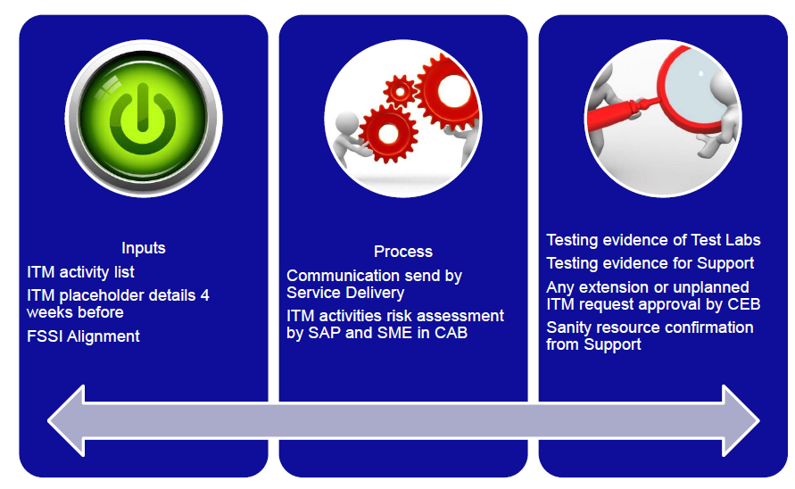
ITM FLOW
Notes:
If any changes require downtime to be clubbed with ITM release window based on Infra SME confirmation (notification 6 weeks in advance)

Slide 12
Projects
Inputs
FSSI entry 6 Months before
Process
FS, SIT, UAT , RT gates clearance conducted by Lever edge Change Management
Evidences
Gate reviews clearance evidences -MOM
Release Calendar Entry 6 Months before
RFC raised as per Release calendar dates
Innovation manager , Landscape Manager , AM , Service delivery approves this RFC
Communication by Lever edge Change Manager
During the activity innovation manager sends the communication
SME sign off
SIT and RT sign off from Test team
UAT sign off evidence
For outside release window –CEB approval required
Downtime alignment with Service delivery even if it is in FSSI
PT Sign-off from Accenture (on need basis)
Notes:
All Evidences to be uploaded to One Drive – CM/PM
Confirm on Business user participation & Sanity testing coordination from Project team
Significant RFCs to be triggered for approval 5 days prior to go live
Yow SingYap, Yow Sing yow.sing.yap@accenture.com(Test Manager) to review and confirm (SIT & RT)
Osorio, Hugo Hugo.Osorio@unilever.com to review & confirm UAT / RT
BUT – Build & Unit Testing
SIT – System Integration Testing
UAT – User Acceptance Testing
RT – Regression Testing
PT – Performance Testing
RFC – Request For Change

Slide 13
FSSI & Release gate links
One Drive: Common repository to upload all evidences
Latest FSSI & Release Gate Documents to be available at One Drive
FSSI (Forward Schedule Service Impacts) Calendar: Contains list of all Projects go live , ITM , SRMR (Security Risk Management Review) & Support fixes details across all the components.
Release Calendar -contains the FS, SIT, UAT , RT/PT completion dates for monthly release of CR’s and Project go live across online and offline lever Edge (Release gates/stages review).
Release Gates Document checklist
Check List for CR’s: | Responsible Team | Uploaded in One Drive | Approver
CR Document | Lead / Functional Consultant | Project Manager/Functional Consultant | - NA-
CAB approval | Functional Consultant | Change Manager | Suhas & Udit (CAB)
Impact analysis | Functional Consultant | Functional Consultant | Pre-CAB
FS Document & Sign-off | Functional Consultant | Functional Consultant | Business (Func.) UL Lead
TS Document & Sign-off | Technical Team | Technical Team | Technical SME
BUT Sign-off & Evidences | Technical Lead/ Functional Consultant | Project Manager | Technical Lead & PM
FAT Sign-off & Evidences | Functional Consultant/Lead | Functional Consultant | Functional Lead & PM
SIT Test Cases & sign-off | Test Labs /Test Manager | Test Labs /Test Manager | Test Labs (Except BW CRs)
UAT sign-off | Project Manager (PM) | PM /Functional Consultant | Business
RT Document & sign-off | Test Labs | Test Labs | Test Labs
Innovation Approval | Release Manager | Release Manager | Rohit Gupta

Slide 14
Approval Matrix
Tracks | Track Leads (Unilever) - Approval in Remedy | SMEs - Approval through Email
Support -ISR | Sreemoyee & Rohit | Sunil, Ragha & Deepak , Sushan (IBM)
Support- Mobility | Anil, Sreemoyee & Rohit | Vijay P
Support - BW | Amber, Sreemoyee (Sandeep) & Rohit (Kumaresh) | NA
Support - IQ | Mohit, Sreemoyee & Rohit | Hitesh
Support - Integration | Kumaresh, Sreemoyee & Rohit | Mallikarjuna
LE- Infra | Rohit /Kumaresh, Sreemoyee | Biju (online) & Vikram (Offline)
New Country/ Project (ISR, BW, PI, IQ & Mobility) go live | Venkat, Anil, Sreemoyee, Rohit, Amber, Mohit, & Kumaresh | Secure approval from the respective SMEs Email Approval
SRMR (ISR, BW, PI, IQ & Mobility) CRs | Venkat, Anil, Sreemoyee, Rohit, Amber, Mohit, & Kumaresh | Secure approval from the respective SMEs Email Approval
S&D Pro (Support & Project) | Naga NG, Sreemoyee & Rohit and Venkat (Project) | Zahid Ali - Technical, Ibrahim/Qamar- SME
Service & Global Change Team | All RFCs to be reviewed and approved in remedy SDM: Apoorva/ Manu and Sri Lanka: Naveen & GCM: Murali/ Richa (SPOC)
Back up or Alternate Approvals | Sreemoyee (Sandeep) & Rohit (Kumaresh), Apoorva (Manu), For Mohit, Amber, Kumaresh & Anil (Rohit), Naga (Venkat)
Lever Edge Remedy Groups :
Remedy Groups Names | Usage
IT-AA-AS NEWSPAGE_L1 | Coordinating with Unisys helpdesk on raising incidents & fixes incidents thru FAQ’s
IT-AA-AS NEWSPAGE_SUPPORT | Accenture L2 Basic fixes
IT-AA-AS NEWSPAGE | Accenture L3 Complex fixes

Slide 15

CEB Approval
Change Exception Board (CEB) Approval Scenarios
Exception Approvals | CEB form to be filled | Directors Approval | Track Leads/SMEs
1) Change of downtime from No to Yes in FSSI |  | Yes | Yes
2) Addition of activities but no change in the existing duration |  | No | Yes
3) For P1 & P2 - Resolution (No downtime) |  | No | Yes
4) For P1 & P2 - Resolution (Require downtime if not align with FSSI) |  | Yes | Yes
5) For P1 & P2 - Resolution (Require downtime align with FSSI) |  | No | Yes
6) Additional release window during week days in FSSI (For P3 & P4 Incident) |  | Yes | Yes
Change Exception Board (CEB) –Lead by Sindhu

Slide 16
Change Requirements
Emergency
Retrospective
Approval matrix refer CEB approval (Previous Slide);
Email/Verbal approval by Change Manager;
RFC should be raised and assigned to CM Queue and should be fully approved in Remedy.
There should be an existing P1 or P2 incident;
Verbal or mail approval by Change Manager;
RFC should be raised and assigned to CM Queue Retrospectively (next day at most);
E-mail sent to Change Manager as evidence for Verbal approval;
There should be an existing P1 or P2 incident;
Approval matrix refer CEB approval Slide;
The prefix “Emergency” in the Summary and Description field of the RFC.
Change Reason* Field to be set as “ Retrospective”
The prefix “Emergency” in the Summary and Description field of the RFC.
Change Reason* Field to be set as “ Emergency”

Slide 17
Service templates
Pre-Approved RFC
Service Request
Raise Pre-approved RFC in remedy and share release sheet with Basis sign-off
If CM team received before 14:00 IST, will implement that change on the same day (night), else will be on next day (night)
All configuration changes (agreed by Unilever team) can track through Service request
Change manager have an authority to reject or put on hold.
New DT Setup or modification of existing DT Details;
Change Manager will review and inform to implementing team
No approval for SRs but Change manager have an authority to reject or put on hold
Service Requests to be notified to CM team for review & validate
Code fix or downtime impact changes are not in scope of SR
Release sheet with Business Sign-off & Implementing team/SME sign-off
NOTE: No scope during Month End or Year End Transport Freeze

