Slide 1
Maven Repository Management with Nexus
Jim McMahon
8/29/10

Slide 2
What is a Maven Repository?
A Maven repository provides a standard for storing and serving binary software
Local repository exists in ~/.m2/repository
Maven Central: http://repo1.maven.org/maven2/

Slide 3
What is Nexus?
Nexus is a Maven Repository Manager created by Sonatype
Simplifies the maintenance of internal repositories and access to external repositories
Proxies requests for external artifacts and caches the results
Provides a deployment destination for your own generated artifacts
Notes:
iptables is a replacement for ipfwadm and ipchains
What is NAT and why would I do NAT?
http://www.netfilter.org/documentation/HOWTO//NAT-HOWTO-2.html#ss2.1

Slide 4
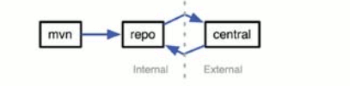
Proxying Remote Repositories
When you proxy a remote repository, your repository manager accepts requests for artifacts from clients
If the artifact is not already cached, the repository manager will retrieve the artifact from the remote repository and cache the artifacts.
Subsequent requests for the same artifact will be served from the local cache.
Notes:
Stateless firewalls don't maintain any state information about TCP connections. They must use simple set of rules to filter TCP packets. Stateless firewalls look for packets containing connection initiation request packets with the SYN flag set.
Example of stateful firewall: http://my.safaribooksonline.com/0672327872/ch10lev1sec3?query=(iptables+firewall)+AND+(flow)&reader=html&imagepage=#X2ludGVybmFsX0ZsYXNoUmVhZGVyP3htbGlkPTA2NzIzMjc4NzIvY2gxMGxldjFzZWMxJmltYWdlcGFnZT0=
Connection tracking module allows stateful packet firewalls
Even stateless protocols such as UDP are stateful.
Packet filters look at the header of the packet and decides the fate of the entire packet. Link to what a packet looks like: http://www.netfilter.org/documentation/HOWTO//networking-concepts-HOWTO-8.html
Patch-o-matic : is a system to apply netfilter-related patches to the latest kernel and/or iptables sources.
http://www.netfilter.org/projects/patch-o-matic/index.html

Slide 5
Artifact Downloads and Caching

Slide 6
Repository Groups

Slide 7
Restricting Downloaded JARs

Slide 8

Hosted Internal Repositories
When you host a repository, your repository manager takes care of organizing, storing and serving binary artifacts
You can use a hosted internal repository to store internal release artifacts, snapshot artifacts, or 3rd party artifacts

Slide 9
Release Artifacts
These are specific, frozen-in-time artifacts
Considered to be solid, stable, and perpetual in order to guarantee that builds which depend on them are repeatable over time
Released JAR artifacts are associated with PGP signatures and checksums that verify both the integrity and authenticity of the binary software artifact
Maven Central stores release artifacts

Slide 10
Snapshot Artifacts
Snapshots capture a work in progress and are used using development
A snapshot artifact has both a version number such as “1.3.0” or “1.3” and a timestamp
e.g.,
  commons-lang-1.3.0-20090314.182342-1.jar

Slide 11
Reasons to Use a Repository Manager
Speeds up builds
Builds will be more stable
You can deploy and host 3rd party artifacts
Easier developer collaboration and sharing of artifacts
Searching and indexing of artifacts
Repository groups makes it easier to retrieve artifacts from a single URL
Procuring External Artifacts: define lists of allowed/blocked repos
Staging and Release Management

Slide 12
Repository Coordinates
Coordinate | Definition
groupId | Groups a set of artifacts into a logical group (e.g. org.apache.maven)
artifactId | Name for a software artifact. (e.g., simple-webapp)
version | Numerical version for a software project (e.g, 1.2.3, 1.2, 1.2-beta)
packaging | Describes the contents of the software artifact (e.g., jar, zip, swc, swr, nar, war, ear, sar

Slide 13
Addressing Resources in a Repository
Tools designed to interact with Maven repositories translate artifact coordinates into a URL which corresponds to a location in a Maven repository
e.g., groupId: castor, artifactId: castor, version 0.9.9 may be found under /castor/castor/0.9.9/castor-0.9.9.jar in the Maven Repository

Slide 14
Nexus Production Server
Spec | Value
Location | Helgerman Court
OS | RHEL 5
CPU | Quad Core
Memory | 16 GB
Form factor | Blade Server

Slide 15
Nexus Software
Spec | Value
Version | Nexus Professional 1.7.2
License and Support Contract | See Collaborate Restricted Content Page https://collaborate.nci.nih.gov/display/CBIITNetOps/CBIIT+Web+Support+-+Restricted+Content
CBIIT Project Page | https://collaborate.nci.nih.gov/display/CBIITNetOps/Sonatype+Nexus+Maven+Repository+Manager
URL | https://ncimvn.nci.nih.gov/nexus

Slide 16
Browsing Repositories

Slide 17
Nexus Maven 2 Release Repositories
Repository ID | Comment
3rd Party | Used to install 3rd party artifacts that are not in one of the common public repositories
Google Code | Repository containing Google projects
Java.net – Maven 2 | Contains some interesting projects like PostgreSQL and JBoss
Maven Central | Main Maven public repo. Very large.
Releases | Hosted repository for internal projects

Slide 18
Nexus Maven 2 Snapshot Repositories
Repository ID | Comment
Apache Snapshots | Snapshots for Maven and many plugins
Codehaus Snapshots | Contains many maven plugins for the Mojo Project and others
Snapshots | Hosted repository for internally developed snapshots

Slide 19
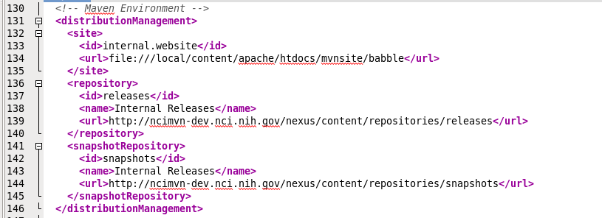
Deploying a SNAPSHOT

Slide 20
Deploying a SNAPSHOT: settings.xml

Slide 21
Deploying a SNAPSHOT cont.
$ mvn clean install deploy
Removes build output under target/ folder
Compiles and installs the application in ~/.m2/repository
Deploys the application to the SNAPSHOT repository
Can be simplified by running 'mvn clean deploy'

Slide 22
Deployed SNAPSHOT in Nexus
Notice that SNAPSHOT is replaced with a timestamp

Slide 23
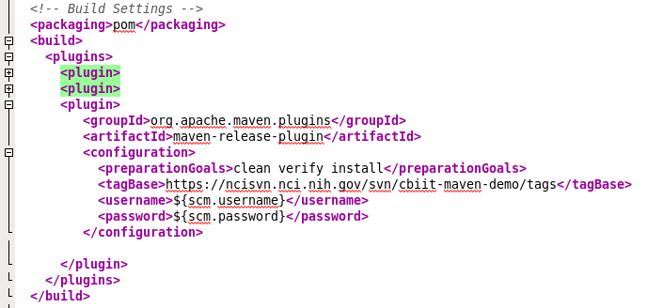
Release plugin configuration
Configure the SCM block
Configure the releases plugin

Slide 24
Automating releases
Deploying a release involves a number of standard steps
  Commit all current changes to Subversion
  Update the version number (release version) and commit the changes
  Tag the release version
  Build and deploy this version
  Update the version number (development version) and commit the changes
These steps are easily automated using the release plugin

Slide 25
Preparing a release
$ mvn release:prepare
Maven will:
Check that there is no uncommitted code
Check that there are no snapshot dependencies
Ask you to confirm the release version, release tag, and new development version
Will update the files and check them into Subversion

Slide 26
Preparing a release cont.
$ mvn release:prepare
Maven will also:
Update the SNAPSHOT version number to a release version number
Perform a build to verify everything is ok
Commit the modified POMs to the SCM
Create a tag in the SCM for the release
Update the POM version number to the next SNAPSHOT version
Commit the modified POMs to the SCM

Slide 27
Deployed release artifacts in Nexus

Slide 28
Manually Uploading Artifacts (3rd party)

Slide 29
System Feeds

Slide 30
Deploying Sites to Nexus
Nexus allows you to create a Maven site repository to hold Maven generated reports
Provides a central location for project information similar to what GForge provides
Unlike GForge, the management of the project info (e.g., trackers, project docs, etc.) is handled by other tools (e.g., Jira, Confluence, AnthillPro, Atlassian Fisheye, etc.)
Maven site pages add links to these tools and provide overall project descriptions

Slide 31
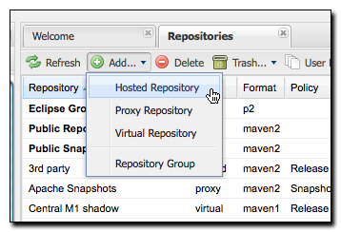
Creating a Maven Site Repository
Add a “Hosted Repository”

Slide 32
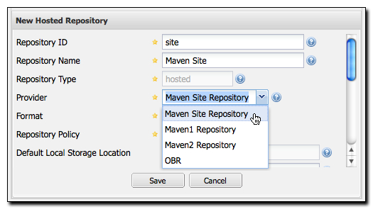
Creating a Maven Site Repository cont.
Change the type (provider) of the repo to “Maven Site Repository”

Slide 33
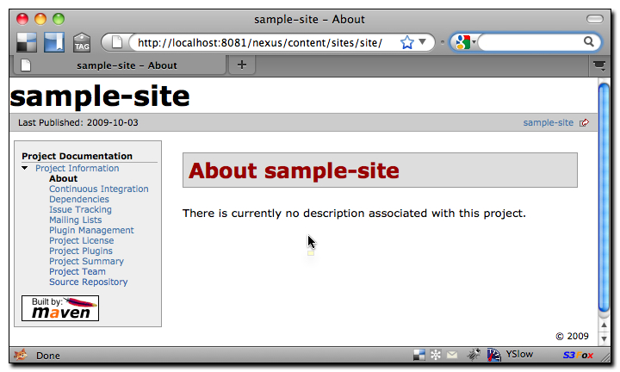
Publishing a Maven Site to Nexus
$ mvn site site:deploy

Slide 34
Build Promotion with Nexus Staging Suite
Without the Staging Suite, an artifact deployed to a Hosted repository is available immediately, with no oversight, approval or certification
Organizations with a QA team may want artifacts deployed to a staging repository for potential release candidates
The Nexus Staging Suite creates temporary repositories that can be promoted as a whole or dropped depending on the results of QA testing

Slide 35
How Staging Suite Works
Developer deploys an artifact or set of artifacts to Nexus
Staging Suite intercepts this deployment and matches the artifact's path against a set of Staging Profiles
If the path of the artifact activates a staging profile, a temporary staging repository is created and the artifacts are deployed to this repository
Once deployed, the developer will “Close” the staging repo
The Staging Suite will add the temporary staging repo to one or more Target Repository Groups.

Slide 36
Staging Suite: intercepting deployed artifacts

Slide 37
Staging Suite: Releasing an artifact

Slide 38
Multi-level Staging and Build Promotion

Slide 39
Nexus Procurement Suite
Gives Nexus administrators control over what artifacts are allowed into an organization from a remote proxied repository such as Maven Central
Can be used to limit based on version or license

Slide 40

Q & A
PM 101
05/13/10

Slide 41

Thank You for coming!
PM 101
05/13/10

