Slide 1

LEARNING
SPRING BATCH

Slide 2

WHAT IS THIS ALL
ABOUT?

Slide 3
Overview of batch processing

Slide 4
WHAT IS
SPRING BATCH?

Slide 5

TAKE A
DEEP DIVE

Slide 6

LOOK AT RELATED
SPRING TECHNOLOGIES

Slide 7
1
SPRING BATCH ADMIN

Slide 8
2
SPRING HADOOP

Slide 9
3
SPRING XD

Slide 10
What is batch processing?

Slide 11
The original processing model

Slide 12
ENAC

Slide 13
What’s old is new again

Slide 14
Big data/MapReduce/etc
Data Science

Slide 15
Definition of batch processing

Slide 16

Batch processing, … is defined as the processing of a finite amount of data data without interaction or interruption.

Slide 17
Finite

Slide 18
Without interaction or interruption

Slide 19
Batch use cases

Slide 20
1
ETL

Slide 21
2
REPORTING

Slide 22
3
DATA SCIENCE

Slide 23
4
BIG DATA

Slide 24
5
NON-INTERACTIVE PROCESSING

Slide 25
What is Spring Batch

Slide 26
The leading framework for batch processing on the JVM

Slide 27
Stats

Slide 28
StackOverflow questions: 2064

Slide 29
Downloads: aprox 750000 downloads over the last year

Slide 30
Basis for JSR-352

Slide 31
Compare JSR-352 doc to our doc

Slide 32
Developed as a partnership between Accenture and SpringSource

Slide 33
1.0 in 2008

Slide 34
3.0.4 is the current version and what we’ll be using in this video series

Slide 35
Features

Slide 36
Job flow state machine

Slide 37
Transaction handling

Slide 38
Declaritive I/O

Slide 39
Robust error handling

Slide 40
Extensive scalability options

Slide 41
Battle tested in virtually every enterprise vertical

Slide 42
Built on Spring!

Slide 43
WHO USES
SPRING BATCH?

Slide 44
1
MORGAN STANLEY

Slide 45
2
CARS.COM

Slide 46
3
eHARMONY

Slide 47
4
ORBITZ

Slide 48
5
FEDERAL RESERVE BANK

Slide 49
6
WALGREENS

Slide 50
7
MLB

Slide 51
8
NHL

Slide 52
9
HSBC

Slide 53
10
CBOE

Slide 54
Who is this video series for?

Slide 55
Developers looking to create robust batch solutions

Slide 56

PREREQUISITES

Slide 57

JAVA

Slide 58

SPRING

Slide 59
<?xml version="1.0" encoding="UTF-8"?> <beans xmlns="http://www.springframework.org/schema/beans" xmlns:xsi="http://www.w3.org/2001/XMLSchema-instance" xsi:schemaLocation="http://www.springframework.org/schema/batch http://www.springframework.org/schema/batch/spring-batch.xsd http://www.springframework.org/schema/beans http://www.springframework.org/schema/beans/spring-beans.xsd"> <job id="ioSampleJob" xmlns="http://www.springframework.org/schema/batch"> <step id="step1"> <tasklet> <chunk reader="itemReader" processor="itemProcessor" writer="itemWriter" commit-interval="2" /> </tasklet> </step> </job> <bean id="itemProcessor" class="org.springframework.batch.sample.domain.trade.internal.CustomerCreditIncreaseProcessor" /> </beans>
XML

Slide 60

GIT/GITHUB

Slide 61
<int:service-activator id=“serviceActivator”
input-channel=“requests”
output-channel=“replies”
ref=“chunkProcessorChunkHandler”
method=“handleChunk”/>
<bean id=“chunkProcessorChunkHandler”
class=“o.sf.b.i.c.ChunkProcessorChunkHandler”>
<property name=“chunkProcessor”>
<bean class=“o.sf.b.c.s.i.SimpleChunkProcessor”>
<property name=“itemWriter”>
<bean class=“MyItemWriter”/>
</property>
<property name=“itemProcessor”>
<bean class=“MyItemProcessor”/>
</property>
</bean>
</property>
</bean>
NEXT THE CODE…

Slide 62

IMAGE CREDITS

Slide 63

SPRING BATCH
101

Slide 64

JOB

Slide 65

STEP

Slide 66

TASKLET

Slide 67

CHUNK

Slide 68
FEATURES
INCLUDE

Slide 69
1
TRANSACTION MANAGEMENT

Slide 70
2
DECLARITIVE I/O

Slide 71
3
START/STOP/SKIP

Slide 72
4
ADMIN APPLICATION

Slide 73
5
BASED ON SPRING!

Slide 74


SPRING BATCH
TODAY

Slide 75
SPRING BATCH
3.0.3

Slide 76



+
=
Notes:
Spring Batch Integration

Slide 77


JSR-352
JBATCH

Slide 78
SPRING BATCH ADMIN
1.3.1

Slide 79
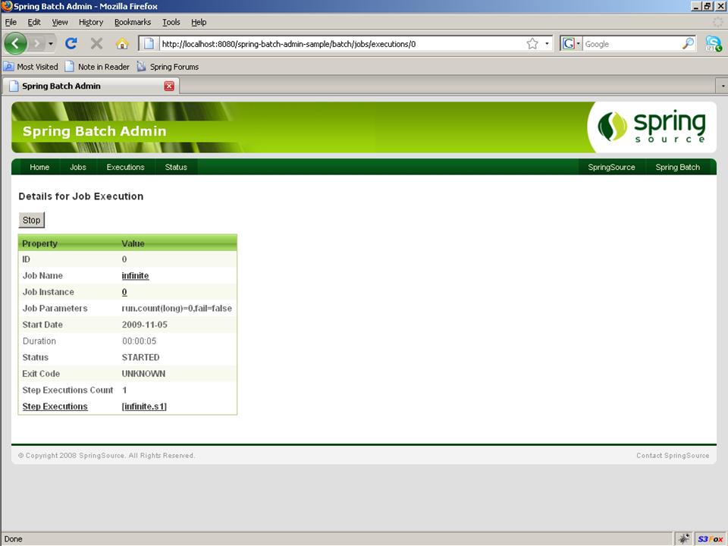

Slide 80
SO WHAT’S
NEW?

Slide 81
NAMESPACE SUPPORT FOR
REMOTE CHUNKING

Slide 82
<bean id=“itemWriter”
class=“o.sf.b.i.c.ChunkMessageChannelItemWriter”>
<property name=“messagingOperations”
ref=“messagingTemplate”/>
<property name=“replies” ref=“replies”/>
</bean>
<bean id=“chunkHandler”
class=“o.sf.b.i.c.RemoteChunkHandlerFactoryBean”>
<property name=“chunkWriter” ref=“itemWriter”/>
<property name=“step” ref=“step1”/>
</bean>

Slide 83
<int:service-activator id=“serviceActivator”
input-channel=“requests”
output-channel=“replies”
ref=“chunkProcessorChunkHandler”
method=“handleChunk”/>
<bean id=“chunkProcessorChunkHandler”
class=“o.sf.b.i.c.ChunkProcessorChunkHandler”>
<property name=“chunkProcessor”>
<bean class=“o.sf.b.c.s.i.SimpleChunkProcessor”>
<property name=“itemWriter”>
<bean class=“MyItemWriter”/>
</property>
<property name=“itemProcessor”>
<bean class=“MyItemProcessor”/>
</property>
</bean>
</property>
</bean>

Slide 84
<batch-int:remote-chunking-master id="itemWriter"
message-template="messagingTemplate"
step="process"
reply-channel="replies"/>

Slide 85
<batch-int:remote-chunking-slave id="remote-chunking-slave"
input-channel="requests"
output-channel="replies" item-processor="itemProcessor"
item-writer="itemWriter"/>

Slide 86
DISTRIBUTED
JOB REPOSITORY

Slide 87



JOB1
JOB2
JOB3
Notes:
Focus on the server icon this time around

Slide 88
JOB1
JOB2
JOB3
Notes:
Focus on the server icon this time around

Slide 89
JOB1
Client
JOB2
Client
Server
JOB3
Client
Notes:
Focus on the server icon this time around

Slide 90
SPRING BATCH
3.1.0

Slide 91
SPRING BATCH ADMIN
2.0.0.M1

Slide 92

SPRING XD
EXTREME DATA

Slide 93

MIGRATE
REST API

Slide 94

REFINE
THE API

Slide 95

REMOVE UI

Slide 96
MULTIPLE
SAMPLE UIs

Slide 97

1

Slide 98

2

Slide 99
SPRING BATCH ADMIN
2.0.0

Slide 100



