Slide 1
OrientDB
Ram Software Engineering Labs Pvt Ltd

Slide 2
Orient DB - Introduction

Slide 3
Motivation to use NoSQL
Performance
Scalability
Lesser footprint
Schema flexibility
Developer productivity

Slide 4
No SQL Models
Key-Value
Hash table of key value pairs
Easily distributed across multiple servers
Ex: Redis, Dynamo, Riak
Column oriented
Data in sections of columns
Easy batch processing, aggregation
Ex: Cassandra (Facebook), Big Table (Google), SimpleDB (Amazon)
Document
Collections of individual documents without a schema
Ex: MongoDB, CouchDB
Graph
Vertices connected by edges having properties without a schema
Ex: Neo4j, OrientDB

Slide 5
Setup OrientDB
Ensure JDK 1.6 or higher is there on PATH
Download community edition
http://orientdb.com/download/
Extract orientdb-community-2.1.10.zip
Start server
%ORIENTDB_HOME%\bin\server.bat
Set root password

Slide 6
Choose the best tool for your use case!

Slide 7
OrientDB is a document-graph database with full native graph capabilities coupled with features found in document databases

Slide 8
OrientDB as a true multi model DBMS – supports Graph, Document, Key-Value, Object models

Slide 9
Orient DB as a Document Model

Slide 10
Document
Document is a Collection of Key / Value pairs referred as fields or properties
Key allows access to its values
Values can hold
Primitive data types
Embedded documents
Arrays of other values
Documents not forced to have schema
Flexible and easy to use

Slide 11
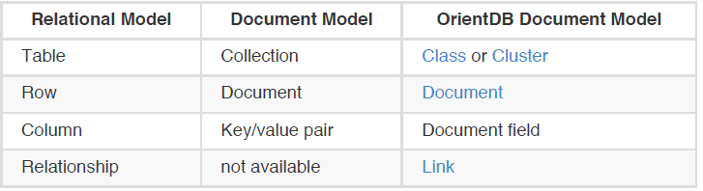
Terminologies – Document Model

Slide 12
Orient DB as a Graph Model

Slide 13
Graph
Network structure with Vertices (also Nodes) interconnected by Edges (also Arcs)
Vertices – entity linked with other vertices. It has
unique identifier
set of incoming Edges
set of outgoing Edges
Optional set of user defined custom properties
Edges – entity linking two vertices. It has
unique identifier
set of incoming Edges
set of outgoing Edges
label defining the type of connection between head and tail vertex
Optional set of user defined custom properties

Slide 14
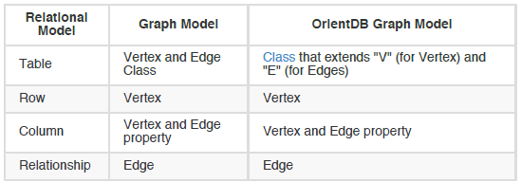
Terminologies – Graph Model

Slide 15
Orient DB as a Key/Value Model

Slide 16
Key / Value Pair
Values can be simple or complex type
Every value can be reached by a key
Documents and Graph Elements as Values in OrientDB

Slide 17
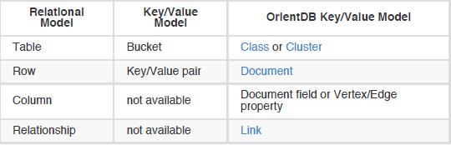
Terminologies – Key/Value Model

Slide 18
Orient DB as an Object Model

Slide 19
Object Oriented Model
OrientDB supports
Inheritance between types
Polymorphism referring to base class
Direct binding from / to objects in programming languages

Slide 20
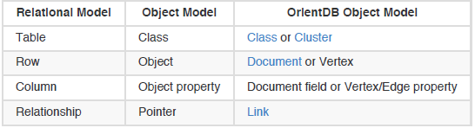
Terminologies – Object Model

Slide 21
Orient DB Setup Overview of clients and APIs

Slide 22
Community Vs Enterprise Editions
Community Edition – Apache 2 license
Enterprise Edition – Built on top of community edition with following additional features
Query Profiler
Distributed Clustering Configuration
Metrics Recording
Live Monitoring with configurable Alerts

Slide 23
Pre-requisites
Java 1.6 or higher
All OS that Java supports

Slide 24
Download OrientDB
Download platform specific community edition
http://orientdb.com/download/

Slide 25
Start OrientDB server
cd bin
server.bat
OrientDB Server listens on 2 ports
Binary port (default: 2424) - Used by
console
clients/drivers supporting network binary protocol
HTTP port (default: 2480) – Used by
OrientDB studio web tool
clients/drivers/tools like CURL supporting HTTP/REST
Change defaults in config/orientdb-server-config.xml

Slide 26
OrientDB Console
Start CLI
%ORIENTDB_HOME%\bin\console.bat
Connect to server
connect remote:localhost root <rootpassword>
Root password in config/orientdb-server-config.xml
See list of databases in server
list databases
Connect to demo database
connect remote:localhost/GratefulDeadConcerts root <rootpassword>
List of classes or record types
classes
Create class
create class Student

Slide 27
OrientDB Studio
Open web browser with URL http://localhost:2480
Login with same user id and password as console

Slide 28
OrientDB SQL-like API
Very few differences between standard SQL and OrientDB SQL
Keywords and class names are case insensitive
Field names and values are case sensitive

Slide 29
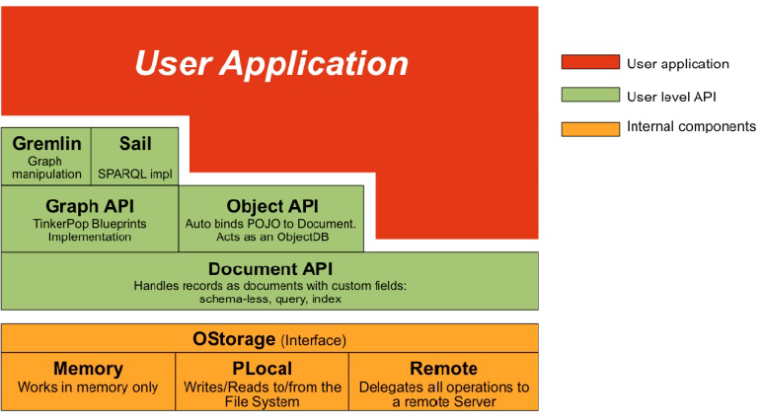
OrientDB Java client –API

Slide 30
OrientDB – Java Graph API
100% Based on Tinkerpop version 2.x
Does not support Apache Tinkerpop 3 yet
Development in progress
Expected to support in OrientDB version 3 scheduled later part of 2016
Use this API to work with Vertices and Edges

Slide 31
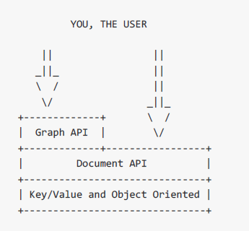
OrientDB Graph API
Recommended Go-To API for all models in just one Multi-model API
Supports schema-less, schema-full, hybrid
Relationships as bidirectional edges
Edges without properties are stored as Lightweight edges

Slide 32
OrientDB – Java Document API
Handles records as documents
Does not need a domain POJO to map it to document in DB
Supports both schema-less and schema-base modes

Slide 33
OrientDB Document API
PROS
Document API simpler than Graph API
Document operations are atomic whereas Graph API maintains In and Out properties requiring Graph operations to be performed within a transaction
CONS
Relationships only mono-directional
Need bidirectional ? ➔ implement and maintain both links

Slide 34
OrientDB – Java Object API
Maps POJO entities with documents
Not to be used
Prefer Graph or Document API over Object API
Similar to JPA

Slide 35
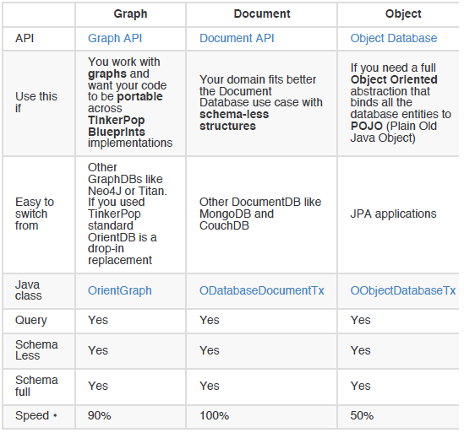
OrientDB – Java API Comparisons

Slide 36
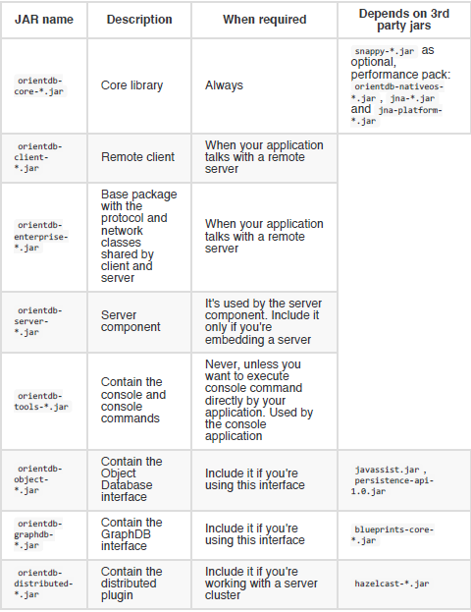
OrientDB – Java Libraries to use

Slide 37
JARs for using Graph API
orient-commons-*.jar
orientdb-core-*.jar
blueprints-core-*.jar
orientdb-graphdb-*.jar
Only for connecting to remote server
orientdb-client-*.jar
orientdb-enterprise-*.jar
To use Pipes data flow framework
orientdb-client-*.jar
orientdb-enterprise-*.jar
To use Gremlin for graph traversals
gremlin-java-*.jar
gremlin-groovy-*.jar
groovy-*.jar

Slide 38
JARs for using Document API
orient-commons-*.jar
orientdb-core-*.jar
Only for connecting to remote server
orientdb-client-*.jar
orientdb-enterprise-*.jar

Slide 39
Orient DB Document Model

Slide 40
Features of Document API
supports Multi threaded access
supports Transactions
supports Queries
supports Traverse (traversing through Links instead of joins)
very flexible: can be used in schema-full, schema-less or schema-hybrid mode

Slide 41
Records
Smallest unit to load and store in database
Record types
Document
RecordBytes – to store Blob-like data (load / store binary data)
Vertex
Edges

Slide 42
Documents
Most flexible data type in OrientDB
Defined by schema classes (optional) with defined constraints and indexes
Also use in schema-less mode (without schema class => thereby no constrains)
Export / import to/from JSON

Slide 43
Classes
Document belongs to a CLASS (type)
Document composed of attributes
By default, document is schema less
No need to define properties
Define schema specifying properties and their data types
To define constraints and indexes

Slide 44
OrientDB Console – Classes and properties
Create class
create class Student
Create properties (mandatory for constraints, indexes)
create property Student.name string
create property Student.birthDate date
Describe schema of Class
info class Student
Add constraint to class / property
alter property Student.name min 3
See all records in class
browse class Student;
Show details in a record based on ID
display record 0

Slide 45
OrientDB Console – Classes and clusters
By default one cluster per class
One Class can have more than one cluster. To add
ALTER CLASS Customer ADDCLUSTER USA_Customers
Need for more than one cluster for class
faster queries as only a sub-set to search
good partitioning reduce/remove use of indexes
parallel queries if on multiple disks
sharding large data sets across multiple disks or server instances
Types of clusters
Physical – persistent, stored in files
Logical – Inmemory, lost on server shutdown

Slide 46
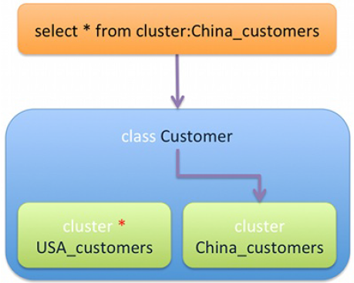
OrientDB Console – Classes and clusters
Show list of clusters
clusters
Fetch records in a cluster
browse cluster OUser

Slide 47
Cluster Selection Strategy
Default
Uses class’ defaultClusterId property
Round-Robin
Clusters of class in a ring, chosen one after another
Balanced
Smaller cluster is chosen
Local
Use current node’s master cluster while running in distributed mode

Slide 48
Record ID / RID
#<cluster-id>:<cluster-position>
Cluster Id
ID of cluster, maximum of 2^15 – 1 => 32,767
Cluster Position
Position of record inside cluster
2^63 => 9,223,372,036,854,780,000 records
Maximum records in database
2^78 records = 302,231,454,903 Trillion of records
Never recycled
Physical location of record inside database
Loading record by ID is fast
Links to records are physical – created at the time of edge
So traversal speed is constant irrespective of database size

Slide 49
OrientDB Console – Record ID / RID
load record #<cluster-id>:<cluster-position>
Loads the record with following details
Type of record: Ex. Document
Class
Current Version
Every change to record increases the version
Used in optimistic transactions to avoid conflicts in commit time
Shows record with properties and data types
LINK to another record (relationship) can be lazily loaded

Slide 50
OrientDB Console – SQL support
SELECT :
select from ouser
browse cluster ouser
browse class ouser
same result
Other Variations :
select from cluster:Ouser
select from #10:3 or select from [#10:1, #10:3, #10:5]
select value from index:dictionary where key = 'Jay‘
Where Condition :
select from Employee where city = 'Rome' order by surname asc, name asc

Slide 51
OrientDB Console – SQL support
SKIP :
select from Employee where gender = 'male' limit 20
select from Employee where gender = 'male' skip 20 limit 20
select from Employee where gender = 'male' skip 40 limit 20
INSERT :
insert into Employee (name, surname, gender) values ('Jay', 'Miner', 'M')
insert into Employee set name = 'Jay', surname = 'Miner', gender = 'M‘
with JSON data :
insert into Employee content {name : 'Jay', surname : 'Miner', gender : 'M'}

Slide 52
OrientDB Console – SQL support
UPDATE :
update Employee set local = true where city = 'London‘
update Employee merge { local : true } where city = 'London'
DELETE :
delete from Employee where city <> 'London‘

Slide 53
OrientDB – Modeling Relationships
LINK, to point to one record only
LINKSET, to point to several records. Like Java Sets, the same RID can only be included once. The pointers also have no order
LINKLIST, to point to several records. Like Java Lists, they are ordered and can contain duplicates
LINKMAP, to point to several records with a key stored in the source record. The Map values are the RIDs. Works like the Java Map<?,Record> .

Slide 54
OrientDB Java API – Document Model

Slide 55
Library Dependencies
For Local / Embedded mode
orient-commons-*.jar
orientdb-core-*.jar
For remote client
orientdb-client-*.jar
orientdb-enterprise-*.jar

Slide 56
Create new database
In Local filesystem
ODatabaseDocumentTx db = new ODatabaseDocumentTx ("plocal:/tmp/databases/petshop").create();
On remote server (Host = dbhost, Database name = dbname, database type = document (change to “graph” for graph database),
new OServerAdmin("remote:dbhost")
.connect("root","kjhsdjfsdh128438ejhj")
.createDatabase("dbname","document","local")
.close();

Slide 57
Schema generation using OriendDB API
public class Foo{
private String text;
private Child reference;
private int number;
//getters and setters
}
OClass foo = db.getMetadata().getSchema().getClass(Foo.class);
OClass child = db.getMetadata().getSchema().getClass(Child.class);
foo.createProperty("text",OType.STRING);
foo.createProperty("number",OType.INTEGER);
foo.createProperty("text",OType.LINK, child);
db.getMetadata().getSchema().save();

Slide 58
Storing documents in OrientDB
// OPEN THE DATABASE
ODatabaseDocumentTx db = new ODatabaseDocumentTx("remote:localhost/petshop").open("admin", "admin“);
// CREATE A NEW DOCUMENT AND FILL IT
ODocument doc = new ODocument("Person");
doc.field( "name", "Luke" );
doc.field( "surname", "Skywalker" );
doc.field( "city", new ODocument("City").field("name","Rome").field("country", "Italy") );
// SAVE THE DOCUMENT
doc.save();
db.close();
Declared type “Person” gets created automatically
Without constraints

Slide 59
Orient DB Graph Model

Slide 60
OrientDB – Graph Model
LINK, to point to one record only
LINKSET, to point to several records. Like Java Sets, the same RID can only be included once. The pointers also have no order
LINKLIST, to point to several records. Like Java Lists, they are ordered and can contain duplicates
LINKMAP, to point to several records with a key stored in the source record. The Map values are the RIDs. Works like the Java Map<?,Record> .

Slide 61
References
Switching to graph model
http://www.slideshare.net/lvca/switching-from-relational-to-the-graph-model
Latest ranking of databases based on several parameters
http://db-engines.com/en/ranking

