Slide 1
Document-Oriented
Databases in Depth
Dr. Fabio Fumarola

Slide 2
Outline
Introduction
What is a Document
DocumentDBs
MongoDB
  Data Model
  Indexes
  CRUD
  Scaling
  Pros and Cons

Slide 3
Document DB introduction
Documents are the main concept.
A Document-oriented database stores and retrieves documents (XML, JSON, BSON and so on).
Documents are:
  Self-describing
  Hierarchical tree data structures (maps, collection and scalar values)

Slide 4
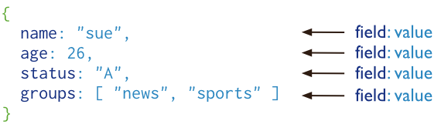
What is a Document DB?
Document databases store documents in the value part of the key-value store where:
  Documents are indexed using a BTree
  and queried using a JavaScript query engine

Slide 5
What is a Document DB?
{
"name": "Phil",
"age": 26,
"status": "A"
}
{
"name": "Phil",
"age": 26,
"status": "A",
"citiesVisited" : ["Chicago", "LA", "San Francisco"]
}
Documents have differences in their attributes
But belongs to the same collection
This is different from relational databases where columns:
  Stores the same type of values
  Or null

Slide 6
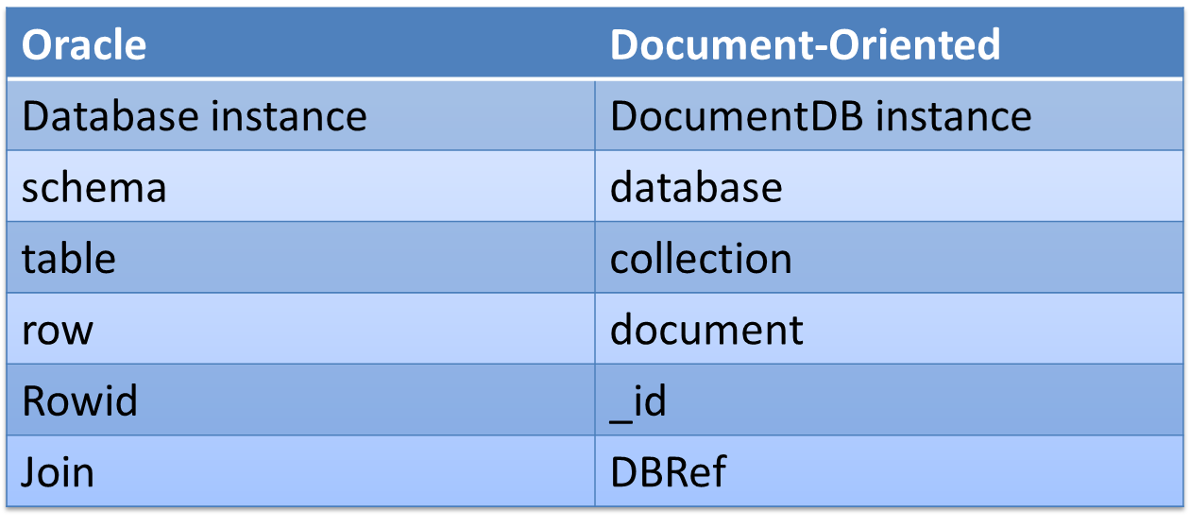
RDBMS vs Document DB: Terminology

Slide 7


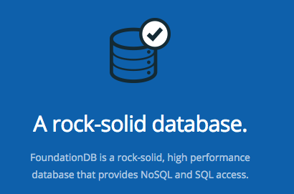

Document DBs
MongoDB
CouchDB
RethinkDB
RavenDB

Slide 8
MONGO DB

Slide 9
DOCUMENTS: DATA MODEL

Slide 10
Documents: Data Model
Data has a flexible schema
This helps in matching document to objects
  Each document can match the fields of a document also if with different structure
Data is represented as a map
Relations can be represented as: references and embedded documents

Slide 11
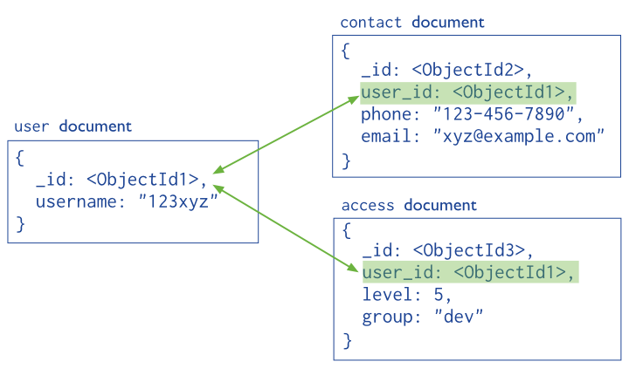
Documents: Structure References

Slide 12
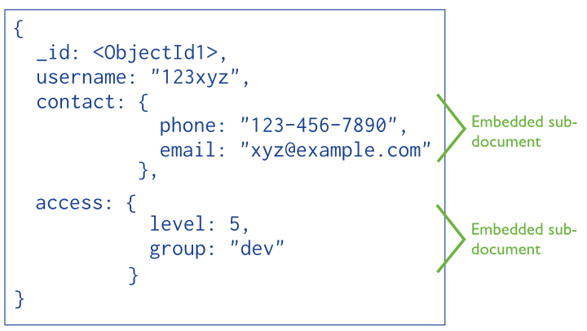
Documents: Structure Embedded

Slide 13
Documents: Write Operations
Writes are atomic at the document level
  A Denormalized data model facilitates atomic write operations.
  Normalizing the data over multiple collection would require multiple write operation that are not atomic.

Slide 14
Documents: Growth
Each time a document is updated the modification are done changing affected attributes
Each document has a maximum size of 16MB
If the document size exceeds MongoDB relocates the document on disk.
In MongoDB 3.0 this problem is minimized using the Power of 2 Sized Allocation

Slide 15
Documents: ObjectId
ObjectId is a 12-byte BSON type, constructed using:
  a 4-byte value representing the seconds since the Unix epoch,
  a 3-byte machine identifier,
  a 2-byte process id, and
  a 3-byte counter, starting with a random value.
It is an interesting approach to generate keys considering that documents are retrieved using document queries

Slide 16
DOCUMENTS: INDEXING

Slide 17
Documents: Indexing
Indexes allows efficient queries on MongoDB.
They are used to limit the number of documents to inspect
Otherwise, it has to scan every document in a collection.
By default MongoDB create indexes only on the _id field

Slide 18
Documents: Indexing
Indexes are created using B-tree and stores data of fields ordered by values.
In addition MongoDB returns sorted results by using the index.

Slide 19
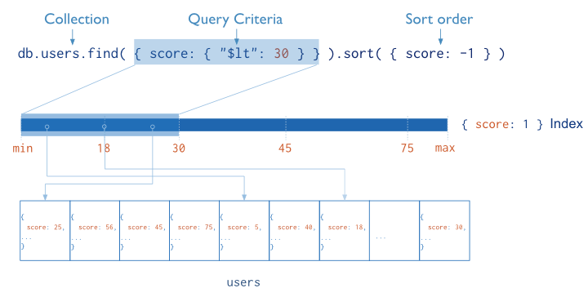
Documents: Indexing
Notes:
Fundamentally, indexes in MongoDB are similar to indexes in other database systems. MongoDB defines indexes at the collection level and supports indexes on any field or sub-field of the documents in a MongoDB collection.

Slide 20
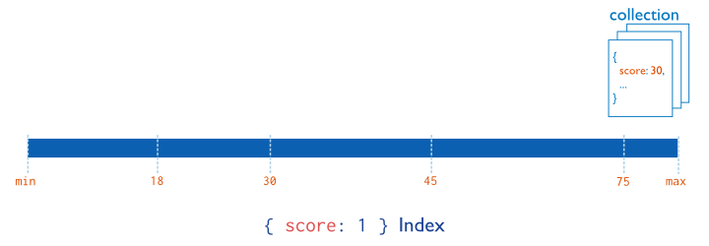
Documents: Index Types
Single Field

Slide 21
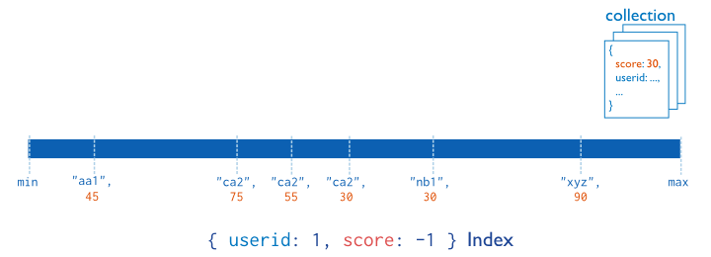
Documents: Index Types
Compound Index: indexed by attributes (left to right)

Slide 22
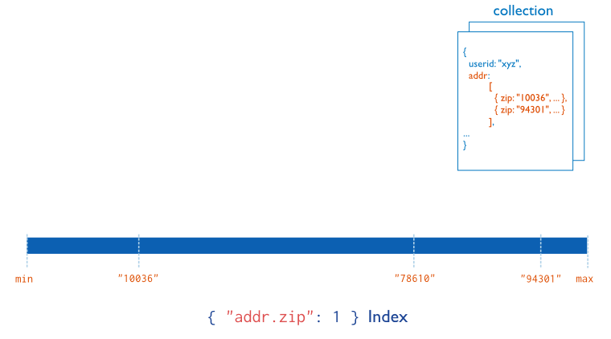
Documents: Index Types
Multikey Index:
to index content in arrays

Slide 23
Documents: Index Types
Geospatial Index: 2d and 2sphere indexes
Text Indexes: performs tokenization, stopwords removal and stemming.
Hashed Indexes: used to provide an hash based sharding

Slide 24
DOCUMENTS: CRUD

Slide 25
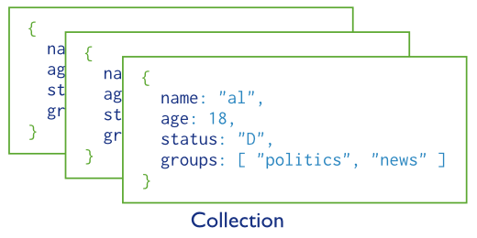
Query a Collection

Slide 26
Queries
Queries specify criteria, or condition that identify documents
A query may include projections to specify the fields to return.
It is possible to impose limits, skips and sort orders.

Slide 27
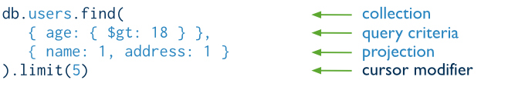
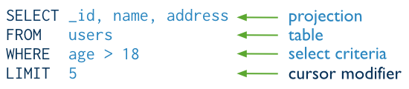
Query Interface
The same query in SQL

Slide 28
Query Behavior
All queries in MongoDB address a single collection.
We impose limits, skips, and sort orders.
The order of documents returned by a query is not defined unless you specify a sort().
Operations that modify existing documents (i.e. updates) use the same query syntax as queries to select documents to update.
In aggregation pipeline, the $match pipeline stage provides access to MongoDB queries.

Slide 29
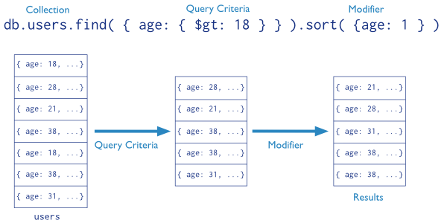
Query Statements

Slide 30
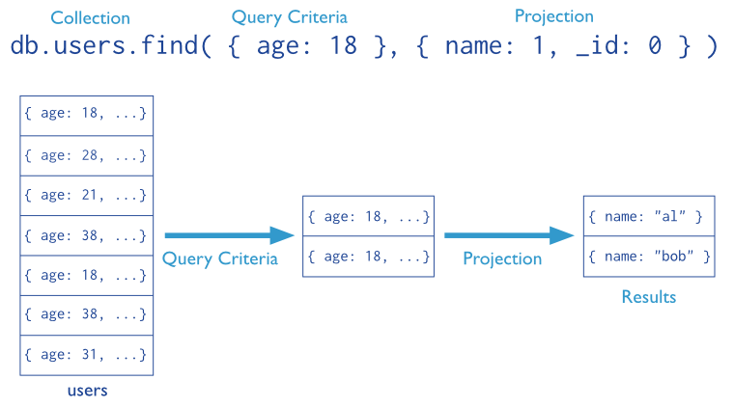
Projections

Slide 31
Cursors
Each Query like db.collection.find() returns a cursor
To access the documents, you need to iterate the cursor.
By default MongDB closes a cursor
  after 10 minutes of inactivity
  or if the client has exhausted the cursor
var myCursor = db.inventory.find().addOption(DBQuery.Option.noTimeout);

Slide 32
Data Modification
Data modification refers to operations that create, update, or delete data. In MongoDB.
These operations modify the data of a single collection.
For the update and delete operations, it is possible to specify the criteria to select the documents to update or remove.

Slide 33
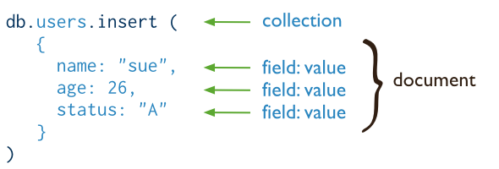
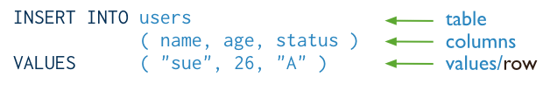
Insert
Which corresponds to the SQL query

Slide 34
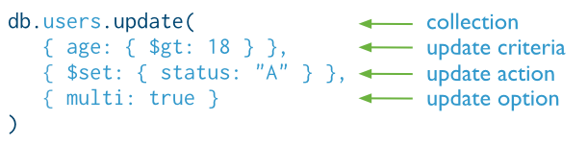

Update

Slide 35
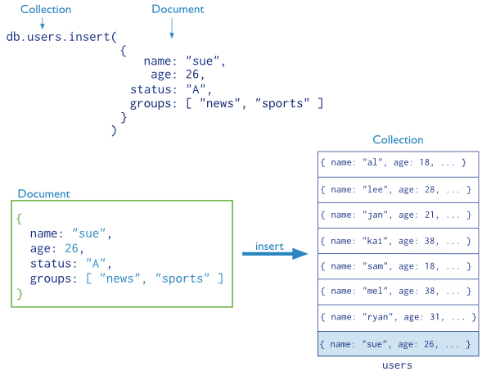
Update: Example

Slide 36
Update Behavior
By default, the db.collection.update() method updates a single document.
However, with the multi option, update() can update all documents in a collection.
If the update() method includes upsert: true and no documents match the query portion of the update operation, then the update operation creates a new document.

Slide 37
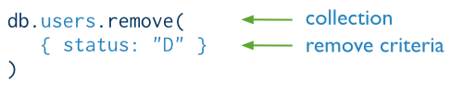

Remove

Slide 38
Remove Behavior
By default, db.collection.remove() method removes all documents that match its query.
However, the method can accept a flag to limit the delete operation to a single document.

Slide 39
Write Concern
There are different levels of guarantee for writes
When inserts, updates and deletes have a weak write concern, write operations return quickly.
In some failure cases, write operations issued with weak write concerns may not persist.
With stronger write concerns, clients wait after sending a write operation for MongoDB to confirm the write operations.

Slide 40
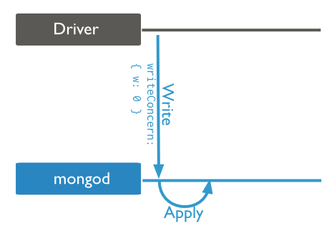
Unacknowledged: Default Write

Slide 41
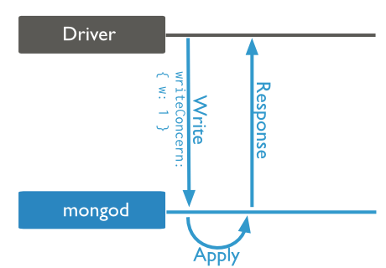
Acknowledged
This is defined in the drivers

Slide 42
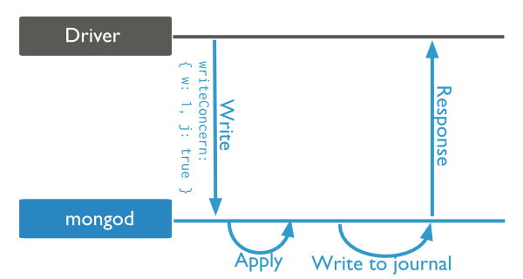
Journaled
Operation are acknowledged only after operations are saved to the journal.

Slide 43
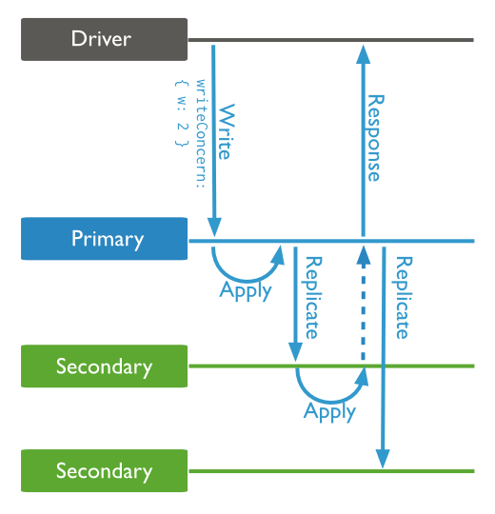
Replica Acknowledged

Slide 44
SCALING

Slide 45
Scaling
The idea of scaling is to add more node to the cluster of nodes.
There are two different context to consider:
  Heavy reads
  Heavy writes

Slide 46
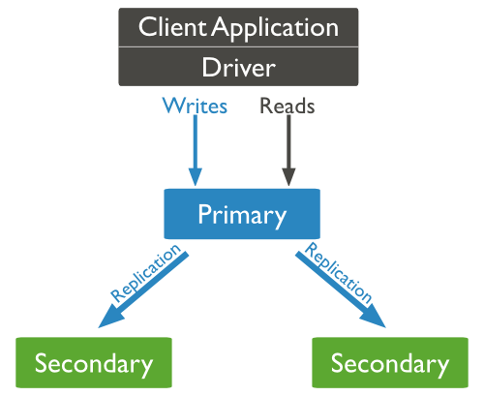
Scaling: Heavy Reads
Scaling here can be achieved by adding more read slaves
All the reads can be directed to the slaves.
When a node is added it will sync with the other nodes.
The advantage of this setting is that we do not need to stop the cluster.
rs.add(“mongo_address:27017”)

Slide 47
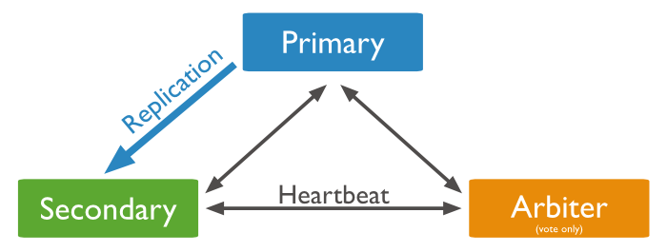
Data Replication

Slide 48
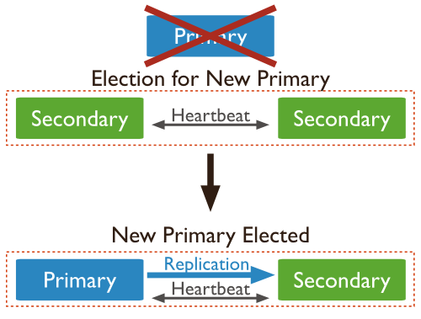
Automatic Failover

Slide 49
Scaling: Heavy Writes
We can start using the Sharding feature.
Sharding, or horizontal scaling divides the data set and distributes the data over multiple servers.
Each shard is an independent database, and collectively, the shards make up a single logical database.

Slide 50
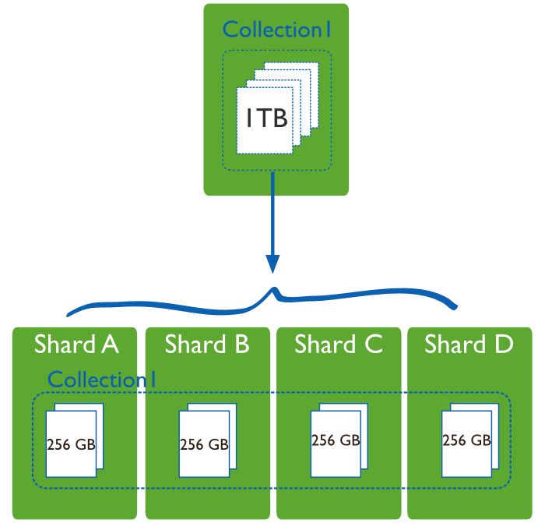
Sharding

Slide 51
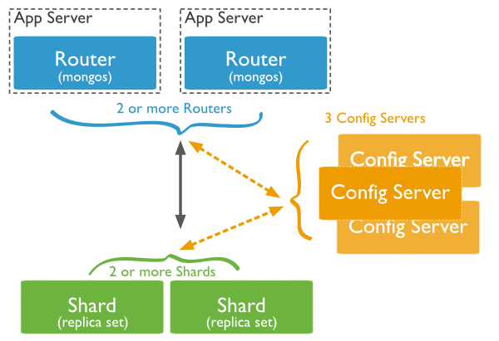
Sharding in MongoDB
Shard: store the data
Query Routers: interface to client and direct queries
Config Server: store cluster’s metadata.

Slide 52
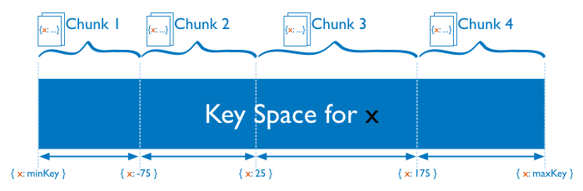
Range Based Sharding
MongoDB divides the data set into ranges determined by the shard key values to provide range based partitioning.

Slide 53
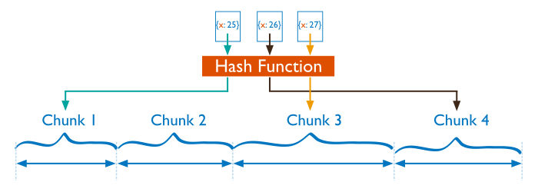
Hash Based Sharding
MongoDB computes a hash of a field’s value, and then uses these hashes to create chunks

Slide 54
Performance Comparison
Range based partitioning supports more efficient range queries.
However, range based partitioning can result in an uneven distribution of data.
Hash based partitioning, by contrast, ensures an even distribution of data at the expense of efficient range queries.

Slide 55
OTHER DOCUMENTDBS

Slide 56
CouchDB
Written in Erlang.
Documents are stored using JSON.
The query language is in Javascript and supports MapReduce integration.
One of its distinguishing features is multi-master replication.
ACID: It implements a form of Multi-Version Concurrency Control (MVCC) in order to avoid the need to lock the database file during writes.
CouchDB does not guarantees (eventual) consistency to be able to provide both availability and partition tolerance.

Slide 57
CouchDB: Features
Master-Master Replication - Because of the append-only style of commits.
Reliability of the actual data store backing the DB (Log Files)
Mobile platform support. CouchDB actually has installs for iOS and Android.
HTTP REST JSON interaction only. No binary protocol
Notes:
Master-Master Couch does every modification to the DB is considered a revision making conflicts during replication much less likely and allowing for some awesome master-master replication or what Cassandra calls a "ring" of servers all bi-directionally replicating to each other. It can even look more like a fully connected graph of replication rules.
Reliability: Because CouchDB records any changes as a "revision" to a document and appends them to the DB file on disk, the file can be copied or snapshotted at any time even while the DB is running and you don't have to worry about corruption. It is a really resilient method of storage.

Slide 58
RethinkDB
The RethinkDB server is written in C++ and runs on 32-bit and 64-bit Linux systems.
It is a JSON based database.
It is characterized by push update queries.
It supports a MapReduce style API, and geospatial queries.
r.table('tv_shows').insert([{ name: 'Star Trek TNG', episodes: 178 },
{ name: 'Battlestar Galactica', episodes: 75 }])

Slide 59
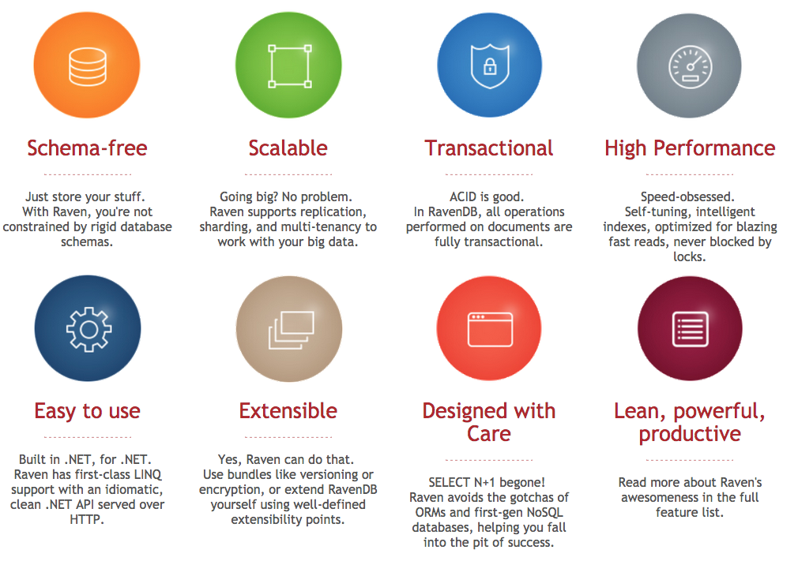
RavenDB
It is a DocumentDB written in C#

Slide 60
Document Store: Advantages
Documents are independent units
Application logic is easier to write. (JSON).
Schema Free:
  Unstructured data can be stored easily, since a document contains whatever keys and values the application logic requires.
  In addition, costly migrations are avoided since the database does not need to know its information schema in advance.

Slide 61
Suitable Use Cases
Event Logging: where we need to store different types of event (order_processed, customer_logged).
Content Management System: because the schema-free approach is well suited
Web analytics or Real-Time Analytics: useful to update counters, page views and metrics in general.

Slide 62
When Not to Use
Complex Transactions: when you need atomic cross-document operations, but we can use RavenDB or RethinkDB
Queries against Varying Aggregate Structure: that is when the structure of your aggregates vary because of data continuous data evolutions

