Slide 1

DeMystifying
Columnar Databases
June Tong
jtong@calpont.com
straycat90@gmail.com
April 2012
®
Calpont Proprietary and Confidential

Slide 2
Agenda
What is a columnar database?
Why is it better than a row-oriented database?
When isn’t it better?
What do I need to know to use it?
How will I need to change my application code?

Slide 3
Who is Calpont?
Calpont Corporation
  Privately held
  Headquartered in Frisco, TX
Our Mission
To provide a scalable data platform that enables analytic business decisions as timely as customers and markets dictate.

Slide 4
InfiniDB
InfiniDB is a columnar MPP MySQL database engine, expressly designed for analytic applications
  InfiniDB Community (single-server)
  InfiniDB Enterprise
    Version 2.2 – shared disk
    Version 3.0 – added shared nothing option
®

Slide 5
Traditional Row-Oriented Storage
Rows stored sequentially
Key | Fname | Lname | State | Zip | Phone | Age | Sex
1 | Bugs | Bunny | NY | 11217 | (718) 938-3235 | 34 | M
2 | Yosemite | Sam | CA | 95389 | (209) 375-6572 | 52 | M
3 | Daffy | Duck | NY | 10013 | (212) 227-1810 | 35 | M
4 | Elmer | Fudd | ME | 04578 | (207) 882-7323 | 43 | M
5 | Witch | Hazel | MA | 01970 | (978) 744-0991 | 57 | F
Provides best performance when most queries are for multiple columns of a single row
(OLTP applications)

Slide 6
Key Lookup in a Row-Oriented Database
Indexes
Indexes on high-cardinality columns make accessing a single row very fast
Key | RowID
1 | 0001B008D23A671A
2 | 0001B008D23A671B
3 | 0001B008D23A671C
4 | 0001B008D23A671D
5 | 0001B008D23A671E
Key | Fname | Lname | State | Zip | Phone | Age | Sex
1 | Bugs | Bunny | NY | 11217 | (718) 938-3235 | 34 | M
2 | Yosemite | Sam | CA | 95389 | (209) 375-6572 | 52 | M
3 | Daffy | Duck | NY | 10013 | (212) 227-1810 | 35 | M
4 | Elmer | Fudd | ME | 04578 | (207) 882-7323 | 43 | M
5 | Witch | Hazel | MA | 01970 | (978) 744-0991 | 57 | F
WHERE key=4
Elmer Fudd calls customer service
but don’t help on analytical queries scanning many rows
Phone | RowID
(207) 882-7323 | 0001B008D23A671D
(209) 375-6572 | 0001B008D23A671B
(212) 227-1810 | 0001B008D23A671C
(718) 938-3235 | 0001B008D23A671A
(978) 744-0991 | 0001B008D23A671E
e.g.
What’s the average age of males?
WHERE phone=‘(207) 882-7323’

Slide 7
Sequential Scans are Killers
What if you had 100 million rows, with 100 columns?
Sex
Age
If the table is 100GB,
you have to read 100GB.
Or build composite indexes on EVERYTHING.
7

Slide 8
Column-Oriented Storage
Each column is stored in a separate file
Key
1
2
3
4
5
Fname
Bugs
Yosemite
Daffy
Elmer
Witch
Lname
Bunny
Sam
Duck
Fudd
Hazel
State
NY
CA
NY
ME
MA
Zip
11217
95389
10013
04578
01970
Phone
(718) 938-3235
(209) 375-6572
(212) 227-1810
(207) 882-7323
(978) 744-0991
Age
34
52
35
43
57
Sex
M
M
M
M
F
Each column for a given row is at the same offset (auto-indexing)

Slide 9
Read Columns, Not Rows
Only read the files you need
Key
1
2
3
4
5
Fname
Bugs
Yosemite
Daffy
Elmer
Witch
Lname
Bunny
Sam
Duck
Fudd
Hazel
State
NY
CA
NY
ME
MA
Zip
11217
95389
10013
04578
01970
Phone
(718) 938-3235
(209) 375-6572
(212) 227-1810
(207) 882-7323
(978) 744-0991
Age
34
52
35
43
57
Sex
M
M
M
M
F
Also get improved compression because all data in one file is the same data type.

Slide 10
I/O Reduction
So you still have 100 million rows, with 100 columns...
Males
Age
But you only read 2 columns,
instead of 100

Slide 11
Vertical Partitioning
Columnar databases produce automatic vertical partitioning
1
2
3
4
:
:
:
:
:
:
:
:
:
8m
Bugs
Yosemite
Daffy
Elmer
:
:
:
:
:
:
:
:
:
Snoopy
Bunny
Sam
Duck
Fudd
:
:
:
:
:
:
:
:
:
Brown
Brooklyn
Wawona
New York
Wiscasset
:
:
:
:
:
:
:
:
:
Springfield
NY
CA
NY
ME
:
:
:
:
:
:
:
:
:
MA
11217
95389
10013
04578
:
:
:
:
:
:
:
:
:
01105
(718) 938-3235
(209) 375-6572
(212) 227-1810
(207) 882-7323
:
:
:
:
:
:
:
:
:
(413) 781-6500

Slide 12
Horizontal Partitioning
InfiniDB also automatically creates horizontal partitions of 8 million rows (default)
1
2
3
4
:
:
:
:
:
:
:
:
:
8m
Bugs
Yosemite
Daffy
Elmer
:
:
:
:
:
:
:
:
:
Snoopy
Bunny
Sam
Duck
Fudd
:
:
:
:
:
:
:
:
:
Brown
Brooklyn
Wawona
New York
Wiscasset
:
:
:
:
:
:
:
:
:
Springfield
NY
CA
NY
ME
:
:
:
:
:
:
:
:
:
MA
11217
95389
10013
04578
:
:
:
:
:
:
:
:
:
01105
(718) 938-3235
(209) 375-6572
(212) 227-1810
(207) 882-7323
:
:
:
:
:
:
:
:
:
(413) 781-6500
Knowing what values are in each partition allows for partition elimination at query time
:
:
:
:
:
:
:
:
:
:
:
:
:
:
:
:
:
:
:
:
:
:
:
:
:
:
:
:
:
:
:
:
:
:
:
:
:
:
:
:
:
:
:
:
:
:
:
:
:
:
:
:
:
:
:
:
:
:
:
:
:
:
:

Slide 13
Bonus: Easy to Add a New Column
Row-oriented: Usually requires rebuilding table
Key | Fname | Lname | State | Zip | Phone | Age | Sex
1 | Bugs | Bunny | NY | 11217 | (718) 938-3235 | 34 | M
2 | Yosemite | Sam | CA | 95389 | (209) 375-6572 | 52 | M
3 | Daffy | Duck | NY | 10013 | (212) 227-1810 | 35 | M
4 | Elmer | Fudd | ME | 04578 | (207) 882-7323 | 43 | M
5 | Witch | Hazel | MA | 01970 | (978) 744-0991 | 57 | F
Golf
Y
N
Y
Y
N
Addition of column shifts every row
Column-oriented: Just create another file
Key
1
2
3
4
5
Fname
Bugs
Yosemite
Daffy
Elmer
Witch
Lname
Bunny
Sam
Duck
Fudd
Hazel
State
NY
CA
NY
ME
MA
Zip
11217
95389
10013
04578
01970
Phone
(718) 938-3235
(209) 375-6572
(212) 227-1810
(207) 882-7323
(978) 744-0991
Age
34
52
35
43
57
Sex
M
M
M
M
F
Golf
Y
N
Y
Y
N

Slide 14
Single-Row Operations
Because of the nature of columnar storage, single-row operations can underperform.
More details on individual DML statements follow...
Do not attempt OLTP-style transactions on a columnar database.

Slide 15
Single-Row Operations: Insert
Row-oriented: new rows appended to the end
Key | Fname | Lname | State | Zip | Phone | Age | Sex
1 | Bugs | Bunny | NY | 11217 | (718) 938-3235 | 34 | M
2 | Yosemite | Sam | CA | 95389 | (209) 375-6572 | 52 | M
3 | Daffy | Duck | NY | 10013 | (212) 227-1810 | 35 | M
4 | Elmer | Fudd | ME | 04578 | (207) 882-7323 | 43 | M
5 | Witch | Hazel | MA | 01970 | (978) 744-0991 | 57 | F
6 | Marvin | Martian | CA | 91602 | (818) 761-9964 | 26 | M
Columnar: new value must be added to each file
Key
1
2
3
4
5
Fname
Bugs
Yosemite
Daffy
Elmer
Witch
Lname
Bunny
Sam
Duck
Fudd
Hazel
State
NY
CA
NY
ME
MA
Zip
11217
95389
10013
04578
01970
Phone
(718) 938-3235
(209) 375-6572
(212) 227-1810
(207) 882-7323
(978) 744-0991
Age
34
52
35
43
57
Sex
M
M
M
M
F
6
Marvin
Martian
CA
91602
(818) 761-9964
26
M

Slide 16
Insert: Solution
Do batch inserts and use cpimport, the bulk loader, instead.
CPIMPORT is your friend.

Slide 17
Single-Row Operations: Delete
Row-oriented: row is deleted
Key | Fname | Lname | State | Zip | Phone | Age | Sex
1 | Bugs | Bunny | NY | 11217 | (718) 938-3235 | 34 | M
2 | Yosemite | Sam | CA | 95389 | (209) 375-6572 | 52 | M
3 | Daffy | Duck | NY | 10013 | (212) 227-1810 | 35 | M
4 | Elmer | Fudd | ME | 04578 | (207) 882-7323 | 43 | M
5 | Witch | Hazel | MA | 01970 | (978) 744-0991 | 57 | F
Columnar: each column must be deleted from its file
Key
1
2
3
4
5
Fname
Bugs
Yosemite
Daffy
Elmer
Witch
Lname
Bunny
Sam
Duck
Fudd
Hazel
State
NY
CA
NY
ME
MA
Zip
11217
95389
10013
04578
01970
Phone
(718) 938-3235
(209) 375-6572
(212) 227-1810
(207) 882-7323
(978) 744-0991
Age
34
52
35
43
57
Sex
M
M
M
M
F

Slide 18
Delete: Solutions
Do batch deletes.
Any extents that contain only data that is to be deleted can be dropped.
Otherwise, consider copying desired rows to a new table using the bulk loader and dropping the old table.

Slide 19
Single-Row Operations: Update
Row-oriented: value replaced
Key | Fname | Lname | State | Zip | Phone | Age | Sex
1 | Bugs | Bunny | NY | 11217 | (718) 852-2352 | 34 | M
2 | Yosemite | Sam | CA | 95389 | (209) 375-6572 | 52 | M
3 | Daffy | Duck | NY | 10013 | (212) 227-1810 | 35 | M
4 | Elmer | Fudd | ME | 04578 | (207) 882-7323 | 43 | M
5 | Witch | Hazel | MA | 01970 | (978) 744-0991 | 57 | F
Column-oriented: value replaced
Key
1
2
3
4
5
Fname
Bugs
Yosemite
Daffy
Elmer
Witch
Lname
Bunny
Sam
Duck
Fudd
Hazel
State
NY
CA
NY
ME
MA
Zip
11217
95389
10013
04578
01970
Phone
(718) 852-2352
(209) 375-6572
(212) 227-1810
(207) 882-7323
(978) 744-0991
Age
34
52
35
43
57
Sex
M
M
M
M
F
Yeah, this one just works.

Slide 20
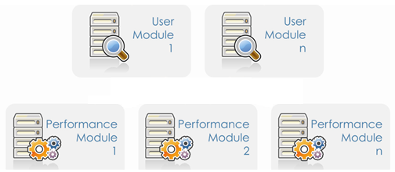
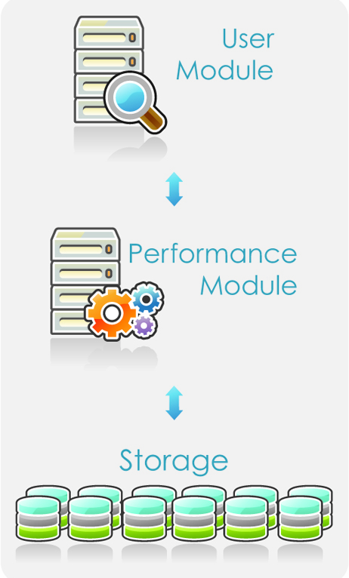

Architecture – Shared Disk
(2.2)
or …
Single Server

Slide 21

Architecture – Shared Nothing
(3.0 option)

Slide 22
What Do I Need to Change?
Uses MySQL front-end
  Standard SQL for DDL and DML
  Most MySQL commands will still work
Exceptions:
No cartesian products
No triggers
(not a comprehensive list)
Notes:
22

Slide 23
InfiniDB Ease of Use
Automatic Everything:
  Vertical partitioning – eliminate unneeded columns
  Horizontal partitioning – eliminate unneeded extents
  Improved compression
  No indexes – columns are de facto indexes
You already know how to use it:
  Standard SQL
  Familiar MySQL front-end
Notes:
23

Slide 24
Info
Links:
www.calpont.com
www.calpont.com/products/tryinfinidb – 30-day trial of Enterprise Edition
www.infinidb.org – Community Edition

Slide 25
The end

