Slide 1
OrientDB
Ram Software Engineering Labs Pvt Ltd

Slide 2
Setup OrientDB
Ensure JDK 1.6 or higher is there on PATH
Download community edition
http://orientdb.com/download/
Extract orientdb-community-2.1.10.zip
Start server
%ORIENTDB_HOME%\bin\server.bat
Set root password

Slide 3
OrientDB Console
Start CLI
%ORIENTDB_HOME%\bin\console.bat
Connect to server
connect remote:localhost root <rootpassword>
See list of databases in server
list databases
Connect to demo database
connect remote:localhost/GratefulDeadConcerts root <rootpassword>
List of classes or record types
classes
Create class
classes

Slide 4
OrientDB Console – Classes and properties
Create class
create class Student
Create properties (mandatory for constraints,indexes)
create property Student.name string
create property Student.birthDate date
Describe schema of Class
info class Student
Add constraint to class / property
alter property Student.name min 3
See all records in class
alter property Student.name min 3
Show details in a record based on ID
display record 0

Slide 5
OrientDB Console – Classes and clusters
By default one cluster per class
One Class can have more than one cluster. To add
ALTER CLASS Customer ADDCLUSTER USA_Customers
Need for more than one cluster for class
faster queries as only a sub-set to search
good partitioning reduce/remove use of indexes
parallel queries if on multiple disks
sharding large data sets across multiple disks or server instances
Types of clusters
Physical – persistent, stored in files
Logical – Inmemory, lost on server shutdown

Slide 6
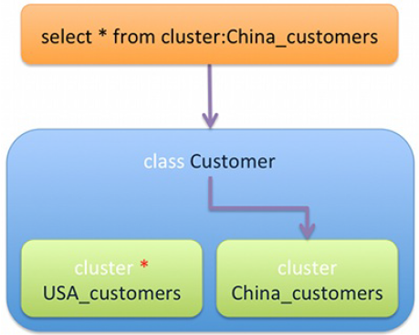
OrientDB Console – Classes and clusters
Show list of clusters
clusters
Fetch records in a cluster
browse cluster OUser

Slide 7
Cluster Selection Strategy
Default
Uses class’ defaultClusterId property
Round-Robin
Clusters of class in a ring, chosen one after another
Balanced
Smaller cluster is chosen
Local
Use current node’s master cluster while running in distributed mode

Slide 8
Record ID / RID
#<cluster-id>:<cluster-position>
Cluster Id
ID of cluster, maximum of 2^15 – 1 => 32,767
Cluster Position
Position of record inside cluster
2^63 => 9,223,372,036,854,780,000 records
Maximum records in database
2^78 records = 302,231,454,903 Trillion of records
Physical location of record inside database
Loading record by ID is fast
Links to records are physical – created at the time of edge
So traversal speed is constant irrespective of database size

Slide 9
OrientDB Console – Record ID / RID
load record #<cluster-id>:<cluster-position>
Loads the record with following details
Type of record: Ex. Document
Class
Current Version
Every change to record increases the version
Shows record with properties and data types
LINK to another record (relationship) can be lazily loaded

Slide 10
OrientDB Console – SQL support
SELECT :
select from ouser
browse cluster ouser
browse class ouser
same result
Other Variations :
select from cluster:Ouser
select from #10:3 or select from [#10:1, #10:3, #10:5]
select value from index:dictionary where key = 'Jay‘
Where Condition :
select from Employee where city = 'Rome' order by surname asc, name asc

Slide 11
OrientDB Console – SQL support
SKIP :
select from Employee where gender = 'male' limit 20
select from Employee where gender = 'male' skip 20 limit 20
select from Employee where gender = 'male' skip 40 limit 20
INSERT :
insert into Employee (name, surname, gender) values ('Jay', 'Miner', 'M')
insert into Employee set name = 'Jay', surname = 'Miner', gender = 'M‘
with JSON data :
insert into Employee content {name : 'Jay', surname : 'Miner', gender : 'M'}

Slide 12
OrientDB Console – SQL support
UPDATE :
update Employee set local = true where city = 'London‘
update Employee merge { local : true } where city = 'London'
DELETE :
delete from Employee where city <> 'London‘

Slide 13
OrientDB – Relational Model
LINK, to point to one record only
LINKSET, to point to several records. Like Java Sets, the same RID can only be included once. The pointers also have no order
LINKLIST, to point to several records. Like Java Lists, they are ordered and can contain duplicates
LINKMAP, to point to several records with a key stored in the source record. The Map values are the RIDs. Works like the Java Map<?,Record> .

Slide 14
OrientDB – Graph Model
LINK, to point to one record only
LINKSET, to point to several records. Like Java Sets, the same RID can only be included once. The pointers also have no order
LINKLIST, to point to several records. Like Java Lists, they are ordered and can contain duplicates
LINKMAP, to point to several records with a key stored in the source record. The Map values are the RIDs. Works like the Java Map<?,Record> .

Slide 15
http://www.slideshare.net/lvca/switching-from-relational-to-the-graph-model

