Slide 1
Single page web application using AngularJS
Ram Software Engineering Labs Pvt Ltd

Slide 2
What is single page application?
a web application that fits on a single web page
providing a more fluid user experience similar to a desktop application
Condition:
all necessary code is retrieved with a single page load
the page does not reload at any point in the process
does not control transfer to another page

Slide 3
What is AngularJS?
Client Side Browser App Framework
Sponsored by Google
Open Source
Augment browser-based applications with model–view–controller (MVC) capability
Basically AngularJS is MVW Framework.
What is MVW?
model–view–whatever

Slide 4
Why we choose AngularJS?
Bootstrapping
Templates
2-way data binding
Module based
Dependency Injection
Routing
Directives
Unit Test

Slide 5
Bootstrapping
Automatic Initialization
Manual Initialization

Slide 6
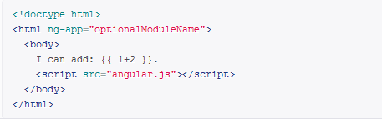
Automatic Initialization
Automatically initializes upon ’DOMContentLoaded’ event
load the module associated with the directive.
create the application injector
compile the DOM treating the ng-app directive as the root of the compilation.

Slide 7
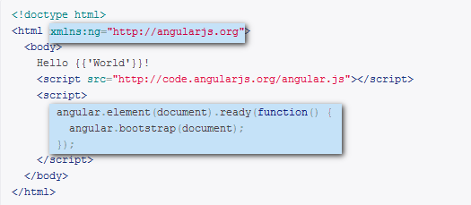
Manual Initialization
Give more control over the initialization process
need to perform an operation before Angular compiles a page

Slide 8
Templates
Below attributes are used in a template:
Directive — An attribute or element that augments an existing DOM element or represents a reusable DOM
Markup — The double curly brace notation {{ }} to bind expressions to elements is built-in angular markup.
Filter — Formats your data for display to the user.
Form controls — Lets you validate user input.

Slide 9
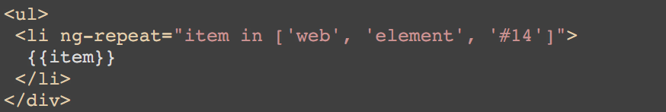
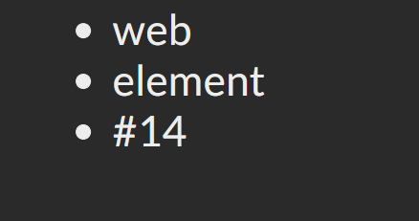
Templates

Slide 10
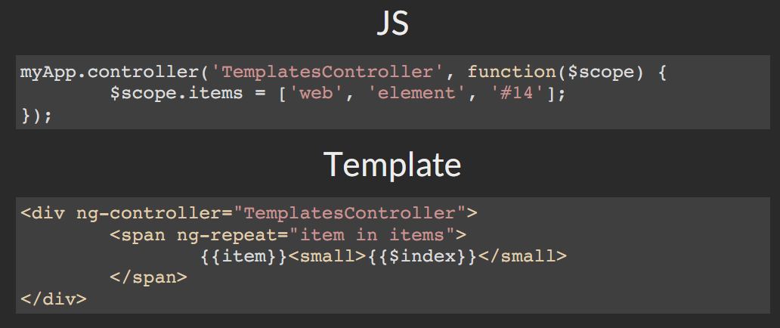
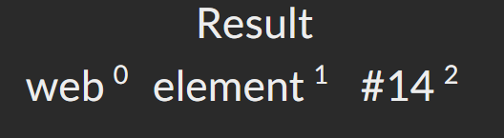
WITH CONTROLLERS

Slide 11
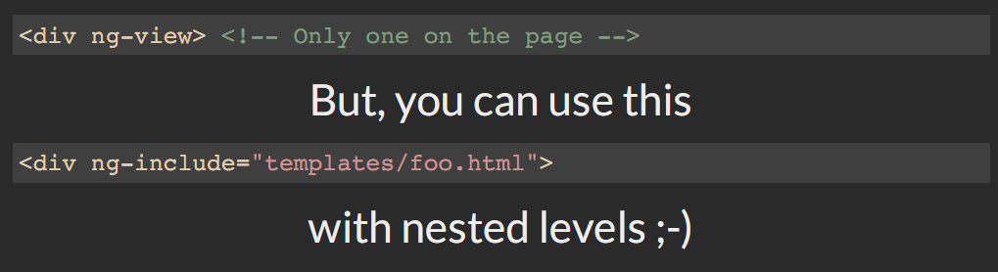
ASYNC TEMPLATES
AngularJS loads the templates asynchronously.

Slide 12
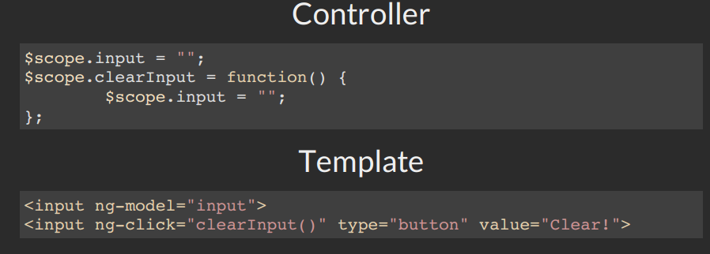

2-WAY DATA BINDING

Slide 13
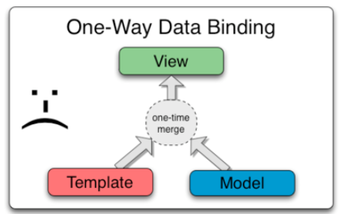
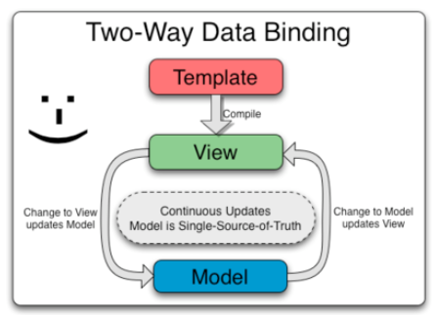
HOW IT WORKS?

Slide 14
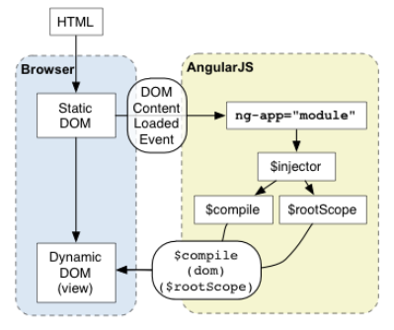
HOW IT WORKS?

Slide 15
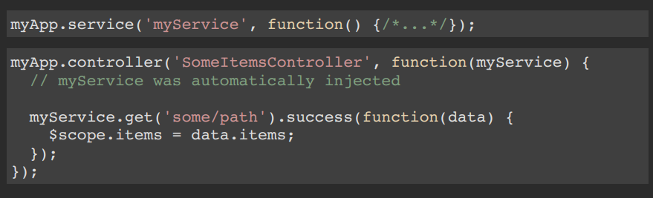
DEPENDENCY INJECTION

Slide 16
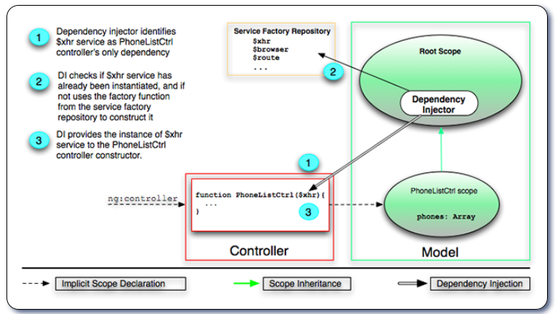
HOW IT WORKS?

Slide 17
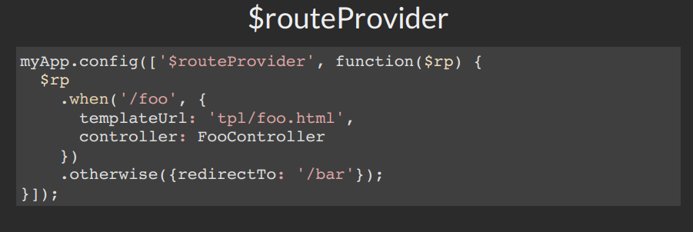
ROUTING

Slide 18
DIRECTIVES
Main power of AngularJS
An attribute or element that augments an existing DOM element or represents a reusable DOM

Slide 19
Use Controllers to
Set up the initial state of the $scope object.
Add behavior to the $scope object.

Slide 20
DO NOT Use Controllers to
Manipulate DOM — Controllers should contain only business logic. Putting any presentation logic into Controllers significantly affects its testability. Angular has databinding for most cases and directives to encapsulate manual DOM manipulation.
Format input — Use angular form controls instead.
Filter output — Use angular filters instead.
Share code or state across controllers — Use angular services instead.
Manage the life-cycle of other components (for example, to create service instances).

Slide 21
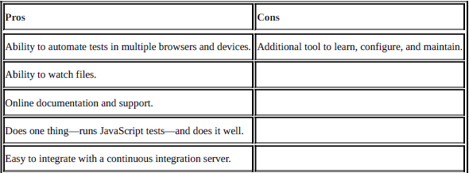
Karma

Slide 22
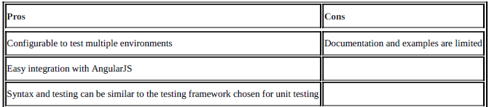
Protractor

