Slide 1
Android Continuous Integration using jenkins
Ram Software Engineering Labs Pvt Ltd

Slide 2
Continuous Integration (CI)
All development work is integrated as early as possible
Resulting artifacts are automatically created and tested
CI Engine typically
Interacts with various Software Engineering tools via their extension / plugin mechanism
Executes list of steps
Produces resulting artifacts ready for shipping or deployment
Continuous Deployment deploys artifacts in target (prod or UAT) system

Slide 3
Jenkins
Open source CI and build automation tool
Exhaustive set of plugins to integrate with various tools
Software Configuration Management / version control
svn, git
Build automation (also includes other review, testing, static analysis through build tool plugins)
ANT, Maven, Gradle
Various platforms
Java, Android

Slide 4
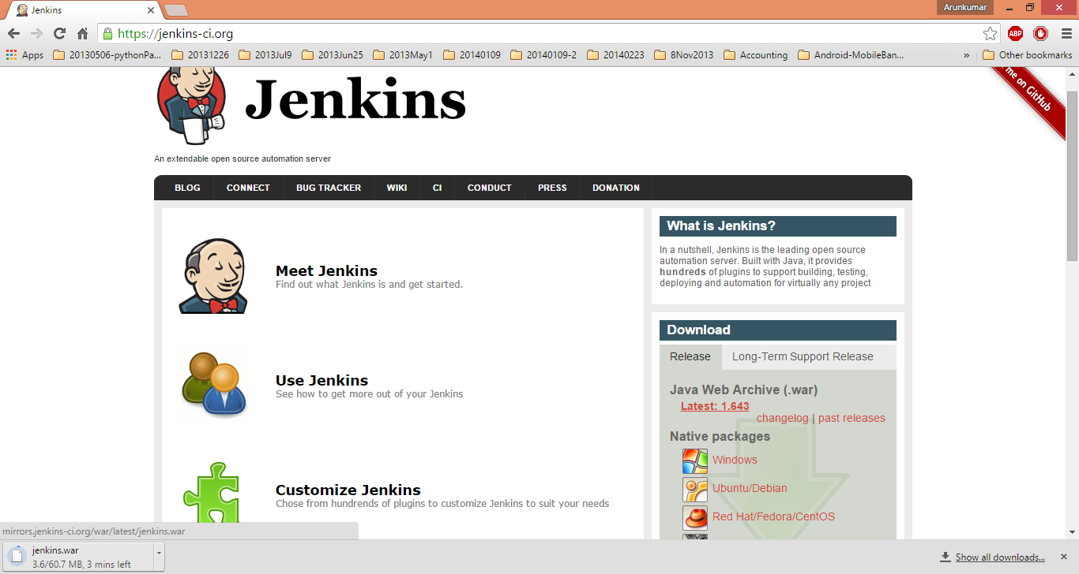
Download jenkins
Download WAR file
Deploy it in tomcat or jetty

Slide 5
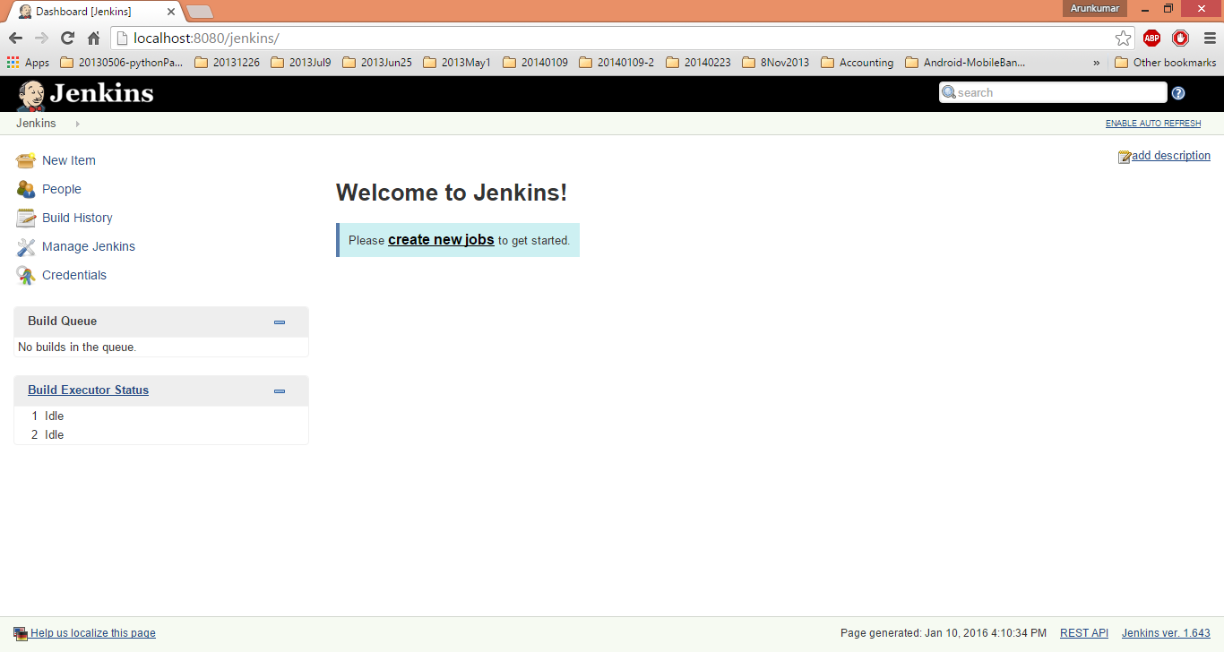
Jenkins Startup
Homepage presents dashboard of recent jobs (builds) run in Jenkins and their status

Slide 6
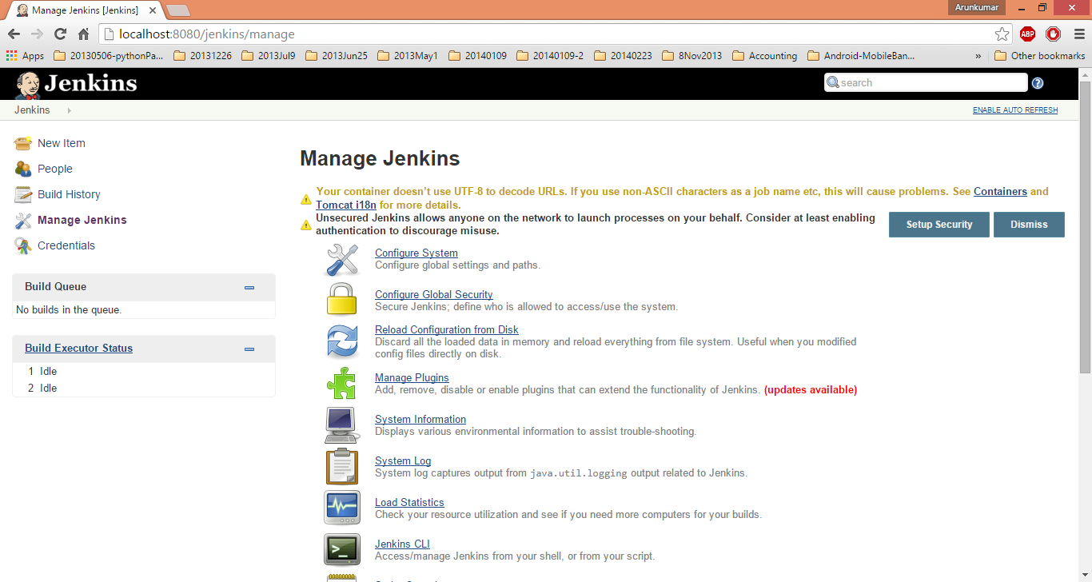
Jenkins Configuration
Select “Manage Jenkins” to see list of Jenkins configuration

Slide 7
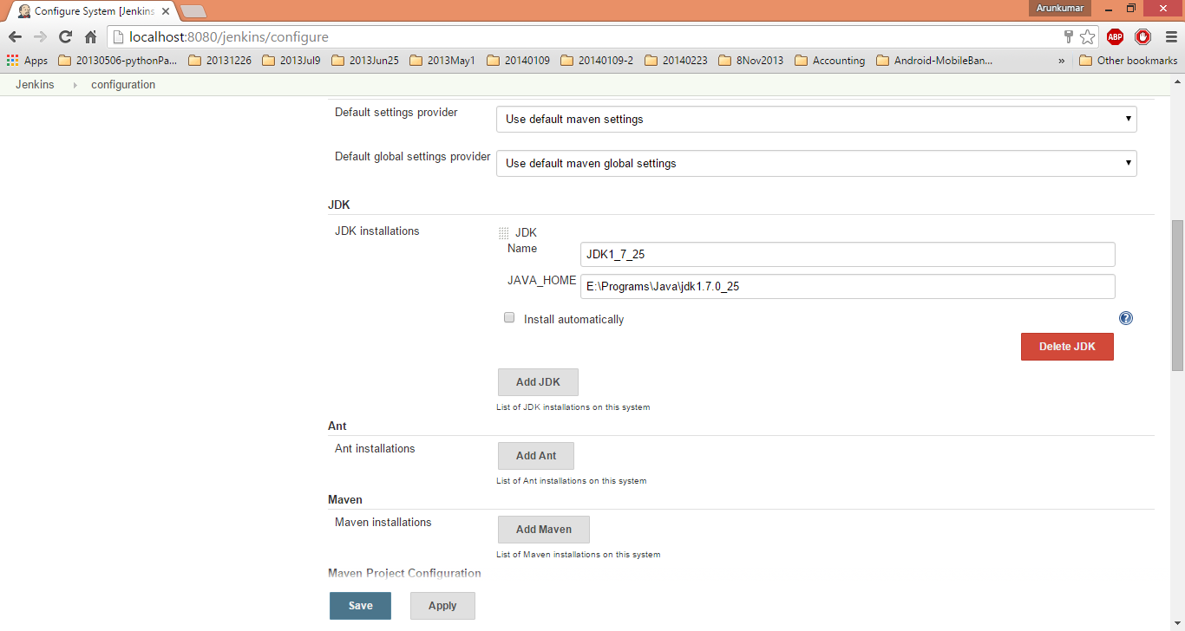
Specify list of configurations for build
Select “Manage Jenkins” to see list of Jenkins configuration

Slide 8
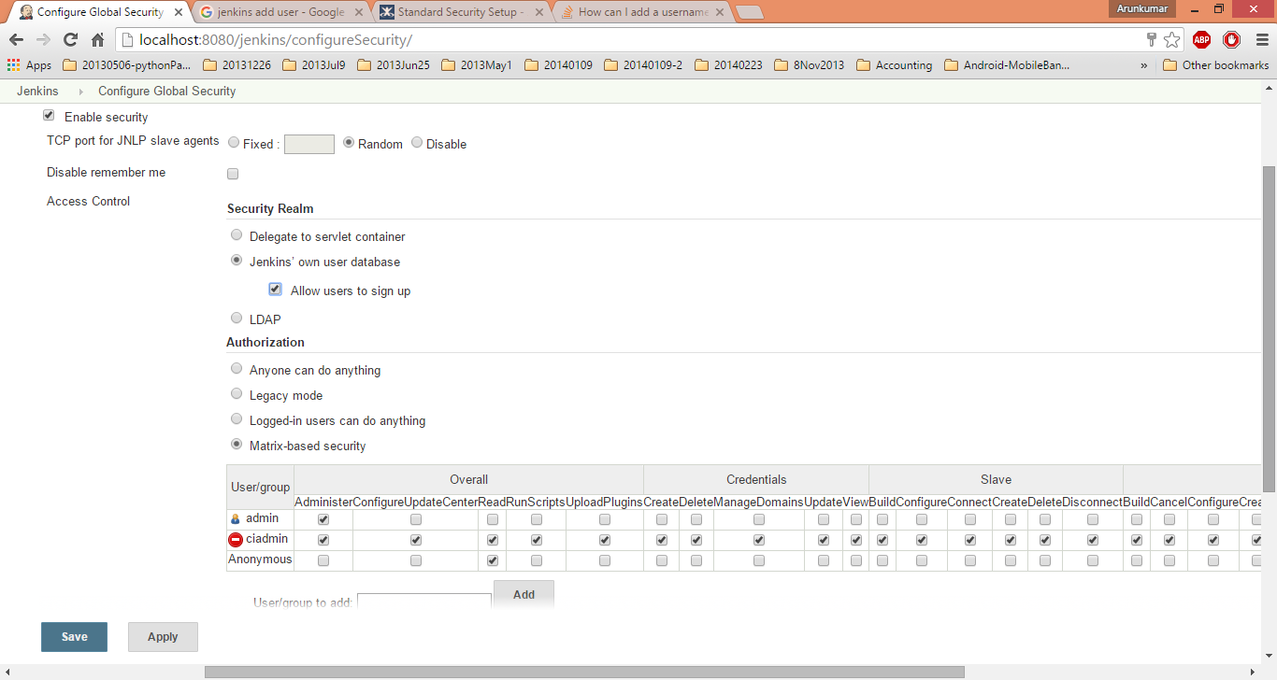
Secure Jenkins
Configure to Secure Jenkins

Slide 9
Install required plugins
Navigate to Manage Jenkins -> Manage Plugins
Select following plugins
Gradle plugin
Maven plugin (More often comes pre-installed)
Github plugin (to integrate with Github SCM)
Github Pull Request Builder (to integrate with Github SCM)
Restart Jenkins

