Slide 1
Android build automation using gradle
Ram Software Engineering Labs Pvt Ltd

Slide 2
Gradle – Quick Summary
Advanced build toolkit
Dependency management
Extensible with plugins

Slide 3
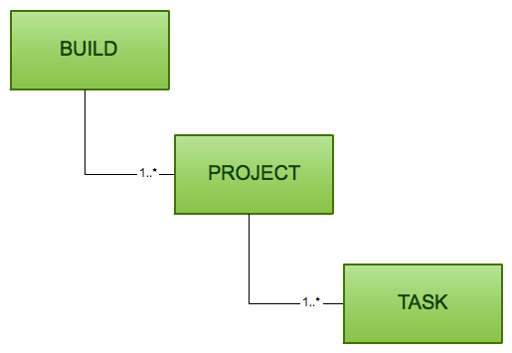
Build, Project, Task
Build
Contains one or more projects
Project
Something we build or do
Task
Atomic unit of work performed in our build

Slide 4
Gradle files
Build script
build.gradle
Specifies a project and its tasks
Gradle properties file
gradle.properties
Configure properties of the build like JVM args, parallel / daemon mode
Gradle settings
settings.gradle
Specify list of projects participating in multi-project build

Slide 5
Gradle plugin
Add new tasks to the project
Provide default configuration for the added tasks
Default configuration adds new conventions to the project
Add new properties
to override the default configuration of the plugin
Add new dependencies to the project

Slide 6
Configuration vs Execution phase
task eclipsify {
// Code that goes here is *configuring* the task, and
// will get evaluated on *every* build invocation,
// no matter which tasks Gradle eventually decides to execute.
// Don't do anything time-consuming here.
doLast {
// `doLast` adds a so-called *task action* to the task.
// The code inside the task action(s) defines the task's behavior.
// It will only get evaluated if and when
// Gradle decides to execute the task.
exec {
commandLine = ["./play1.3.x/play", "eclipsify"]
}
}
}

Slide 7
Gradle in Android
Android plugin for Gradle
Runs independent of Android Studio
Helps in Continuous Integration and deployment

Slide 8
Build Configuration
Defined in build.gradle file
Uses Groovy DSL
Build variants
Generate multiple APKs with different product and build configurations for the same module
Dependencies
Manages project’s and support’s dependencies
Supports both local file system and remote repositories

Slide 9
… Build Configuration
Manifest entries
Override values in manifest file especially while generating multiple APKs
Manifest merging
Signing
Sign APKs during build process
ProGuard
Different ProGuard rules for each variant
Testing
Create test APK and execute tests

Slide 10
Build by Convention
Sensible defaults for project structure and build options
Configure every aspect of build process

Slide 11
Project and Module Settings
Module
Component to build, test or debug independently
Contain source code and resources
Android application modules
Contain application code
May depend on library modules
Build generates APK for application modules
Most often Android app contains only one application module

Slide 12
Modules
Library modules
Contain reusable code and resources
Build generates Android Archive (AAR) package
App Engine modules
Code and resources to integrate with Google App Engine
Java library moules
Contain reusable code
Build generates JAR package

Slide 13
Build.gradle
Root build.gradle build file
Add configuration options common to all application modules
Application module build.gradle file
Each application module has its own build.gradle file

Slide 14
Project Build File
Define Gradle repositories and dependencies
Supports Jcenter, Maven Central, Ivy repositories
SDK location in local.properties file
// Top-level build file - add configuration options common to all sub-projects/modules.
buildscript {
repositories {
jcenter()
}
dependencies {
classpath 'com.android.tools.build:gradle:1.5.0'
// NOTE: place application dependencies in individual module build.gradle files
}
}
allprojects {
repositories {
jcenter()
}
}
task clean(type: Delete) {
delete rootProject.buildDir
}

Slide 15
Module build file
Configure module build settings
Override src/main manifest settings
Android settings
compileSdkVersion
buildToolsVersion
defaultConfig and productFlavors
manifest properties such as applicationId, minSdkVersion, targetSdkVersion, and test information
buildTypes
build properties such as debuggable, ProGuard enabling, debug signing, version name suffix and testinformation
dependencies

Slide 16
Module build file
apply plugin: 'com.android.application' android { compileSdkVersion 20 buildToolsVersion "20.0.0" defaultConfig { applicationId "com.happiestminds.gradleapp" minSdkVersion 13 targetSdkVersion 20 versionCode 1 versionName "1.0" } buildTypes { release { minifyEnabled false proguardFiles getDefaultProguardFile('proguard-android.txt'), 'proguard-rules.pro' } debug { debuggable true } } } dependencies { compile fileTree(dir: 'libs', include: ['*.jar']) compile 'com.android.support:appcompat-v7:20.0.0' compile project(path: ':app2, configuration: 'android-endpoints') }

Slide 17
Custom build logic with groovy
def computeTargetSdkVersion() { ... } android { defaultConfig { targetSdkVersion computTargetSdkVersion() ... } }

Slide 18
Dependencies
Module Dependencies
List of other dependent modules
Cascade builds on dependent modules
Local Dependencies
List of dependent jar files in the local file system
Remote Dependencies
Dependencies from Maven, Ivy
Specify Maven dependencies using maven coordinates: groupId:artifactId:version

Slide 19
Build Tasks
Hierarchical
Top level tasks invoke dependent tasks to produce collective build outcomes
assemble
Builds the project output
check
Runs checks and tests
build
Runs both assemble and check
clean
Performs the clean
connectedCheck
Runs all checks on currently connected devices
deviceCheck
Runs all device checks using Device Providers and Test Servers

Slide 20
Build variants
Combinations of
product flavours – build versions of free / paid
build types – debug / release
APK for each combination
freeDebug, freeRelease, paidDebug, paidRelease

