Slide 1
Android Memory Management
Ram Software Engineering Labs Pvt Ltd

Slide 2
Need for Memory Management
Optimized use of constrained device resource
Allow other applications to functions by not consuming unnecessary memory when not in use
Avoid memory leaks
Don’t hold object references in global members
Dalvik VM reclaims memory when object references leave scope of app’s active threads

Slide 3
Need for Memory Management
Optimized use of constrained device resource
Allow other applications to functions by not consuming unnecessary memory when not in use
Avoid memory leaks
Don’t hold object references in global members
Dalvik VM reclaims memory when object references leave scope of app’s active threads

Slide 4
Android’s Memory Management
No swap space for memory
Uses paging and memory-mapping (mmapping)
Apps use memory resident in RAM and cannot be paged out
So release object for GC
Mmapped files (readonly like code) can be paged out of RAM when needed

Slide 5
Shared Memory between Apps
On system boot, Zygote process starts
Loads common framework code and resources (active themes, dalvik code, .so files)
Each app process is a fork of Zygote process
Shares pages in RAM for accessing framework code and resources

Slide 6
Shared Memory between Apps
Static data mmapped into app’s process
Allows data sharing between processes
Allows pageout when needed
Allows sharing data between processes (Ex:cursor buffers use shared memory between content provider and client)

Slide 7
Allocating App Memory
Each process constrained to a single virtual memory range
Applicable within system defined limit
Android computes “Proportional Set Size” (PSS) for each App
Proportion of RAM used by the process
Includes both dirty and clean pages shared with other processes

Slide 8
Why no swapping?
Transparently writing pages of memory to flash storage is bad for
battery life
life of flash storage
performance since application has no control over which parts of memory are “paged out”
Gives control to app to choose what states to save
As each write and read from storage costs time and power

Slide 9
Reclaiming App Memory
No heap compaction / defragmentation
Shrink heap size when space at the end is unused

Slide 10
Restricting App Memory
Android sets hard limit on heap size for each app
Limit depends on device
OutOfMemoryError when app tries to allocate more memory than limit
App can check space left for it on the device
Use “getMemoryClass” returning MB left

Slide 11
Use services sparingly
Keep services running only for active job
System keeps process for the service running
RAM used by the service can’t be used by anything else or paged out
Limits number of cached processes in the LRU cache
Makes app switching less efficient
Use self-finishing IntentService

Slide 12
Release memory when your user interface becomes hidden
Release resources used only by your UI
Increases capacity for cached processes
Implement onTrimMemory() callback
Listen for TRIM_MEMORY_UI_HIDDEN level
Invoked when all the UI components of your app process become hidden from the user
Implement onStop() callback to release activity resources
Like Network connection or broadcast receivers
NOT UI resources

Slide 13
Release memory when tight
Implement onTrimMemory() callback to handle when overall device memory is getting low
TRIM_MEMORY_RUNNING_MODERATE
System running low, started to kill processes in LRU cache
TRIM_MEMORY_RUNNING_LOW
System running much lower, low on performance, release unused resources
TRIM_MEMORY_RUNNING_CRITICAL
Most of the processes killed, release all non-critical resources
TRIM_MEMORY_BACKGROUND
Low on memory, release resources easy to recover
TRIM_MEMORY_MODERATE
Low on memory, middle of LRU list, release resources
TRIM_MEMORY_COMPLETE
Low on memory, process is first to be killed

Slide 14
Check how much memory you should use
Use getMemoryClass() to get available memory
Use getLargeMemoryClass() and set largeHeap attribute to true in manifest file.
Use largeHeap only when you know
exactly where all your memory is being allocated
why it must be retained
Recommended to keep the usage lesser than getMemoryClass()

Slide 15
Avoid wasting memory with bitmaps
Load a bitmap, keep it in RAM only at the resolution you need for the current device's screen
scale it down if the original bitmap is a higher resolution
An increase in bitmap resolution results in a corresponding increase in memory needed
As both the X and Y dimensions increase

Slide 16
Use optimized data containers
Use optimized containers in the Android framework
SparseArray, SparseBooleanArray, LongSparseArray
Avoids intermediate object creation while doing autobox
Use raw arrays when possible

Slide 17
Be aware of memory overhead
Enums require twice as much memory as static constants
Every class uses about 500 bytes of code
Every class instance has 12-16 bytes of RAM overhead
Putting a single entry into a HashMap requires the allocation of an additional entry object that takes 32 bytes
Don’t make the App class or object heavy

Slide 18
Be careful with code abstractions
Require more code to be executed
Require more time and more RAM for the code to be mapped into memory
Avoid when not getting significant benefit

Slide 19
Use nano protobufs for serialized data
Protocol buffers from Google for serializing structured data
Use nano version

Slide 20
Avoid dependency injection framework
Avoid Guice or RoboGuice
Performs lot of process initialization by scanning your code for annotations
Require significant amounts of your code to be mapped into RAM even though you don't need it
These mapped pages are allocated into clean memory so Android can drop them,
That won't happen until the pages have been left in memory for a long period of time

Slide 21
Be careful about external libraries
Can be inefficient when used for work on a mobile client
Analyze the library in terms of code size and RAM footprint
Don’t use shared library for one or two features out of dozens of other things it does

Slide 22
Adopt other best practices
Reduce number of layout objects required by your UI
Optimize UI with layout debugging tools
Address optimization suggestions provided by the lint tool
Use ProGuard to strip out any unneeded code
Use zipalign on your final APK
Else resources can no longer be mmapped from the APK

Slide 23
Adopt other best practices
Analyze how much RAM your app is using throughout all stages of its lifecycle
Use Multiple processes
dividing components of your app into multiple processes
Use android:process attribute in manifest
empty process doing basically nothing has an extra memory footprint of about 1.4MB
Use only one process for all UI
Overhead in the code gets replicated in the processes

Slide 24
Adopt other best practices
Use Multiple processes
Manage dependencies between processes as one process might expect other process to be in RAM
Don’t have dependency on UI process from a background process
Notes:
http://developer.android.com/training/articles/memory.html

Slide 25
Interpreting Log Messages
Every GC prints the following information to logcat:
D/dalvikvm: <GC_Reason> <Amount_freed>, <Heap_stats>, <External_memory_stats>, <Pause_time>
D/dalvikvm( 9050): GC_CONCURRENT freed 2049K, 65% free 3571K/9991K, external 4703K/5261K, paused 2ms+2ms
GC Reason
GC_CONCURRENT
Concurrent GC that frees up memory as heap fills up
GC_FOR_MALLOC
System had to stop app and allocate memory when heap is already full
GC_HPROF_DUMP_HEAP
GC when we request to create HPROF file
GC_EXPLICIT
When we invoke System.gc() is called
Notes:
http://developer.android.com/training/articles/memory.html

Slide 26
Interpreting Log Messages
Amount Freed
Amount of memory reclaimed from this GC
Heap Stats
Percentage free of the heap and (number of live objects)/(total heap size)
External memory stats
Only for API Level 10 and lower (amount of allocated memory) / (limit at which collection will occur)
Pause time
Larger heaps will have larger pause times. Concurrent pause times show two pauses: one at the beginning of the collection and another near the end
If Heap Stats value continues to increase, you may have a memory leak.
Notes:
http://developer.android.com/training/articles/memory.html

Slide 27
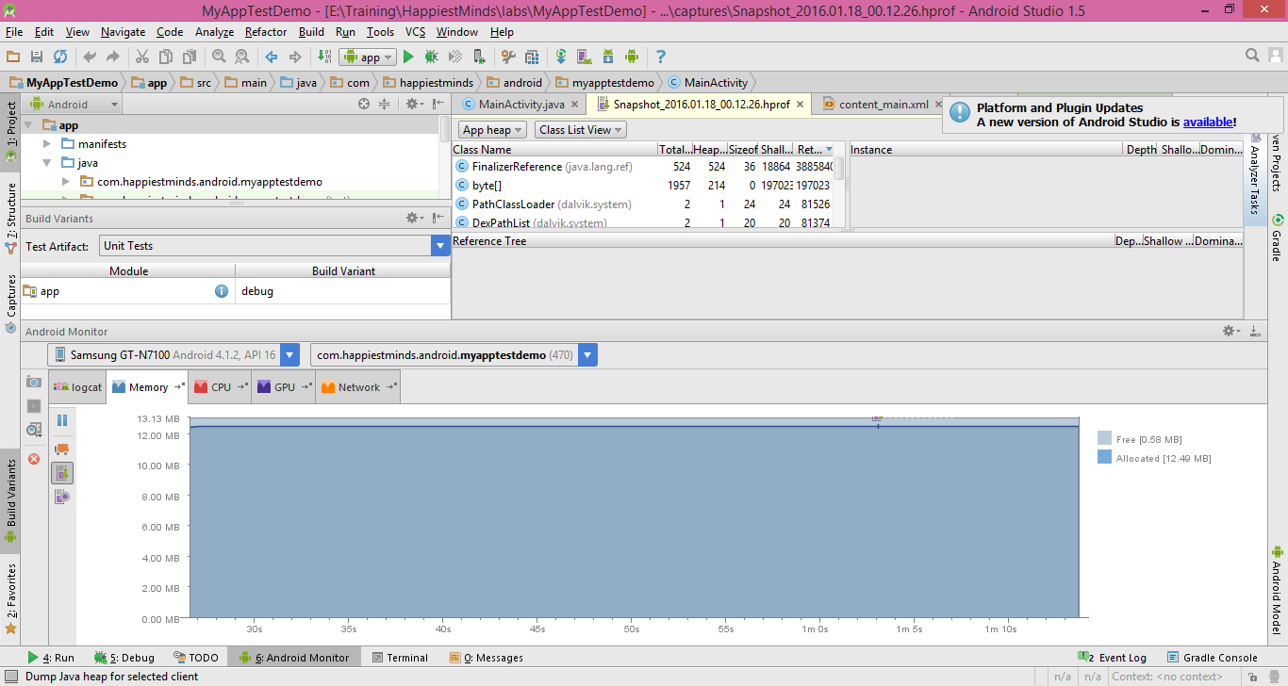
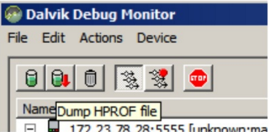
Step 1 – Identifying the source of leak
Use DDMS (Dalvik Debug Monitor Server) to dump heap snapshots (an HPROF file)

Slide 28
Step 2 – Convert to generic HPROF file
Use Android SDK’s “hprof-conv” tool to convert Android specific HPROF file into generic HPROF file
Can be analyzed by Eclipse MAT

Slide 29
Step 3 – Open HPROF file in Eclipse MAT
Use standalone version of Eclipse MAT to open the converted HPROF file

Slide 30
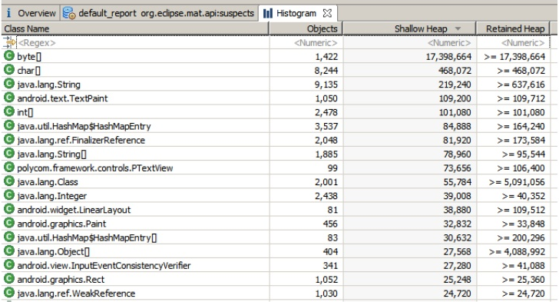
Step 4 – Analyze results using Histogram view
Identifies type of objects allocated
Compare 2 HPROF snapshots to identify objects responsible for leak

Slide 31
Step 5 – Obtain 2nd HPROF snapshot
Execute the app in the fashion it may cause memory leak
Take HPROF snapshot and convert it into normal format

Slide 32
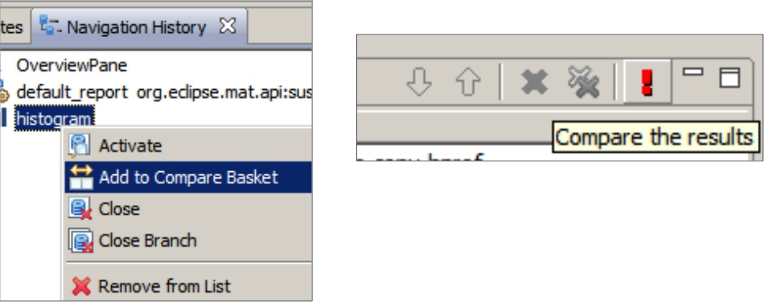
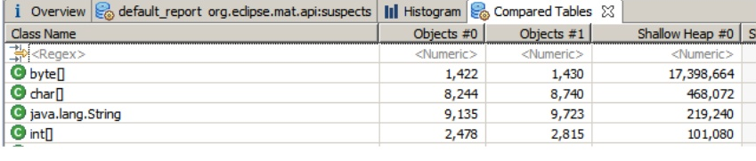
Step 6 – Compare 2 snapshots in MAT
Open both HPROF files in MAT and compare their histograms
Compare number of instances and size of each type of object btw 2 snapshots
Sustained increase may indicate a leak

Slide 33
Step 7 – Shallow and Retained heap
Shallow heap
Size of the objects themselves
Retained heap
Amount that can be claimed if this is freed
Uses dominator tree to compute

Slide 34
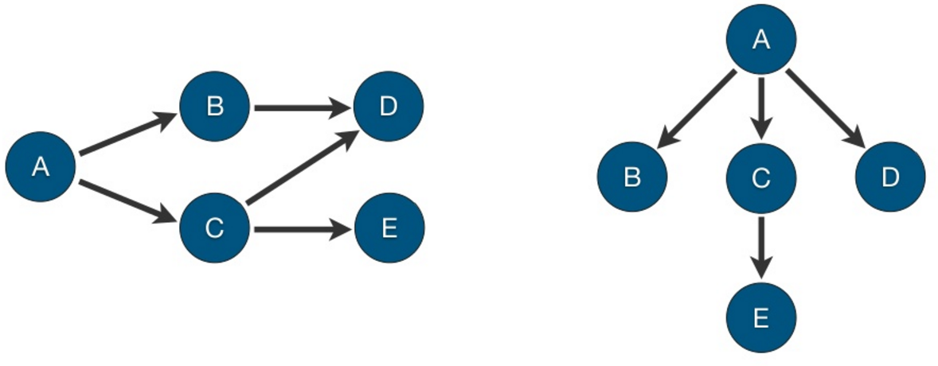
Dominator Tree

Slide 35
Step 8 – Fixing the heap
Leak must be the result of unused objects still having references to them
Stop creating objects
Stop maintaining references to objects
Use Weak Reference where possible
Close open streams and connections

Slide 36
More information
Articles on Android Developers Blog
Memory Analysis for Android Applications
Avoiding Memory Leaks by Romain Guy
Eclipse Memory Analyzer: http://www.eclipse.org/mat/
Markus Kohlerʼs Java Performance Blog: http://kohlerm.blogspot.com/

