Slide 1
Reactive Programming in Android - RxAndroid
Ram Software Engineering Labs Pvt Ltd

Slide 2
Classical Scenario: loading a web page
1. User writes the url in the address bar
2. Browser sends a request and shows a loading bar
3. <something>
4. Profit

Slide 3
Imperative Way
A = 0
B = A + 1
A = 2
- Place the value of 0 into variable A
- Read the value of A, calculate A + 1 and place it into B
- Place the value 2 into A
Result: B remains untouched

Slide 4
Modern Scenario: Android App
User navigates within the app
Friends list is refreshed in the background
Message delivery fails (for a message sent 20 seconds ago in another screen)
Application is suddenly suspended
FarmVille request arrives and is shown as an in-app notification

Slide 5
Result:
Any part of any view may be updated at any time
The app is no longer a simple command line script but a complex system of multiple input and entry points

Slide 6
So we need just more callbacks.. or?

Slide 7
RxJava

Slide 8
Observable
// Implemented elsewhere
Observable<String> observable;
Observer<String> observer = new Observer<String>() {
public void onCompleted() { }
public void onError(Throwable e) { }
public void onNext(String s) {
// Handle new value
}
};
observable.subscribe(observer);

Slide 9
Observer pattern
observable.onNext(“Hello World!”);
observable.onComplete();
This sends a new value to every observer that is subscribed. onNext is in FRP terms the same as setting the value of a variable.

Slide 10
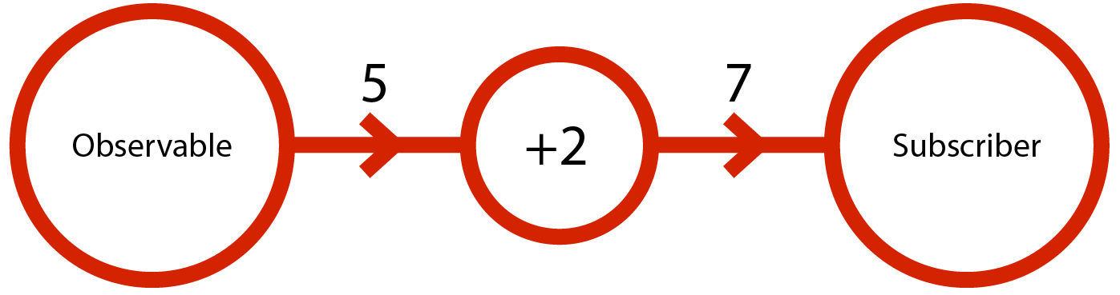
The Observable
Observables are objects that emit values
The emitted values are immutable, a new object comes when something changes
You can subscribe to an observable to receive the emitted values henceforth
Operations can be performed on the values that observables emit (a kind of a wrapper pattern)
Multiple observables can be combined into one with different kinds of conditions, resulting in one observable

Slide 11
So it’s just a pub/sub?
That’s it?
Observable
Observer

Slide 12
Well, kind of.
Network again
UI
get additional information
Network
Observable
parse
cache
View logic
Disk store

Slide 13
It’s a typed data flow
Network again
UI
Author POJO
get additional information
View Model
property
Network
Observable
parse
cache
View logic
string
Book POJO
… of pure logic
Disk store

Slide 14
.. the entry points of which we know exactly.
Network again
UI
get additional information
Network
Observable
parse
cache
View logic
Network
Disk store
Content Provider

Slide 15
Adding new features
Network again
UI
get additional information
Network
Observable
parse
cache
View logic
Disk store

Slide 16
Plugging non-rx things into the system
observable
emitted
onNext
FutuVille API
Websocket
Observable wrapper

Slide 17
Adding new features
Network again
UI
get additional information
View logic
Network
Observable
parse
cache
UI state handler
Disk store
New feature

Slide 18
Values/events can go into the system only from the designated entry points.
that’s a period

Slide 19
Variable vs. Observable
Observable fills the role of a variable in FRP systems
The subscriber (observer) is expected to react consistently every time a new value is set
The new value is used to do whatever changes necessary (UI state, storage) and it is then discarded
Saving the incoming values is usually not necessary and it can be dangerous – holding state leads to bugs

Slide 20
History of Rx
Developed by Microsoft as Reactive Extensions
“...is a library to compose asynchronous and event-based programs using observable collections and LINQ-style query operators.”
Has been ported on most platforms and languages (except PHP)

Slide 21
Rx is..
Also known as Functional Reactive Programming
A way of composing (pure) functions into processing chains
A way to avoid callback hell
A very fancy event publish / listen mechanism

Slide 22
Characteristics of Rx Apps
Basic building blocks of a program become observables – not variables
Favoring push over pull (reacting to change instead of polling it)
Observables do not hold state that can be pulled, but they instead emit values whenever something changes
You can declare “pipes” or “flows” within the app that have defined entry points for data process it in a deterministic way

Slide 23
What is Rx good for?
Applications nowadays are increasingly asynchronous and imperative programming is not enough for app logic
Data can come into the application from many points
… or to not come
Reactive chains make sure the correct action happens each time new data arrives
The entry points for unexpected data are clearly defined
Processing of asynchronous streams, such as throttling and composing

Slide 24
Goals of system design
Pass immutable objects through the system
Combine elaborate data reliably
Keep all data dependencies up-to-date
Permanent subscriptions as event buses
View models for increased testability

Slide 25
So in which parts of the app
should we use RxJava?

Slide 26
All of them!

Slide 27
Complete Rx Skeleton
Fragment
ViewModel
One-off subscriptions,
essentially async calls
Data processing
Network layer
View
DataLayer
create and destroy
UI State Handler
Content
Provider
manage events / data
that require showing
dialogs etc.
Websocket

Slide 28
Data Layer
Gives the last cached value to new subscribers
Uses the network client to fetch data
Offers open subscriptions for receiving a new value whenever a data entry changes (usually identified by an Uri string)
Keeps track of all needy observers
Can refresh all data in the background

Slide 29
View Models
Contains all logic necessary for processing “backend data” into rendereable values
Upon subscription the latest value is immediate emitted and after that refreshed as necessary
Bindings (subscriptions) are done with weak references
Subscribe to the appropriate data sources in Data Store
Unsubscribes from everything whenever the owner is destroyed

Slide 30
Views
Plain layouts and drawing code
No further processing of values received from view models

Slide 31
The Problems in Android
RxJava subscriptions create strong references – memory leaks if not unsubscribed
Unsubscribing at the right time is hard especially with nested view models
No established view model / binding structure
Rx in general forces one to think more and closes many shortcuts
Bridging the gap between native components and view models can sometimes be challenging since the views hold complex state

Slide 32
Why You Should do It?
Cleaner code
Makes you understand where bugs come from
It feels right

Slide 33
What is RxJava
RxJava is a reactive extension for the java virtual machine.
What is reactive programming.
“In computing, reactive programming is a programming paradigm oriented around data flows and the propagation of change. This means that it should be possible to express static or dynamic data flows with ease in the programming languages used, and that the underlying execution model will automatically propagate changes through the data flow.” – Wikipeda
Reactive programming is programming with asynchronous data streams.
Functional Reactive Programming combines reactive programming and functional programming. We will be using functional reactive programming.

Slide 34
RxJava Basic Building Blocks
Observables
Contains all the heavy processing.
Emit items (Objects, Strings, Integers etc.).
Does not start emitting till someone subscribes.
Subscribers
Consumes data.
Manipulation operators (this is the “functional programming” part)
Transforms
Filters
Etc.
Similar to the observer pattern. Except, doesn’t start emitting till there is a subscriber.

Slide 35
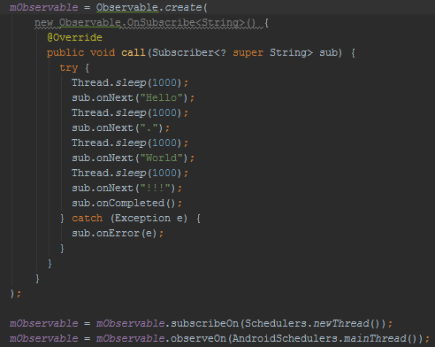
Observers
Create a Observer
Optional
Which thread to compute on.
Which thread to return result on.

Slide 36
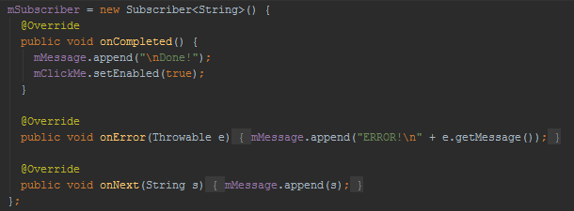
Subscribers
Create a subscriber

Slide 37
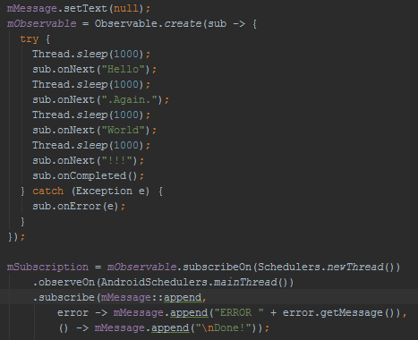
Simplify Code!
Reduce boilerplate code.
Chain method calls.
Use lambdas.

Slide 38
Data Manipulation Operators
Used to transform or filter data.
Keep as much processing on the background thread as possible.
Goal is to clean up data and simplify data processing and code.

Slide 39
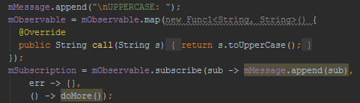
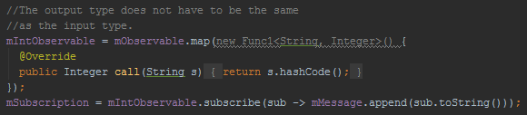
Transform Example
Map() is one of dozens of operators that let you transform data.
Map does not have to return the same type as the one passed in.

Slide 40
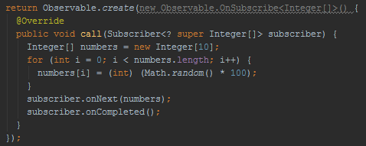
Transform some more…
What if our observer returns lists of data?
Just an example, this could be an API call returning a JSON array.

Slide 41
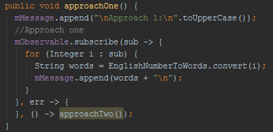
First Approach
We could just look through the data in our subscriber.
Problem: There is a loop and processing is on the main thread.

Slide 42
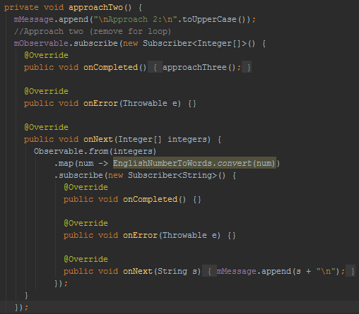
Second Approach
Problem: Loop is gone, but we are still doing a lot of processing on the main thread and the nested code is ugly.

Slide 43
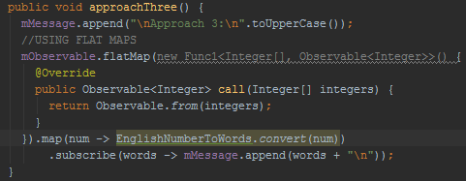
Third approach using flatMap
FlatMap takes in data and returns an other Observable. The end subscriber does not know anything about the data transformation going on.
Minimal processing on the main thread, simpler code.

Slide 44
RxAndroid
An extension for RxJava built just for Android

Slide 45
RxAndroid
RxAndroid provides bindings for Android.
ViewObservable & WidgetObservable provides bindings for views, clicks, scroll, input etc.
AndroidObservable provides facilities for working within the Android lifecycle. Bind to activity, fragment or even broadcasts.
AndroidSchedulers provides ready for use with the Android multi-threading system.

Slide 46
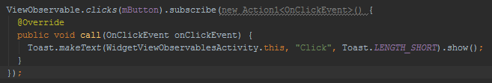
ViewObservable & WidgetObservable
WidgetObservable.text() to capture text change.
ViewObservable.clicks() to capture clicks.
Look at Widget and View Example in demo app

Slide 47
AndroidObservable
Provides bindActivity and bindFragment which automatically use the main thread for observing.
Provides fromBroacast which allows you to create an Observable that works like a BroadcastReceiver.
They also stop emitting automatically when the activity and fragment are finishing.

Slide 48

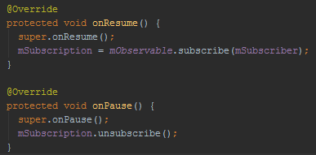
AndroidObservable
Cache & replay calls continue execution even after we unsubscribe.
When you subscribe with a new subscriber, they receive all the emitted data.
Hello World Lifecycle Example in demo app

Slide 49
RxJava has its own issues
Backpressure
Android – Memory leaks by Observables because they retain references to Context.
Continuing subscription during orientations changes can be difficult.
Error Handling.
NotRxAndroid by Jake Wharton
A from-scratch, re-implementation of RxAndroid with a consistent, opinionated API. This library will not have releases and is subject to deletion at any time.

Slide 50
Links
Demo app source https://github.com/alphamu/RxAndroidDemo
RxJava https://github.com/ReactiveX/RxJava
RxAndroid https://github.com/ReactiveX/RxAndroid
Gradle Retro Lambda https://github.com/evant/gradle-retrolambda
Allows you to use Java 8 features with Android
Retrofit https://github.com/square/retrofit
Type-safe REST client for Android and Java by Square, Inc.

Slide 51
Resources
Github sample project: https://github.com/tehmou/rx-android-architecture
My blog post: http://blog.futurice.com/top-7-tips-for-rxjava-on-android
Official RxJava Wiki: https://github.com/Netflix/RxJava/wiki
A good intro to programming RxJava on Android:http://mttkay.github.io/blog/2013/08/25/functional-reactive-programming-on-android-with-rxjava/
Original Rx: http://msdn.microsoft.com/en-gb/data/gg577609.aspx

