Slide 1
Android Security
Ram Software Engineering Labs Pvt Ltd

Slide 2
Outline
Introduction
Android Applications
Security Enforcement
Security Refinements
Lessons in Defining Policy
Notes:
Our presentation is organized as here.
First we will give brief introduction about android OS. Then let’s looking to the android application framework.
Next we are willing to talk about security enforcement and security refinements of android application.
And finally about the lesion in defining security policy.

Slide 3

Introduction
Android (Google)
Open source
A base operation system for mobiles
Application middleware layer
Java software development kit
Collection of system applications
Notes:
Android is a base operating system for mobile applications which is led by Google.
It is widely anticipated open source application development platform and a large community of developers organized around android. Because of that many new products and application are now available for it.
Android provides base operating system, application middleware layer, Java development kit (SDK) and collection of system level applications.
Android is supporting for lot of online services like Google's Gmail, calendar and contacts. Phones which are used android is automatically synchronized with these services.

Slide 4
Feature of Android OS
Doesn’t support applications developed for other platforms
Restricts application interaction to its special APIs by running each application as its own user identity
Uses a simple permission label assignment model to restrict access to resources and other applications
Notes:
Here we can see several main features of android which is very important when we talked about the android application security.
First android OS Doesn’t support applications developed for other platforms
Android Restricts application interaction to its special APIs by running each application as its own user identity
Android Uses a simple permission label assignment model to restrict access to resources and other applications
We will looking to these in more details under security enforcements section.

Slide 5
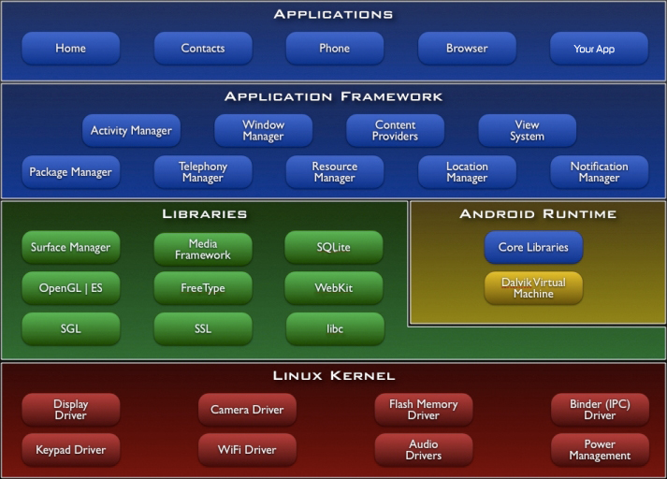
Android OS Architecture
Notes:
The Android operating system is built on a modified Linux kernel.
The software stack contains Java applications running on a virtual machine called Dalvik virtual machine.
The system components are written in Java, C, C++, and XML.
Android OS consist of lot of core libraries which is support java.
On top of that application framework is build to support android application developments.

Slide 6
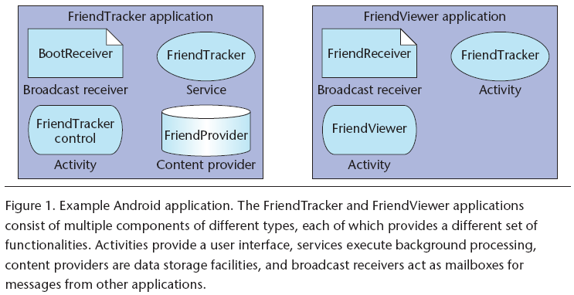
Example Application
Notes:
Authors are developed sample application to explain android application components.
Which is called friend tracker application and developed as two android applications. One is called friend tracker and other is friend viewer. This is mainly due to explain communication between two applications.
Android application doesn’t have a main () function or single entry point for execution, instead, developers must design applications in terms of components. There are four components Activity, Broadcast Receiver, Service and Content Provider.

Slide 7
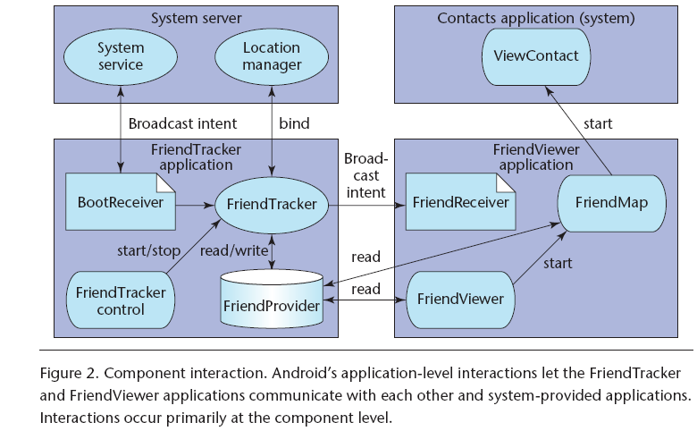
FriendTracker - Component Interaction
Intent - message object containing a destination component address and data
Action - the process of inter-components communication
Notes:
Components in android applications are communicate each other using intents and actions.
Intent is a message object, which is containing a destination component address and data.
Action is a process of inter component communication.

Slide 8
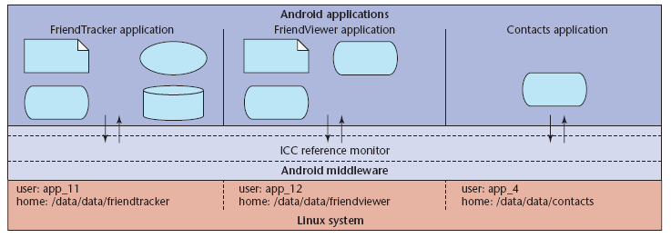
Security Enforcement
Android applications execute as its own user identity, allowing the underlying Linux system to provide system-level isolation
Android middleware contains a reference monitor that mediates the establishment of inter-component communication (ICC)

Slide 9
Security Enforcement
Core idea of Android security enforcement - labels assignment to applications and components
A reference monitor provides mandatory access control (MAC) enforcement of how applications access components
Access to each component is restricted by assigning it an access permission label. Applications are assigned collections of permission labels
When a component initiates ICC, the reference monitor looks at the permission labels assigned to its containing application and— if the target component’s access permission label is in that collection— allows ICC establishment to proceed.

Slide 10
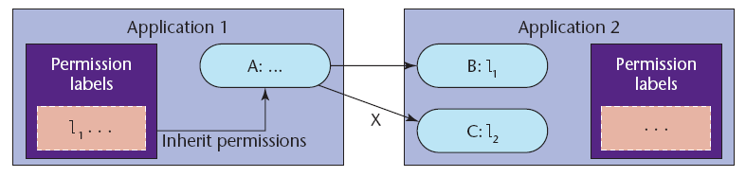
Security Enforcement : Access permission logic Example
Component A’s ability to access components B and C is determined by comparing the access permission labels on B and C to the collection of labels assigned to application 1.

Slide 11
Android Security Refinements
Notes:
9 security refinements
Some are extension to basic MAC model and some are new concepts

Slide 12

Public and Private Components
Applications often contain components that another application should never access. For example, component related to password storing.
The solution is to Instead of defining an access permission user can define the component as private.
Best Practice: Always set the “exported” attribute.
This significantly reduces the attack surface for many applications.
Notes:
Some Applications often contain components that another application should never need access.

Slide 13
Implicitly Open Components
At development time, if the decision of access permission is unclear, The developer can permit the functionality by not assigning an access permission to it.
If a public component doesn’t explicitly have an access permission listed in its manifest definition, Android permits any application to access it.
Best Practice: Should always assign access permissions to public components.
Notes:
This is also related to the first point.

Slide 14
Intent Broadcast Permissions
Sending the unprotected intent is a privacy risk.
Android API for broadcasting intents optionally allows the developer to specify a permission label to restrict access to the intent object.
Best Practice: Always specify an access permission on Intent broadcasts
Notes:
That can leak the user privacy information to explicitly listening attackers.

Slide 15
Content Provider Permissions
If the developer want his application to be the only one to update the contents but for other applications to be able to read them.
Android allows such a security policy assigning read or write permissions.
Best Practice: Always deﬁne separate read and write permissions.
Notes:
Insert, Update or delete

Slide 16
Service Hooks
Android only lets the developer assign one permission label to restrict starting, stopping, and binding to a service.
Under this model, any application can start or stop Friend tracker can also tell it to monitor new friends.
Best Practice: Use service hooks and let the developers write code to perform custom runtime security.
Eg.. Use checkPermission() to mediate “administrative” operations in Friend Tracker .

Slide 17
Protected APIs
Not all system are accessed through components—instead, Android provides direct API access.
Android protects these sensitive APIs with additional permission label checks: an application must declare a corresponding permission label in its manifest file to use them.
Best Practice: Application need to request permissions for protected APIs
Notes:
resources(for example, network, camera, microphone

Slide 18
Permission Protection Levels
The permission protection levels provide a means of controlling how developers assign permission labels.
Normal – grant to any application that request them in its manifest
Dangerous – granted only after user confirmation
Signature – granted only to application signed by the same developer key
Signature or system – same like signature but exist for legacy compatibility.
Best Practice: Use either signature or dangerous permissions depending on the application behaviour
Notes:
Early model had two levels application or system
But new model has 4 protection levels for permission labels
Nomal is same as application permission in previous model

Slide 19
Pending Intents
The Pending Intent object is simply a reference pointer that can pass to another application.
Recipient application can modify the original intent and specify when the action is invoked.
Pending intents allow applications included with the framework to integrate better with third-party applications.
Best Practice: Only use Pending Intents as “delayed callbacks” to private Components and always specify the private broadcast receiver.
Notes:
In Android defines an intent object to perform an action.
However, instead of performing the action, it passes the intent to a special method that creates a Pending Intent object corresponding to that action.

Slide 20
Lessons in Defining Policy
Android security policy begins with a relatively easy-to-understand MAC enforcement model
Some refinements push policy into the application code
The permission label itself is merely a text string, but its assignment to an application provides access to potentially limitless resources
Notes:
Android has to find a answer for how to control access to permission label
Things like allowing a application to use both microphone and internet

