Slide 1
Android Testing Framework
Ram Software Engineering Labs Pvt Ltd

Slide 2
Agenda/Outline/Overview
Testing Approach
Android testing framework
Android The Testing API
Android testing tools
Different automated testing frameworks

Slide 3
Testing Approach
Unit testing
Integration testing
Manual testing
Automated testing

Slide 4
Unit Testing
tests only the functionality of a certain component such as a method (function) in a class, with all dependencies mocked up
tests tend to be simpler and faster than integration tests
also known as local tests
run on a local JVM on the development machine instead of the Android Runtime
the execution speed of the unit test is very fast compared to tests which require the Android system
unit tests are executed against a modified version of the android.jar which allows you to mocking libraries, like Mockito

Slide 5
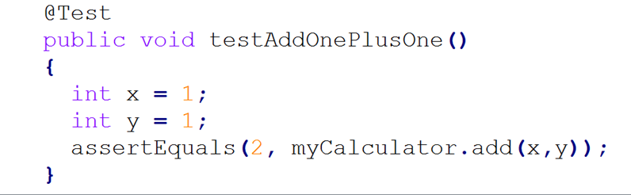
Unit Testing
Tools : JUnit

Slide 6
Integration Testing
tests more than one component and how different pieces of the system work together
requires resources like database instances and hardware to be allocated for them
test many methods and may interact with dependencies like Databases or Web Services

Slide 7
Unit Testing Vs. Integration Testing
Let's, for example, assume a button in an Android activity is used to start another activity. A unit test would determine if the corresponding intent was issued, not if the second activity was started.
An integration test would also check if the activity was correctly started.

Slide 8


Manual Testing
Requires Human interaction
Tool : Human being

Slide 9

Automated Testing Frameworks
No Human Interactions
Lots of Frameworks to automate testing
Robotium
Espresso
uiautomator
Robolectric
Calabash
Appium

Slide 10
Automated Testing Frameworks
most popular approaches used for automated Android testing:
Google’s Android Testing Framework- This is the framework included as part of the platform
Robotium - Black box integration testing for Android
Robolectric - Unit tests that run outside the emulator making the tests very fast

Slide 11

Android Testing Framework
An Integral part of the development environment
Assist on testing every aspect of application from unit testing to framework

Slide 12
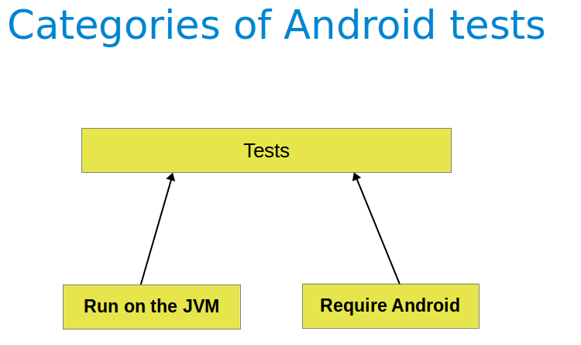
Categories of Android Tests
Testing for Android can be classified into:
Local tests - tests which can run on the JVM
Instrumented tests - tests which require the Android system
If possible, you should prefer to use local tests as the test execution is much faster compared to the time required to deploy and run the test on an Android device

Slide 13
Android The Testing API
The Android testing API is based on the JUnit API and extended with a instrumentation framework and Android-specific testing classes.
Junit
Instrumentation
TestCase Classes
AndroidTestCase
Component-specific test cases
ApplicationTestCase
InstrumentationTestCase
Assertion classes
Mock object classes
Contexts for testing

Slide 14
Android Testing Framework
Key Features of Testing Framework
test suites are based on Junit
test suites are contained in test packages similar to main application packages
The SDK also provides
use plain JUnit to test a class that doesn't call the Android API
use Android's JUnit extensions to test Android components
monkeyrunner, an API for testing devices with Python programs
UI/Application Exerciser Monkey, a command-line tool for stress-testing UIs by sending pseudo-random events to a device

Slide 15
Android Testing Tools
Testing Support Library
This library provides a set of APIs that helps to build and run test code for app
The Android Testing Support Library includes the following test automation tools:
AndroidJUnitRunner: JUnit 4-compatible test runner for Android
Espresso: UI testing framework; suitable for functional UI testing within an app
UI Automator: UI testing framework; suitable for cross-app functional UI testing across system and installed apps

Slide 16
Android Testing Tools
Testing Support Library
Monkey
is a command-line tool
a program that runs on emulator or device
generates pseudo-random streams of user events (such as clicks, touches, or gestures, as well as a number of system-level events) and sends them into system
acts as a stress test on the application, in a random yet repeatable manner
watches the system under test

Slide 17
Android Testing Tools
Testing Support Library
monkeyrunner
provides an API for writing programs that control an Android device or emulator from outside of Android code
monkeyrunner tool provides these unique features for Android testing: Multiple device control, Functional testing, Regression testing, Extensible automation
The monkeyrunner tool uses Jython
Jython allows the monkeyrunner API to interact easily with the Android framework

Slide 18
Android Testing Tools
Testing Support Library
monkeyrunner
monkeyrunner API is contained in three modules : MonkeyRunner, MonkeyDevice and MonkeyImage
it does not import these modules automatically
To import a module, use the Python from statement:
from com.android.monkeyrunner import <module>

Slide 19
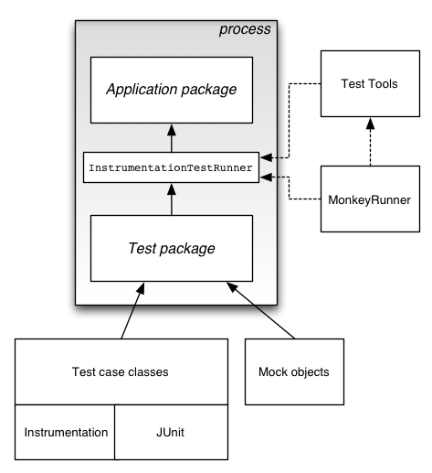
How does Android Test Framework works
is based on JUnit
test tools are used to load the test package and the application under test
after loading package and application test tools execute an Android-specific test runner
Test cases are run by a test runner class that loads the test case class, setups, runs, and tears down each test.
InstrumentationTestRunner is the primary Android test runner class.

Slide 20
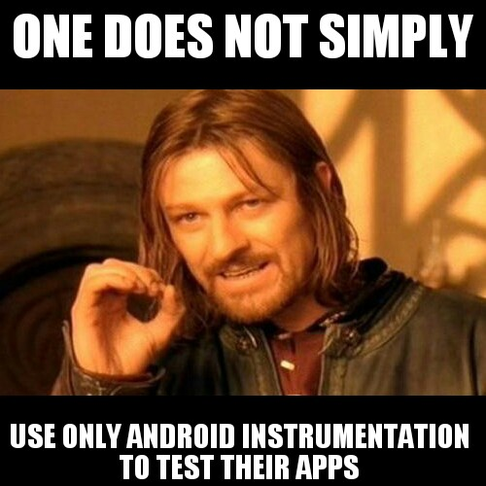
Robotium
is an open source library extending JUnit with plenty of useful methods for Android UI testing
require the application to be running on emulator/device
provides powerful and robust automatic black-box test cases for Android apps (native and hybrid)
Inherit from extension of Android class: ActivityInstrumentationTestCase2
Uses “Solo” class to interact with your UI
Robotium Recorder for capturing test output and screenshots

Slide 21
Robotium
The framework handles multiple Android activities automatically.
Minimal time needed to write solid test cases.
Readability of test cases is greatly improved, compared to standard instrumentation tests.
Test cases are more robust due to the run-time binding to UI components.
Integrates smoothly with Maven, Gradle or Ant to run tests as part of continuous integration.
Relatively slow

Slide 22
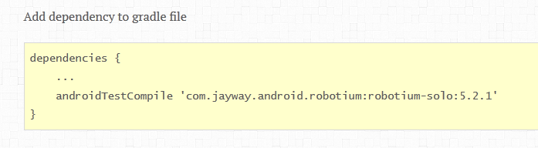
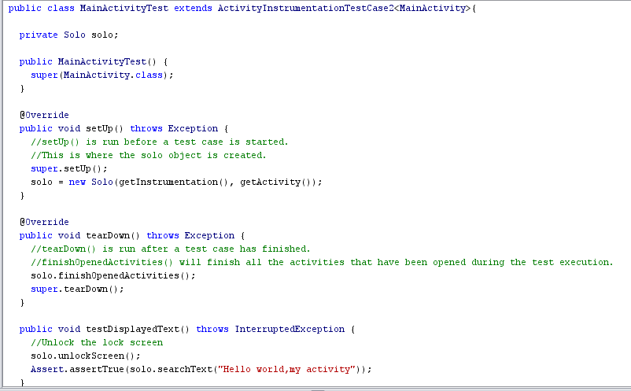
Robotium

Slide 23
Espresso
latest Android test automation framework of Google
API is small, predictable, easy to learn and built on top of the Android instrumentation framework
Espresso tests can run on devices running Android 2.2 (API level 8) and higher
we can write concise and reliable Android UI tests within a single target app
is an instrumentation-based API and works with the AndroidJUnitRunner test runner
Safer synchronization and thread handling
The syntax is also a lot cleaner
tests run optimally fast! Leave your waits, syncs, sleeps, and polls behind
does not have support for webviews

Slide 24
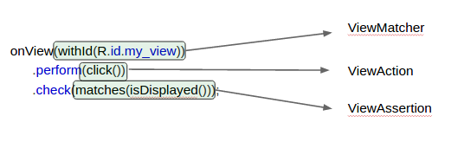
Espresso
Espresso is built up from 3 major components :
ViewMatchers – allows you to locate a view in the current view hierarchy [“find something“]
ViewActions – allows you to interact with views [“do something“]
ViewAssertions – allows you to assert the state of a view [“check something“]
To avoid flakiness Turn off animations on testing device

Slide 25
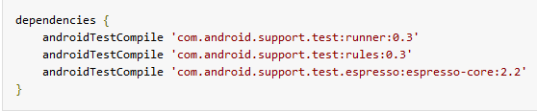
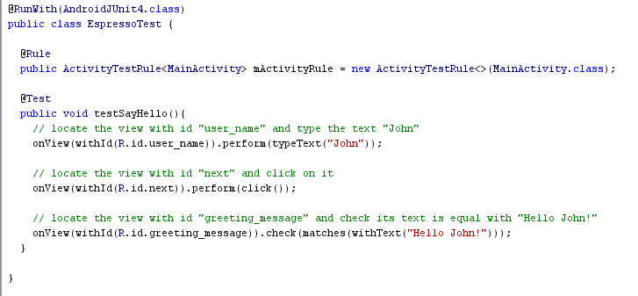
Espresso

Slide 26
Robotium Vs. Espresso
The major advances in Espresso over Robotium:
Synchronization.
API.
Clear failure information.

Slide 27
Espresso Vs. Robotium
Espresso test run is in sync with the UI thread and does not rely on sleep/poll mechanisms but is rather event driven
Espresso is much faster than Robotium, but only works on some SDK versions.
More robust and extendable
Tightly coupled with Android
Example: ViewMatcher
Custom Exception Handling
Espresso has a small, well-defined and predictable API, which is open to customization
Robotium attempts to address thread safety with sleep/retry mechanisms, which makes it unreliable and slower than necessary
Easier to use, Very stable
prior versions of Robotium suffered from inconsistent failure handling
In Robotium's API, it is expected to choose from 30+ click methods
Robotium exposes dangerous methods like getCurrentActivity and getView, which allow you to operate on objects outside of the main thread

Slide 28
uiautomator
Can Test UI of native Android apps on one or more devices
perform interactions on user apps and system apps
is an instrumentation-based API and works with the AndroidJUnitRunner test runner
Requires Android 4.3 (API level 18) or higher
is well-suited for writing black box-style automated tests
APIs interact with visible elements on a device, regardless of which Activity is in focus
runs JUnit test cases with special privileges, which means test cases can span across different processes.
doesn’t support webview, with no way to directly access Android objects.

Slide 29
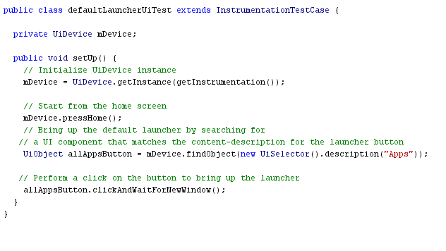
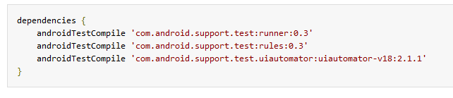
uiautomator

Slide 30
Espresso Vs. uiautomotor
Testing UI for a Single App:
checks that the target app returns the correct UI output in response to user interactions in the app’s activities.
Espresso framework is used to simulate user actions programmatically and test complex intra-app user interactions.
Testing UI for Multiple Apps:
verifies the correct behavior of interactions between different user apps or between user apps and system apps.
UI Automator framework is used to support cross-app interactions.

Slide 31
Robolectric
Robolectric is a unit test framework
lets you run your tests inside the JVM
Doesn’t require emulator/Device to run test
Fastest testing suite; reduces test cycles from minutes to seconds
No Mocking Framework is needed
does not work for every case and only supports unit tests
When tests fall outside its scope then we need to rely on Robotium for complete integration testing

Slide 32
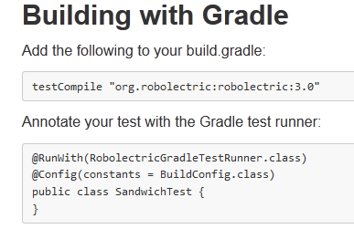
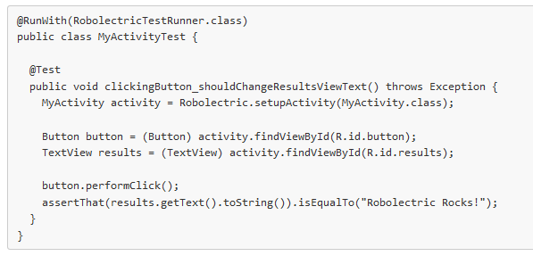
Robolectric

Slide 33
Other 3rd Party Frameworks
Selendroid
http://selendroid.io/
Testdroid
http://testdroid.com/
Appium
Calabash

Slide 34
References
http://developer.android.com/tools/testing/testing_android.html
https://code.google.com/p/robotium/
http://robolectric.org/
https://github.com/codepath/android_guides/wiki/Android-Unit-and-Integration-testing
http://developer.android.com/training/testing/ui-testing/espresso-testing.html
https://code.google.com/p/android-test-kit/wiki/Espresso
http://developer.android.com/tools/testing-support-library/index.html#UIAutomator
http://testdroid.com/tech/top-5-android-testing-frameworks-with-examples
https://www.youtube.com/watch?v=TGU0B4qRlHY
https://androidresearch.wordpress.com/2015/04/04/an-introduction-to-espresso/
http://www.vogella.com/tutorials/AndroidTestingEspresso/article.html
http://www.vogella.com/tutorials/AndroidTesting/article.html

