Slide 1
Refactoring
Ram Software Engineering Labs Pvt Ltd

Slide 2
Why do good developers write bad software?
Requirements change over time, making it hard to update your code (leading to less optimal designs)
Time and money cause you to take shortcuts
You learn a better way to do something (the second time you paint a room, it’s always better than the first because you learned during the first time!)
Two questions:
How do we fix our software?
How do we know our software is “bad”… when it works fine!

Slide 3
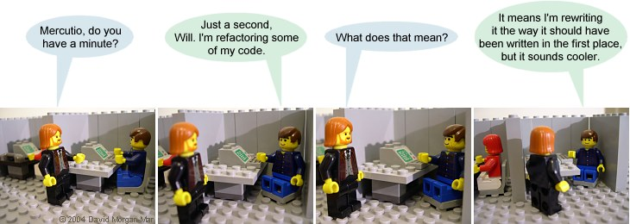
Refactoring
Definition: Refactoring modifies software to improve its readability, maintainability, and extensibility without changing what it actually does.
External behavior does NOT change
Internal structure is improved

Slide 4
Refactoring
The goal of refactoring is NOT to add new functionality
The goal of refactoring is to make code easier to maintain in the future

Slide 5
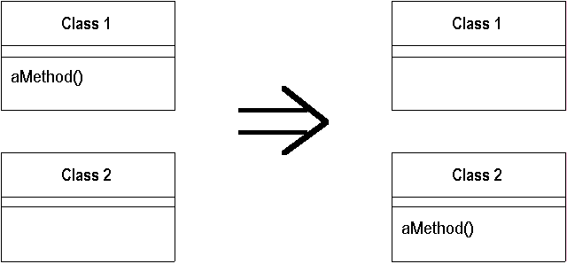
Refactoring Simple Example
Move a method:
Motivation: A method is, or will be, using or used by more features of another class than the class on which it is defined.
Technique: Create a new method with a similar body in the class it uses most. Either turn the old method into a simple delegation, or remove it altogether.

Slide 6
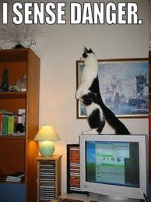
Danger!
Refactoring CAN introduce problems, because anytime you modify software you may introduce bugs!
Management thus says:
Refactoring adds risk!
It’s expensive – we’re spending time in development, but not “seeing” any
external differences? And we still
have to retest?
Why are we doing this?

Slide 7
Motivation
We refactor because we understand getting the design right the first time is hard and you get many benefits from refactoring:
Code size is often reduced
Confusing code is restructured into simpler code
Both of these greatly improve mainatainability! Which is required because requirements always change!

Slide 8
Refactoring: Complex Example
Introduce Null Object
Motivation: You have many checks for null
Technique: Replace the null value with a null object.
Customer c = findCustomer(...);
...
if (customer == null) {
name = “occupant”
} else {
name = customer.getName()
}
if (customer == null) {
…

Slide 9
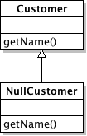
Refactoring: Complex Example
public class NullCustomer extends Customer {
public String getName() {
return “occupant”
}
------------------------------------------------------------
Customer c = findCustomer() name = c.getName()
Completely eliminated the if statement by replacing checks for null with a null object that does the right thing for “null” values.

Slide 10
Refactoring Example: Replace Conditional with Polymorphism
Motivation: You have a condition that chooses different behavior depending on the type of an object.
Technique: Move each leg of the conditional to an overriding method in a subclass. Make the original method abstract.
double getSpeed() { switch (_type) { case EUROPEAN: return getBaseSpeed(); case AFRICAN: return getBaseSpeed() - getLoadFactor() * _numberOfCoconuts; case NORWEGIAN_BLUE: return (_isNailed) ? 0 : getBaseSpeed(_voltage); } throw new RuntimeException ("Should be unreachable");
}

Slide 11
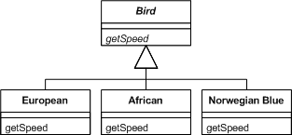
Refactoring Example: Replace Conditional with Polymorphism
Notes:
More examples at http://www.refactoring.com/catalog/index.html

Slide 12
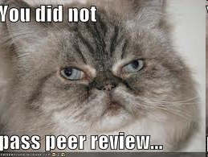
When do I refactor?
When you add functionality
Before you add new features, make sure your design and current code is “good” this will help the new code be easier to write
When you need to fix a bug
When you do a peer review

Slide 13

How do I identify code to refactor?
Martin Fowler uses “code smells” to identify when to refactor.
Code smells are bad things done in code, somewhat like bad patterns in code
Many people have tied code smells to the specific refactorings to fix the smell

Slide 14
Code Smells
Duplicated Code
bad because if you modify one instance of duplicated code but not the others, you (may) have introduced a bug!
Long Method
long methods are more difﬁcult to understand
performance concerns with respect to lots of short methods are largely obsolete

Slide 15
Code Smells
Large Class
classes try to do too much, which reduces cohesion
Long Parameter List
hard to understand, can become inconsistent
Divergent Change
Related to cohesion: symptom: one type of change requires changing one subset of methods; another type of change requires changing another subset

Slide 16
Code Smells
Lazy Class
A class that no longer “pays its way”
e.g. may be a class that was downsized by a previous refactoring, or represented planned functionality that did not pan out
Speculative Generality
“Oh I think we need the ability to do this kind of thing someday”
Temporary Field
An attribute of an object is only set in certain circumstances; but an object should need all of its attributes

Slide 17
Code Smells
Data Class
These are classes that have ﬁelds, getting and setting methods for the ﬁelds, and nothing else; they are data holders, but objects should be about data AND behavior
Refused Bequest
A subclass ignores most of the functionality provided by its superclass
Subclass may not pass the “IS-A” test
Comments (!)
Comments are sometimes used to hide bad code
“…comments often are used as a deodorant” (!)

Slide 18
Many more code smells
Many more smells at:
http://c2.com/cgi/wiki?CodeSmell
Given a smell, what refactorings are likely?
http://wiki.java.net/bin/view/People/SmellsToRefactorings

Slide 19
SMELLS EXAMPLE – See which smells you find in the sample code Duplicated Code Long Method Large Class Long Parameter List Divergent Change- Related to cohesion: symptom: one type of change requires changing one subset of methods; another type of change requires changing another subset Data Class - These are classes that have ﬁelds, getting and setting methods for the ﬁelds, and nothing else; they are data holders, but objects should be about data AND behavior Refused Bequest - A subclass ignores most of the functionality provided by its superclass Comments (!) - Comments are sometimes used to hide bad code Lazy Class - A class that no longer “pays its way” Speculative Generality - “Oh I think we need the ability to do this kind of thing someday” Temporary Field - An attribute of an object is only set in certain circumstances; but an object should need all of its attributes
Notes:
CODE: http://vivekagarwal.wordpress.com/2008/06/21/code-smelling-exercise/#more-105

Slide 20
Why use them?
Code smells and refactoring are techniques to help you discover problems in design and implementation and apply known solutions to these problems
Should they be used all the time? You should always think about them, but only apply them when they make sense… sometimes you need a long method… but think about it to make sure!

Slide 21
Adding safety
Remember that making these changes incurs some risk of introducing bugs!
To reduce that risk
You must test constantly – using automated tests wherever possible
Use refactoring patterns – I’ve shown you two… there are more.. many more!
http://www.refactoring.com/catalog/index.html
Use tools! Netbeans and Eclipse both support basic refactoring (http://wiki.netbeans.org/Refactoring)

Slide 22
Question from your boss
"Refactoring is an overhead activity - I'm paid to write new, revenue generating features."
Tools/technologies are now available to allow refactoring to be done quickly and relatively painlessly.
Experiences reported by some object-oriented programmers suggest that the overhead of refactoring is more than compensated by reduced efforts and intervals in other phases of program development.
While refactoring may seem a bit awkward and an overhead at first, as it becomes part of a software development regimen, it stops feeling like overhead and starts feeling like an essential.
Quoted from: http://st-www.cs.illinois.edu/users/opdyke/wfo.990201.refac.html

Slide 23
Summary
Refactoring improves the design of software
without refactoring, a design will “decay” as people make changes to a software system
Refactoring makes software easier to understand
because structure is improved, duplicated code is eliminated, etc.
Refactoring helps you find bugs
Refactoring promotes a deep understanding of the code at hand, and this understanding aids the programmer in finding bugs and anticipating potential bugs
Refactoring helps you program faster
because a good design enables progress

Slide 24
References
Comic from: http://www.irregularwebcomic.net/comic.php?comic=687
http://www.refactoring.com/catalog/index.html
Code smells exercise at: http://vivekagarwal.wordpress.com/2008/06/21/code-smelling-exercise/#more-105

