Slide 1
UDDI v3.0
(Universal Description,
Discovery and Integration)
http://www.oasis-open.org/committees/uddi-spec/doc/spec/v3/uddi-v3.0.2-20041019.pdf

Slide 2
Overview
  The adopted standard for service discovery.
  Two components
    Standards-based specifications for service description and discovery
    UDDI registry itself implemented as a web service
  UDDI Business Registry (UBR)
  --- operated by IBM, Microsoft, NTT Comm., SAP.
  Keyword search, categories and classifications.
  Managed by OASIS standards body.

Slide 3



How UDDI Works
A technical specification for publishing and finding businesses and Web services.
4.
1.
Companies, standards bodies, and programmers populate the registry with
descriptions of different types of services
Marketplaces, search engines, and business apps query the registry to discover services at other companies
2.
5.
Business
Registrations
Service Type
Registrations
Businesses populate
the registry with
descriptions of the services they support
Business uses this data to facilitate easier integration with each other over the Web
3.
UBR assigns a programmatically unique identifier to each service and business registration

Slide 4
What’s in UDDI?
UDDI Data Model
Programmer APIs
Behaviors of Node and Registry
Policy

Slide 5
UDDI Data Model
UDDI describes four core types of information:
  businessEntity
    A business or organization providing services.
    White page.
  businessService
    Services provided by an organization.
    Support classification using various taxonomy systems.
    Yellow page.
  bindingTemplate
    Technical information necessary to access a service.
    Green page.
  tModel (Technical Model)
    Descriptions and pointers to a reusable concept, external technical specifications or taxonomies.
    E.g., Web service type, a protocol used by Web services, a category system.

Slide 6
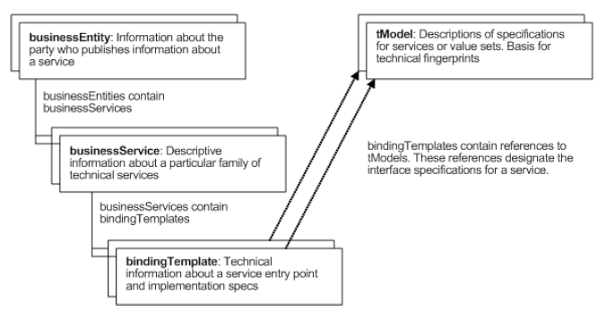
UDDI Data Model

Slide 7
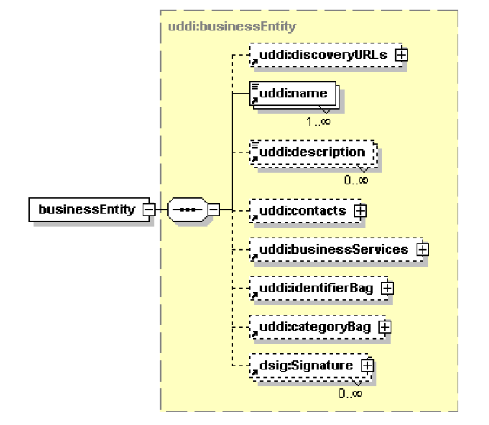
businessEntity

Slide 8
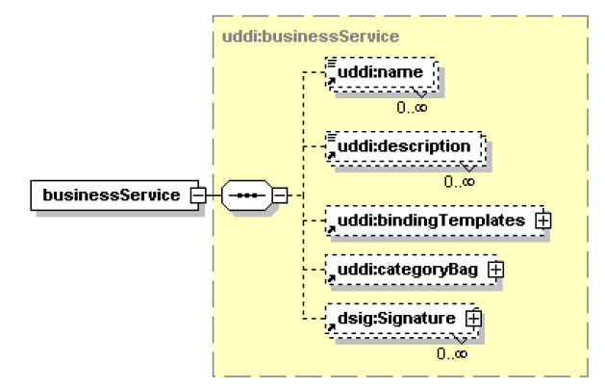
businessService

Slide 9
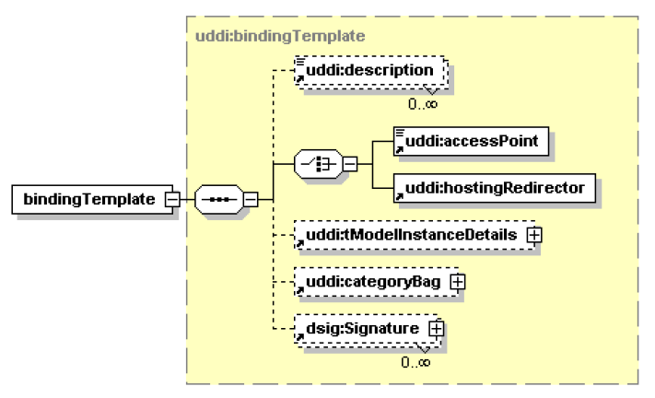
bindingTemplate

Slide 10
tModel
tModel documents are a core data structure in the UDDI specification and represent the most detailed information that a UDDI registry can provide about any specification
There are several places within a businessEntity that can refer to tModels
  Defining the technical fingerprint
    One common use for tModel entities is to represent technical specifications
    e.g. a tModel can be used to represent a specification that defines wire protocols
  Defining value sets
    specify organizational identity and various categories
    represents the system of values used to identify or categorize UDDI entities
  Defining a find qualifier
    Find qualifiers are values that modify how the find_xx APIs work.

Slide 11
Example of tModel
<t Model>
Name
Description
URL pointers
<tModel tModelKey="uuid:aa254698-93de-3870-8df3-a5c075d64a0e">
<name>uddi-org:protocol:soap</name>
<description>A tModel for the SOAP 1.1 protocol</description>
<overviewDoc>
<overviewURL>
http://www.oasis-open.org/.../uddi-spec-tc-tn-wsdl-v2.htm#soap
</overviewURL>
</overviewDoc>
<categoryBag>
<keyedReference
tModelKey="uuid:c1acf26d-9672-4404-9d70-39b756e62ab4"
keyName="uddi-org:types" keyValue="protocol"/>
</categoryBag>
</tModel>
<business Entity>
name, contacts,
descriptions, categories
<business Service>
(1..n)
<binding Template>
TModel Definition for SOAP Protocol

Slide 12
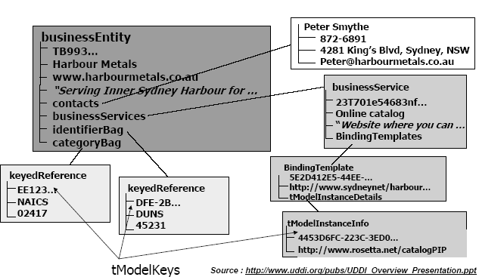
Example of a Registration

Slide 13
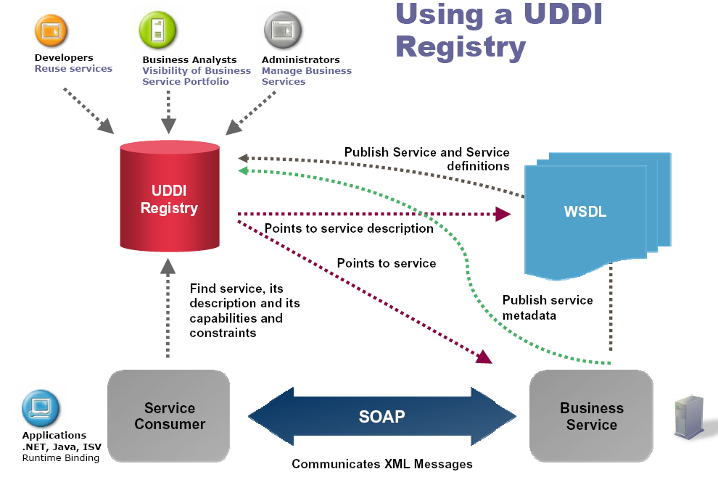
Overview of UDDI Registry

Slide 14
publisherAssertion
Many businesses and organizations are not effectively represented by a single businessEntity
  Examples include corporations with a variety of subsidiaries, private exchanges with sets of suppliers and their customers and industry consortiums with their members.
An obvious solution is to use the publisherAssertion structure
  Such a set of businessEntity structures represents a more or less coupled community whose members often would like to make some of their relationships visible in their UDDI registrations
A relationship between two businessEntity structures is visible to the "public" when both companies have created the same assertion with two separate publisherAssertion documents independently

Slide 15
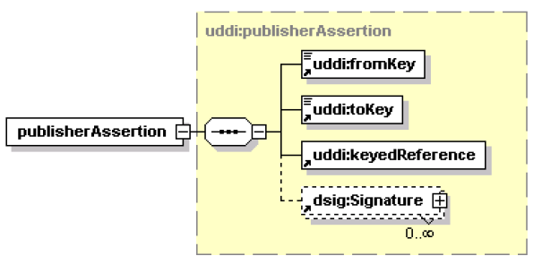
publisherAssertion Structure

Slide 16
UDDI APIs
Builds on SOAP
  Identifies all records by UUIDs
  UDDI provides inquiry and publishing APIs, allowing applications to interface programmatically with a registry
Finding Business and Service
  Includes set of methods to discover records
  Includes set of methods to retrieve detailed records
  What can we search on?
    name
    categoryBag
    tModelBag
  For businesses only, also
    identifierBag
    discoveryURLs

Slide 17
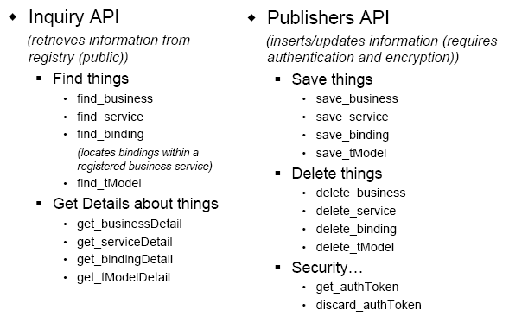
Registry APIs

Slide 18
UDDI Node, Registry & Affiliated Registries
Definition of the hierarchical relationship between instances of a UDDI implementation
There are three major classifications of UDDI servers:
  Node - UDDI server that supports at least the minimum set of functionality defined in the specification. It is a member of exactly one UDDI registry.
  Registry - composed of one or more nodes. A registry performs the complete set of functionality as defined in the specification.
  Affiliated Registries - individual UDDI registries that implement policy-based sharing of information among them
    They share a common namespace for UDDI keys that uniquely identify data records

Slide 19
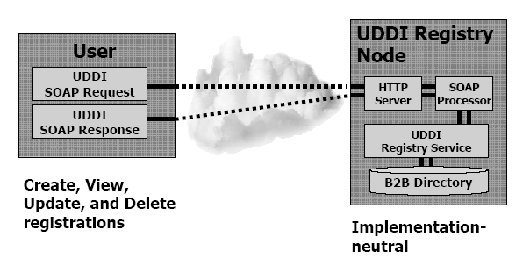
UDDI and SOAP

Slide 20
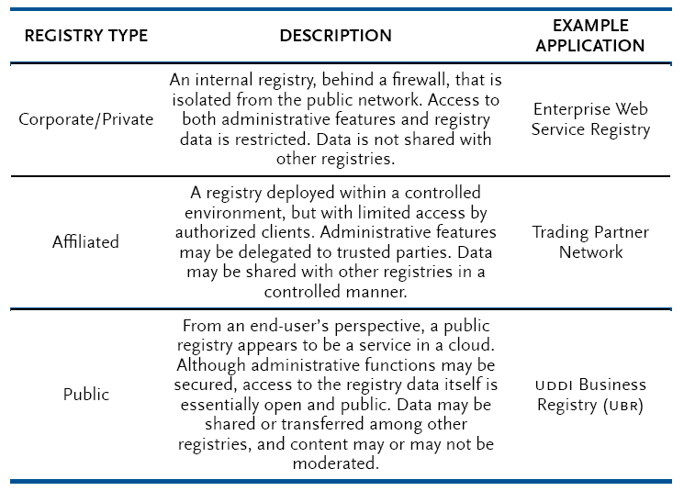
Types of Registries
Supporting a variety of infrastructural permutations
  The current version provides an open, standardized approach to ensure widely interoperable communication

Slide 21
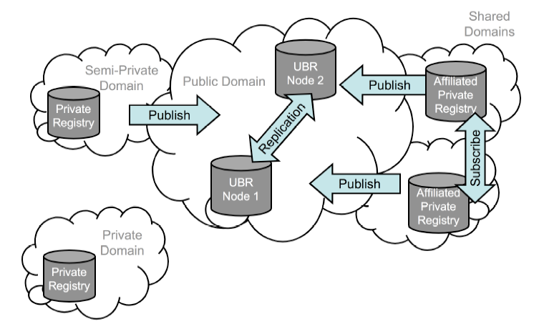
Registry Affiliation
Operations in and between nodes and between affiliated registries are defined in UDDI

Slide 22
Policy
Policies within UDDI are statements of required and expected behavior.
Policies:
  The registry defines the domain of the policy for the nodes
  The registry may delegate the definition of a particular policy to one or more of the nodes within its domain.
  A hierarchical relationship between registry policies and node policies
    e.g, whether a registry allows nodes to specify polices
  The Registries also identify the Policy Decision Points & Policy Enforcement Points
  Affiliated registries are sets of registries that share compatible policies for assigning keys and managing data

Slide 23
Security in UDDI
The security model for a UDDI registry can be characterized by the collection of registry and node policies and the implementation of these policies by a UDDI node.
In order to authorize or restrict access to data in a UDDI registry, an implementation of a UDDI node MAY be integrated with one or more identification systems.
Integration of UDDI APIs and data with an identification system MAY be implemented through the authentication and authorization APIs to provide access control.
Other authentication and authorization mechanisms and policies are represented in UDDI through use of tModels.
UDDI also supports XML Digital Signatures on UDDI data to enable inquirers to verify the integrity of the data with respect to the publisher.

Slide 24
Security Policy APT set
The security API includes the following API calls:
  discard_authToken: Used to inform a node that a previously obtained authentication token is no longer required and should be considered invalid if used after this message is received.
  get_authToken: Used to request an authentication token from a UDDI node.
Authentication Token can be
  Id/Password based system
  SAML authorization Assertion

Slide 25
The End
Thanks

