Slide 1
Suggest “the” Doctor

Slide 2
Proposal
Analyze a Doctor rating website on statistical basis for recommending a doctor for the situation based on the historical rating and comments provided for the doctors in the website.
Based on the patient ailment and the requirement the doctor will be suggested.
The System will provide perception after comparing the necessary attributes among similar websites to give a holistic view to the patients concerned

Slide 3
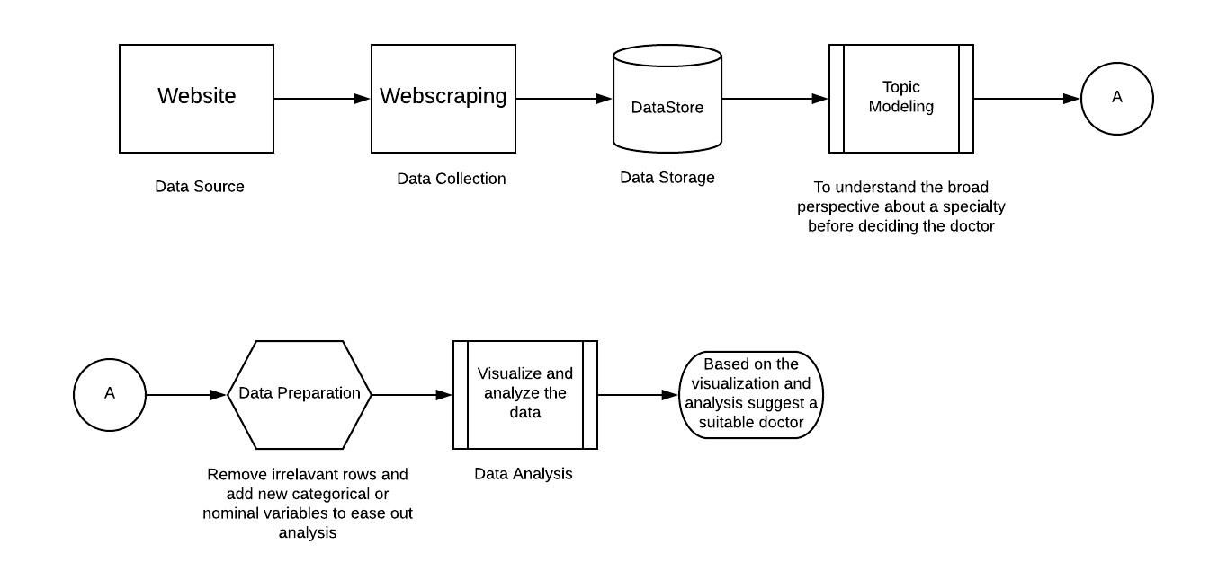
Plan to implement the Idea

Slide 4
Data Source
I have decided to go with Rate MDs to mock up the idea for one specialty and in the WNY region.
Analysis done for:
Rating Website: Rate MDs
Specialty: Gynecology

Slide 5
Data Collection
Using webscraping and webcrawling, I gathered necessary details about doctors from the website.
Attributes for comparison:
Doctor Name
Specialty
Rating provided by patients for Staff,Punctuality,Helpfulness,Knowledge
Reviews by Patients
Number of Likes for each comment
Date when the review was submitted

Slide 6
Topic Modeling
Using the LDA principle(unsupervised learning) we try to derive the over all sentiment about the specialty that is under concern.
In our case, gynecology is a quite renowned specialty in the WNY region with a significantly high percentage of them with good ratings according to the attributes scraped from the website.

Slide 7
Data Preparation
Descriptive statistics was performed on each variable to check the normality of the nominal variables present in the dataset.
For gynecology specialty the nominal variables were found to be skewed negatively with a chunk of rating leaning towards 5 rating.
More Categorical variables were added to the dataset.
Poor Rate:
P: for Doctors with Average rating < 3 and Number of likes > 0
E: for Doctors with Average rating > 3 and Number of likes >0
N: for reviews with 0 likes.

Slide 8
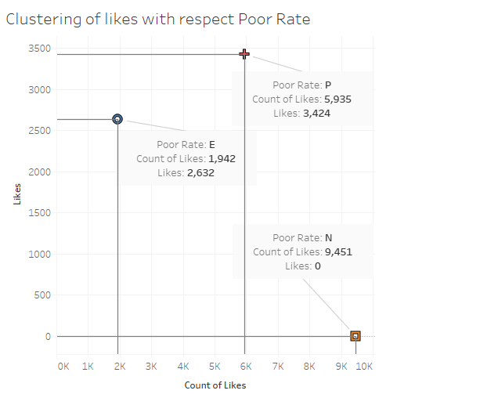
Visualization and Data Analysis
After Preparing the data, to derive a conclusion we go through the process of visualizing.

Slide 9
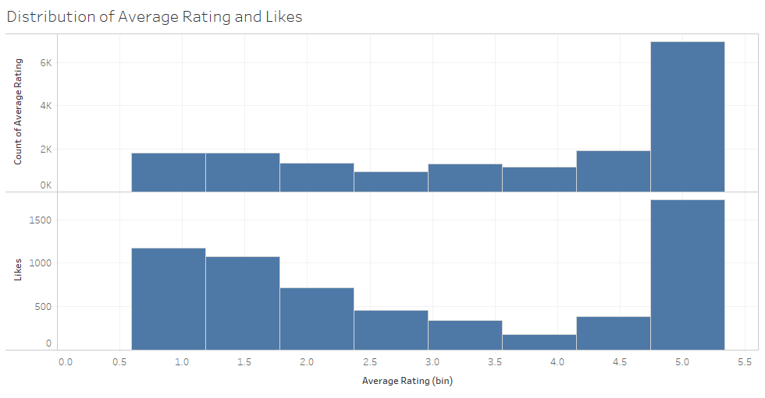
Visualization and Data Analysis

Slide 10
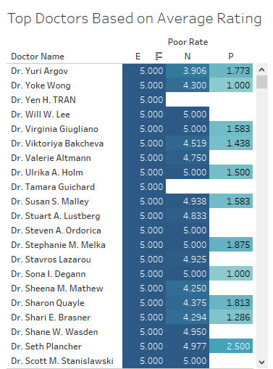
Top Doctors Based on Average rating

Slide 11
Challenges
Extraction using Webscraping takes a lot of time and data collection is a bottleneck in devising the system which requires high level of computing and a dedicated server to overcome this.
Anyone can make change to the rating or the review in the rating website and this can add turbulence in the data that is collected and analysis.

