Slide 1




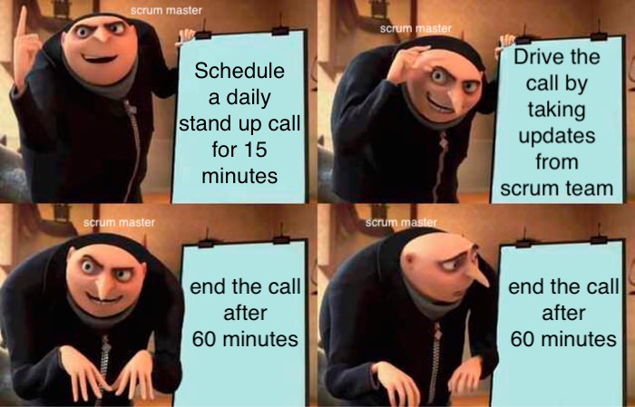





Any Modification you would like to Propose in an Existing Agile SE Model - Scrum
Agile methodology enables teams to provide client service in an effective and efficient manner with fewer difficulties through an iterative approach to project management and software development. Scrum framework is an agile project methodology that offers a structure for teams to deliver incrementally while prioritizing on collaborative execution and continuous improvement
Problem
Scrum meetings / Daily stand ups are an essential part of scrum framework and in agile methodology. A scrum call is scheduled for 15m on paper whereas in most of real scenarios it goes way beyond that
Proposed Solution
Introducing an ‘extended scrum meeting’, immediate to the scrum call by limiting the participants
Techniques to manage for Scrum master and Scrum Team
5W’s of SCRUM MEETING / DAILY STAND-UP
Ways to improve current scenario
Scrum
Master
The elements to be considered for modification / improvement are
Scrum Master
Scrum team
Extended Scrum Meeting
Limit the participants list to absolute necessary | Ensure the team is updating the time and stories at end of the day
Effective Utilization of team chats / discussion forums | Proper A/V setup, in case of virtual meet
Limit the individuals update when exceeding their time slots | Focus on 1) What does the team need to know 2) What do a member need help with
WHAT | It is a meeting which follows a simple structure of 3 questions What did I work on yesterday ? What am I working today ? What issues are blocking me ?
WHO | The Product owner, Scrum team and Scrum master involves in the call
WHEN | Happens daily in a sprint for 15 minutes at same time
WHERE | Happens over a virtual connect or in person meeting
WHY | The call highlights the development progress and help flag team blockers
Scrum team
Team should be given a proper template of how a scrum meet happens during the initial project setup
The task updates should be precise without going into much technical depth
For further clarifications, mention it to scrum master that they would have a discussion in the extended scrum call
Prepare ahead on the updates to be given along with the code dependencies, documents etc.
0.5k
1k
6k
1k
1.5k
Satisfied
( The above graph represents the employee satisfaction rating over their scrum meeting. A total sample size = 10K)
Dissatisfied
Current Scenario
Extended Scrum Meeting
In most companies and from many employees' feedback, most scrum meetings run beyond the given 15 minutes. On an average, scrum meetings run for 30 minutes
In the below scenario, we have noted the theoretical time taken for all the calls in a sprint vs the actual practical scenario. We can observe that we are losing 25hrs of productivity because of the longer duration of daily stand ups.
As scrum call gets extended due to ‘one-to-one’ or ‘one-to-many’ or ‘many-to-many’ discussions, others time is wasted leading to loss in productivity
100%
scrum call time $∝$ $\frac{1}{productivity}$
Components | Sprint Retrospective | Sprint Review | Backlog Refinement | Daily Scrum | Sprint Planning | Working Hours
Actual Planned | 15 | 20 | 60 | 25 | 40 | 640
In Practice | 15 | 20 | 60 | 50 | 40 | 615
Conclusion
About 80% of scrum teams are dissatisfied about their scrum meetings (graph in scrum team section) Some of the factors that leading to overflow of scrum meet are
Discussing multiple points rather than sticking to one
Scrum master improper and ineffective orchestration of the meet
Development on new technology results in more blockers and more time
In case of huge teams, the duration extends to 60 minutes
Yay or Nay! scrum meetings help in teams' development and focus on goals ahead
Since it’s the first meeting of the day, organizing and managing the duration of scrum calls is prominent. Implementing it effectively will lead to a positive impact on teams internally and boost productivity
( The above estimation is taken for a team size = 10 and all units are in hours. A sprint = 2 weeks)
Solution : An extended Scrum meeting initiated by scrum master including team members who want to participate and freeing the rest of the team. From the above ex. if we assume at least half of the team members are not required for the call, 50% of 25 = 12.5 hours are added to productivity
An extended Scrum meet duration would be 15-30 minutes depending upon the team requirement
Reference: Raj Sudhakar Karepu, Infosys Ltd - https://www.linkedin.com/in/raj-karepu0710/
Name: Arun Reddy Nalla, Harsh Bharath Nimmakuri, Kalyan Venkatesh Poludasu, Veera Venkata Bharat Kumar Vayitla
Prof. Dr. Usama Mir
110088379
110088953
110089120
110088432

