Slide 1
YOUTUBE SPAM COMMENTS DETECTION
Guide: A. Sirisha, Assistant Professor
CBIT/IT/2020-21/119
B. Aravind Kumar(160117737033)
N. Arun Reddy(160117737035)

Slide 2
ABSTRACT
People now feel more comfortable socializing over the internet through popular social networking and media websites than face to face. YouTube is a vastly popular social media site which is expanding at very fast pace. YouTube depends mostly on user created contents and sharing and spreading.
YouTube has become more susceptible to different types of unwanted and malicious spammers. This project classifies whether the comments are legitimate or spam comments.

Slide 3
PROBLEM STATEMENT
Youtube themselves have tackled this issue with very limited methods which revolve around blocking comments that contain links. Such methods have proven to be extremely ineffective as Spammers have found ways to by pass such heuristics.
Standard machine learning classification algorithms have proven to be somewhat effective but there is still room for better accuracy with new approaches.
To detect spam comments in real time we have used some machine learning classification algorithms

Slide 4
ALGORITHMS USED
Naive Bayes:A Naive Bayes classifier is a probabilistic machine learning model that’s used for classification task. The crux of the classifier is based on the Bayes theorem.
P(A/B)=P(B/A)P(A)/P(B)
Random Forest It is an ensemble learning model which uses number of decision trees together. It contains blocks of decision trees together in a single instance.

Slide 5
Logistic Regression It is an algorithm that uses statistical approach to find the outcome that is binary in nature it uses a logistic function called as logit. It can be model several classes of events such as whether to determine an image of its features.
Support vector machine (SVM) is machine learning algorithm that analyses data for classification and regression analysis. SVM is a supervised learning method that looks at data and sorts it into one of two categories. An SVM outputs a map of the sorted data with the margins between the two as far apart as possible. SVMs are used in text categorization, image classification, handwriting recognition and in the sciences

Slide 6
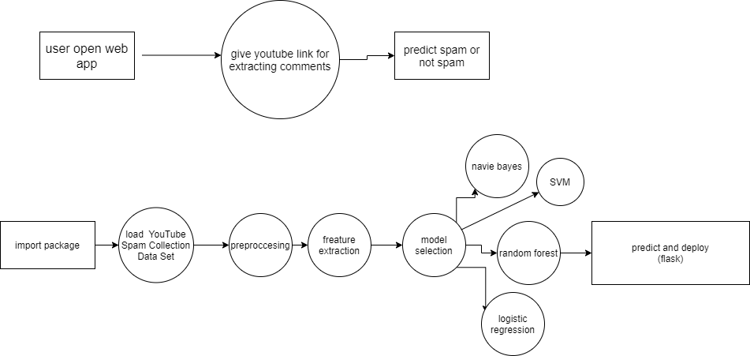
SYSTEM DESIGN

Slide 7
DATASETS USED
Dataset Name | Spam | Ham | Total
Youtube-01 Psy.csv | 175 | 175 | 350
Youtube-02 KatyPerry.csv | 175 | 175 | 350
Youtube-03 LMFAO.csv | 236 | 202 | 438
Youtube-04 Eminem.csv | 245 | 203 | 448
Youtube-05 Shakira.csv | 174 | 196 | 370
Spam.csv | 4497 | 672 | 5169

Slide 8
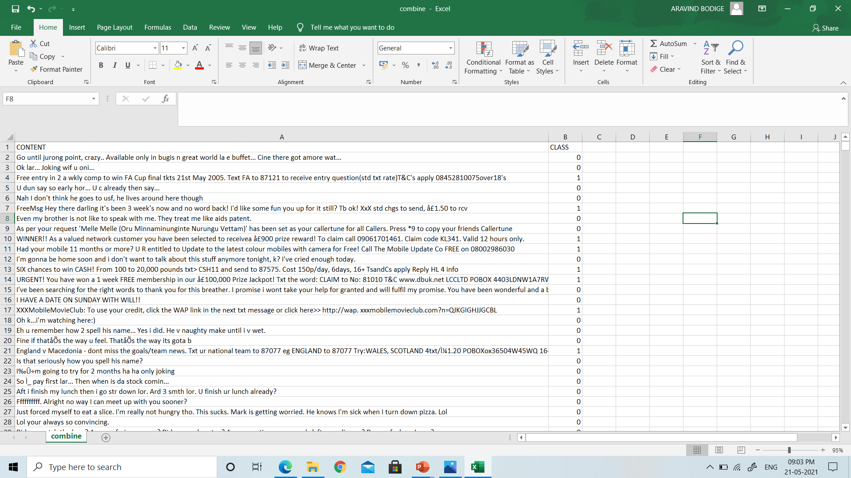

Slide 9
IMPLEMENTATION
Web scrapping is the first step in the implementation where scrape(url) function takes youtube URL as the input and it scrolls all comments under video and stores in results.csv file.
Preprocessing of the dataset is being done means unnecessary attributes are being dropped only required attributes like class and content is taken.
Next required features class and content are taken and fitted into our model.
Then our model predicts the comments and classifies them as Spam and Ham comments.

Slide 10
Comparison of Accuracy for various models with different proportions of test data
Test date size Proportion | Logistic Regression Proportion | Random Forest Accuracy Proportion | Multinomial Accuracy Proportion | SVM Accuracy Proportion
0.2 | 0.93 | 0.93 | 0.89 | 0.93
0.33 | 0.93 | 0.95 | 0.89 | 0.93
0.43 | 0.94 | 0.95 | 0.87 | 0.94

Slide 11
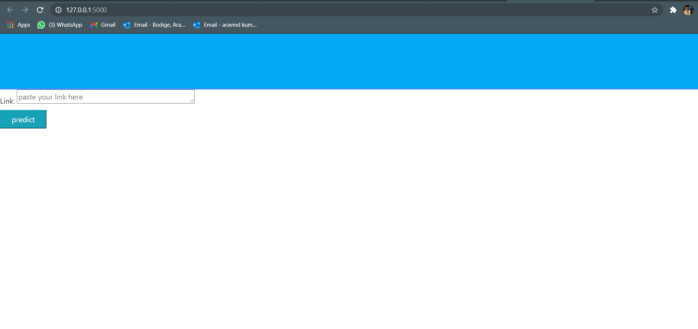
TESTING & RESULTS
Web application of proposed Youtube spam detector

Slide 12
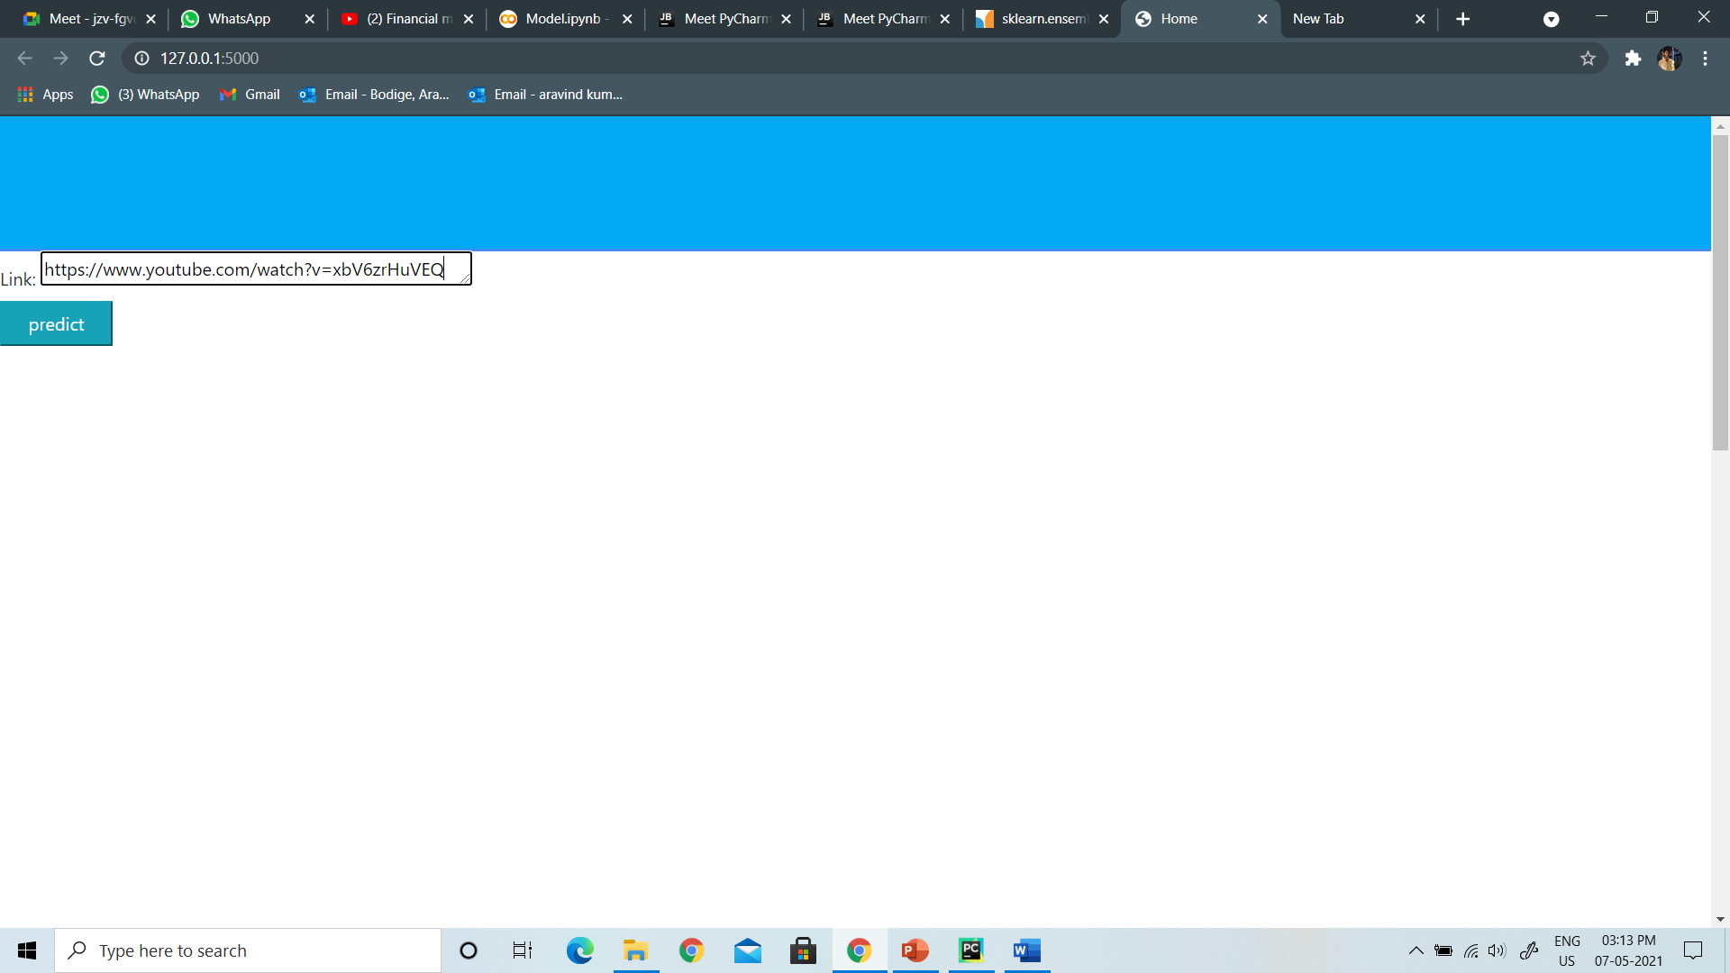
Giving youtube URL as input for the model

Slide 13
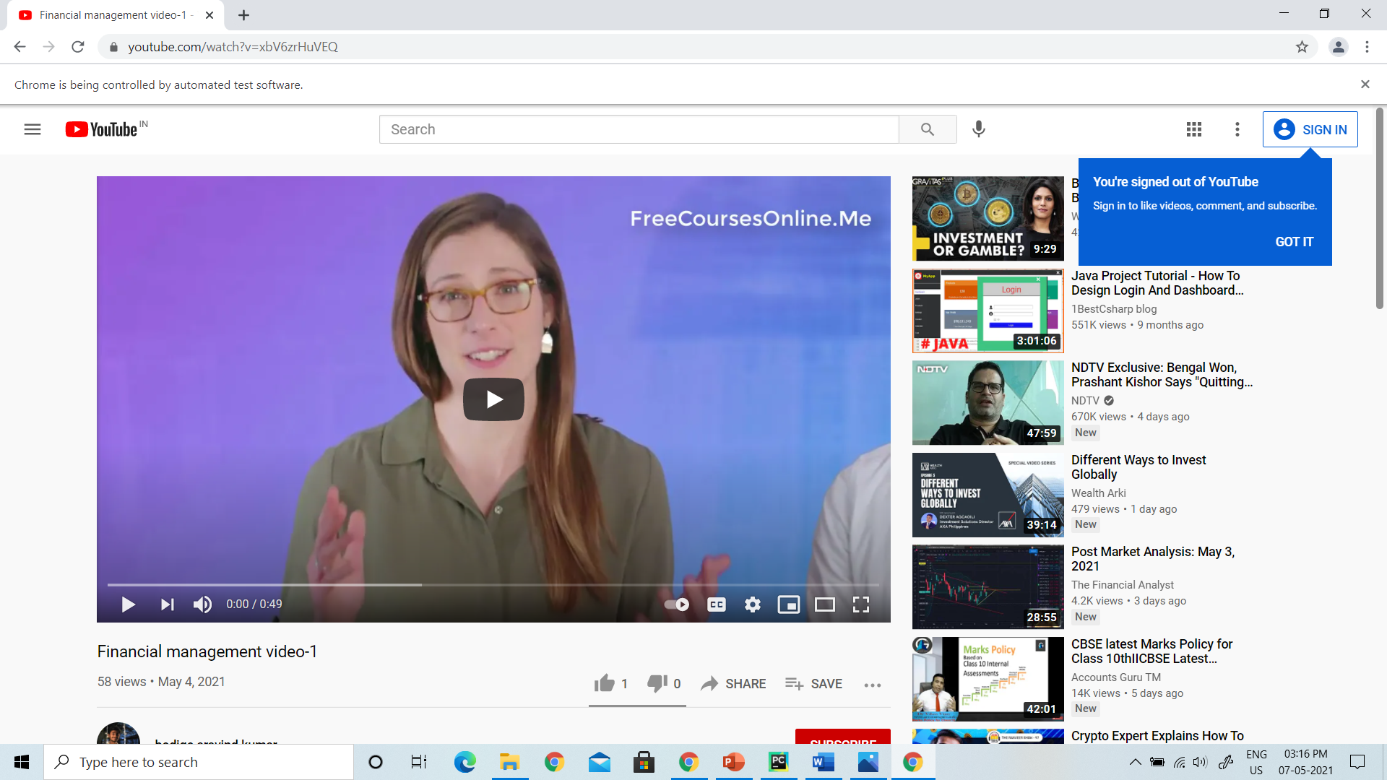
Extracting Comments from the youtube URL

Slide 14
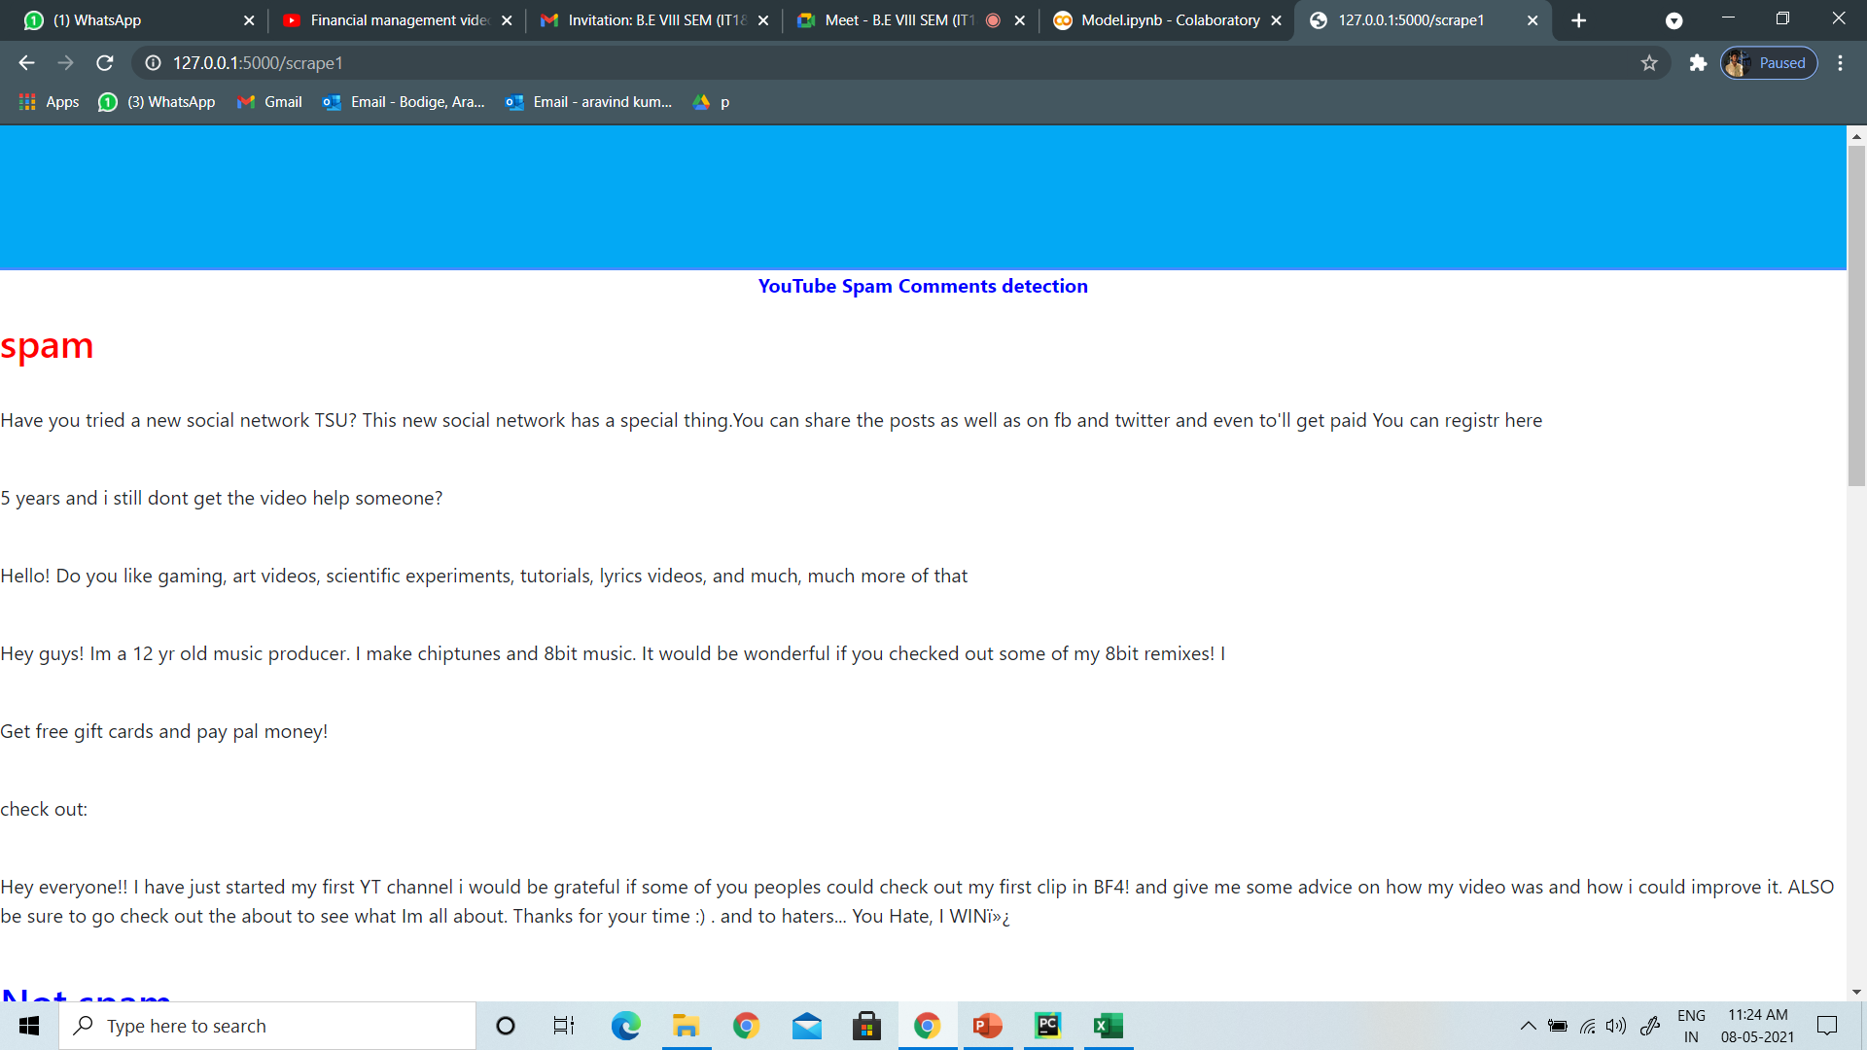
Detected Spam comments

Slide 15
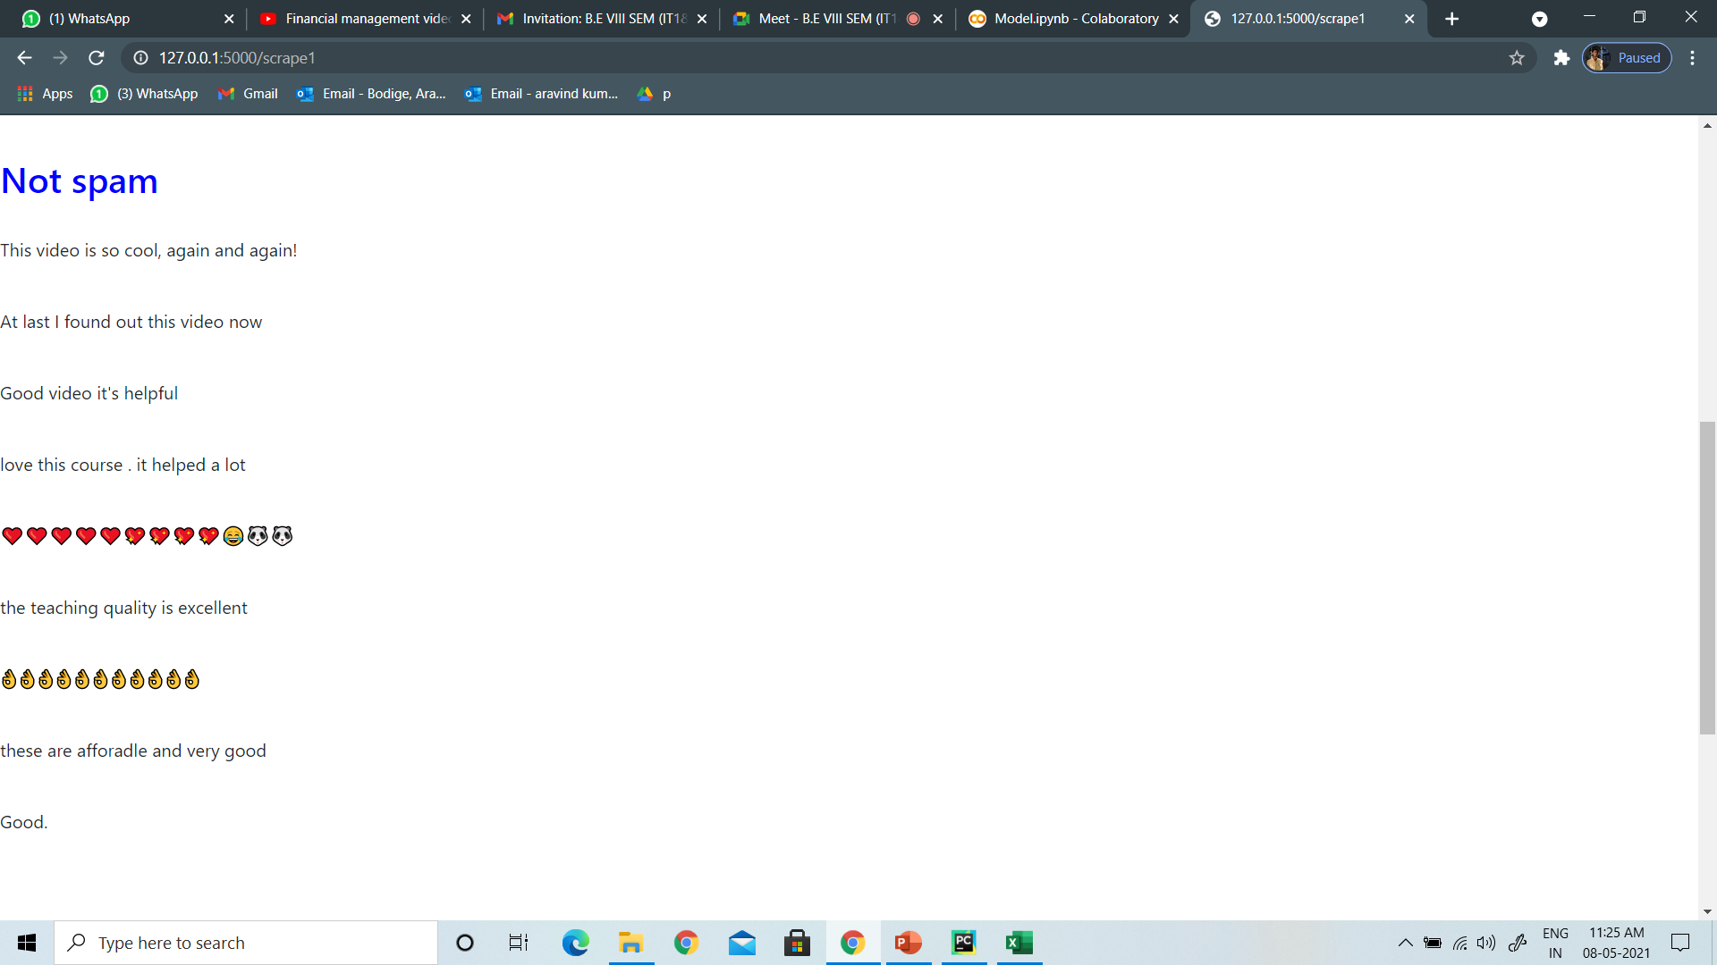
Detected Ham Comments

Slide 16
CONCLUSION & FUTURE SCOPE
So, by using this project we can detect the spam comments and Ham comments corresponding to a given URL of a youtube video.
One drawback of this project is when the comments are very high for a youtube video then it takes more time and sometimes the machine struck.
In future the model can be modified so that more accurate results can be obtained in low processing time.

Slide 17
BIBILORAPHY
[1] A Novel Approach for Youtube Video Spam Detection using Markov Decision Process , Simran Kanodia,Rachna Sasheendran,Vinod Pathari-IEE,2018
[2] N-Gram Assisted Youtube Spam Comment Detection, Shreyas Aiyar,
Nisha P Shetty-IEEE,2018
[3]A Comparative Analysis of Common YouTube Comment Spam Filtering Techniques Abdullah O. ,Abdulkadir Sengur,Murat Karabatak, Mashhood A. Ali- IEE,2018
[4] Youtube, Youtube Moderate & review comments, https://support.google.com/youtube/answer/111870?hl=en.

Slide 18
THANK YOU

