Slide 1


Department of Computer Science and Engineering
Third Generation ATM Machine Using Advance Image Processing
Team Members Name / Register Number
Arun kumar M [211419104024]
Balasubramaniyan R [211419104038]
Bandi Chaitanya Krishna Reddy [211419104039]
Guide Name & Designation
Dr.P.J.SATHISH KUMAR,M.E.,Ph.D.,
Coordinator Name & Designation
Dr.N.PUGHAZENDI,M.E.,Ph.D.,

Slide 2
Introduction
A computer-implemented method for cardless use of an automated teller machine (ATM) is provided.
The method includes receiving as an input, a user-identified ATM that the user wishes to use.
The method also includes generating and transmitting a one-time password (OTP) for the user to enter at the identified ATM.
The method further includes receiving and verifying the OTP entered into the ATM, and on successful verification, authorizing access to services available through the ATM, without use of a card.

Slide 3
Objectives
The main objective of the project is to detect the proper details for the transaction of the ATM.
So we should give proper details if details correct means then we should create OTP and if OTP correct means face recognition we should do.
If face not matched with the data base means it wont allow to the transaction.

Slide 4
Literature Review
S.NO | TITLE | AUTHOR | YEAR | PUBLISHERS
1. | ATM security system using fingerprint authentication. | Christiawan, B.A.Sahar, F.Rahardian and E.Muchtar | October 24, 2018 | IEEE
2. | An IOT based ATM surveillance System. | V. Jacitha, J.Nagarajan, K.T.Yogesh, S.Tamilarasu and S.Yuvaraj | December, 2019 | IEEE
3. | Advanced ATM surveillance using iris scanner. | Banerjee, Mookherjee, Saha, S.Ganguli, S.Kundu and D.Chakravarthi. | March, 2019 | ResearchGate

Slide 5
S.no | TITLE | AUTHOR | YEAR | PUBLISHERS
4 | Design and implementation of ATM alarm data analysis system. | Y.Cheng, W.Shang, L.Zhu, and D.Zhang. | June, 2016 | IEEE
5 | A new vision for ATM security management. | C.Poretti, R.Lahaije and D.Kolev | December,2016 | ResearchGate
6 | Face recognition Application for automatic teller machine | H.R.Babalei,O. Molalapata and A.pandor | March, 2018 | ResearchGate

Slide 6
Problem Statement
The Skimming is a common form of ATM fraud where criminals attach a device to the ATM card reader to capture card information, which is then used to create counterfeit cards.
By incorporating image processing techniques such as object detection, facial recognition, and OCR (Optical Character Recognition), ATMs can detect and prevent skimming attempts.
For example, a facial recognition system could verify the identity of the user before allowing a transaction to occur, and an OCR system could verify the authenticity of the card being used.

Slide 7
Existing System
In existing system RFID card is used as ATM card, IR sensor in order to sense the presence of the card holders and to turn on Fan and Light, if ATM is tampered then SMS is sent to two main stations via GSM.
Based on WI fall detection get security, that network access is not that much secured.
In existing system RFID card is used as ATM card, IR sensor in order to sense the presence of the card holders and to turn on Fan and Light, if ATM is tampered then SMS is sent to two main stations via GSM.
The biometrics like finger print and eye ball authentication are prone for easy spoofing. Used SVM classification for face recognition

Slide 8
Proposed System
In proposed method, apply deep neural network and face of haar cascade classifier.
Then the OTP based transaction is very simple with the more security.
Face recognition
OTP based
Cascade classifier
Video streaming
Pre-process

Slide 9
Development Environment
HARDWARE REQUIREMENTS:
Hard Disk : 500GB and Above
RAM : 4GB and Above
Processor : I3 and Above
GPU
SOFTWARE REQUIREMENTS:
Operating System : Windows 10 (64 bit)
Software : Python idle
Tools : Opencv

Slide 10
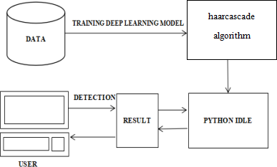
System Architecture

Slide 11
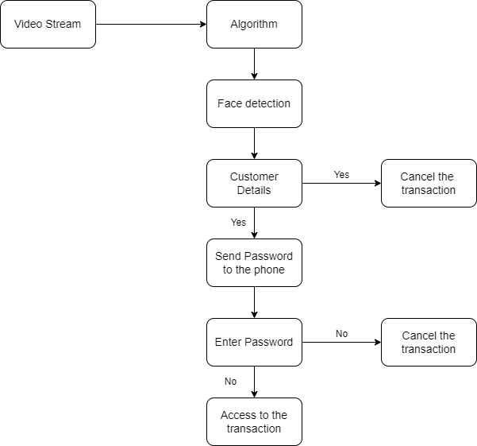
DATA FLOW DIAGRAMS

Slide 12
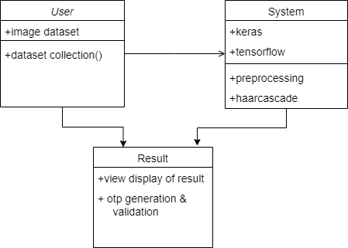
Class diagram :

Slide 13
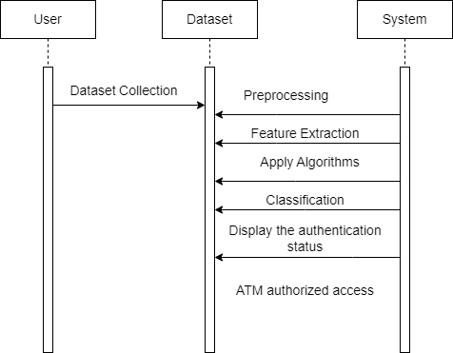
Sequence diagram :

Slide 14
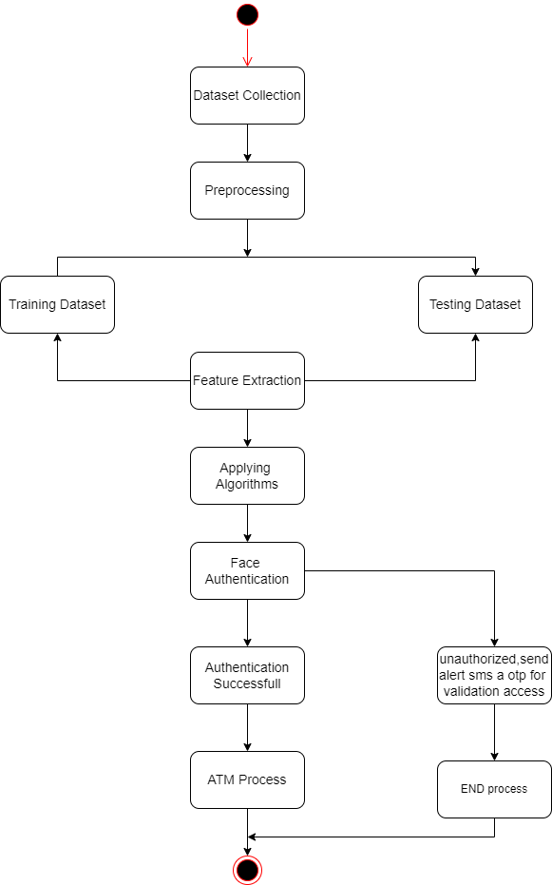
Activity diagram :

Slide 15
Module Description
MODULES :
Video Streaming
Pre-processing
Haar cascade
Database

Slide 16
MODULE EXPLANATION:
1.VIDEO STREAMING:
Video streaming technology is one way to deliver video over the Internet.
Using streaming technologies, the delivery of audio and video over the Internet can reach many millions of customer using their personal computers, PDAs, mobile smartphones or other streaming devices.
2. PREPROCESSING :
In this step we have to reduce the complexity of the picture of license plate using resize and the conversion.
Using these pre-process we can change the size of the video using resize.

Slide 17
3. HAAR CASCADE :
It is an Object Detection Algorithm used to identify faces in an image or a real time video.
The algorithm uses edge or line detection features proposed by Viola and Jones in their research paper “Rapid Object Detection using a Boosted Cascade of Simple Features” published in 2001.
4. DATABASE:
Database is a collection of digitized images.
It is maintained primarily to support research in image processing, image analysis, and machine vision.

Slide 18
Testing
Testcase ID | Testcase/ Action to be performed | Expected Result | Actual Result | Pass/Fail
1 | Verify the user by validating the photo of the user who is currently trying to access. | Sent successfully | Sent successfully | PASS
2 | Validating the OTP of the user via the email and if not then doesn’t grant the permission. | Validated successfully | Validated successfully | PASS

Slide 19
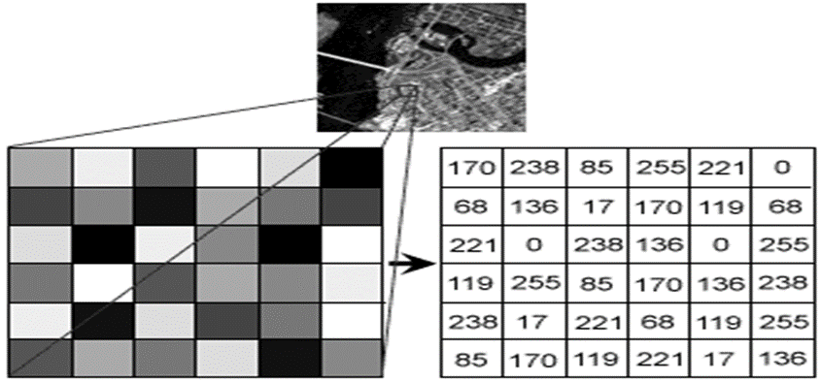
Screenshots

Slide 20
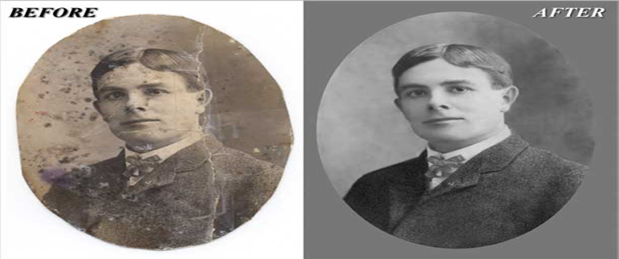

Slide 21
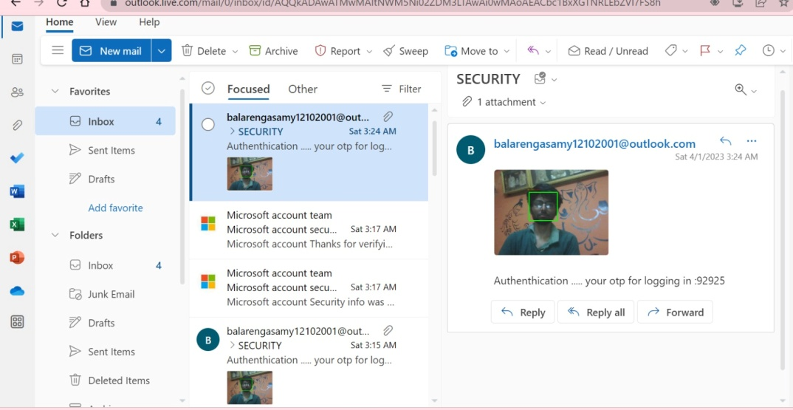

Slide 22
Conclusion
The use of face recognition technology in smart ATM systems can also increase the efficiency of transactions, as it eliminates the need for physical ATM cards.
This can save time for customers and reduce the risk of card skimming or cloning. Furthermore, facial recognition technology can be beneficial for customers who have trouble remembering their PINs or have difficulty inserting and withdrawing cards.
However, it is important to note that the use of facial recognition technology raises concerns about privacy, accuracy, and bias. Therefore, it is crucial to implement privacy protection measures and ensure that the technology is accurate and unbiased.
Furthermore, banks and financial institutions must be transparent about the use of facial recognition technology and communicate their policies clearly to customer. For example, the use of artificial intelligence (AI) can enable ATMs to provide personalized recommendations to customers based on their transaction history, location, and preferences.

Slide 23
Future Enhancement
There are several potential future enhancements to human search and rescue operations. Here are a few examples:
Facial recognition technique seems more challenging as compared to other biometrics, thus more efficient algorithm can be developed. The flaws in face recognition technique like the inability to detect face when beard, aging, glasses and caps can be rectified and eliminated or reduced. If the cost of retina or iris recognition reduces, it can be used instead of face recognition.
This can also be a replacement of all the smart cards which can easily been lost since our face can be our identity it will be useful and a super-fast to verify the user identity. Advanced 3D face recognition technology can be used to improve the accuracy and reliability of face recognition systems, making it more difficult for fraudsters to bypass the security system using fake images.
The privacy of users can be protected by ensuring that the facial images captured by the ATM are securely stored and not used for any other purpose than authentication.

Slide 24
References
[1] A. M. Iyabode, Y. N. Nureni, A. F. Adebayo, O. A. Olamide, “Cardless-Electronic AutomatedTeller Machine(EATM) with Biometric Authentication,” International Journal of Engineering Trends and Technology (IJETT), vol. 30, no. 1, 2015
[2] History.com Editors. “Automated Teller machine”, Internet: http://www.history.com/topics/inventions/automated-teller-machines, Aug. 21, 2018 [Jul.05, 2018]
[3] Mike Flacy. “SMART ATM USES QR CODES INSTEAD OF CARDS TO DISPENSE CASH”, Internet: http://www.digitaltrends.com/cool-tech/smart-atm-uses-qr-codesinstead-of- cards-to-dispense-cash/, Jun. 16, 2012 [Jul. 05, 2018]
[4] T. Maqua, R. Neff, M. Wbbeling, Improve ATM Withdrawal Security and Usability with your Smartphone.

Slide 25
[5] ATM Market Place. “ATM cardless cash access: Why the QR code matters (alot) to FIs,” Internet: http://www.atmmarketplace.com /articles/atm-cardless-cash-accesswhy-the-qr-code- matters-a-lot-to-fis/, Nov. 4, 2013 [Jul. 05, 2018]
[6] Victoria Woollaston. “Next-generation cash machines set to replace bank cards with facial recognition”, Internet:http://www.dailymail.co. uk/sciencetech/article- 2365166/Nextgeneration-cash-machines-set-replace-bank-cards-facialrecognition.html, Jul. 16, 2013 [Jul. 05, 2018]
[7] Odusina, A. Olumide, Automated Teller Machine Usage And Customers’ Satisfaction In Nigeria Elite Research Journal of Accounting and Business Management Vol. 2(3) pp. 43 - 47, July, 2014. Available online http://www.eliteresearchjournals.org/erjabm/index.html.
[8] Md. Mosabber Hossain, “Understanding of ATM (Automated Teller Machine) in Bangladesh”, B.Sc Thesis BRAC university, Bangladesh, 2006.

Slide 26
THANK YOU!

