Slide 1
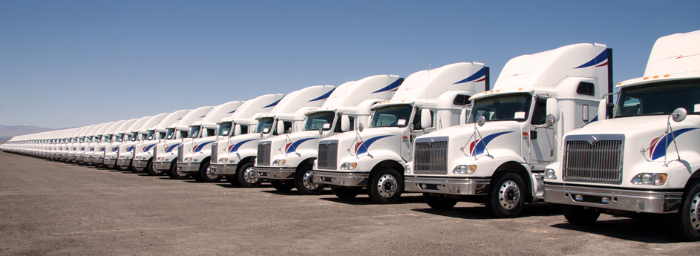
M
App Name
M
App Name
M
Login
Enter user id
Hi, Ganesh
App Name
Enter password
Booking List
New Booking
Login
Forget Password
Settings
Profile
Register New User

Slide 2



Booking List
Request List
Booking List
Booking List
Traders info
Traders info
10/05/2016
10/05/2016
Root Info : From: Chennai To: Trichy
Root Info : From: Chennai To: Trichy
Vehicle Type : Mini Dist.: 350k.m.
Vehicle Type : Mini Dist.: 350k.m.
Open
Open
Traders info
Traders info
10/05/2016
10/05/2016
Root Info : From: Chennai To: Trichy
Root Info : From: Chennai To: Trichy
Vehicle Type : Mini Dist.: 350k.m.
Vehicle Type : Mini Dist.: 350k.m.
Show only Open
Progress
Progress
Show only Progress
No booking found
Traders info
Traders info
10/05/2016
10/05/2016
Booking now
Show only Closed
Root Info : From: Chennai To: Trichy
Root Info : From: Chennai To: Trichy
Vehicle Type : Mini Dist.: 350k.m.
Vehicle Type : Mini Dist.: 350k.m.
Closed
Closed
Traders info
Traders info
10/05/2016
10/05/2016
Root Info : From: Chennai To: Trichy
Root Info : From: Chennai To: Trichy
Vehicle Type : Mini Dist.: 350k.m.
Vehicle Type : Mini Dist.: 350k.m.
Progress
Progress

Slide 3
Booking List
Booking Details
Booking Details
Traders info
10/05/2016
ABC Limit
101, New Street,
Chennai - 600022
Driver Details :
Root Info : From: Chennai To: Trichy
Vehicle Type : Mini Dist.: 350k.m.
Name : Chennai
Open
Open
Vehicle No : TN22- CA1234
Traders info
Mobile No : 9876543210
10/05/2016
From : Chennai
Call
Root Info : From: Chennai To: Trichy
Vehicle Type : Mini Dist.: 350k.m.
To : Trichy
Payment History :
Open
Material KG : 1500KG
Paid : 6000
Kilometer : 420 K.m.
Balance : 9000
Vehicle : Type 1
Total Amount : 15000
Start Date : 20/05/2017
Estimated : 20/05/2017
Driver Details :

Slide 4


New Booking
Select City
New Booking
Pick up Address:
ABC Limit
101, New Street, Chennai - 600022
Select State
Pick up Address:
ABC Limit
101, New Street, Chennai - 600022
City1
From :
From :
City2
To :
To :
Enter KG
Material KG :
City3
Material KG :
City4
OK
Kilometer :
Kilometer :
Vehicle Required
City5
Vehicle Required
City6
Type1
Type1
Type1
Type1
Type1
Type1
Type1
Type1
POST
POST

Slide 5


New Booking
New Booking
Pick up Address:
ABC Limit
101, New Street, Chennai - 600022
Pick up Address:
ABC Limit
101, New Street, Chennai - 600022
From : Chennai
From : Chennai
To : Trichy
To : Trichy
Successfully booking created
Material KG : 1500KG
Material KG : 1500KG
OK
Kilometer : 420 K.m.
Kilometer : 420 K.m.
Vehicle Required
Vehicle Required
Type1
Type1
Type1
Type1
Type1
Type1
Type1
Type1
POST
POST

