Slide 1
Microsoft HACKATHON -2022
DATA NORMALIZATION FOR LOGGING MECHANISM USING AZURE CLOUD SERVICES
DEVELOPER VELOCITY
Team Name: SGSActive

Slide 2

Agenda
Abstract
Introduction
Problem Statement
Architecture
Implementation
Q&A
Conclusion

Slide 3
Abstract
Logging is essential for a software development project, but it's often disregarded until the program crashes. Logging serves numerous purposes including root cause analysis, bug analysis, and even performance reviews for the application. With . NET, the programmer can log to several locations and not just a flat file.
Structured and Unstructured data also can be logged
Python AI/ML/DL, and any other languages also we can log data in this method.

Slide 4
Introduction
What is logging in C#?
Logging levels are used to filter logging output, tailoring the amount of data output to the situation in hand. Each logging level is associated with the type of data logged. DEBUG, INFO, and TRACE events are typically non-error conditions that report on the behavior of an application.
Add rich search experiences to your applications in Azure with Elastic
Enterprise search
Engines
Analytics
Web crawler
Search UI
Relevance tuning
Some of the best practices to take your C# logging to the next level.
Write Logs to Files, Not the Console. ...
Use A Third-Party Logging Library. ...
Make Use of Logging Levels. ...
Control Log Messages With Filters. ...
Log Contextual and Diagnostic Data. ...
Use Structured Logging.

Slide 5
Problem Statement
You just can’t visualize all the logs when we are developing multiple application which is hosted in multiple location.
Risk of Human Error in Setup and Configuration manually for Logging.
Missed Notification During Network Failure.

Slide 6
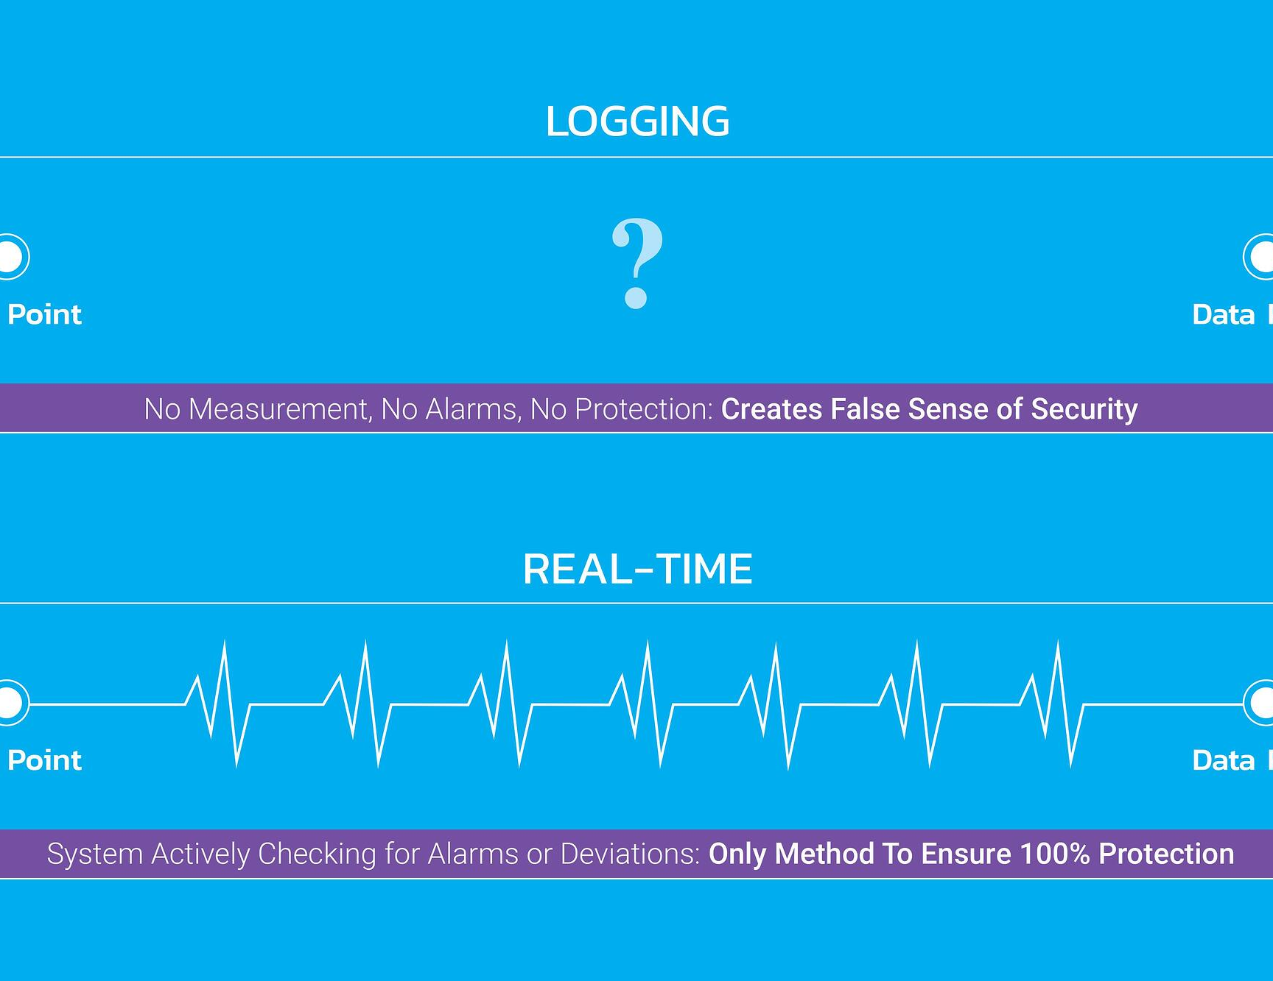
WHY LOGGING?
Network Failure
Huge Size in file which written in Server
Tracking is Complex
No Notification if any major issue

Slide 7
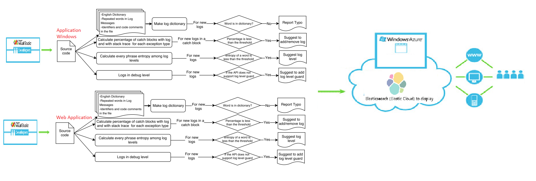
ARCHITECTURE

Slide 8
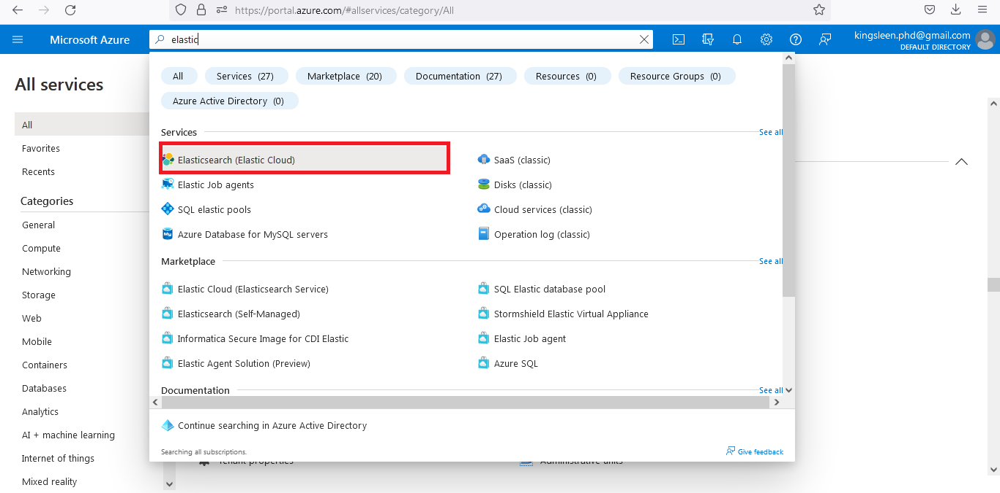
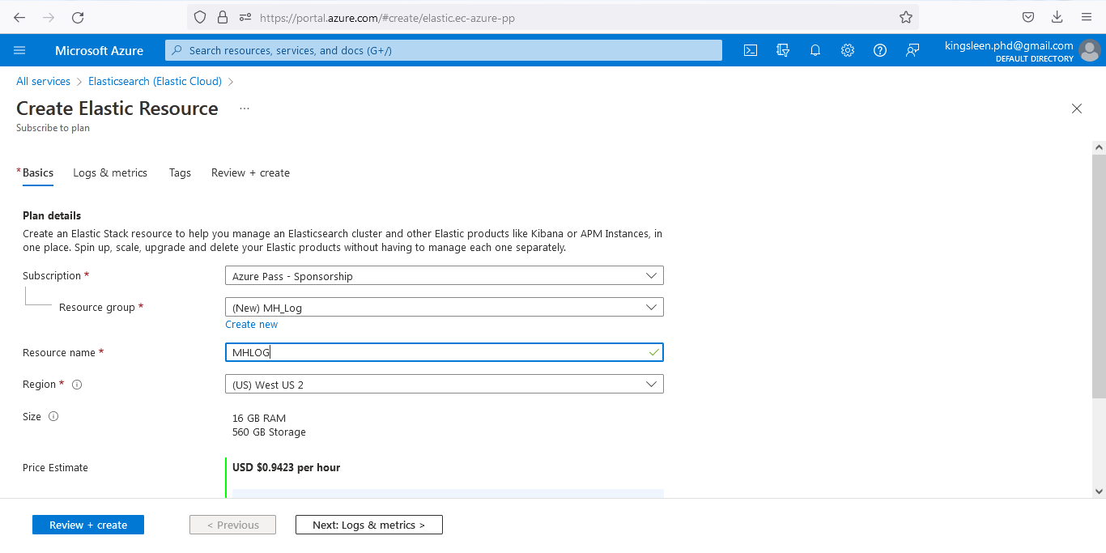
IMPLEMENTATION
STEPS TO IMPLEMENT
Login into the Azure Cloud using Azure Credential
Go to the Service Listing page and find the Elastic Search
Follow the steps to create the elastic search as shown in the figures
Use the URL and the Credential generated in the Azure inside our development application code.
View the Logs in the Kibana dashboard
Enjoy easy logging

Slide 9
Conclusion
By using Elastic Search service in azure we can able to log data and visualize the data in graph and easy searching filter.

Slide 10

Q & A?

Slide 11
THANK YOU

